Slide 1
Pink / Pediatrics
Primary Author: Dr. David Saquet
2019 Protocol Update
Notes:
Title slide

Slide 2
The Big Picture
The biggest change for the pediatric protocol section is the decrease of pediatric specific pages.
Protocols that matched, or nearly matched, adult protocols were combined.
Notes:
Biggest change is the reduction in number of slides, focusing on truly specific pediatric issues. If treatments were very close to adult treatments, the protocols were combined into a condition/complaint-based protocols rather than an age-based protocol. (This may be a challenge for some providers but we expect an easier flow of treatment protocols once this style is used a few times).

Slide 3


Pediatric Coma vs. Adult Coma
2018 Version
Notes:
The pediatric and adult coma protocols are great examples of similarity and unnecessary duplication. The only difference between the two slides are the caveats at the beginning of the adult coma, and the note of not administering naloxone to a neonate is at the top of the pediatric protocol and near the bottom of the adult protocol. Other than page referrals (which now match), there are no other differences.

Slide 4
Pediatric Coma vs. Adult Coma
These protocols are almost entirely identical!
Notes:
The pediatric and adult coma protocols are great examples of similarity and unnecessary duplication. The only difference between the two slides are the caveats at the beginning of the adult coma, and the note of not administering naloxone to a neonate is at the top of the pediatric protocol and near the bottom of the adult protocol. Other than page referrals (which now match), there are no other differences.

Slide 5
Why Combine?
Repeating protocols or having to make a decision about when to use a pediatric vs. adult protocol may lead to delays, confusion or errors in care.
Where protocols were extremely similar, they were combined.
Notes:
One of the challenges is in the “gray” area of age and weight – does a 150 lb 14 y/o follow the adult or pediatric protocol? By combining the protocol, it allows providers to have doses and treatment differences immediately available to compare and decide which to follow.

Slide 6

New Combined Coma Protocol
2019 Version
Notes:
This is the new combined adult and pediatric protocol

Slide 7
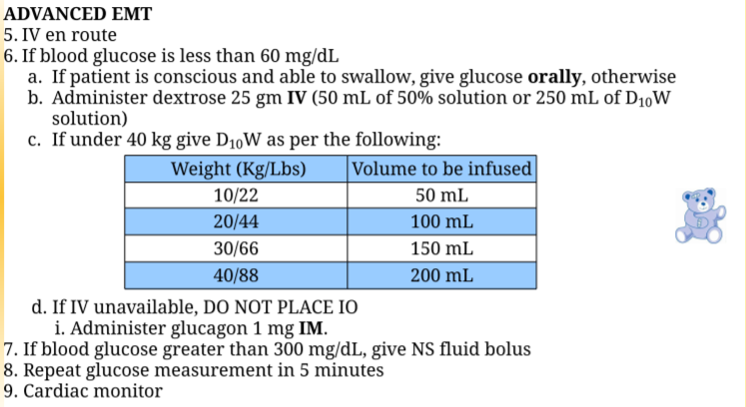
Pediatric Specific Differences
In cases where specific pediatric doses or treatments vary, they are highlighted with the EMS for Children bear logo
Notes:
In combined protocols, the pediatric specific treatments and dosages are emphasized by the presence of the EMS-C teddy bear.

Slide 8
What’s Been Combined? (1 of 2)
Nausea & Vomiting (Gold 19)
Pediatric Pain Scale #1 and #2 (Green 17 – 19)
Pediatric Coma (Gold 5)
Pediatric Seizure #1 and #2 (Gold 8 – 9)
Pediatric Respiratory Distress (Blue 7 – 9)
Pediatric Respiratory Failure (Blue 7 – 9)
Notes:
This and the next slide are the listing of protocols combined with adult protocols to make one new encompassing protocol for each. The 2019 section color and page are listed for reference purposes. Utilizing the index in the 2019 protocols, providers can find the names of the previous protocols and click to link to the new protocol location.

Slide 9
What’s Been Combined? (2 of 2)
Pediatric Respiratory Distress with Wheezing #1 and #2 (Blue 7 – 9)
Pediatric Diabetic/Hypoglycemic Emergencies (Gold 6 – 7)
Pediatric Medical Shock #1, #2 and #3 (Gold 14 – 17)
Pediatric Cardiac Arrest (Red 7 -11)
Pediatric Cardiac Arrest Medications & Dosages (Red 11)
Notes:
This and the next slide are the listing of protocols combined with adult protocols to make one new encompassing protocol for each. The 2019 section color and page are listed for reference purposes. Utilizing the index in the 2019 protocols, providers can find the names of the previous protocols and click to link to the new protocol location.

Slide 10

What is Left?
Brief Unresolved Unexplained Event
Pediatric Respiratory Distress with Inspiratory Stridor
Neonatal and Young Infant Fever
Childbirth
APGAR Score
Neonatal Resuscitation
Normal Pediatric Vital Signs
Pediatric Specific Equipment Sizes
Pediatric Transportation #1 and #2
Notes:
This is the list of all the pink protocols for 2019, including 2 new protocols (Fever and Pediatric transportation).

Slide 11

Brief Resolved Unexplained Event (1 of 3)
Where: Pink 1
What:
  Removed statement "when assessed by responding prehospital personnel“ from PEARL
Who: EMR, EMT, AEMT, Paramedic
Why:
  Repetitious. Already clear who is doing the assessment.
Notes:
There are three changes in the BRUE (Brief Resolved Unexplained Event). Remember that BRUE is the new term for ALTE (Apparent Life-Threatening Event). The name was changed at the national level to better cover the condition (Not all events were life-threatening, additionally, the name ALTE created fear for providers and parents). This first change is merely language as it was repetitious (it is implied that prehospital personnel are doing the assessment).

Slide 12
Brief Resolved Unexplained Event (2 of 3)
Where: Pink 1
What:
  Emphasis on observing and documenting home environment of the patient.
Who: EMR, EMT, AEMT, Paramedic
Why:
  The home environment may help yield clues as to the cause of the BRUE.
Notes:
An addition to the BRUE protocol is the emphasize on assessing and documenting the condition of the environment the patient is in. EMS providers have the unique ability to see the patient in their home environment which may shed clues on the causes and/or contributing factors to the event. This is extremely important to downstream providers and not obtainable from anyone else.

Slide 13
Brief Resolved Unexplained Event (3 of 3)
Where: Pink 1
What:
  Emphasis on using OLMC for refusals in these cases.
Who: EMR, EMT, AEMT, Paramedic
Why:
  Non-transport of the patient having a BRUE is extremely risky. More than 50% of these patients have an underlying medical condition requiring hospital admission (Hall, et al., 2005).
`
Notes:
In cases of suspected BRUE, evaluation at a hospital is of utmost importance. EMS providers must not assume it was a one-time event or a panicky new parent. Emphasize that providers should not “brush off” that a child is fine in appearance upon their arrival. Do not write it off as “they must be a new or overprotective parent”. Devasting results may occur in cases of non-transport. Evidence shows that over 50% of BRUE incidents require hospital admission and further work-up (Hall, K., et al. (2005). Evaluation and management of apparent life-threatening events in children. Am Fam Physician; 71(12): 2301-8). Studies also show BRUE occurrence in up to 6% of patients under 2 years of age, with a mortality rate of 1 in 10 (Carolan, Windle, Sharma & McColley, 2019).

Slide 14
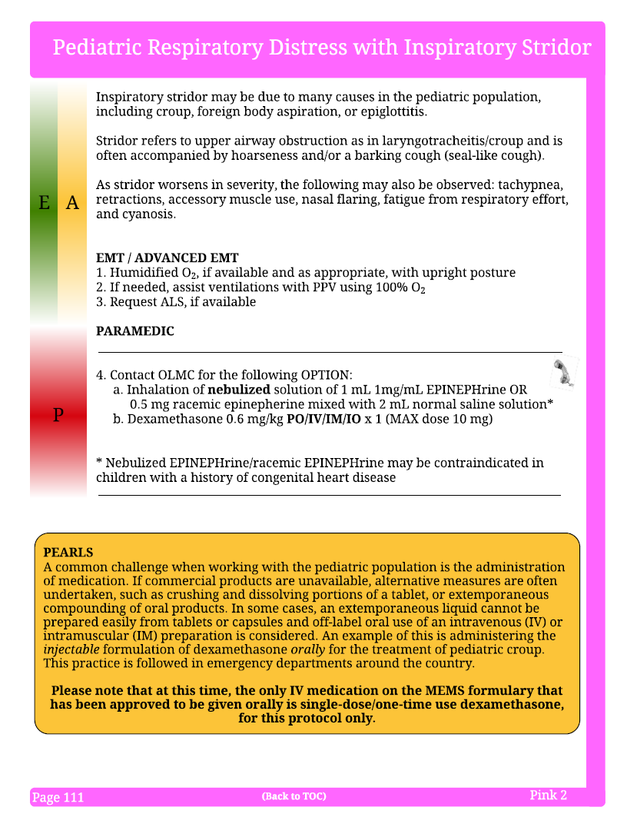
Pediatric Respiratory Distress with Inspiratory Stridor (1 of 2)
Where: Pink 2
What:
  Punctuation corrections, boldfaced “nebulized” and removed 1:1000
Who: Paramedic
Why:
  To improve safety, the MDPB emphasized the route of EPINEPHrine for stridor is nebulized. Additionally, throughout the protocol, we have removed 1:1000 and 1:10000 references to epi, as listing 1mg/ml or 1mg/10ml is safer.
`
Notes:
2 slides reference stridor in the pediatric patient. This slide emphasizes that if, with OLMC, a paramedic opts to use EPINEPHrine to treat the stridor, it must be nebulized (hence the boldface). . If racemic EPINEPHrine is available, it may be used instead of the EPINEPHrine 1mg/ml. The dose of racemic EPINEPHrine is 0.5mg mixed in 2ml normal saline and nebulized.
As a safety measure, the MDPB has also removed 1:1000 and 1:10000 throughout the protocols as they look similar, and better, and safer, practice is the use of concentrations (in this case 1mg/ml).

Slide 15
Pediatric Respiratory Distress with Inspiratory Stridor (2 of 2)
Where: Pink 2
What:
  Added dexamethasone & PEARL
Who: Paramedic
Why:
  Dexamethasone was added as an option for pediatric patients with inspiratory stridor. This is an option for Paramedics with OLMC. Additionally, it can be administered orally (PO) at the same dose as IV/IM/IO. This is the ONLY Maine EMS IV medication that can be administered orally.
`
Notes:
Although dexamethasone is part of the current protocols ⁽Emphasize that although the medication is not new for paramedic providers, this indication, as well as the possibility of PO administration is. This is the ONLY Maine EMS IV/IM/IO medication that can be administered orally, and only to this patient subset), it was not used for pediatric stridor. This addition is new and the dose is 0.6 mg/kg PO/IV/IM/IO x1 (MAX dose 10mg). Use is done as an option with OLMC. An important part of this addition is that the option exists to administer the dexamethasone orally (PO). The dose is the same and may be diluted with drinking water. This is the ONLY IV medication that can administered orally, and ONLY in this protocol.

Slide 16
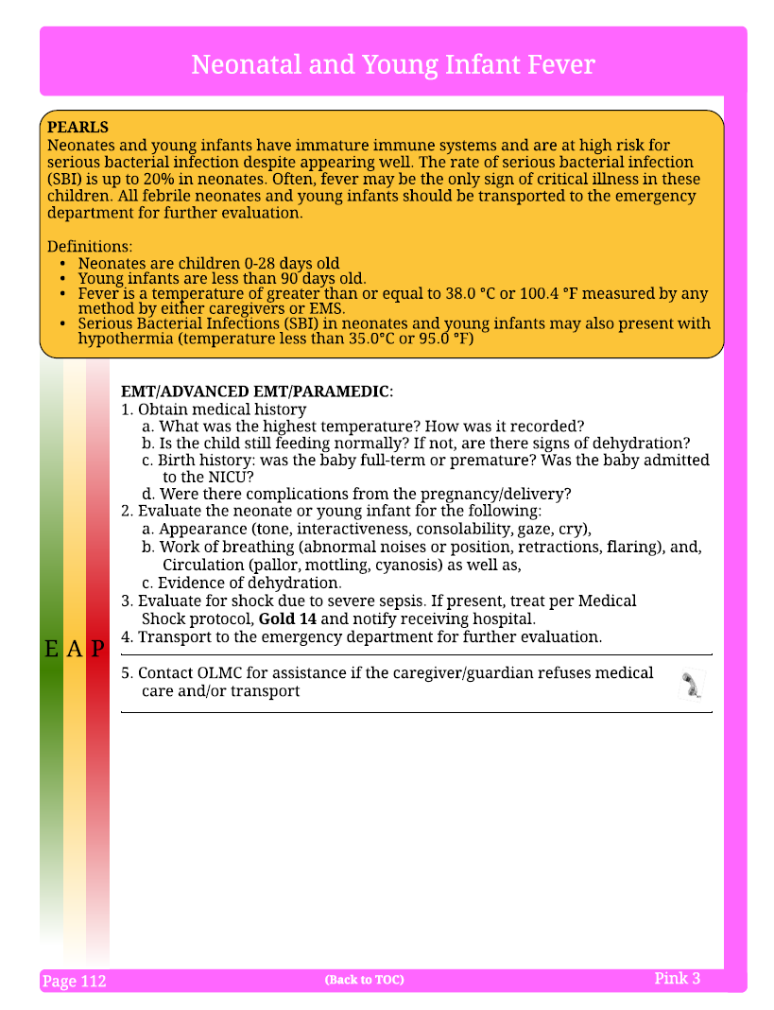
Neonatal and Young Child Fever
(1 of 6)
Where: Pink 3
What: Entirely new protocol on neonatal and young infant fever.
Who: EMR, EMT, AEMT, Paramedic
Why: To better assess, identify and treat potential sepsis in neonates and young infants.
Notes:
This protocol on Neonatal and Young Child Fever is new for 2019. The goal is to help identify and treat those patients who may be at risk for sepsis.

Slide 17
Neonatal & Young Child Fever (2 of 6)
Neonates and young children may have serious or occult bacterial infection as opposed to sepsis.
Presentation may be markedly similar.
A patient less than 90 days old, with a fever, is an ominous finding needing hospital evaluation.
Notes:
In many cases, sepsis may not be present, but the patient has a serious bacterial infection instead. This may be nearly impossible to distinguish, b ut the treatment, and need for hospitalizations remains the same. In neonates, it is notable that 100% of neonates presenting with any fever will be admitted to the hospital.

Slide 18
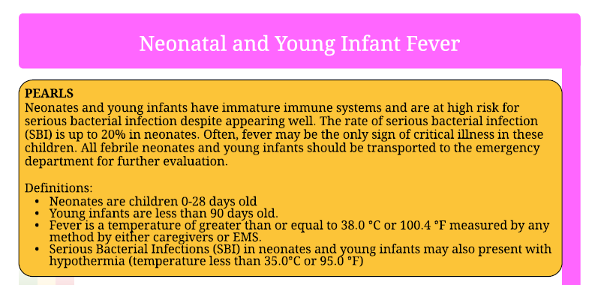
Neonatal and Young Child Fever (3 of 6)
Less than 90 days old
Temp equal to, or greater than, 38.0°C (100.4°F), or
Temp less than 35.0°C (95.0°F)
Notes:
The protocol is aimed at those patients less than 90 days old and have either a fever greater or equal to 38.0°C (100.4°F) or a temperature less than 35.0°C (95.0°F). This temperature can be measured by any route and is equally valid whether measured by the EMS provider, another healthcare provider or a parent/guardian. This fever may be the only clinical sign present for the patient and may otherwise have normal appearances and vital signs. With a 20% rate of serious infections, all patients presenting with a fever at this age should be transported for evaluation at any emergency department.

Slide 19
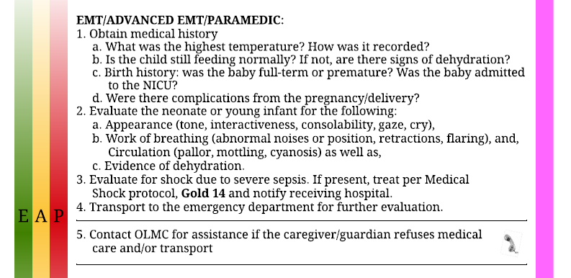
Neonatal and Young Child Fever (4 of 6)
Determine
Highest / lowest temp
Signs of dehydration
Birth history/complications
`
Notes:
A thorough history of this patient is critical for management of the pediatric patient presenting with a fever. This history should be both verbally relayed to the receiving hospital, as well as documented in the patient care report.

Slide 20
Neonatal and Young Child Fever (5 of 6)
Assess
Appearance
Work of breathing
Signs of dehydration
Signs of shock
`
Notes:
In addition to the history, a thorough assessment of the patient’s current condition must be conducted. The four main components are:
Appearance (muscle tone, interactiveness, consolability, gaze & cry)
Work of breathing (abnormal noises/position, retractions, flaring, pallor, mottling, cyanosis
Signs of dehydration
Evaluate for any signs of shock

Slide 21
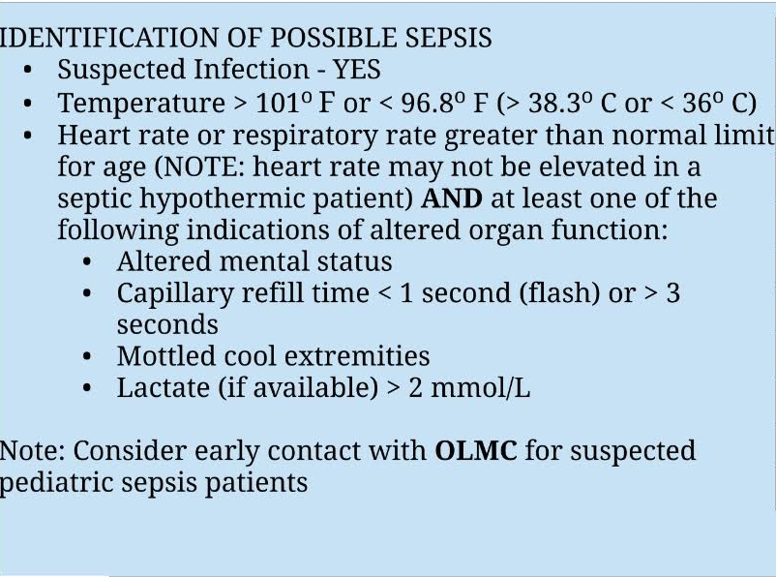
Neonatal and Young Child Fever (6 of 6)
Goal is to determine
“Is this child septic?”
Transport, utilize OLMC for refusals
`
Notes:
The overall goal of this protocol is to guide providers in answering the assessment question of “Is this child septic?”. Key findings center on the presence of 2 or more of the following:
Temp. < 96.8°F or > 101°F
Heart rate above 90/minute
Respiratory rate above 20/minute
Systolic BP less than 90 mmHg or Mean Arterial Pressure (MAP) less than 65 mmHg
New onset altered mental status OR increasing mental status change with previous altered mental status.
Serum lactate (if available) greater than 2 mmol/L
Mottling, Cap refill less than 1 sec OR greater than 3 seconds

Slide 22
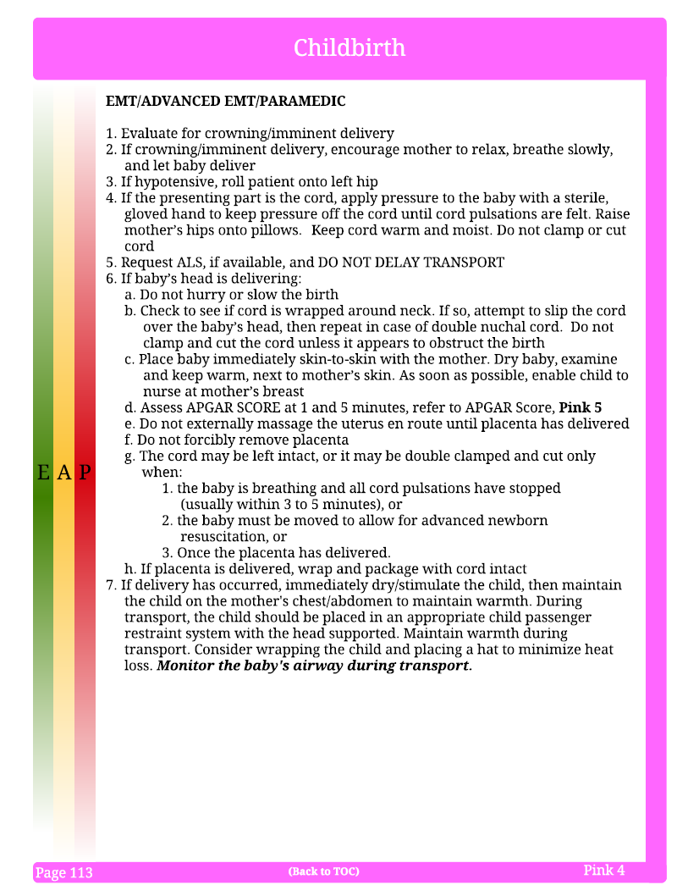
Childbirth (1 of 6)
`
Where: Pink 4
What: Added #1, “Evaluate for crowning/imminent delivery”
Who: EMR, EMT, AEMT, Paramedic
Why: The MDPB wanted to re-emphasize to providers to perform a visual assessment rather than rely solely on a report from the mother.
Notes:
Childbirth protocol added the statement “Evaluate for crowning/imminent delivery” to emphasize to providers the importance of a medical assessment for this, as opposed to merely the question to the mother.

Slide 23
Childbirth (2 of 6)
`
Where: Pink 4
What: In #4, added “until cord pulsations are felt” and to keep cord warm “and moist”.
Who: EMR, EMT, AEMT, Paramedic
Why: The MDPB wanted to provide a measurable goal when keeping pressure off of a presenting cord. Additionally, to keep the cord warm and moist.
Notes:
In the case of an umbilical cord prolapse prior to delivery of the infant, recall that the risk is that the umbilical cord is essentially pinched/clamped off between the body of the infant and the birth canal. In these cases, death of the infant is imminent. Providers must use their fingers to create space for umbilical blood flow. The goal is to achieve palpable, and continuous pulsations in the cord, indicating blood flow has been restored and maintained. Additionally, any presenting part of the umbilical cord must be kept warm and moist.

Slide 24
Childbirth (3 of 6)
Where: Pink 4
What: In 6b, added “then repeat in case of double nuchal cord”
Who: EMR, EMT, AEMT, Paramedic
Why: The MDPB wanted to remind providers that a cord may be wrapped around an infants neck more than once which has been reported in up to 8% of all pregnancies (Larson, 1995).
`
Notes:
In the event of a cord wrapped around the neck of a newborn during delivery, the EMS provider must slip the cord over the neck of the infant during the delivery process. In approximately 8% of the cases of a nuchal cord, the cord is wrapped around the neck twice. Given this, the provider must ensure both loops are removed from around the neck.

Slide 25
Childbirth (4 of 6)
Where: Pink 4
What: In 6g, added #3 “Once the placenta has delivered”
Who: EMR, EMT, AEMT, Paramedic
Why: This was added for better clarification.
`
Notes:
For clarification of when to clamp and cut the cord

Slide 26
Childbirth (5 of 6)
Where: Pink 4
What: In #7, added “immediately dry/stimulate the child”
Who: EMR, EMT, AEMT, Paramedic
Why: The MDPB wanted to emphasize that even when a child has been delivered prior to EMS arrival, it is important to complete this step.
`
Notes:
In cases where EMS arrives after the delivery of a newborn, the steps of warm, dry and stimulate should still be conducted. Assuming the newborn had this done prior to EMS arrival may lead to poor outcomes for the newborn.

Slide 27
Childbirth (6 of 6)
Where: Pink 4
What: In #7, removed “while in a child safety seat”
Who: EMR, EMT, AEMT, Paramedic
Why: The requirement to be in a safety seat is referenced previously in the paragraph, and was repetitious.
`
Notes:
Clarification only

Slide 28
No changes
Pink 5 – APGAR Score
Pink 6 – Neonatal Resuscitation
Pink 7 – Pediatric Vital Signs
Notes:
Protocols that had no changes for 2019

Slide 29
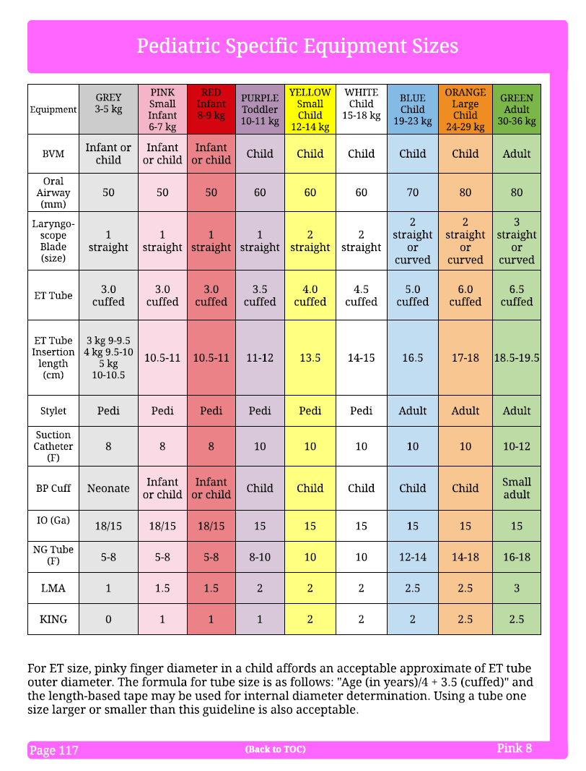
Pediatric Specific Equipment Sizes (1 of 2)
Where: Pink 8
What: Added requirement for all pediatric endotracheal tubes to be cuffed
Who: Paramedic
Why: Evidence has shown that cuffed ET tubes in the pediatric patient are less likely to leak or dislodge, allow higher inspiratory pressure, and cause less trachea trauma compared to uncuffed tubes. Cuffs should be inflated to manufacturer’s specifications. (Chambers et al., 2017).
Notes:
Maine EMS has implemented a change to the use of cuffed ET tubes for all ages. Previous education emphasized the use of uncuffed tubes for this population, but studies over the past decade has shown that the benefits of the use of a cuffed ET tubes are significant. Use of cuffed tubes has shown to have less air leakage, allows for higher pressures for lung inflation, and has less potential to move in the airway. Cuffs should be inflated with an amount of air to make the pilot bulb firm to the touch, but not overinflated. Because of the variations of tracheal diameter, the volume will vary but should never exceed 10-12 ml of volume instilled.

Slide 30
Cuffed ET Tubes
Previous education taught uncuffed tubes.
Evidence shows cuffed tubes have:
  Less mucosal damage/irritation
  Less air leakage
  Greater PEEP pressures
  Less dislodgement
  Accurate ETCO₂
The trachea (blue) is actually oval shaped compared to the round ET tube (white), allowing air leakage.
Notes:
Cuffs should be inflated with an amount of air to make the pilot bulb firm to the touch, but not overinflated. Because of the variations of tracheal diameter, the volume will vary but should never exceed 10-12 ml of volume instilled.

Slide 31
Pediatric Specific Equipment Sizes (2 of 2)
Where: Pink 8
What: Adjusted pediatric ET tube size formula
Who: Paramedic
Why: The American heart Association PALS guidelines recommend use of the formula age(in years)/4 + 3.5 for pediatric cuffed endotracheal tubes (AHA, 2015).
`
Notes:
Because of the change to cuffed ET tubes, the formula reflects the AHA formula for cuffed ET tubes

Slide 32
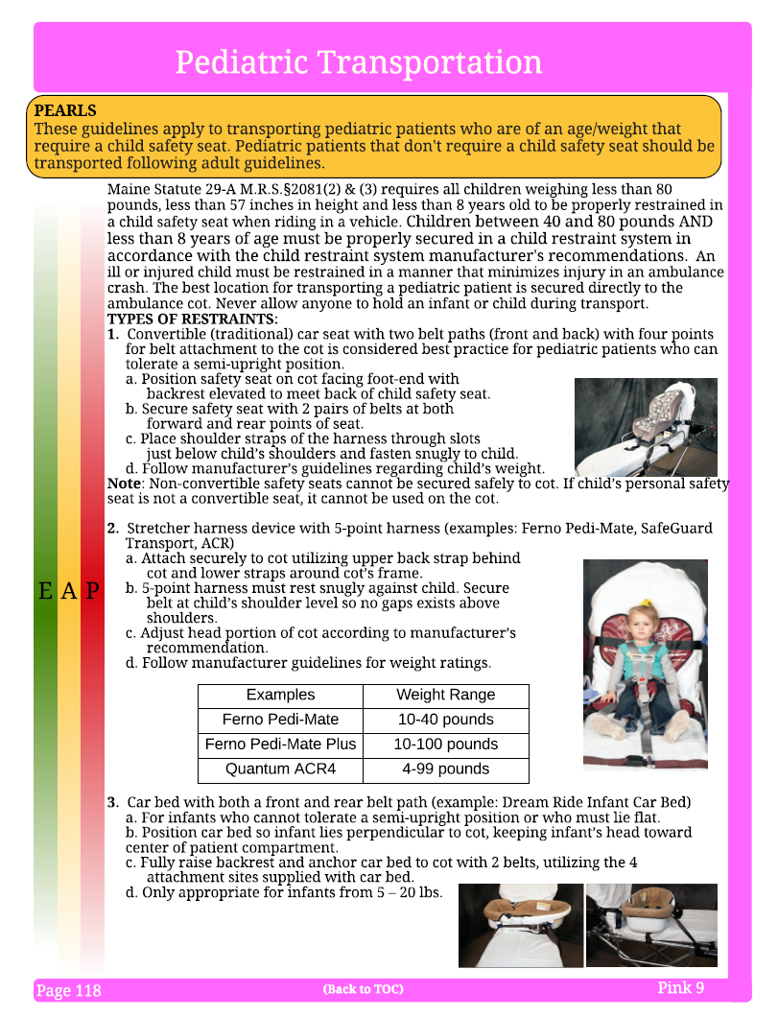
Pediatric Transportation (1 of 9)
Where: Pink 9 - 10
What: New protocol for selecting methods of safely transporting pediatric patients needing a car seat.
Who: EMT, AEMT, Paramedic
Why: Safer transport of children in ambulances.
Notes:
Providers often seek further guidance on how to secure pediatric patients during transport, and this protocol can help provide further information. Local training, education and practice are key to successfully securing a child during transport.

Slide 33
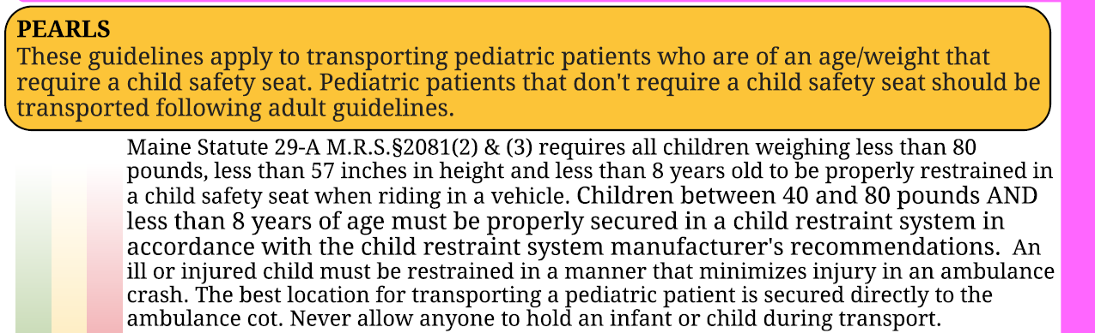
Pediatric Transportation (2 of 9)
Maine enacted new child safety seat and seat belt laws as of September 19, 2019 (LD 1269).
Notes:
The Maine Statute can be located at https://legislature.maine.gov/legis/bills/getPDF.asp?paper=SP0389&item=3&snum=129

Slide 34
Pediatric Transportation (3 of 9)
General Maine State Law Summary
CHILD IS | USE
Under age 2 | Rear Facing Child Seat
Over 2 years old AND Weighs less than 55 Pounds | Forward Facing Child Seat
Under age 8 AND Weighs less than 80 pounds AND Is less than 57 inches tall | Booster Seat
Under age 12 AND Weighs less than 100 pounds | Back Seat of Vehicle
Notes:
This is a brief summary of the laws effecting 9/19/19 as they apply to passenger vehicles. Recall there are no Maine laws regarding patients in the back of the ambulance, but are protocols and best practices to minimize injuries from motor vehicle crashes

Slide 35
Pediatric Transportation (4 of 9)
Note
Currently, there are NO federal standards, car seats or devices approved for pediatric transport in the back of an ambulance.
There are only assumed best practices.
Notes:
NHTSA is seeking to crash test devices, but has not yet been allocated money to do so. There is a list of devices that are available on the NHSTA website, as well as on the Maine EMS-C Resources page of the Maine EMS website.

Slide 36
Pediatric Transportation (5 of 9)
What does that mean for ambulance transport?
NEVER TRANSPORT A CHILD SITTING IN THE LAP OR HELD BY A PERSON ON THE STRETCHER.
If the child is not the patient:
  Best solution – Transport in a different vehicle
  Alternate 1: In front seat of ambulance with airbags deactivated, using the child’s car seat.
  Alternate 2: In “captain’s chair” using integrated child restraint or safety seat.
Notes:
In cases where the child is not the patient (such as when the parent or guardian has a medical emergency and no one to take over care of the child), best practice to is place the child in a car seat in a different passenger vehicle and not in the ambulance (potential distraction to EMS vehicle operator or care provider). Alternates are listed.
NEVER place the child in a lap or allow to be held as this is the single most dangerous method of transport.
Additionally, rear facing car seats should NEVER be placed on the captains chair .
The strength and design of rear facing car seats is based upon the car seat facing the rear of the vehicle
To correctly protect the infant in rear facing car seats, it is critical that the vehicle seat back must be at the foot end of the car seat and is not an option on the captains seat, thus do not use

Slide 37
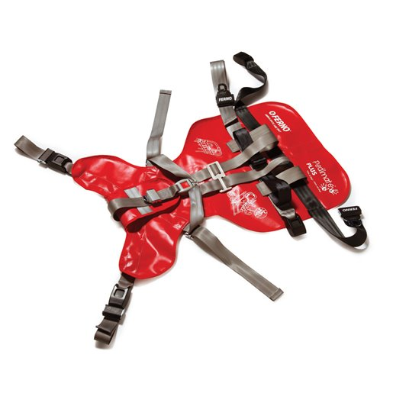
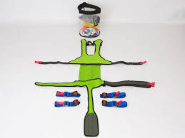
Pediatric Transportation (6 of 9)
If the child is the patient and spinal restrictions are not needed:
  Best solution – Use a 5 point harness designed for pediatric patients, attached to the stretcher, following manufacturers instructions.
  Alternate 1: Use the patient’s own safety seat, attached to the stretcher.
  Alternate 2: In “captain’s chair” using integrated child restraint or safety seat.
NEVER TRANSPORT A CHILD SITTING IN THE LAP OR HELD BY A PERSON ON THE STRETCHER.
Ferno Pedi Mate +
Quantum ACR4
Notes:
Maine EMS does NOT recommend any particular product, the two pictured are representative examples only. A list of available devices is found on the Maine EMS-C Resources page on the Maine EMS website. Providers should conduct regular and in-depth local training based on the device manufacturers instructions.
NEVER place the child in a lap or allow to be held as this is the single most dangerous method of transport. Additionally, rear facing car seats should NEVER be placed on the captains chair as the strength and design of rear facing car seats is based on facing to the back of the vehicle with a seat back at the foot end of the car seat (and not behind the head as would be the case in this position)

Slide 38
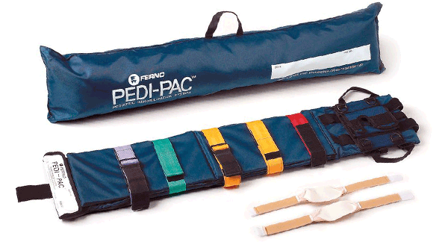
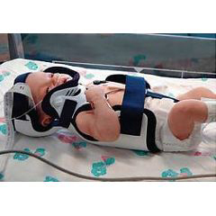
Pediatric Transportation (7 of 9)
If the child is the patient and spinal restrictions are needed:
  Best solution – Use a pediatric spinal restriction device.
  Alternate 1 – Use an adult backboard with proper padding.
NEVER TRANSPORT A CHILD SITTING IN THE LAP OR HELD BY A PERSON ON THE STRETCHER.
Ferno Pedi-Pac
Papoose Infant Spinal Immobilizer
Notes:
Maine EMS does NOT recommend any particular product, the two pictured are representative examples only. A list of available devices is found on the Maine EMS-C Resources page on the Maine EMS website. Providers should conduct regular and in-depth local training based on the device manufacturers instructions.

Slide 39
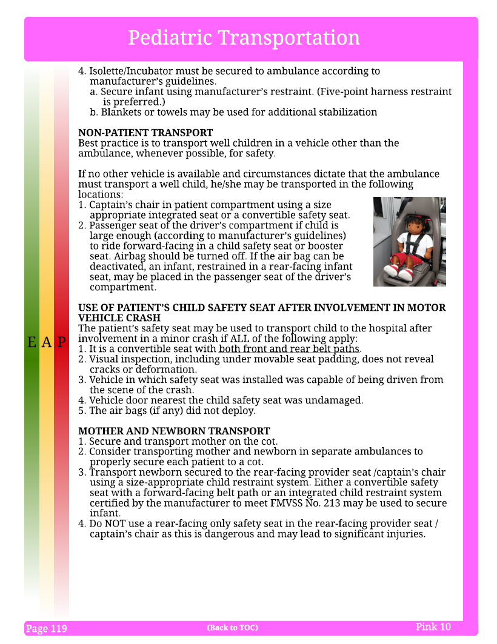
Pediatric Transportation (8 of 9)
Using a car seat after a motor vehicle crash
Visual inspection
  No cracks or obvious deformities
Is car involved drivable?
Door nearest child seat is not damaged
No airbag deployment
`
Notes:
Providers may utilize the patients own car seat for transport if they are comfortable with its use and how to secure the device (remember that ambulances are not equipped with LATCH devices (the D ring installed in back seats of passenger vehicles)) The questions must all have a Yes answers to use a car seat involved in a motor vehicle accident

Slide 40
Pediatric Transportation (9 of 9)
Mother & Newborn Transport
Mother on stretcher
Newborn
  Best solution: Use a second ambulance (allow bonding/skin-to-skin contact with Mom prior to transport)
  In forward facing car seat on “captain’s chair”.
  Do not use rear facing car seat on “captain’s chair” as it will not secure correctly.
`
Notes:
Although a different approach, when EMS rpvoders are transporting a mother and recently delivered newborn, allow mother and baby to bond with skin-to-skin contact on scene (as stability and conditions allow), and then explain the safety precautions and transport separately with appropriate care levels for the patients. Transporting mother holding the newborn is the single most dangerous method and should not be done.

Slide 41

EMS for Children
For more pediatric education and information, contact the Maine EMS for Children program:
207-636-3860
Marc.A.Minkler@maine.gov
EMS-C Resources on the Maine EMS website (maine.gov/ems)
Notes:
For more info, use this info as a starting point

Slide 42
References
American Heart Association. (2017). Web-based Integrated Guidelines for Cardiopulmonary Resuscitation and Emergency Cardiovascular Care (Part 12, 4.1.15 Endotracheal Tube Size). https://eccguidelines.heart.org/index.php/circulation/cpr-ecc-guidelines-2/
Carolan, Patrick L., Windle, Mary L., Sharma, Girish D., & McColley, Susanna A. (2019, February 28). Brief Resolved unexplained Events. Pediatrics. Retrieved from https://emedicine.medscape.com/article/1418765-overview
Chambers, N.A., Ramgolam, A., Sommerfield, D., Zhang, G., Ledowski, T., Thurm, M., Lethbridge, M., Hegarty, M., von Ungern-Sternberg, B.S. (2017, November 23). Cuffed vs. uncuffed tracheal tubes in children: a randomised controlled trial comparing leak, tidal volume and complications. Anaesthesia, 73, 147-50. https://doi.org/10.1111/anae.14113
Hall, K., et al. (2005). Evaluation and management of apparent life-threatening events in children. Am Fam Physician; 71(12): 2301-8.
Larson JD, Rayburn WF, Crosby S, Thurnau GR. (1995, October). Multiple nuchal cord entanglements and intrapartum complications. American Journal of Obstetrics & Gynecology, 173 (1228). https://doi.org/10.1016/0002-9378(95)91359-9
Notes:
Please see relevant white papers on the Maine EMS website for further resources and information.

Slide 43
Questions?

