Slide 1

SIM Steering Committee Meeting
n
July 10, 2013

Slide 2
SIM will not be successful without collaboration among all stakeholders
n
“If you bring the appropriate people together in constructive ways with good information, they will create authentic visions and sustainable responses to issues and opportunities within their communities and organizations.”
- David Chrislip, Collaborative Leadership Strategist

Slide 3
SIM Steering Committee Agenda
Agenda Topic | Lead | Time Allocated
Live Microphone Introduction | Dr. Flanigan | 5
By-Law Adoption | Dr. Flanigan | 10
Introductions of New Members | Dr. Flanigan | 5
Early Operational Plan – Status and Overview | Randy Chenard | 20
Review of Executive Summary | Jim Leonard | 30
Work Group Overviews | Dr. Flanigan/Randy Chenard | 10
Public Comment

Slide 4

Operational Plan Development and Review:
Timeline and Process
n
June 10 – 28 Operational Plan Development
June 28: Deadline for Content Submission
July 10: Steering Committee receives high level draft
July 24:
Steering Committee Approval for Submission
Aug 1: Submission of SIM Operational Plan to CMMI
Oct 1: Deadline for CMMI approval to move into implementation phase

Slide 5
SIM Final Operational Plan Components : July 24
n
High Level Overview Information
Executive Summary
SIM Logic Models and Driver Diagrams
SIM Project Plan
List of Deliverables
Gantt Chart
CMMI Demonstration Readiness Review (DRR) Content
Main content detail
Multiple Contributors

Slide 6
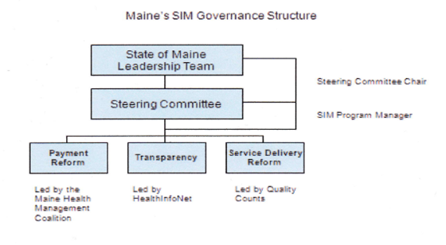
Work Group High Level Overview
n

Slide 7
Steering Committee Member Expectations
n
Expertise and Knowledge
What is achievable
What is not achievable
Communicate back to communities and engage communities in SIM discussion

Slide 8
SIM Steering Committee
n
Fundamental Accountability/Role: Cross-Stakeholder/Partner leadership group responsible for Grant execution oversight and alignment of effort toward grant objectives
Expectations of the Steering Committee:
Consistent understanding of status against plan overall and responsible for removing barriers and providing course correction when needed
Ensure working groups focus/efforts maintain alignment with overall SIM Grant objectives
Approval of delivery, approaches, recommendations from working groups.
Operate with the mindset of overall success in reform/innovation against the SIM Grant objectives versus stakeholder-specific interest
Make best decisions on the right approach versus requiring perfect solutions; innovation/reform requires bold action with an understanding that adjustments will be made based on learning
Reach consensus on a high percentage of issues escalated from workgroups. A small % of issues should require escalation to Maine State Leadership Team

Slide 9
The ‘Maine’ SIM Theme: Collaboration
n
“If you bring the appropriate people together in constructive ways with good information, they will create authentic visions and sustainable responses to issues and opportunities within their communities and organizations.”
- David Chrislip, Collaborative Leadership Strategist

