Slide 1
Health Information Privacy and Security
Maine Department of Health and Human Services

Slide 2
Contents
  Purposes for this Training
  Basics
  Best Practices
  Permitted Disclosures
  Breach Notification and Enforcement
  Research
  Summary
  Knowledge Check

Slide 3
Three Purposes for This Training
1. Legal and Regulatory Mandate
The law requires education on privacy and security. It also requires the Department to have and enforce a Sanction Policy for failure to comply with our confidentiality policies.
Compliance is MANDATORY.
2. Reinforcing a Culture of Compliance
The Department is committed to ensuring compliance with federal and state requirements at every level of our operations.
3. It’s the Right thing to Do
We honor the confidentiality of our consumers’ confidential and sensitive information, just as we would want our own data to be honored and protected.

Slide 4
Basics: What Does HIPAA Protect?
The Health Insurance Portability and Accountability Act, or HIPAA, (and its update “HITECH,”) safeguard “Protected Health Information” or PHI.
PHI essentially is identifiable information about an individual’s physical or mental health, services rendered, or payment for services. It may be:
  verbal, such as a conversation between healthcare providers
  recorded on paper, such as in a medical chart or claims record
  kept or shared electronically

Slide 5

Basics: The Department Protects Different Types of Consumer Data
Our
PROTECTED INFORMATION
includes:
Confidential information
Restricted data
Protected
Health
Information
Personal or Identifiable Health
Information

Slide 6
Basics: Protected HIPAA/HITECH Identifiers
Dates of birth, death, admission, treatment, discharge.
Names
Social Security Number
Addresses
Full face photos
Vehicle identifiers including license plate and serial number
Medical record number
Email address
Genetic history and test results
Telephone and fax numbers
Health plan beneficiary number/ID
Device Identifiers including serial number
Account number
Any other unique number, characteristic or code
Certificate License number
URLs and IP addresses
Biometric identifiers – finger and voice prints

Slide 7



Basics: Hybrid Entity
The Department is a “hybrid” entity from a HIPAA perspective.
That means that the Department has activities that are considered “HIPAA-covered” and other activities that are not covered by the HIPAA Privacy and Security Rules.
Click here to see the Department’s Hybrid “map.”

Slide 8



Basics: Our Completely HIPAA-Covered Entities
Healthcare providers and health plans, including Medicaid, must comply with HIPAA, as well as with other applicable statutes, regulations and rules that govern health information privacy and security. The Department’s completely HIPAA-covered entities are:
Office of MaineCare Services
Riverview Psychiatric Center
Dorothea Dix Psychiatric Center

Slide 9

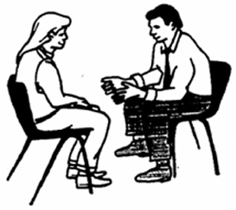
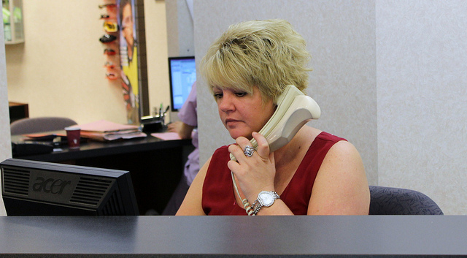
Basics: Our Partially HIPAA-Covered Entities
The Centers for Disease Control and Prevention has several covered programs:
Public Health Nursing
Health and Environmental Testing Lab (for human/clinical specimens)
Most Office of Aging and Disability Services programs are HIPAA-covered, except for Adult Protective and Legal Services
Office for Family Independence is covered for its work on behalf of OMS, but not for other programs such as ASPIRE, TANF, or its Child Support Enforcement efforts.

Slide 10
Basics: Additional
HIPAA-Covered Components
Other offices, programs or services that are “HIPAA-covered” by virtue of the oversight or business functions performed in support of the Department’s HIPAA Covered Entities include:
DAFS (Division of Administrative Financial Services)/Financial Service Center
District Operations Accounting
District Operations Facilities
Office of Administrative Hearings
The Commissioner’s Office
The General Counsel and Director of Healthcare Privacy
Division of Audit
Fraud
Constituent Services

Slide 11

Basics: Safeguard All
Protected Information
Even if your office or program is not HIPAA-covered, our workforce must treat Protected Information as confidential, based upon other laws, regulations, rules and Department policy.

Slide 12

Basics: Our Colleagues
Remember that some of our colleagues may be receiving Department services and must receive the same confidentiality protections as other consumers.

Slide 13


Best Practices: Safeguards
  HIPAA and HITECH requires safeguards to secure the integrity, confidentiality, and availability of PHI.
  These safeguards are common sense best practices.

Slide 14

Best Practices: Administrative Safeguards
  Administrative safeguards include:
  Privacy/Security Officials (such as the Director of Healthcare Privacy and our Privacy/Security Liaisons)
  Policies and procedures
  Business Associate Agreement language
  Training and education

Slide 15

Best Practices: Physical Safeguards
Physical safeguards relate to protections from natural, environmental, and man-made hazards and may include:
  Using structural workstation protections like dividers and Plexiglas windows
  Turning computer screens and paper files away from the public’s view
  Putting documents away in files and file cabinets
  Securing mobile devices containing the Department’s confidential information

Slide 16



Best Practices: Technical Safeguards
  Technical safeguards include:
  Locking your computer when you leave your desk
  Using strong passwords and not posting or sharing them
  Saving Protected Information to the appropriate network drive or encrypted device
  Not emailing Protected Information to your personal email address
  Not downloading programs unless approved by OIT (Office of Information Technology)
  Not clicking on unknown links received through email

Slide 17



Best Practices:
Communication Methods
Fax
Keep machine in a secure location.
Include only the minimum necessary Protected Information in your coversheet.
Don’t leave faxes on the machine.
Double check fax numbers before sending.
Contact your Privacy/Security Liaison if your fax is
received by the wrong party.
Phone
Speak in a low voice and in a private location when discussing Protected Information either on or off site.
Email
Avoid using Protected Information in the subject line.
Use encryption wherever possible.
Slow down and be careful about the “auto-fill” feature, so you don’t accidentally send Protected Information to the wrong recipient!

Slide 18

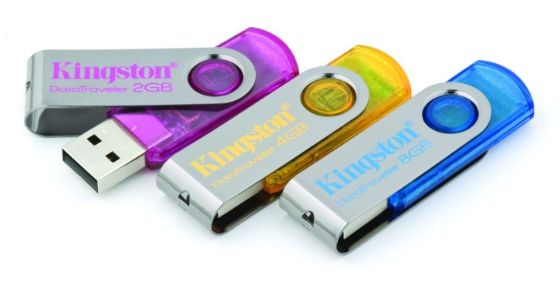
Best Practices: Portable Devices
Use encrypted devices.
Physically protect devices on or off site. Keep Protected Information private and secure at home if you have permission to work outside the office or facility.

Slide 19
Best Practices: Portable Devices
Never use your cell phone to photograph Department schedules or other documents.
Never copy Protected Information onto a portable device without specific permission of your supervisor.
Never leave your Department-issued laptop, cell phone, electronic device or other Protected Information visible or unlocked in a vehicle.
Never leave your passwords with your portable devices.
Keep paper-based Protected Information separate from your electronic device(s) when traveling.

Slide 20


Best Practices: Portable Devices
Consider your surroundings. Do not display Protected Information in cafés or other public settings.
Contact immediately your Privacy/Security Liaison if Protected Information is lost.
This, and all privacy and security policies, apply to our entire workforce, including staff, students, interns, volunteers and contractors.

Slide 21


Best Practices: Policies and Education
We are only as strong as our weakest link. Best practices call for strong policies, an understanding of those policies, and education on privacy and security issues impacting our work.
  A Department Intranet Privacy and Security Page is available for our workforce and is updated regularly. It includes our policies, forms, blog posts, and much more.
  Click on the link to view the webpage.

Slide 22

Best Practices:
Maintaining a Culture of Compliance
Along with complying with Department policies and using our forms, we can weave awareness of confidentiality through the work we do by:
  Putting up posters and including privacy and security topics on our meeting agendas
  Doing regular walk-through reviews of our offices
  Addressing confidentiality gaps
  Commending those who protect our consumer information
  Retaining documentation of all compliance efforts, including discussions at meeting and training for proof of efforts

Slide 23
Best Practices: Staying Informed Through the Privacy/Security Liaison Program
Director of Healthcare Privacy
Office and Program Privacy/Security Liaisons
District and
Off-site
Workforce
Local Workforce
The list of Privacy/Security Liaisons is located on the Department’s
Privacy/Security intranet webpage. Click here to review.

Slide 24
Best Practices or the
“Minimum Necessary” Standard
Only access and use the minimum Protected Information necessary to do your job.
Only disclose Protected Information that is specifically requested or that is required or permitted by law to be disclosed.
Only access Protected Information when there is a work-related “need to know.”
Never access, copy, take or send Protected Information from the office - even if it involves you or your family - unless specifically authorized to do so by your supervisor.

Slide 25



Permitted Disclosures
HIPAA: PHI May be Used and Disclosed for Treatment, Payment or Healthcare Operations (“TPO”)
Treatment includes information used to provide or manage care and services to a patient or client, including referral to other providers, tests, prescriptions, medical devices, and care coordination.
Payment for a Provider includes information used to obtain payment for services including billing and collection activities.
AND
Payment for a Health Plan includes information used to fulfill coverage responsibilities including to authorize and provide benefits, conduct financial operations, process claims, and conduct utilization review activities.
Healthcare Operations are certain administrative, financial, legal, and quality improvement activities of a covered entity that are necessary to run the program, plan, or healthcare entity’s business, and to support the core functions of treatment and payment.

Slide 26
Permitted Disclosures: HIPAA
Additional Disclosures permitted by designated Department staff include:
  After first consulting with our General Counsel and Director of Healthcare Privacy, for judicial and administrative proceedings under specified circumstances
  To a health oversight agency for oversight activities authorized by law such as licensing and compliance
  For public health purposes including public health surveillance, investigations, and interventions
  For research after receiving permission from a Department approved research board
  To report abuse or neglect
  To comply with workers' compensation program requirements
  After first consulting with our General Counsel and Director of Healthcare Privacy, to law enforcement officials pursuant to a valid court order, subpoena, or other legal mandate; to help identify and locate a suspect, fugitive, or missing person; to report or provide information related to a crime
Where required by other laws

Slide 27
Permitted Disclosures: By Authorization Form or “Release”
Other than for TPO purposes or where permitted or required by law, uses and disclosures of Protected Information should be made only upon authorization by the client or consumer.
The Department has one Authorization Form (also called a “Release of Information” or “ROI”) that is located on both the Department’s internet and intranet pages.
Our workforce members and our consumers should be directed to use that form before we share Protected Information with third parties.

Slide 28

Breach Notification
The Department is subject to the HIPAA/HITECH and Maine State Breach Notification laws.

Slide 29
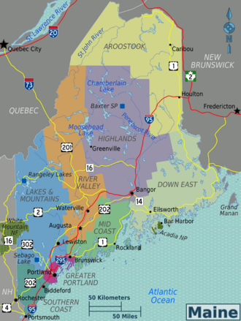
Maine Breach Notification Law:
Virtually every state has its own breach notification law. Maine’s law only applies to incidents involving electronic data. We must investigation incidents if there is even a possibility of a breach.

Slide 30

Breach Notification:
Reporting Concerns or Incidents
All security or privacy concerns or incidents must be reported to
  The Director of Healthcare Privacy
  Your Privacy/Security Liaison
  Please report verbally wherever possible, to reduce the potential of alarm. Not all incidents amount to a breach!

Slide 31

Breach of Protected Information -
It’s Personal!
The Department handles the most sensitive health and financial information imaginable.
Any of us can be, or may have been, subject to identity theft due to a breach of Protected Information.
Imagine having to address, or try to undue, the impact of a breach of health or financial data. It is time consuming, stressful, and may not be effective.
Your role in keeping Protected Information secure is vital and personal.

Slide 32


Breach Notification - Process
Every incident is not a breach. Scenarios are reviewed case by case.
Whether or not you work for a HIPAA-covered office or program, you are required to contact your Privacy/Security Liaison and Director of Healthcare Privacy if you are aware of, or suspect, a privacy or security incident.
Investigation and documentation will be managed centrally with office/program cooperation.
Our agreements should include language requiring vendors to contact the Department within 24 hours in the event of an actual or suspected breach of our Protected Information. Direct any questions to the Director of Healthcare Privacy.
Breach Notification is now included in the Notice of Privacy Practices provided by our HIPAA-Covered Entities.
No retaliation for good faith reporting is permitted.

Slide 33
Breach Notification: Department Obligations in the Event of a Breach Include:
Where 500 or more consumers are impacted, notice by letter and media must be provided within 60 days.
Where 1000 or more consumers are impacted, Maine adds additional reporting requirements to state regulators.
The burden is on the Department to show thorough investigation to support our decisions.
  Notice may be delayed by law enforcement request, so as not to impede an investigation.

Slide 34
Breach Notification: In the News…
The “Wall of Shame” is the nickname for the Federal DHHS Office of Civil Rights webpage where HIPAA-covered entities are required to report breaches of individuals’ unsecured PHI impacting 500 or more individuals. The breaches are posted for public viewing and are searchable.
Most breaches are caused by a loss or theft of a laptop or portable devices.
Paper continues to be a risk as well.

Slide 35

Enforcement:
Penalties Under HITECH
What could happen if there were a HIPAA/HITECH breach or violation?
A maximum Civil Monetary Penalty amount of up to $1.5 million for multiple violations of the same provision.
Criminal conviction and jail terms
    Unknowing and with reasonable cause – up to one year
    Under false pretenses – up to 5 years
    For personal gain or malicious reasons – up to 10 years

Slide 36


Research Requests
The Department is required to meet research compliance standards.
As part of those requirements, the Department works with the University of Southern Maine’s Institutional Review Board (IRB) to review any research requests.

Slide 37

Research
The Department’s process for conducting or providing Protected Information for research may be viewed here.
After a review by the IRB, if the Department agrees to share Protected Information or provide de-identified information with a researcher, a Data Sharing and Protection Agreement must be signed and maintained centrally.
Please contact the Director of Healthcare Privacy, who also serves as the Human Protections Administrator, with any questions.

Slide 38
Summary: Remember…
Never:
    Forward work email containing Protected Information to your home/off-site address.
    Leave unsecured Protected Information in a car or other non-work location. Secure Protected Information is appropriately encrypted or destroyed to make it unusable or unreadable to others.

Slide 39
Summary: Remember…
Always:
    Use the minimum necessary information to accomplish your work. Only access Protected Information on a need-to-know basis.
    Immediately report lost or stolen consumer records or devices containing Protected Information including flash drives, smart phones, or computers.
    Review correspondence or documents before sending. Look for mistakes involving Protected Information, such as sharing more information than necessary, attaching the wrong document to an email, mail merge errors, hidden columns in a spread sheet, or incorrect postal or email addresses.

Slide 40

Summary:
Confidentiality Basics
Even if your office or program is not HIPAA-covered, all Department workforce members must treat Protected Information as confidential based upon other laws, regulations, rules, and Department policy.

Slide 41

Summary: Our Responsibility
The responsibility for protecting and securing the Protected Information we access, use, disclose, transmit, or maintain to do our jobs belongs
to each of us.

Slide 42
Knowledge Check: True or False
Q: The minimum necessary/need-to-know standard only applies to the Department’s HIPAA-covered entities.
A: False. Department Policy requires that our entire workforce, including staff, contractors, volunteers and students, use only the minimum Protected Information necessary to accomplish our jobs, and only view the Protected Information that we need for a legitimate work purpose.

Slide 43
Knowledge Check: True or False
Q: If you are presented with a warrant or a subpoena, you should immediately provide the information requested by the attorney or law enforcement officer.
A: False. You should immediately contact the General Counsel or the Director of Healthcare Privacy, because the demand may not be valid.

Slide 44
Knowledge Check: True or False
Q: Identifiers such as vehicle license numbers, URLs and thumb prints are considered HIPAA Identifiers.
A: True! There are numerous identifiers beyond the name, address, phone and account numbers that may identify the consumer. We need to keep them all confidential.

Slide 45
Knowledge Check: True or False
Q: If you know of, or suspect, a privacy or security incident involving the Department’s Protected Information, should speak with your Privacy/Security Liaison and the Director of Healthcare Privacy right away.
A: True! Contact your Privacy/Security Liaison and the Director of Healthcare Privacy immediately. Your assistance is required by Department policy!

Slide 46
Knowledge Check: True or False
Q: If, in good faith, you make a report of a privacy or security issue, you may be in trouble if an investigation finds no concerns.
False! There is no retaliation permitted for a good faith report, even if no breach is found to have occurred.

Slide 47

Questions?
Director of Healthcare Privacy and Human Protections Administrator
207.287.9362
stacey.mondschein@maine.gov
Resources
DHHS Employee Information Center
http://inet.state.me.us/dhhs/privacy-security/index.php
Policies
http://inet.state.me.us/dhhs/privacy-security/policies.php
Posters
http://inet.state.me.us/dhhs/privacy-security/posters.php

Slide 48
Credit
Get credit
Please click on the above link to submit a completion form and get credit for reviewing this program.

