Slide 1
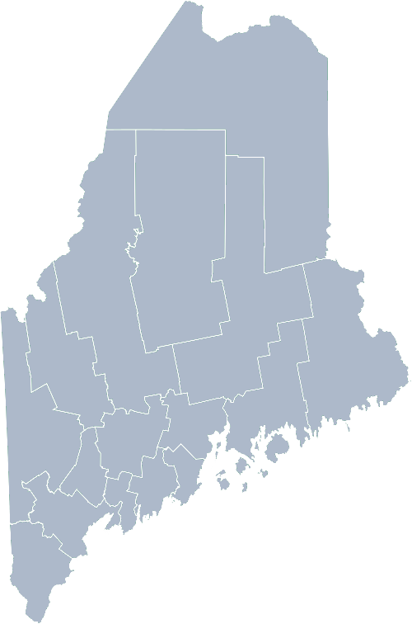
Maine Shared Community Health Needs Assessment FORUM ORIENTATION
2021
Notes:
Welcome to the Maine Shared Community Health Needs Assessment (also referred to as the Maine Shared CHNA), a statewide collaboration between Central Maine Healthcare, Maine Center for Disease Control and Prevention, MaineGeneral Health, MaineHealth, and Northern Light Health.
This is a brief orientation for your upcoming forum

Slide 2
Forum purpose
These forums bring together many community stakeholders to identify priority needs, local resources and opportunities for partnership and collective action.
Notes:
We want to hear your thoughts on the health of your community, and together with your neighbors, identify the top health concerns, populations most at risk, as well as resources and gaps to address those concerns.
These forums and other community feedback will be used as guidance for several organizations to create new health improvement plans in the spring of 2022.

Slide 3
What to expect at the forum
Presentation
Review of county specific community health data
Breakout sessions
Small groups of 5 or more
Discuss and vote on health indicators and priorities
Use of online tools
Survey Monkey
Mentimeter
IdeaBoardz
Reconvene with larger forum
Full forum priority voting results
Next steps
Wrap-up
Notes:
What to expect at the forum
Your forum will review county specific community health data
After the presentation,
Attendees will be placed randomly into breakout sessions consisting of small groups of 5 or more people to allow for small group conversations
In this session, a number of online tools will be used for you to:
Identify health indicators of importance
Vote for your top 4 priority health topics
Identify gaps/barriers and assets/strengths for priorities
Finally, we will reconvene everyone back into the larger forum where we will view the full forum priority voting results and briefly discuss anticipated next steps before wrapping up the forum

Slide 4
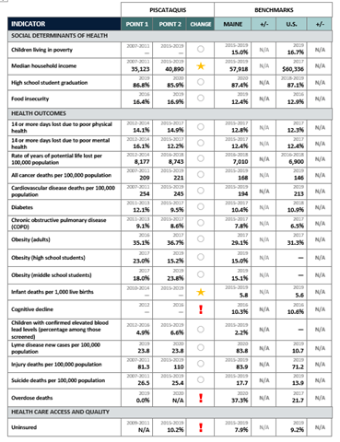
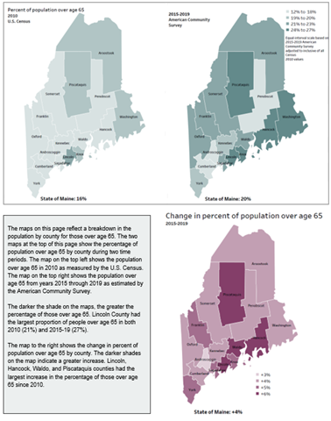
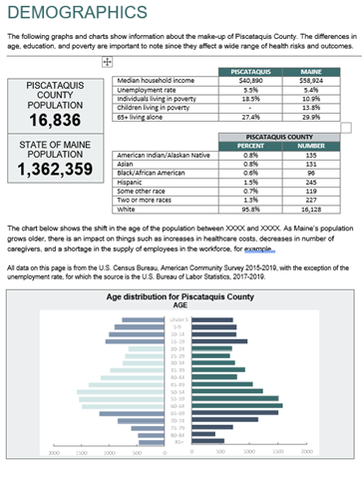
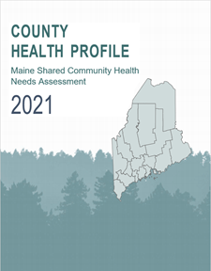
Documents for your review
County Health Profile
Notes:
There are a few documents available for you to review prior to the forum that will provide you with additional county-level insights:
The County Health Profile consists of key demographics as well as data on over 200 health indicators. In this document, you’ll find
Demographic Maps that looks at who makes up our communities to
Key indicators providing an overview of the health of your county
All indicators compare county, state, and national level health data where possible.

Slide 5
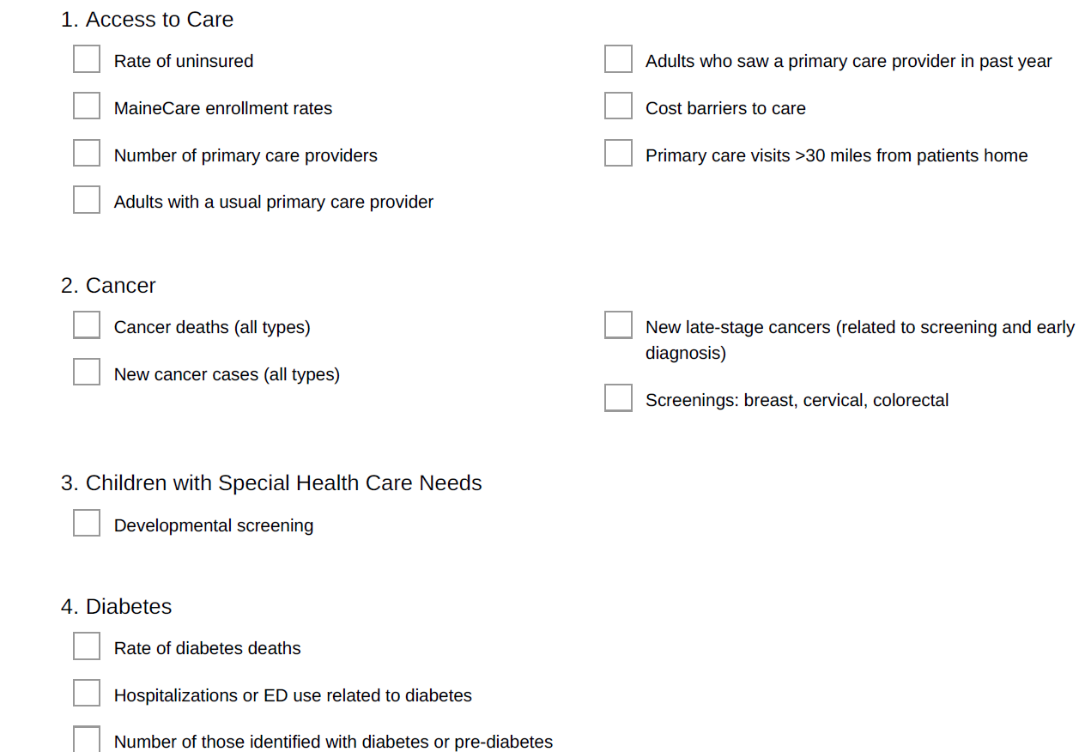
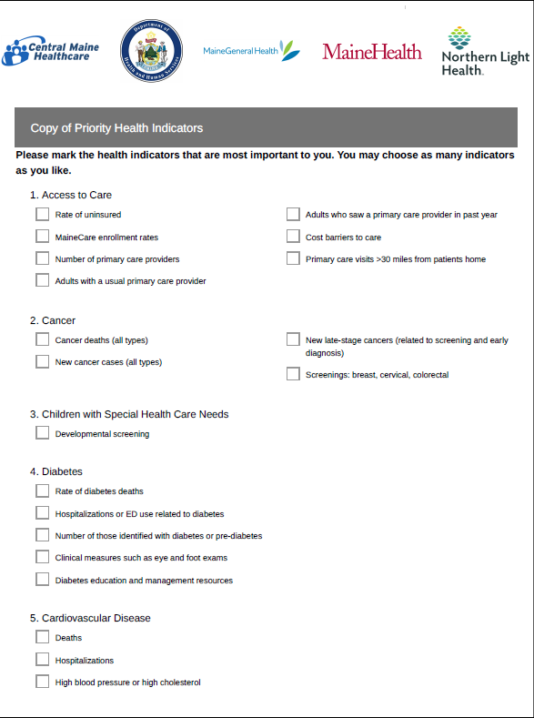
Documents for your review
Priority Health Indicators handout
Notes:
The Priority Health Indicators handout contains a list of 20 priority areas and their associated health indicators ranging from Access to Care to Older Adult Health to Mental Health, Social Determinants of Health and many more.
This document will be used during the breakout session, consider having it available either printed or on your screen during the breakout session for reference

Slide 6
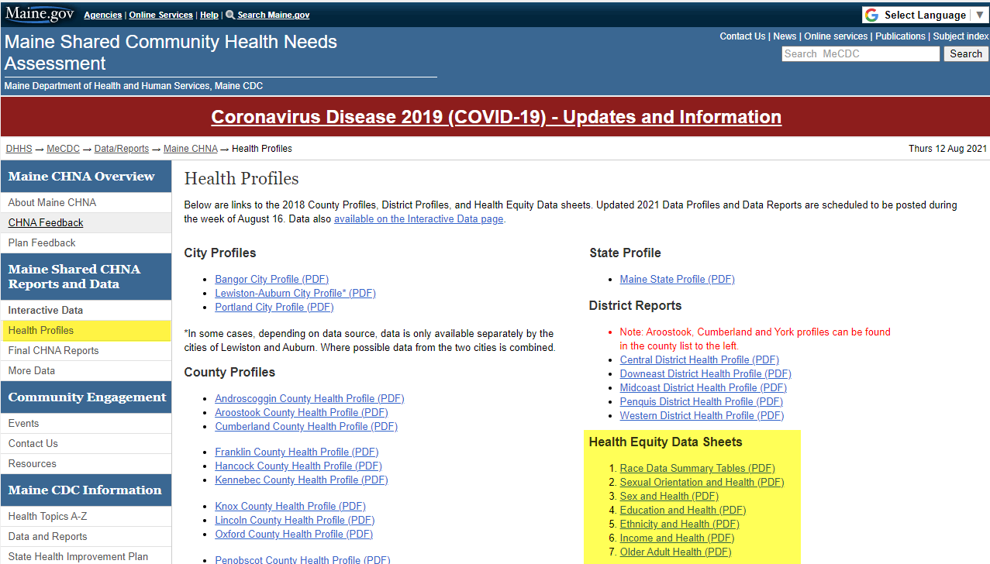
Documents for your review
www.mainechna.org
Notes:
The Health Equity Data Sheets consists of data that has been chosen in collaboration with members of the Maine Shared CHNA Health Equity Work Group to raise awareness on health disparities experienced by various communities across our state, such as education and health to sexual orientation and health.
[CLICK] These documents can be found on www.mainechna.org
In addition, the health profiles page will house the various profiles for you to download

Slide 7
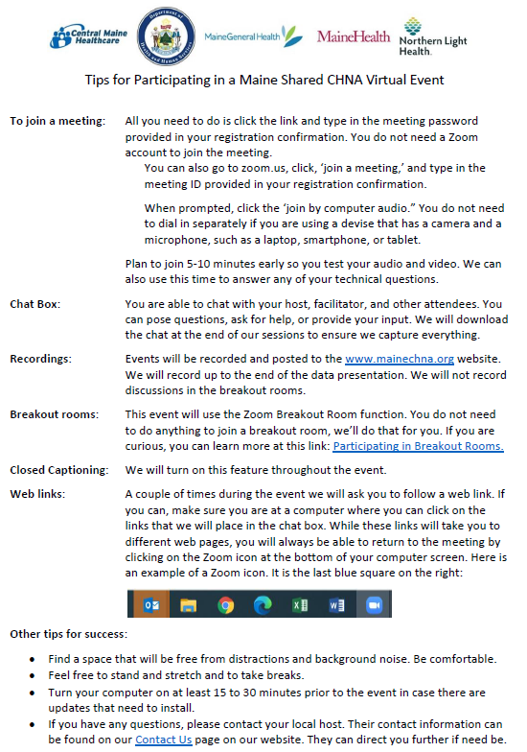
Documents for your review
How to join the meeting
Using Chat Box
Recordings
Closed captioning
Other tips
Notes:
Finally,
Tips for participating in Virtual Event
This short document shares information on how to join the zoom meeting, use of the chat box, recordings, closed captioning and other helpful tips

Slide 8
Thank you!
We look forward to your participation at the upcoming Shared Community Health Needs Assessment Forum
Notes:
Thank you for your time and we look forward to your participation at the upcoming Shared Community Health Needs Assessment Forum

