Slide 1
Air Pollution
Environmental Education, Middle School Program
MAINE DEPARTMENT OF ENVIRONMENTAL PROTECTION
Protecting Maine’s Air, Land and Water
Notes:
Sources of Information for this presentation as detailed in your teacher notes:
The Plain English Guide to the Clean Air Act - https://www.epa.gov/sites/production/files/2015-08/documents/peg.pdf
Thermal Inversion - http://www.wrh.noaa.gov/slc/climate/TemperatureInversions.php
Donora, PA Weather Event - https://en.wikipedia.org/wiki/1948_Donora_smog
Thermal Inversion Demonstration – Inversion in a Cup - https://www.deq.idaho.gov/media/570177-inversion_in_cup_lp.pdf

Slide 2
Air Pollution
Air Pollution can impact your
Health
Environment
Nation’s Economy
MAINE DEPARTMENT OF ENVIRONMENTAL PROTECTION www.maine.gov/dep
Notes:
Your health
Breathing polluted air can make your eyes and nose burn. It can irritate your throat and make breathing difficult.
Pollutants like tiny airborne particles and ground-level ozone can trigger respiratory problems
The environment
Pollutants and the chemicals that form acid rain and ground-level ozone can damage trees, crops, wildlife, lakes and other bodies of water – they can also harm fish and other aquatic life.
The economy
Each day, air pollution causes thousands of illnesses leading to lost days at work and school.
Air pollution also reduces agricultural crop and commercial forest yields by billions of dollars each year.
Image: https://equalitycumbria.org/awaz-cumbria/news/more-ethnically-diverse-populations-uk-local-areas

Slide 3
Clean Air Act
The original Clean Air Act was established in 1963. It established funding for the study and the cleanup of air pollution.
In 1970 Congress created the Environmental Protection Agency (EPA) and gave it the primary role in carrying out the law.
In 1990, Congress revised and expanded the Clean Air Act,
Provided the EPA even broader authority to implement and enforce regulations reducing air pollutant emissions.
Placed an increased emphasis on more cost-effective approaches to reduce air pollution.
MAINE DEPARTMENT OF ENVIRONMENTAL PROTECTION www.maine.gov/dep
Notes:
But there was no comprehensive federal response to address air pollution until Congress passed a much stronger Clean Air Act in 1970. That same year Congress created the EPA and gave it the primary role in carrying out the law. 1970, EPA has been responsible for a variety of Clean Air Act programs to reduce air pollution nationwide.

Slide 4
Clean Air Act
By reducing air pollution, the Clean Air Act has led to significant improvements in human health and the environment in the U.S.
Since 1970, the six commonly found air pollutants have decreased by more than 50 percent.
Notes:
Photo: www.blueskies.org.nz

Slide 5
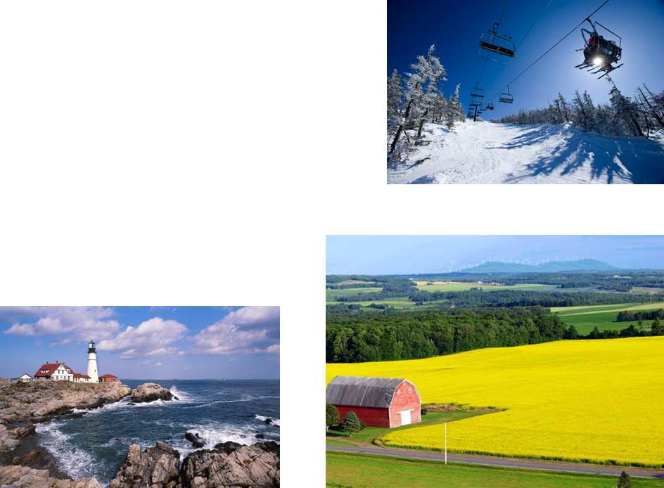
Criteria Air Pollutants
Ozone
Particle Pollution
Carbon Monoxide
Lead
Sulfur Dioxides
Nitrous Dioxides
Notes:
EPA calls these pollutants "criteria" air pollutants because it regulates them by developing human health based and/or environmentally-based criteria (science-based guidelines) for setting permissible levels.
Ozone - Ground level or "bad" ozone is not emitted directly into the air, but is created by chemical reactions between oxides of nitrogen (NOx) and volatile organic compounds (VOC) in the presence of sunlight. Breathing ozone can trigger a variety of health problems, particularly for children, the elderly, and people of all ages who have lung diseases such as asthma. Ground level ozone can also have harmful effects on sensitive vegetation and ecosystems.
Particle Pollution - Particulate matter contains microscopic solids or liquid droplets that are so small that they can be inhaled and cause serious health problems Fine particles are the main cause of reduced visibility (haze) in parts of the United States, including many of our treasured national parks and wilderness areas.
Carbon Monoxide
Breathing air with a high concentration of CO reduces the amount of oxygen that can be transported in the blood stream to critical organs like the heart and brain.
At very high levels, which are possible indoors or in other enclosed environments, CO can cause dizziness, confusion, unconsciousness and death.
Very high levels of CO are not likely to occur outdoors. However, when CO levels are elevated outdoors, they can be of particular concern for people with some types of heart disease.
Lead
Once taken into the body, lead distributes throughout the body in the blood and is accumulated in the bones. Depending on the level of exposure, lead can adversely affect the nervous system, kidney function, immune system, reproductive and developmental systems and the cardiovascular system.
Sulfur Dioxides
Short-term exposures to SO₂ can harm the human respiratory system and make breathing difficult. Children, the elderly, and those who suffer from asthma are particularly sensitive to effects of SO₂.
Nitrous Dioxides
Breathing air with a high concentration of NO₂ can irritate airways in the human respiratory system. Such exposures over short periods can aggravate respiratory diseases, particularly asthma, leading to respiratory symptoms (such as coughing, wheezing or difficulty breathing), hospital admissions and visits to emergency rooms. Longer exposures to elevated concentrations of NO₂ may contribute to the development of asthma and potentially increase susceptibility to respiratory infections.
Lighthouse Image: I95rock.com; barn image: http://www.etravelmaine.com/region/aroostook/; ski image mainetoday.com

Slide 6
How You Can Help Reduce Air Pollution?
Conserve Energy
Drive Wisely / Ride Wisely
Notes:
A few examples…
Conserve Energy
■Turn off appliances and lights when you leave the room. ■ Recycle paper, plastic, glass bottles, cardboard, and aluminum cans. (This conserves energy and reduces production emissions.) ■Wash clothes with warm or cold water instead of hot. ■ Choose products that have less packaging and are reusable. ■ Shop with a canvas bag instead of using paper and plastic bags.
Drive Wise
■Plan your trips. Save gasoline and reduce air pollution. ■ Keep tires properly inflated and aligned. ■ Join a carpool or vanpool to get to work.

Slide 7
Thermal Inversions
Thermal inversion occurs when a layer of warm air settles over a layer of cooler air that lies near the ground. The warm air holds down the cool air and prevents pollutants from rising and scattering.
Notes:
There are two types of temperature inversions: surface inversions that occur near the Earth's surface, and aloft inversions that occur above the ground. Surface inversions are the most important in the study of air quality.
The most common manner in which surface inversions form is through the cooling of the air near the ground at night. Once the sun goes down, the ground loses heat very quickly, and this cools the air that is in contact with the ground. However, since air is a very poor conductor of heat, the air just above the surface remains warm. Conditions that favor the development of a strong surface inversion are calm winds, clear skies, and long nights. Calm winds prevent warmer air above the surface from mixing down to the ground, and clear skies increase the rate of cooling at the Earth's surface. Long nights allow for the cooling of the ground to continue over a longer period of time, resulting in a greater temperature decrease at the surface. Since the nights in the wintertime are much longer than nights during the summertime, surface inversions are stronger and more common during the winter months.
During the daylight hours, surface inversions normally weaken and disappear as the sun warms the Earth's surface. However, under certain meteorological conditions, such as strong high pressure over the area, these inversions can persist as long as several days. In addition, local topographical features can enhance the formation of inversions, especially in valley locations.

Slide 8
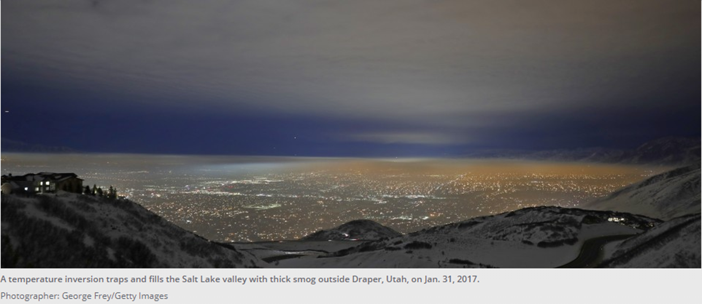
Thermal Inversion – Salt Lake Valley
Notes:
Photo provided by MDEP.

Slide 9
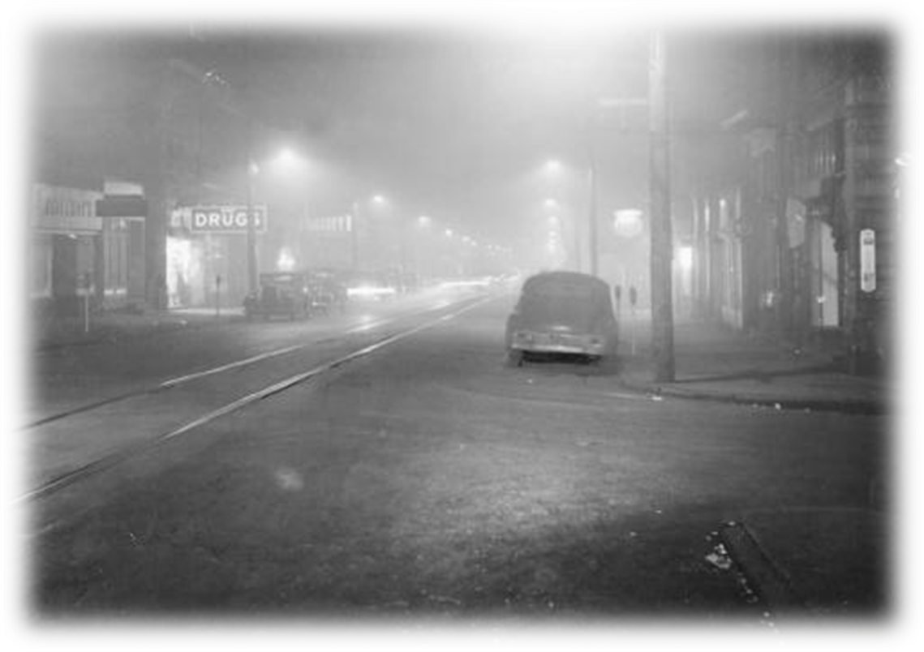
Donora, Pennsylvania Event
Notes:
LS2.C: Ecosystem Dynamics, Functioning, and Resilience: Ecosystems are dynamic in nature; their characteristics can vary over time. Disruptions to any physical or biological component of an ecosystem can lead to shifts in all its populations.
Note that thermal inversions create a change in ecosystem – air pollution levels in the local area are raised greatly – the most sensitive populations (elderly, very young, health compromised) are typically affected first and most severely.
The 1948 Donora smog was a historic air inversion that resulted in a wall of smog that killed 20 people and sickened 7,000 more.
The fog started building up in Donora on October 27, 1948. By the following day it was causing coughing and other signs of respiratory distress for many residents of the community in the Monongahela River valley. The smog continued until it rained on October 31, by which time 20 residents of Donora had died and approximately one third to one half of the town's population of 14,000 residents had been sickened. Another 50 residents died of respiratory causes within a month after the incident.
Hydrogen fluoride and sulfur dioxide emissions from U.S. Steel's Donora Zinc Works and its American Steel & Wire plant were frequent occurrences in Donora. What made the 1948 event more severe was a temperature inversion, a situation in which warmer air aloft traps pollution in a layer of colder air near the surface. The pollutants in the air mixed with fog to form a thick, yellowish, acrid smog that hung over Donora for five days. The sulfuric acid, nitrogen dioxide, fluorine, and other poisonous gases that usually dispersed into the atmosphere were caught in the inversion and accumulated until rain ended the weather pattern.
The smog was so intense that driving was nearly abandoned; those who chose to continue driving were risky.
It was not until Sunday morning, the 31st of October, that a meeting occurred between the operators of the plants, and the town officials. It was requested the plants temporarily cease operations. The superintendent of the plants said the plants had already begun shutting down operation at around 6 a.m. that morning. With the rain alleviating the smog, the plants resumed normal operation the following morning.
Photo/Source: Noontime Smog Donora PA, 1948 - https://www.google.com/search?q=donora+pennsylvania+1948&rlz=1C1GGRV_enUS751US751&source=lnms&tbm=isch&sa=X&ved=0ahUKEwjb2sHSitrVAhVBQCYKHWhTB9UQ_AUICygC&biw=1242&bih=602#imgrc=wsKgS-IiJ2mmwM:

Slide 10
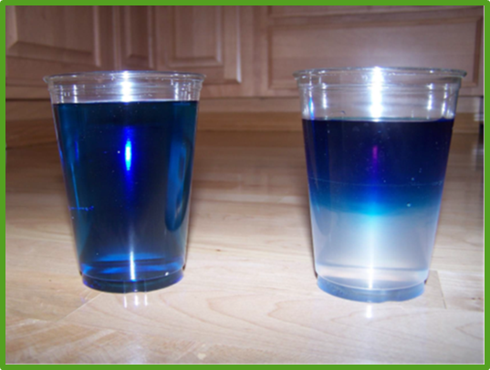
Introduction to Demonstration
Inversion in a Cup
Objective: To observe how temperature inversions are formed and discuss how inversions influence air pollution levels.
Notes:
Cross Cutting Idea: Stability and Change – Small changes (temperature) in one part of a system might cause large changes (air pollutants unable to disperse) in another part.
Discuss how the warm air at a higher elevation than cold air can cause a thermal inversion to occur. This change in the system can cause a “trap” where pollutants are not dispersed, and people, animals, and the environment can be exposed to higher than normal pollutant levels.
Engaging in Argument from Evidence: Use an oral argument supported by empirical evidence (shown in demonstration) to support or refute the explanation for the phenomenon.

Slide 11
Add contact information www.maine.gov/dep

