Slide 1
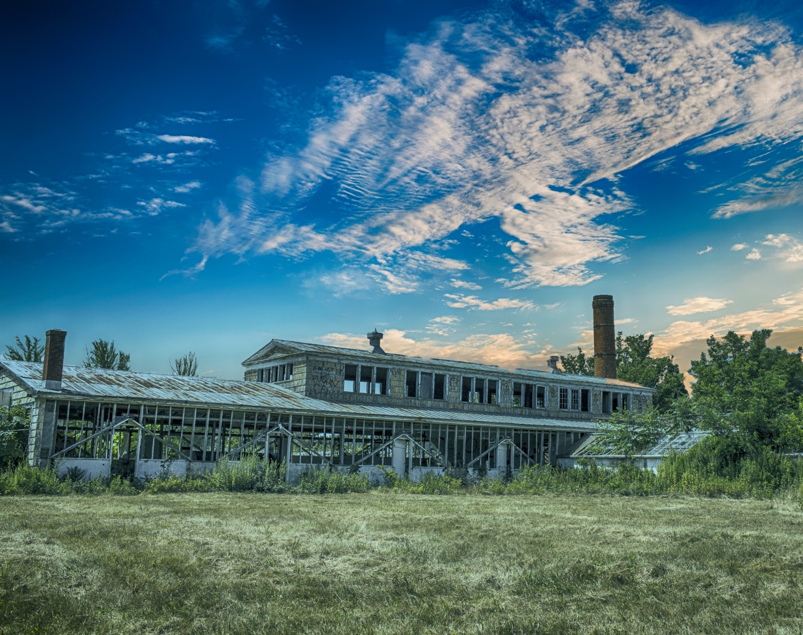
UConn TAB Support and Services
Environmental Justice and Brownfields
Marisa Chrysochoou
UConn TAB Program Director

Slide 2
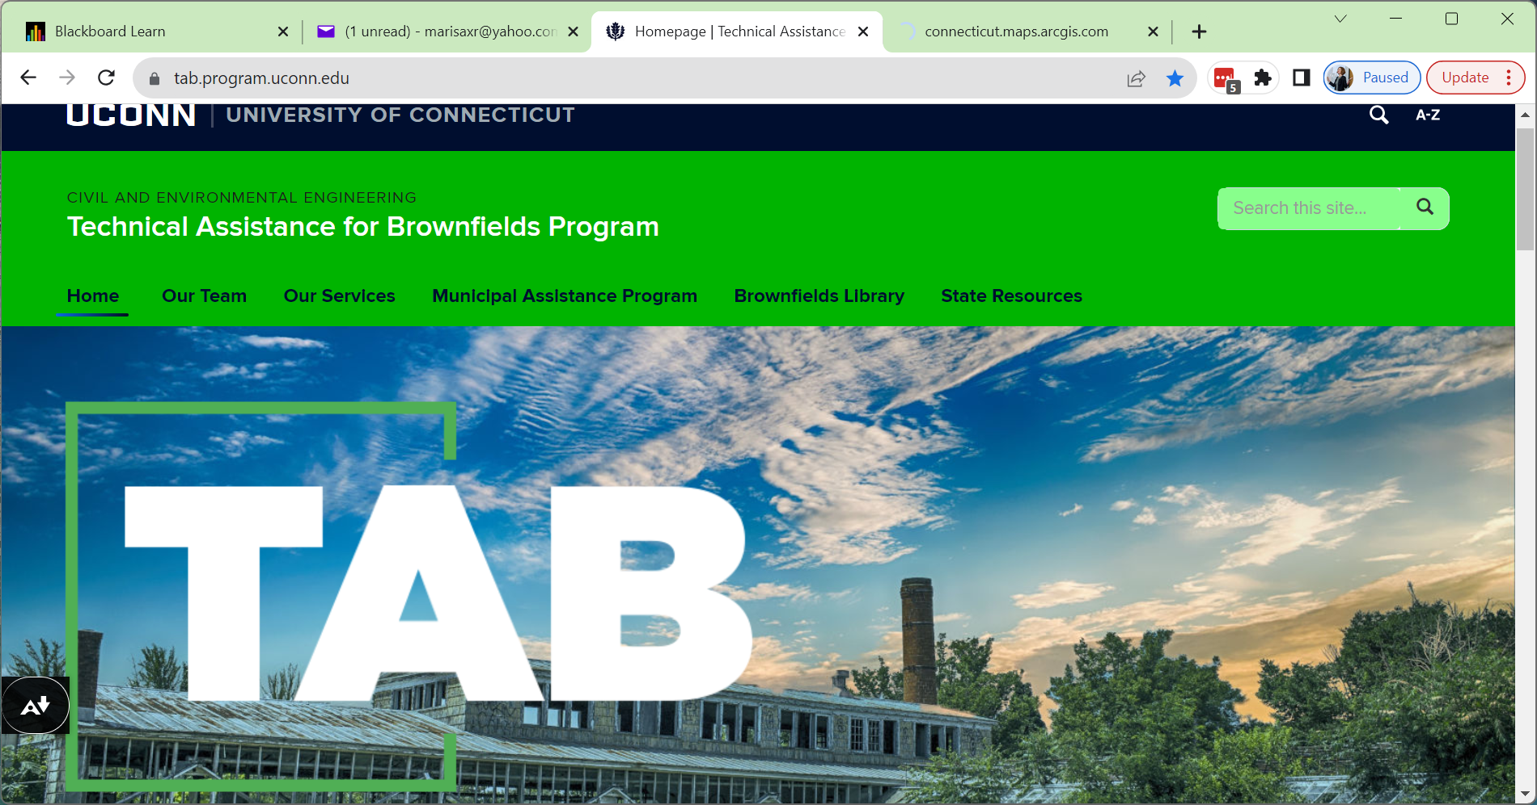
UConn TAB Support and Services
UConn TAB
Email: Uconn-tab@uconn.edu
Website: Tab.program.uconn.edu

Slide 3
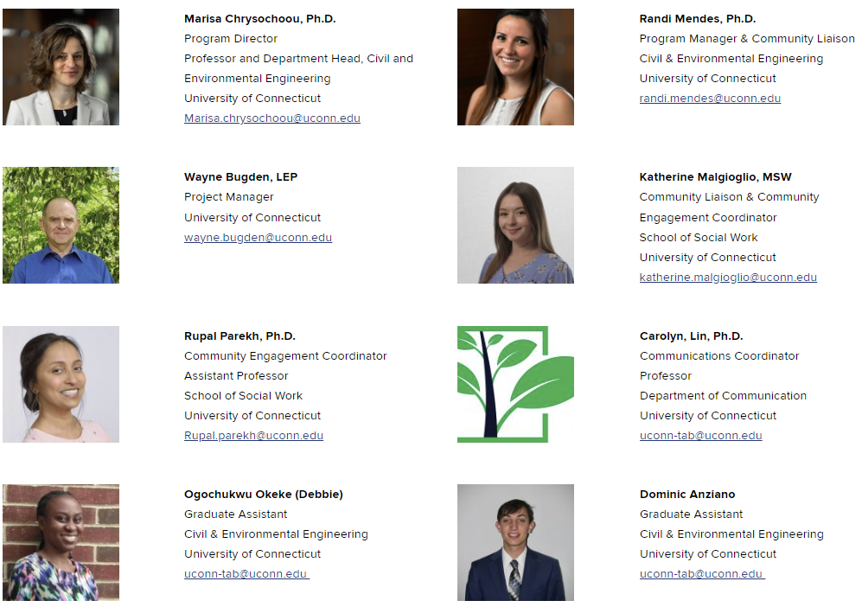


Meet
Our
Team

Slide 4
Our Services at a Glance
Direct Technical Assistance
Continuing Education
Municipal Assistance Program
Community Engagement

Slide 5
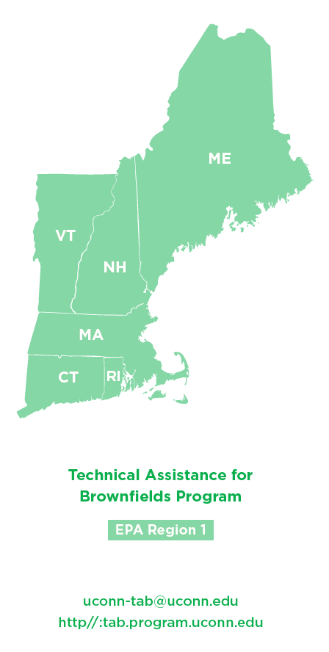

Who we serve
CITIES, TOWNS, TRIBES
Equal Distribution of Resources in all 6 New England States and Tribes
Geographic Diversity
Rural & Urban Communities
Small and Larger Towns, Cities
Environmental Justice Communities receive priority
NON-PROFIT, COMMUNITY BASED ORGANIZATIONS
Regional PLANNING ORGANIZATIONS

Slide 6
Direct Technical Assistance
Technical Document Review
Review of Environmental Site Assessment Reports, Remedial Action Plans, Planning Documents
Brownfields Proposals Review
EPA Brownfields proposals (assessment, cleanup, multipurpose, RLF) and State Program proposals
Online Office Hours
Answer Technical Questions
Access to Resources
Fact sheets, example proposals, and documents

Slide 7

Additional Educational Resources Available
https://tab.program.uconn.edu/brownfields-library/

Slide 8
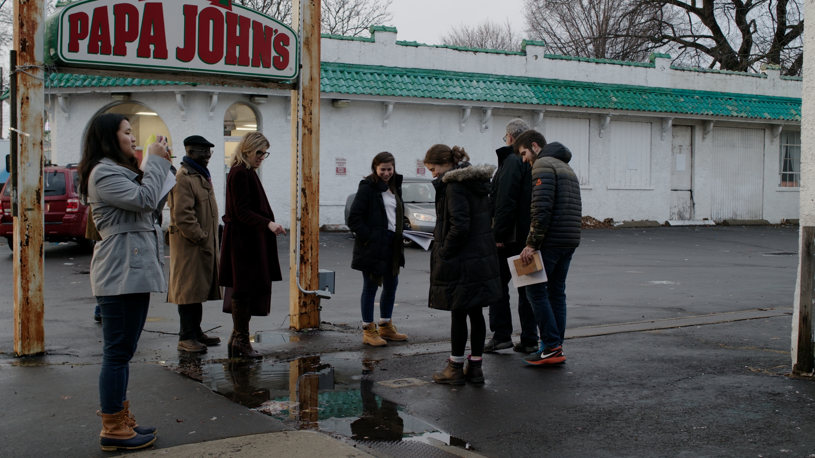
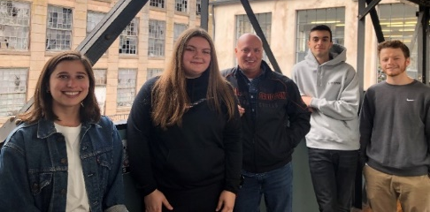

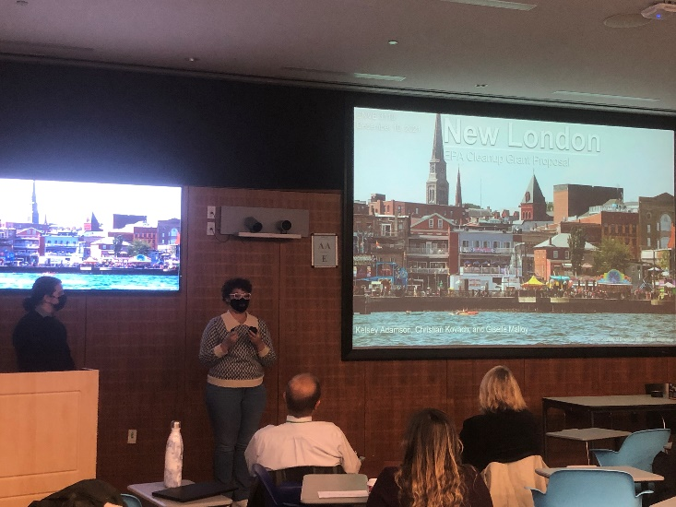
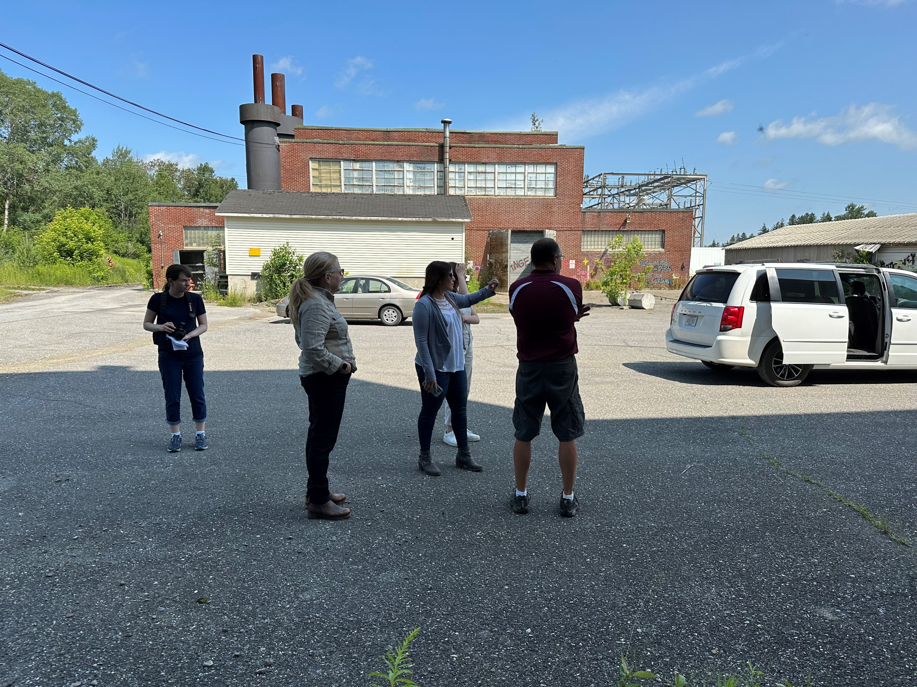
Municipal Assistance Program
Community
Info & Input
TAB Staff
Supervise
UCONN Students
Technical Work

Slide 9
Municipal Assistance Program
Sep-Dec
Jan-April
May-Aug
EPA Brownfields Grant Support
TECHNICAL SUPPORT
Target Area and Brownfield Site Description
Community Need (Demographics, EJSCREEN data)
Brownfield Inventories
Data Review and Gap Analysis for brownfield sites
Draft Scope of Work for site investigations
Site reuse planning
Community Engagement Planning and Materials

Slide 10
Upcoming
FY24 EPA Brownfields MARC Grant Support
October
October - November
MARC Grant Bootcamp:
Half day (9-12) workshop how to put together the project description
Location: ONLINE
Dates: 10/6
PREREGISTRATION REQUIRED
Application Review:
Two rounds of review: all documents
1st round of review (4 weeks before EPA deadline):
It consists of comments on how the narrative addresses EPA’s guidelines, suggestions on how to address these comments, and resources to identify data
2nd round or review (2 weeks before EPA deadline): After the feedback of the 1st round of review is addressed, the 2nd round will provide additional feedback to fine-tune the narrative and provide feedback on the complete application package.
tab.program.uconn.edu/epa-grant-review-submission/

Slide 11
Upcoming Webinars
September
9/20: Community Engagement for MARC Grants
October
10/11: Public Health Data for MARC grants
November
11/1: Affordable Housing and Brownfields
10/4: How to use EJ SCREEN for MARC grants
10/18: Displacement: Identifying It & Addressing It
tab.program.uconn.edu/workshops-webinars/

Slide 12
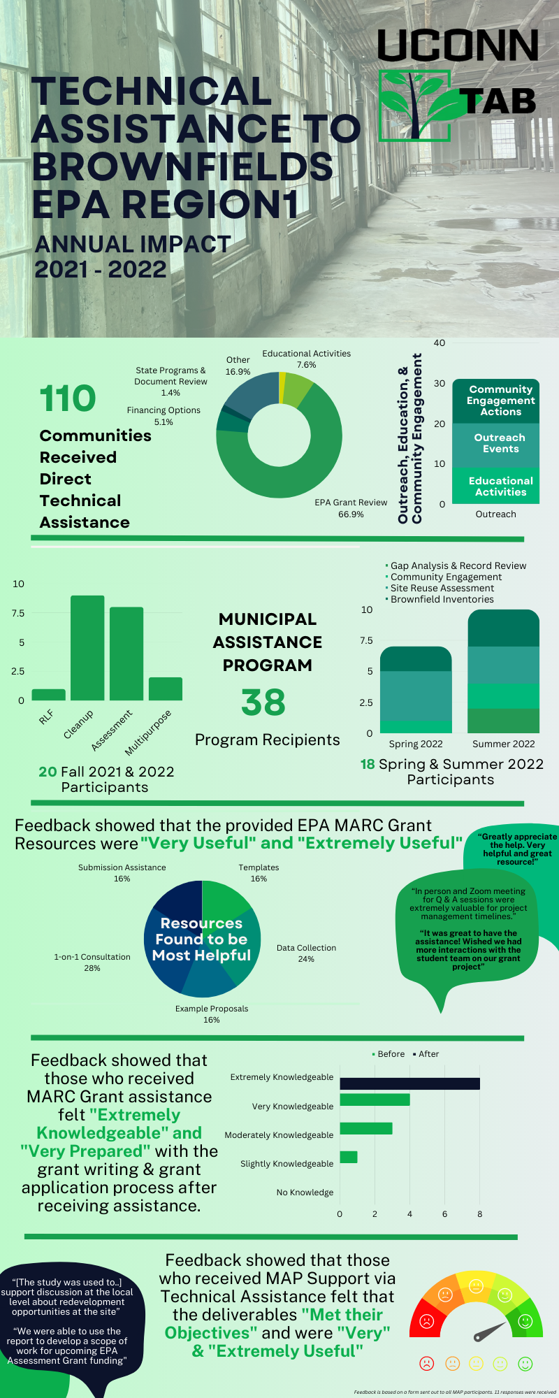
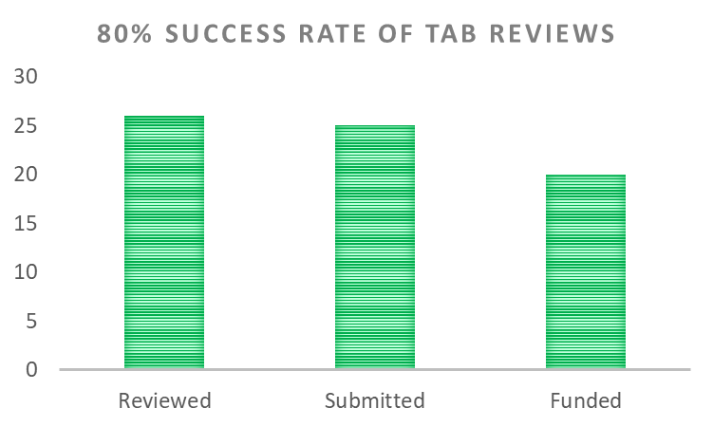
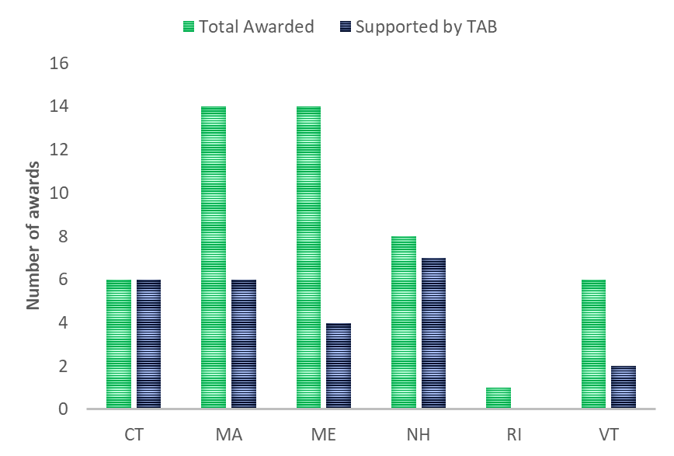
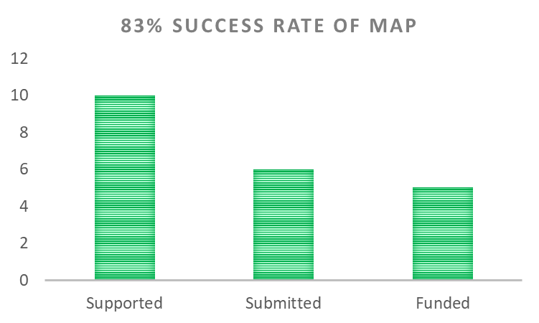
Impact of our Support
FY23 MARC Grant Support

Slide 13
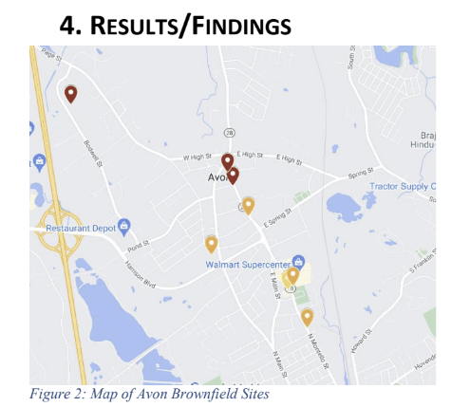
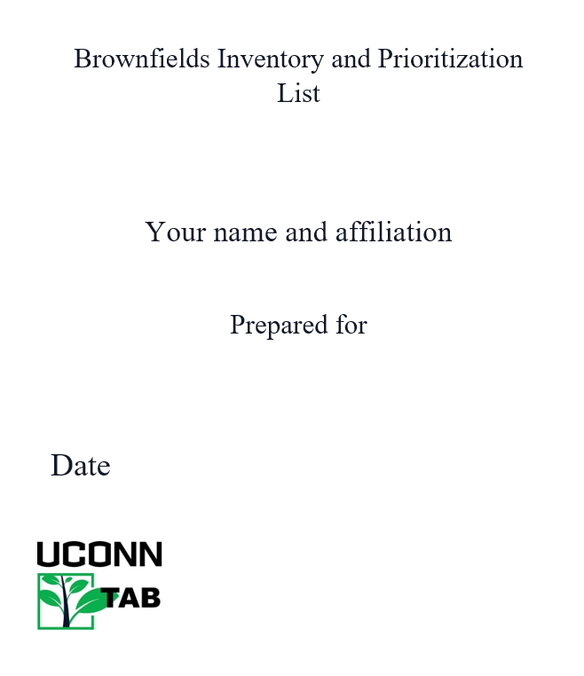
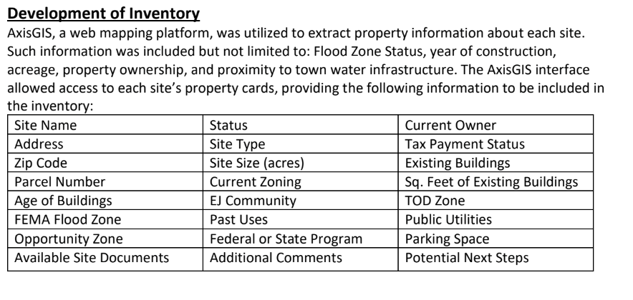
Brownfield Inventories
Communities Helped:
Athol, MA
Attleboro, MA
Hamden, CT
Bethany, CT
Winchester, CT
Watertown, CT
Milton, MA
Dalton, MA
Avon, MA
Colchester, CT
Preston, CT
North Stonington, CT
Bozrah, CT
Griswold, CT
Sprague, CT
Westborough, MA
Greater Grove Hall, MA
Borough of Naugatuck, CT

Slide 14
Site Reuse Assessment Projects
Property Information
Opportunities & Constraints
Market
Community
Local Economy
Regional Economy
Demographics
Land Availability
Strengths & Weaknesses
Expectations
Useable Acreage
Viability
Accessibility
Structure
Infrastructure
Utilities
Neighboring Land Use
Ownership
Land value
Tax status
Occupancy
Zoning
GOAL: Identify potential reuse options for the brownfield based on the community’s vision and other site and surrounding area conditions
Provides a full evaluation of the opportunities, constraints and range of redevelopment possibilities related to the reuse of a brownfield site.
Site characteristics and needs
Area economy and demographics
Physical, environmental conditions
Applicable regulations
Real estate market conditions
Deliverables: Formal report, Sketchup Renderings of Reuse Scenarios

Slide 15
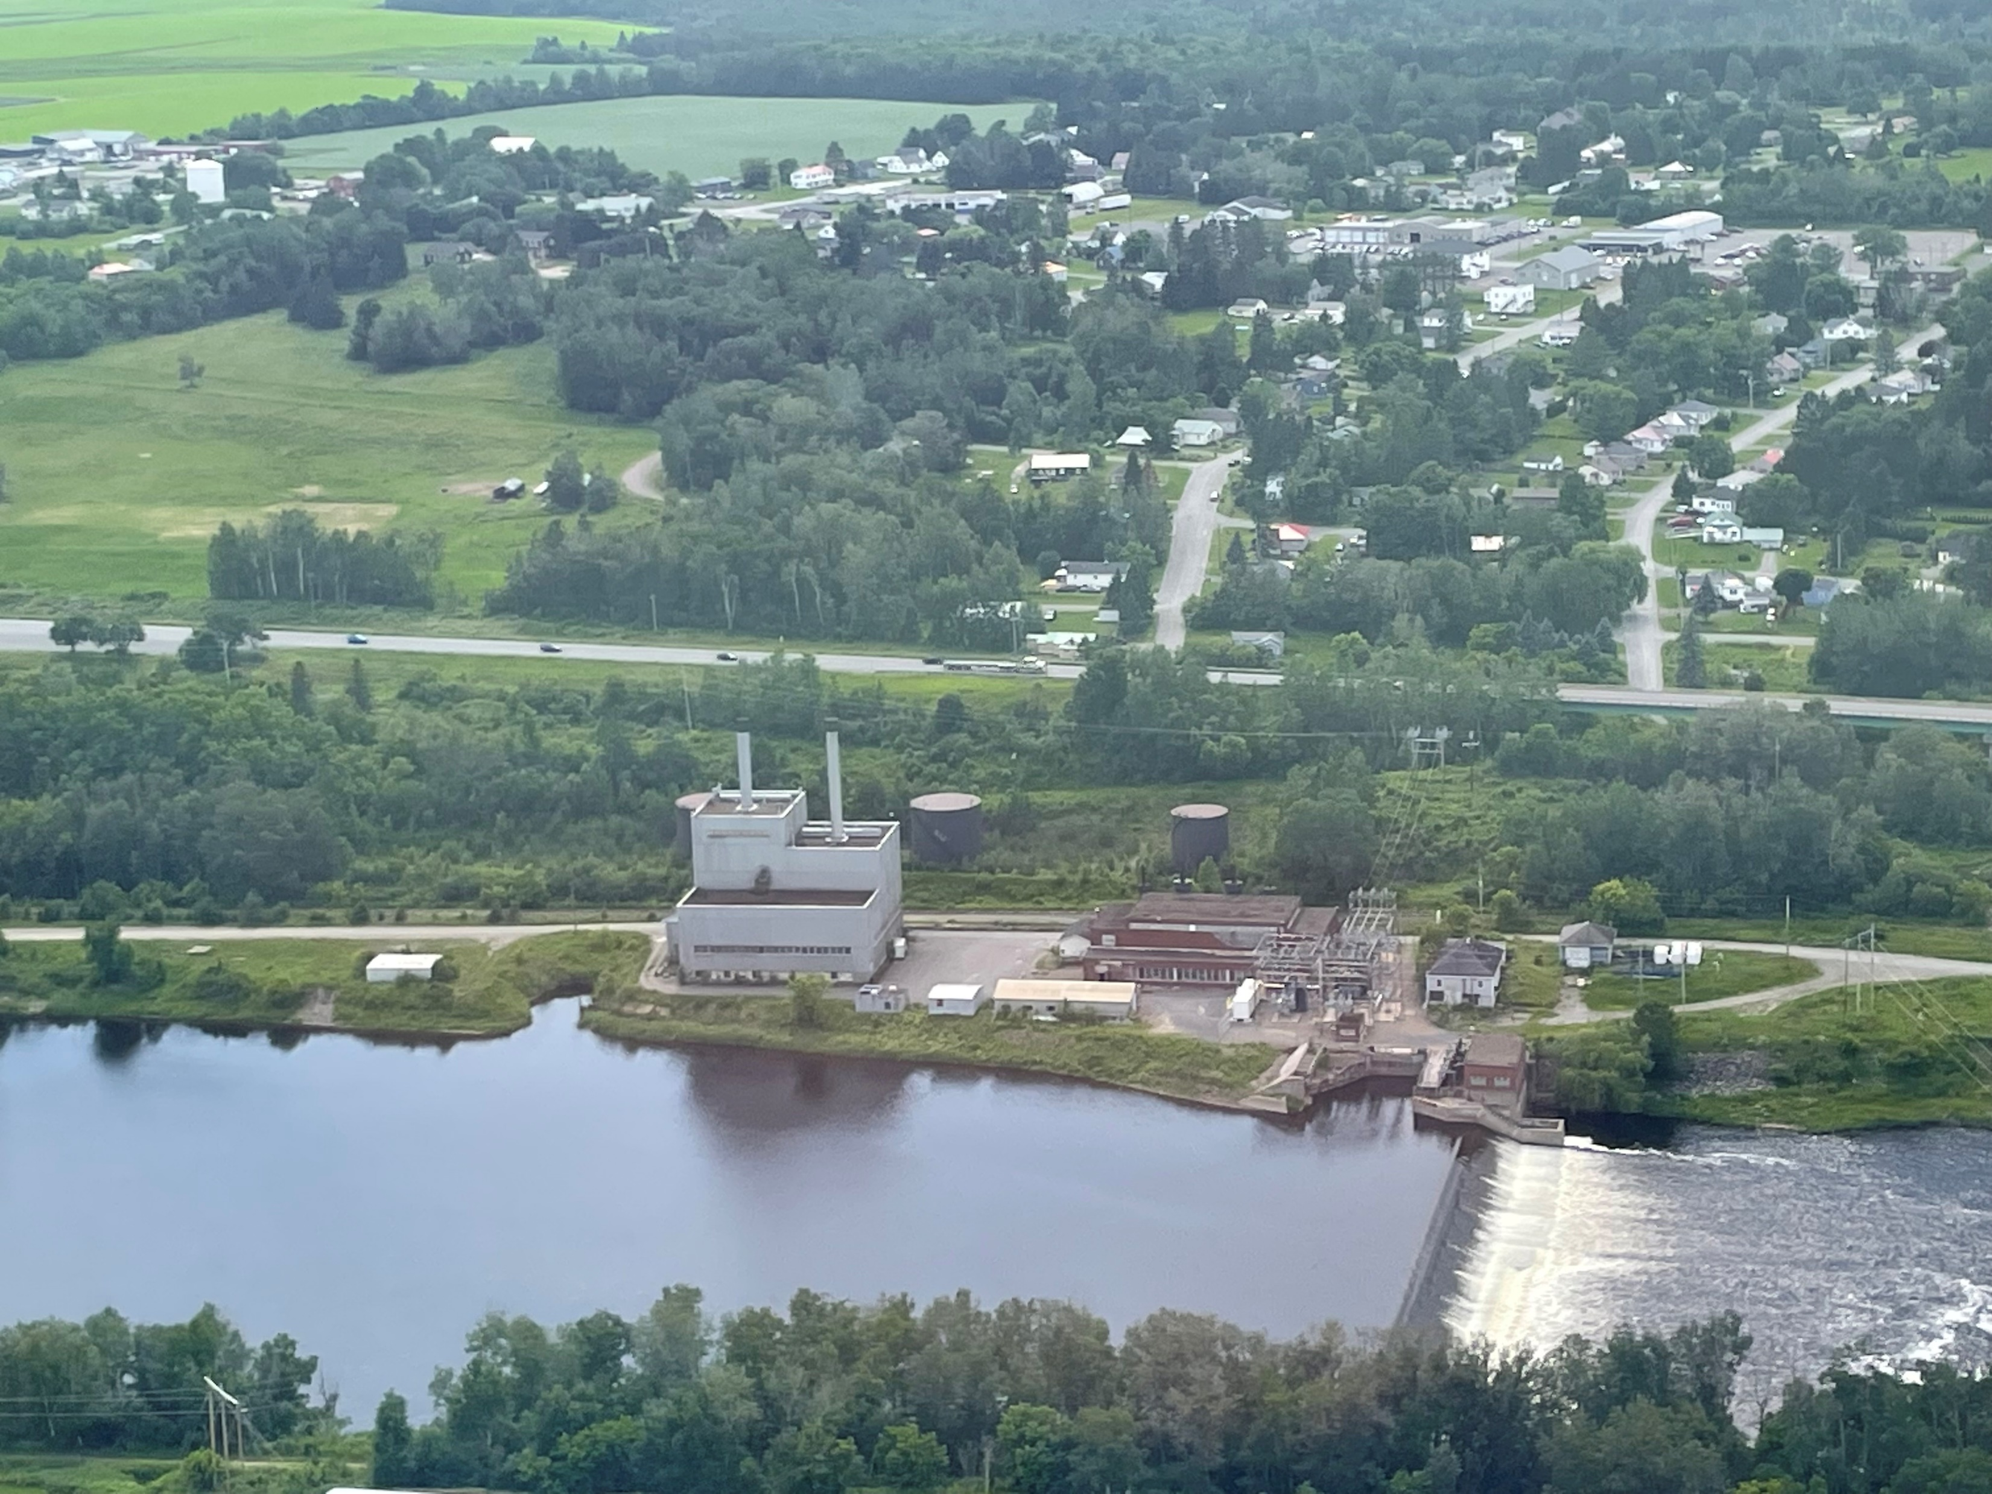
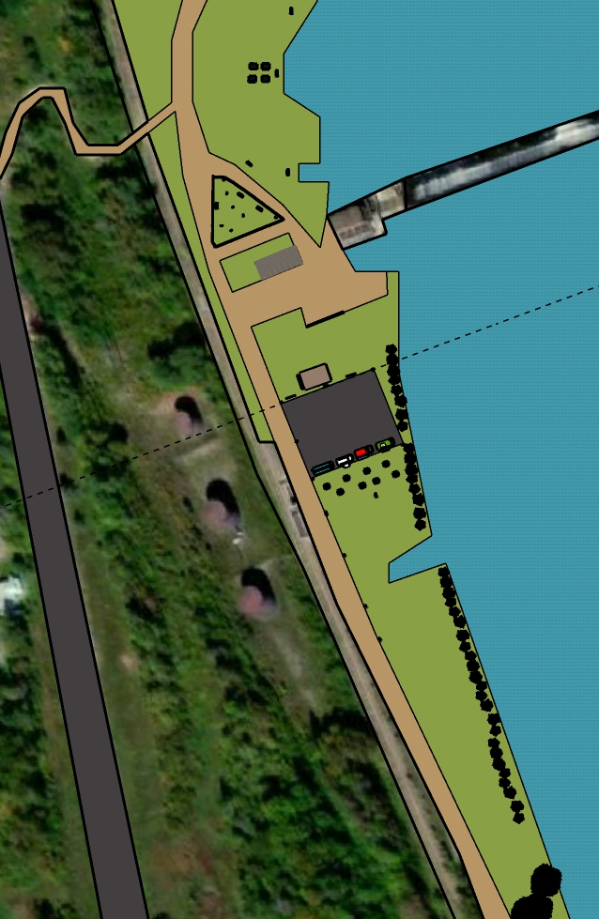
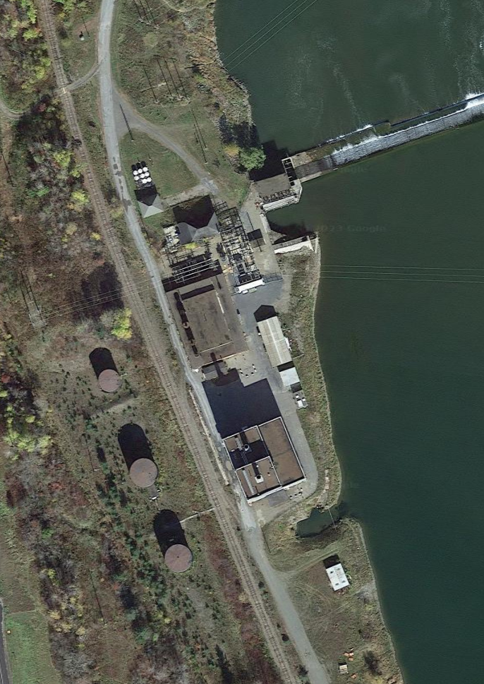
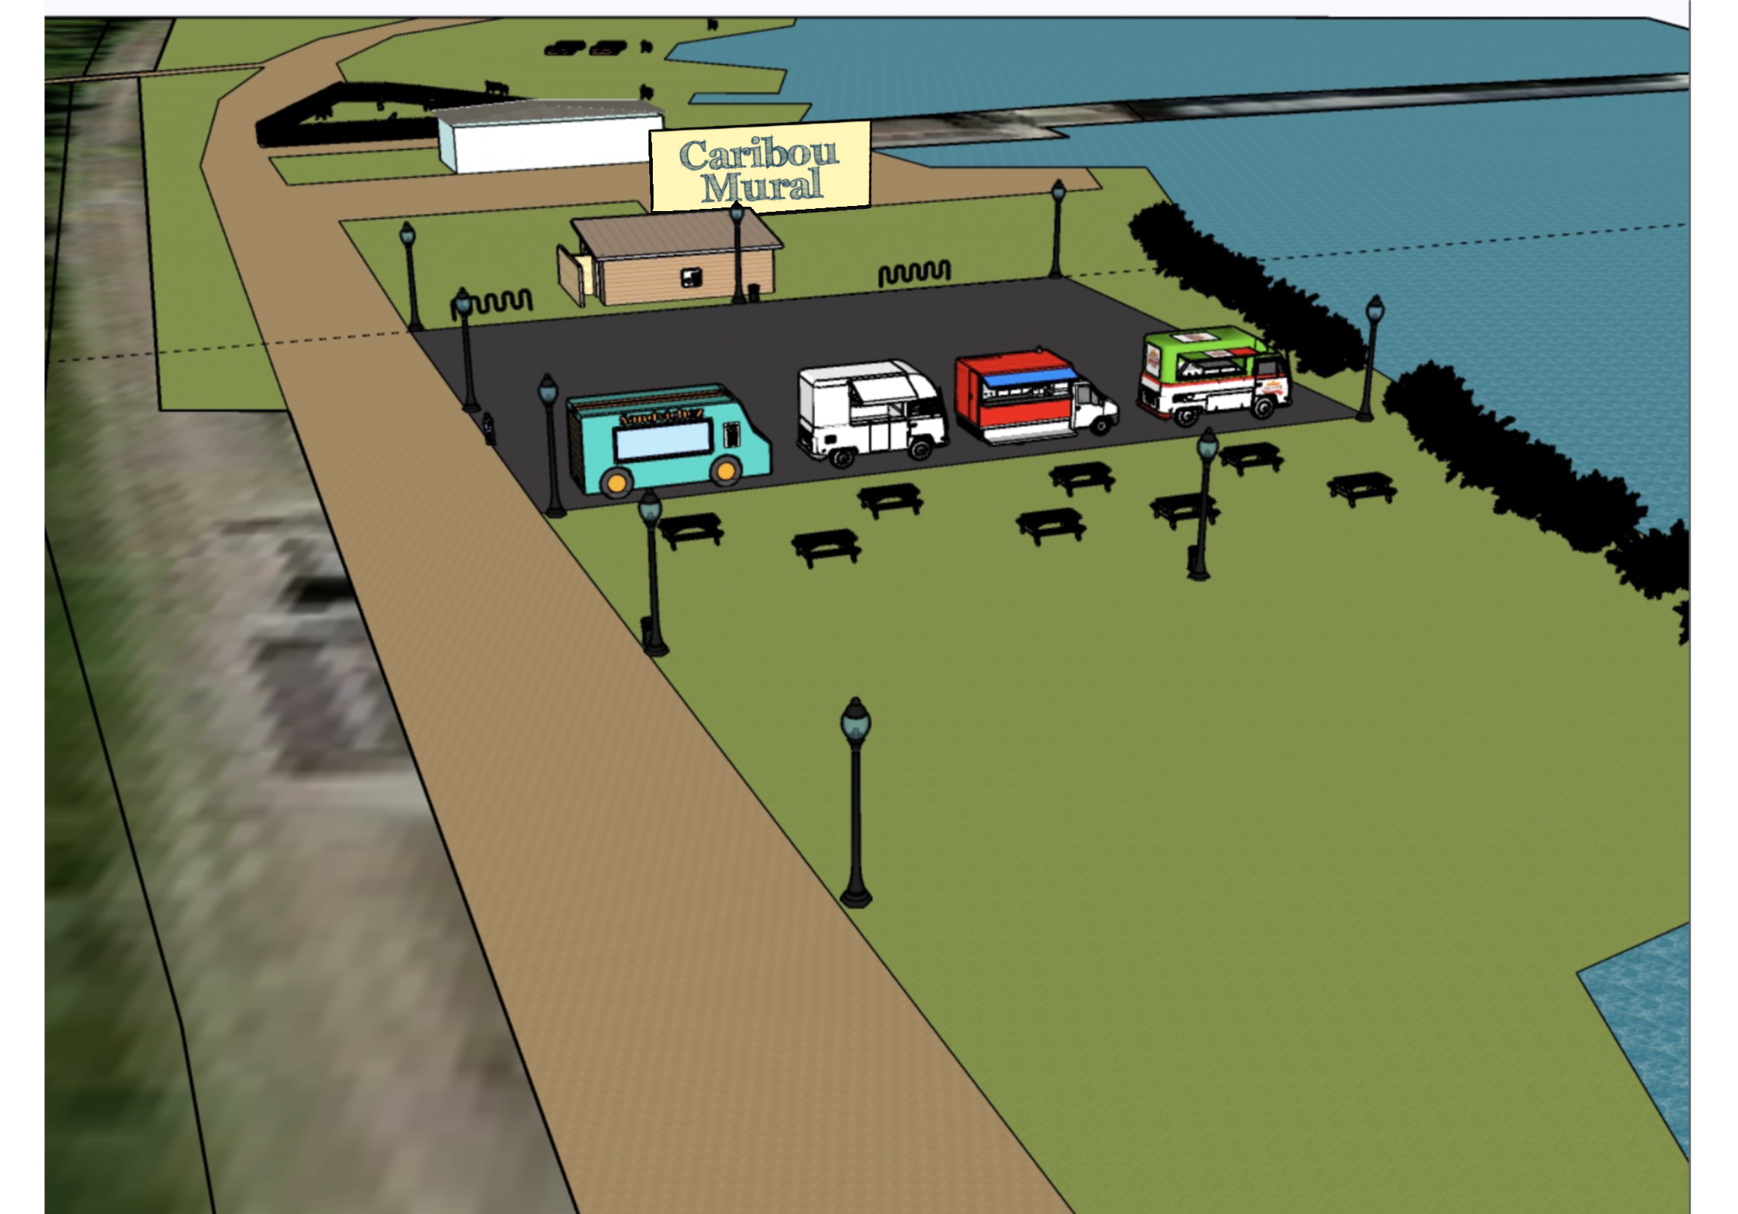
Caribou, ME
Communities Helped:
Monson, MA
Lyndon, VT
Waterbury, CT
Claremont, NH
Foxborough, MA
Rockingham, VT
Middleborough, MA
Winchester, NH
Derby, CT
Norwich, CT
Redding, CT
Caribou, ME
Enfield, CT
Clinton, MA
Bolton, MA
Spofford, NH
New Ipswich, NH

Slide 16

Environmental Justice and Brownfields

Slide 17
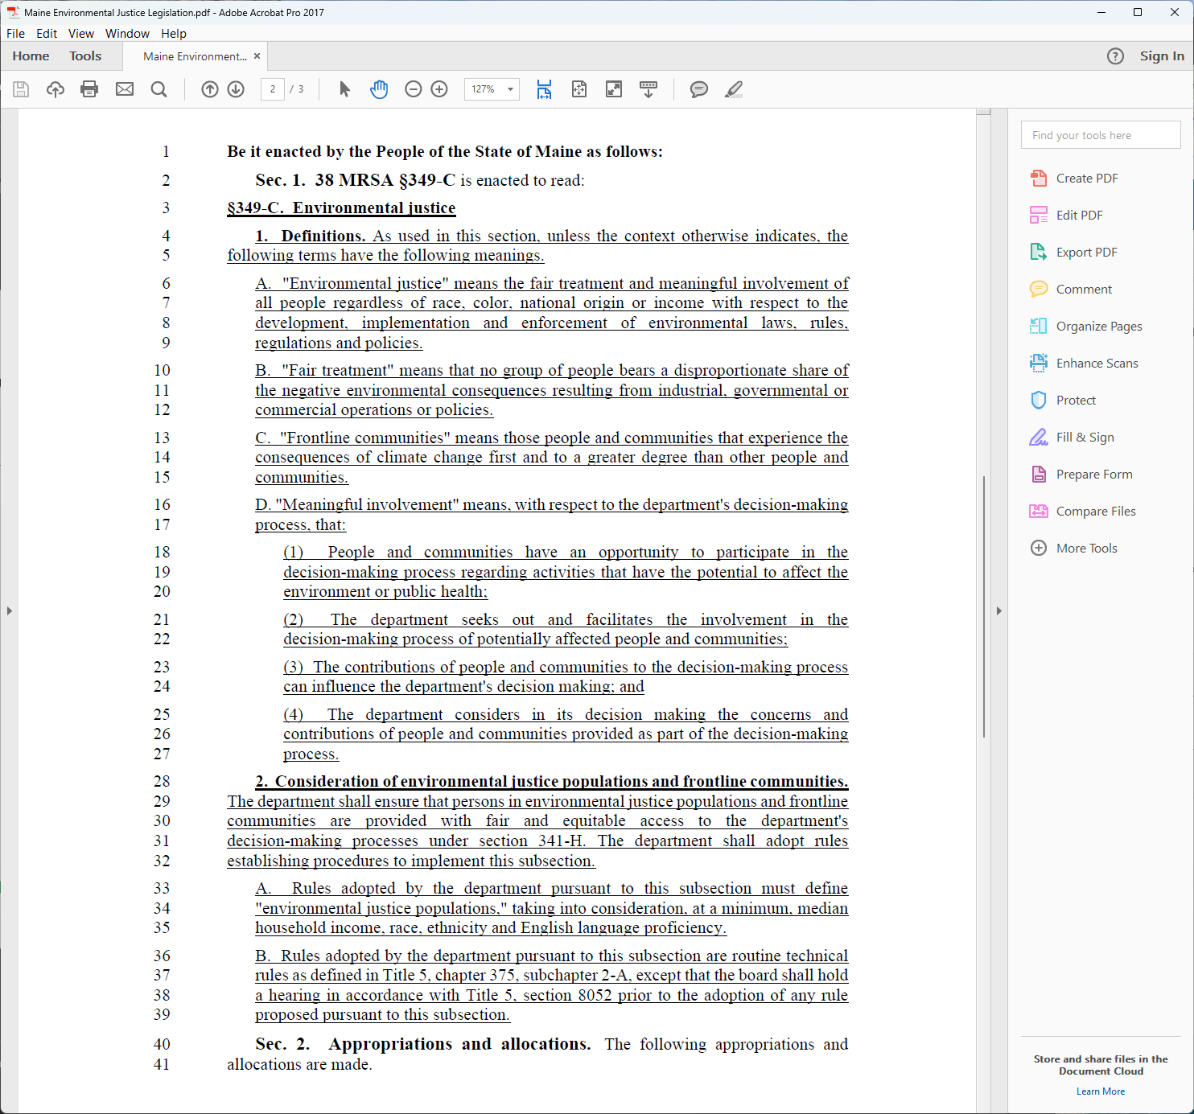
Environmental Justice in Maine

Slide 18

Environmental Justice populations: what does it mean?
There is no single firm definition

Slide 19
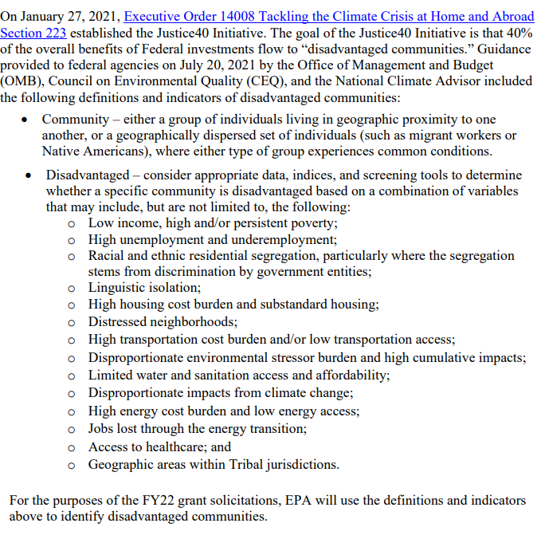
Disadvantaged communities under the Justice 40 initiative are defined as follows
Climate and Economic Justice Screening Tool
EJSCREEN

Slide 20
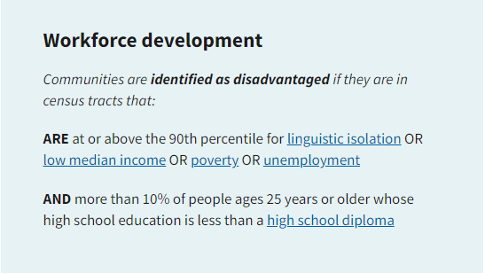
CJEST Census Tracts that are identified as disadvantaged
At least one indicator >90th percentile
OR
Climate Change
Energy
Health
Housing
Legacy pollution
Transportation
Water and Wastewater
Over 65th percentile for Low income
AND ALL Federally Recognized Tribes

Slide 21
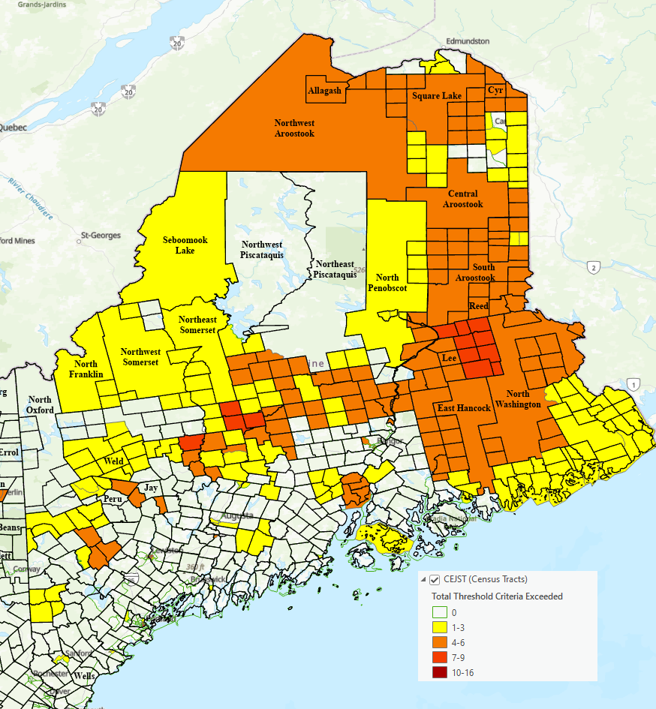
Overlay between Justice40 Census Tracts and municipalities
290 out of 453 municipalities in ME have are in a Census Tract with at least 1 threshold criterion exceeded
Most frequent indicators exceeded
Energy Burden (96)
Asthma (68)
Expected Agricultural Loss Rate (51)
Heart Disease (50)
Transit barriers (33)

Slide 22
Brownfields and Environmental Justice – what does it mean?
Identify and prioritize sites in disadvantaged census tracts – sensitive populations
Meaningfully engage communities in site selection, cleanup and redevelopment

Slide 23
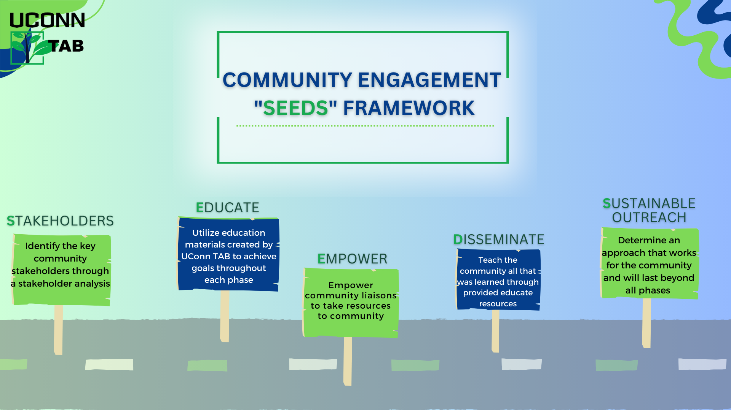

Slide 24
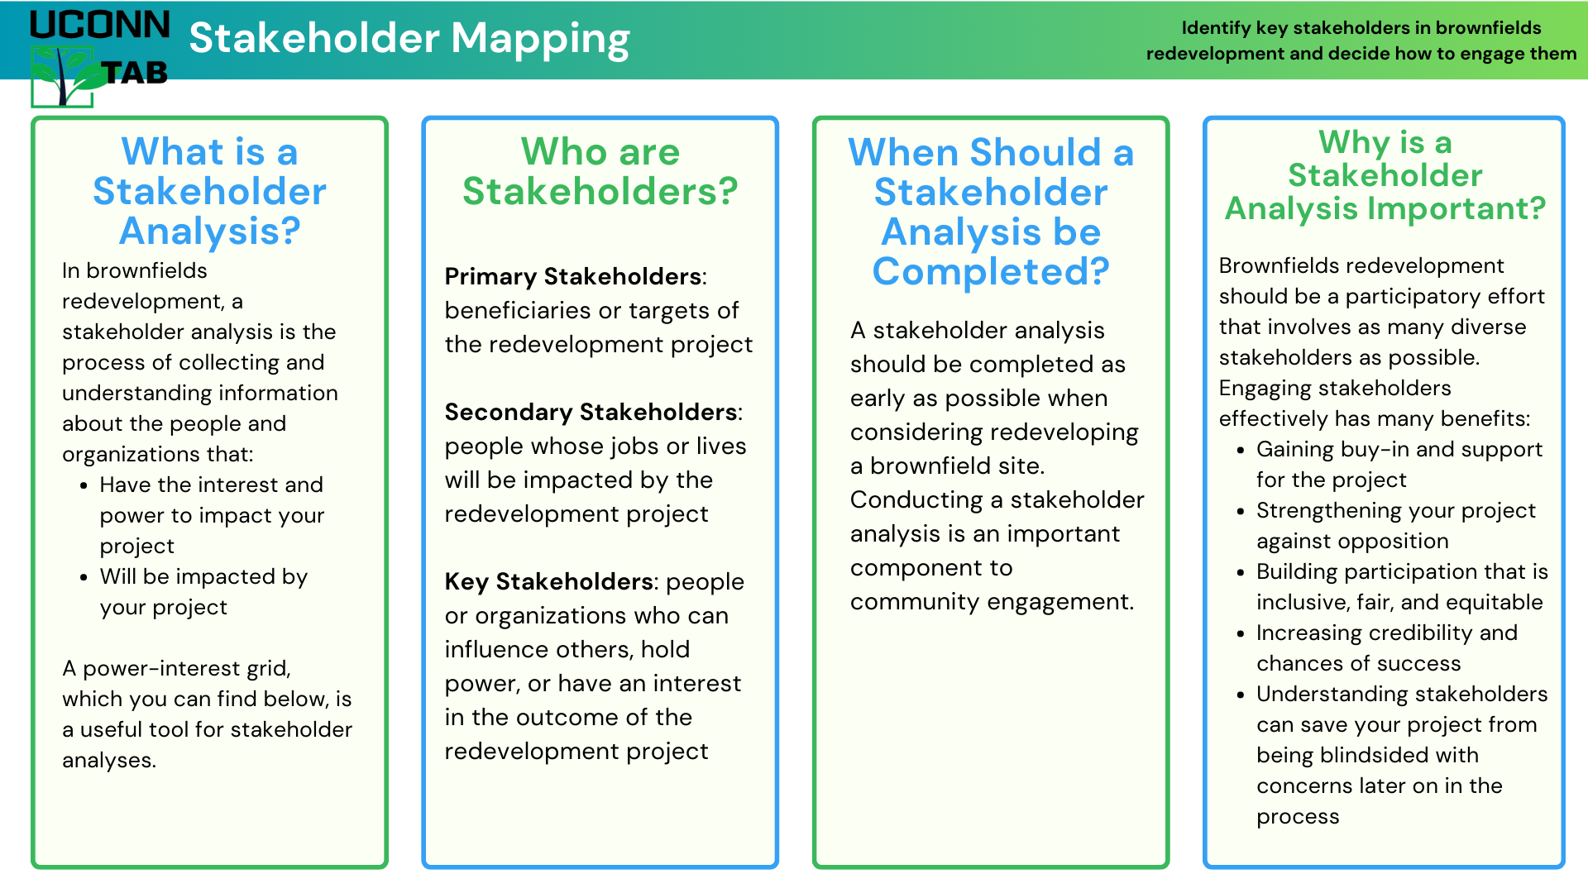
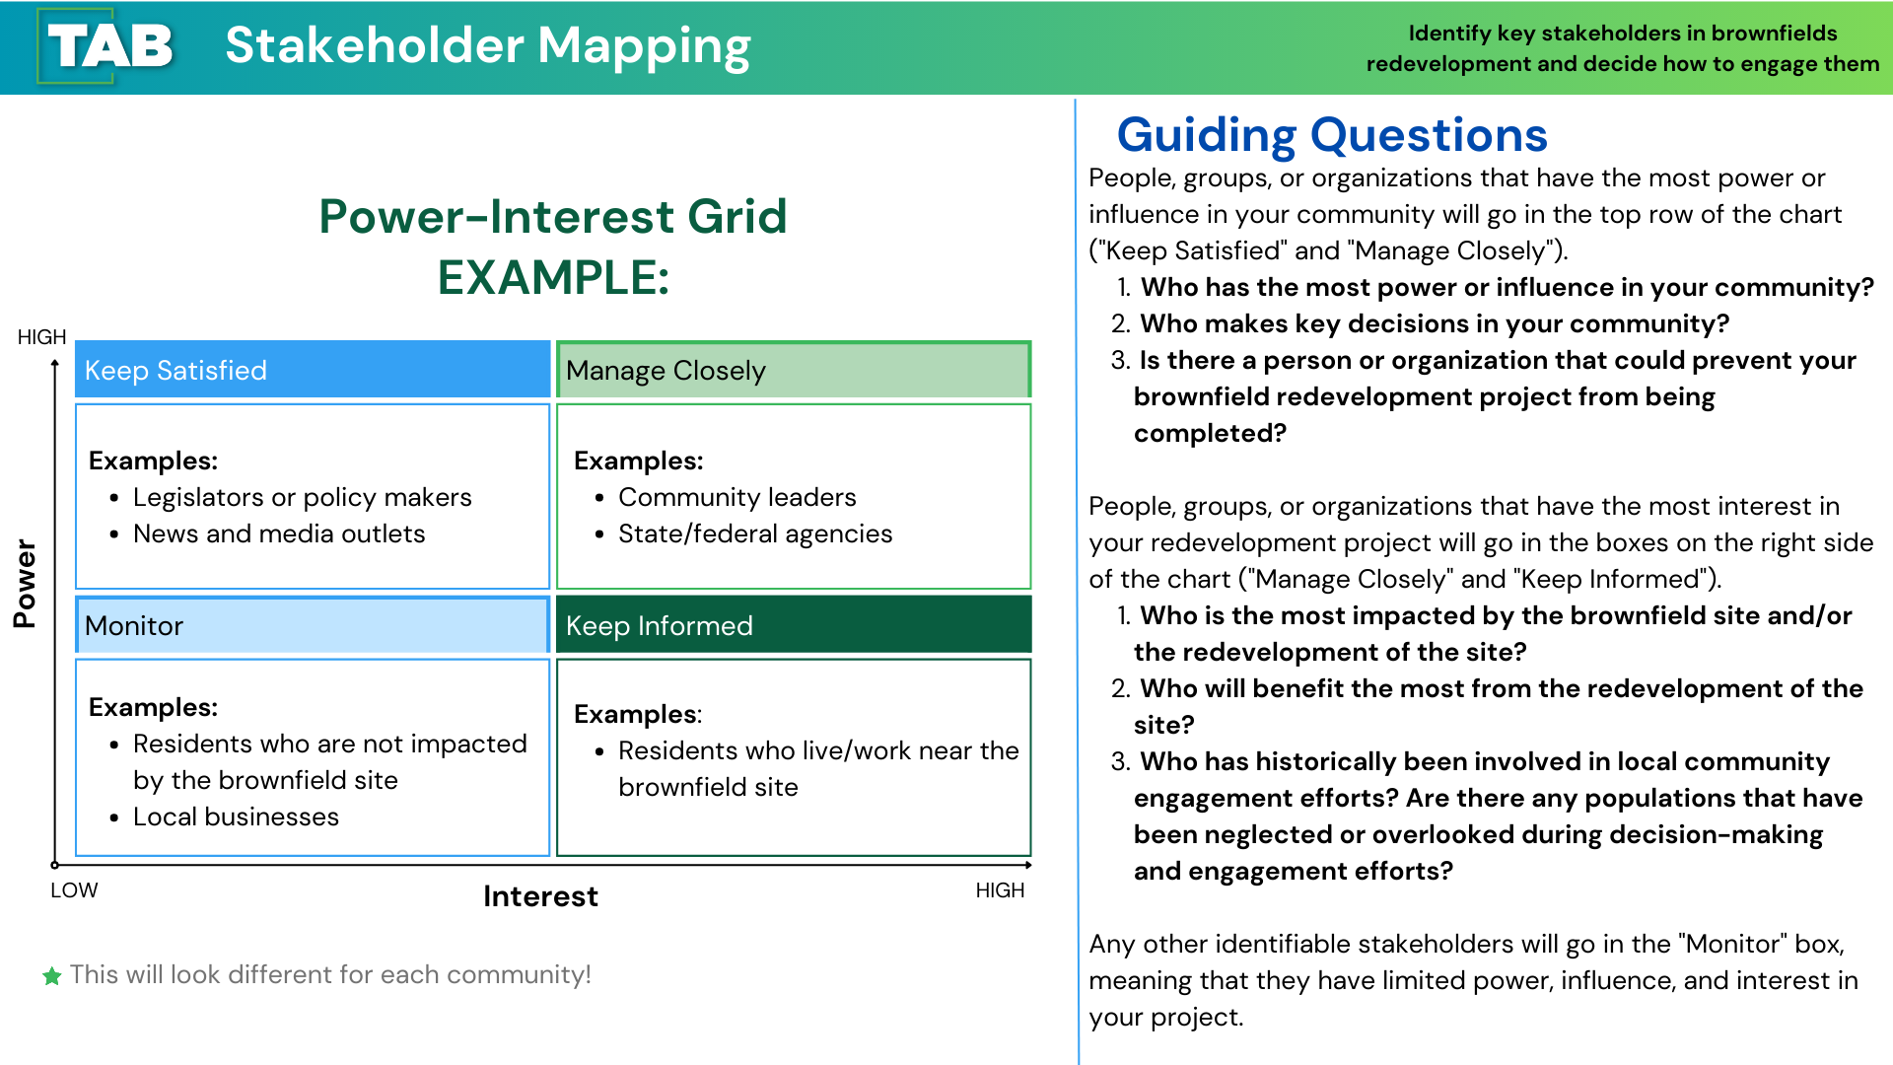

Community Engagement in Practice

Slide 25
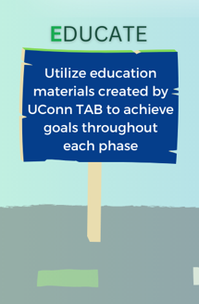
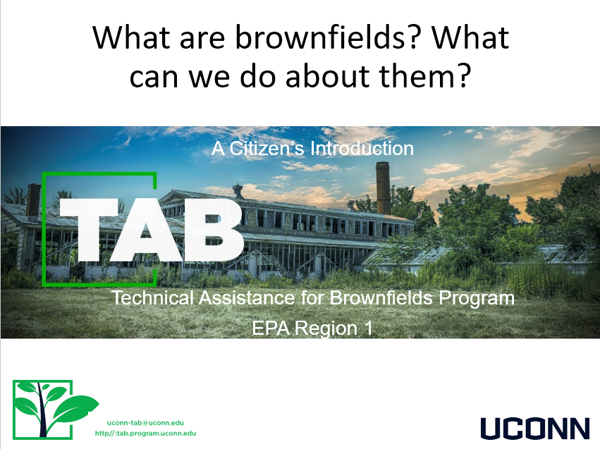
Community Engagement in Practice

Slide 26

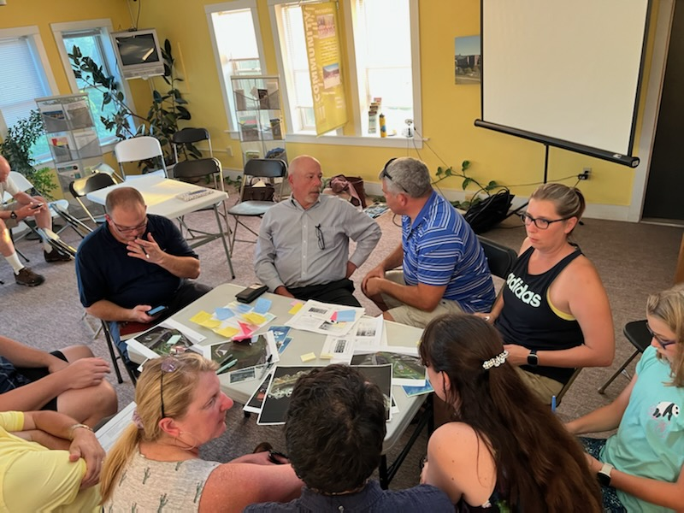
Community Engagement in Practice

Slide 27

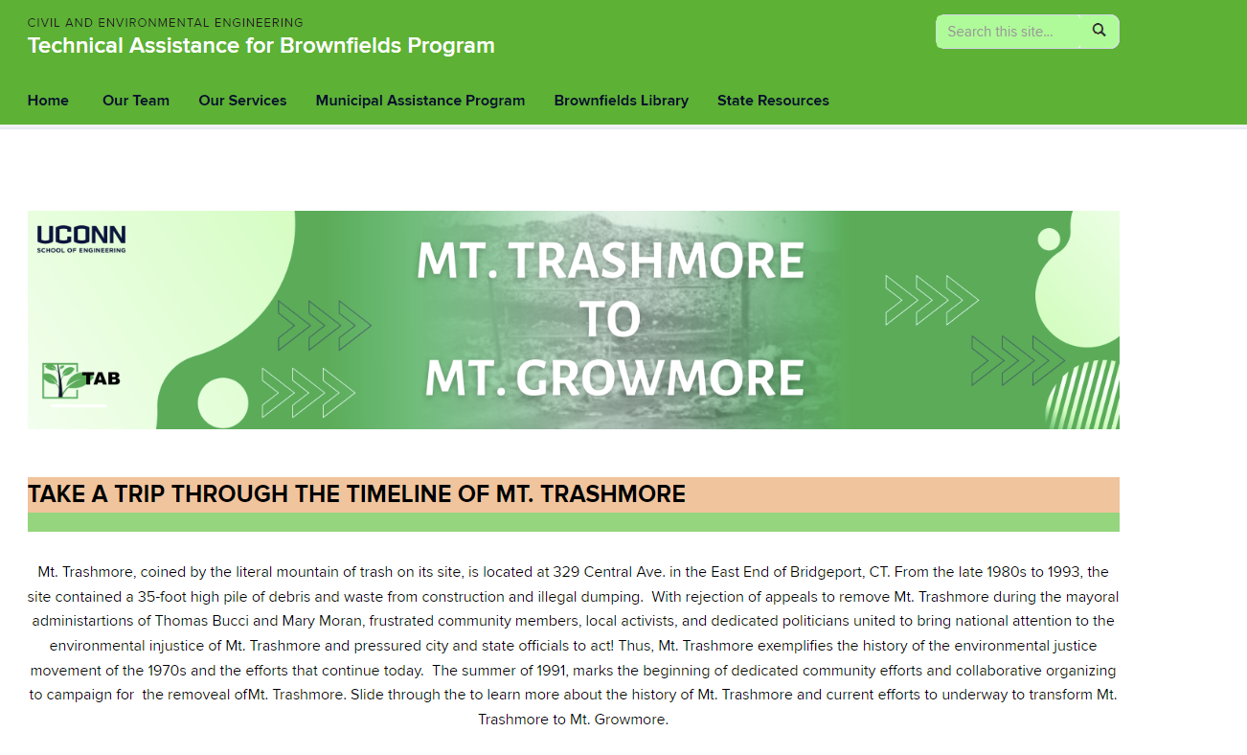
Community Engagement in Practice

Slide 28
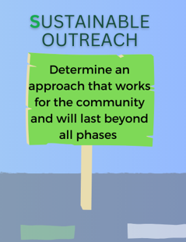

Community Engagement in Practice

Slide 29

Contact Us:
UConn TAB Email: Uconn-tab@uconn.edu
Website: tab.program.uconn.edu
More Info on MAP: tab.program.uconn.edu/map-acc

