Slide 1
Region 1 Environmental Protection Agency

Slide 2
Upcoming Events
National Brownfields Conference: August 7-11, 2023
Maine Brownfields All Grantee Meeting: September 14, 2023
BCONE: September 19-20, 2023
New Grantee Training: September 27, 2023
Region 1 Brownfields Summit: May 29-30,2024

Slide 3
Updates to the Bipartisan Infrastructure Law

Slide 4
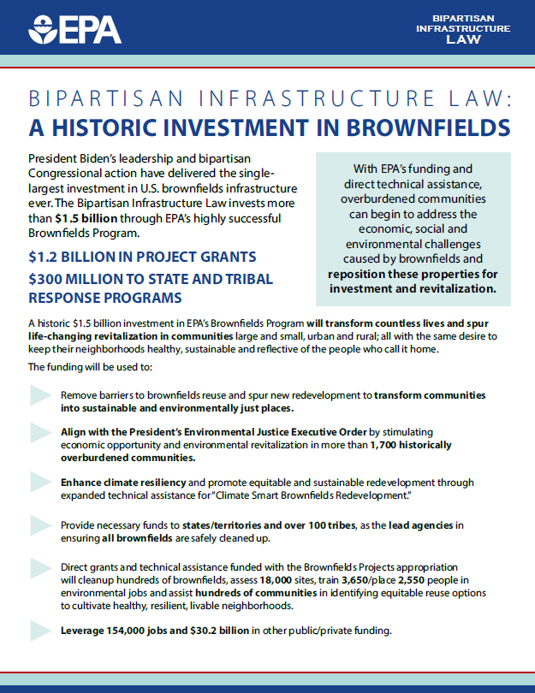
Bipartisan Infrastructure Law – A historic Investment for Brownfields
$1.5 billion for Brownfields
$150 million in Multipurpose Grants
$600 million in Assessment Grants
$160 million in Cleanup Grants
$150 million in RLF Grants
$30 million in Job Training Grants
$300 million in Cooperative Agreements to State and Tribal Response Programs
$110 million in Technical Assistance, including Targeted Brownfields Assessment
Fact Sheet Available Here

Slide 5
Summary of EPA Grant Types
Assessment
$500k - $2M
RLF (Initial)
$5M
Cleanup
$500k - $5M
Multipurpose
$1M
Job Training
$500k

Slide 6
Brownfield and LUST Collaboration
The Brownfields team has been partnering with the LUST Program for years to see how we can support each others mission
Increased funding due to BIL has allowed us to begin actual projects to remove USTs and clean up sites
Forms of Support:
State Programs (128a)
Targeted Brownfields Assessment
Supporting MARC grantees

Slide 7
Advancing Equitable Development in Brownfield Cleanup and Redevelopment
How can grantees incorporate environmental justice and equitable development during the brownfields grant process?
Notes:
Welcome to this discussion on Advancing Equitable Development in Brownfield Cleanup and Redevelopment, from the EPA Region 1 Brownfields Program.
The following training is designed to provide best practices and case study examples of how grantees can incorporate environmental justice and equitable development during the brownfield cleanup and reuse planning process.

Slide 8
Environmental Justice and Equitable Development
An equitable development process should incorporate:
Meaningful engagement throughout the duration of working with a community
Learning about the community and different stakeholder groups
Assessing the community needs
Addressing barriers to engage in the process
EPA Region 1 Brownfields Program
EPA 901F23005
Notes:
EPA’s Brownfields Program provides grants and technical assistance to communities, states, tribes and others to assess and safely clean up and sustainably reuse contaminated properties in New England.
A primary purpose of Region 1’s Brownfields Program is to reduce environmental risks and blight from neighborhoods. These outcomes are especially important for neighborhoods in both urban and rural areas within any underserved communities, with disproportionate environmental impacts, associated health outcomes and other environmental justice concerns. Revitalizing brownfield sites can also create benefits for the community such as jobs, housing, services, resiliency and open space.
Environmental justice and equitable development need to be at the forefront when cleaning up and revitalizing brownfields. Equitable development is especially important for neighborhoods that have historically been left out of decision-making and as a result, face long-term disinvestment challenges.
An equitable development process needs to incorporate meaningful engagement throughout the duration of working with a community. This involves learning about the community and different stakeholder groups, assessing the community needs and addressing barriers to engage in the process.

Slide 9
Equitable Engagement Throughout Brownfields Grant Process
EPA Region 1 Brownfields Program
EPA 901F23005
Notes:
Environmental justice principles needs to be incorporated throughout the duration of working with a community and the entire brownfields grant process. This includes, pre-proposal, during the grant funded work, and post award.
Pre-award, the community should be involved in creating plans and goals for the area, to build that initial trust and relationships.
During the work, the community should continue to be engaged and informed while additional partnerships and funding opportunities are sought after to implement additional community goals.
Lastly, after the award, you should reflect on how to improve the process and maintain the momentum generated through broader revitalization.

Slide 10
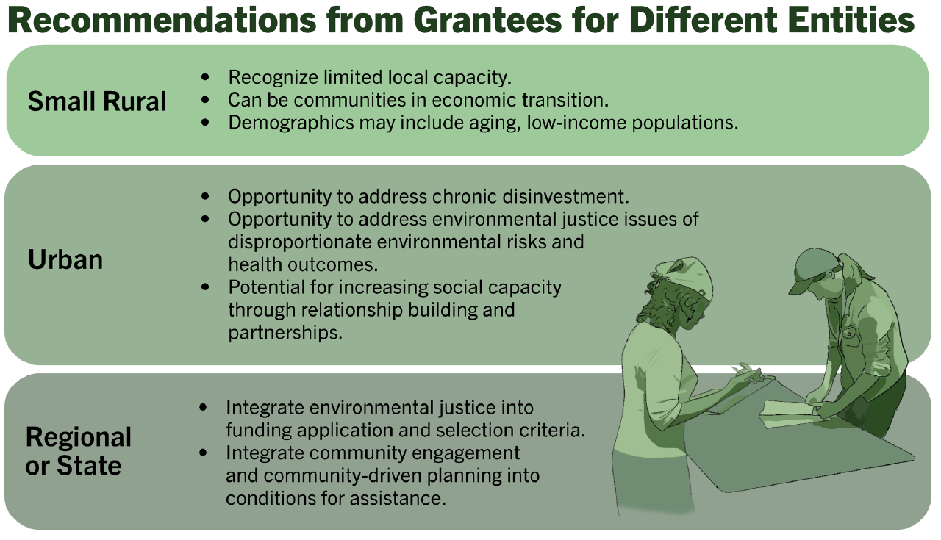
Recommendations for Different Entities
EPA Region 1 Brownfields Program
EPA 901F23005
Notes:
Both urban and rural areas have underserved communities, with environmental justice concerns.
Different entities must consider factors unique to them, whether small rural, urban, or at the regional or state level.
The following recommendations from Region 1 grantees are highlighted for these different entities to keep in mind when incorporating EJ and equitable development principles.
Small rural areas often must recognize the limited local capacity with aging and/ or low-income populations.
Urban areas that face chronic disinvestment leading to EJ issues, can use relationship building and partnerships to be key in increasing social capacity.
Regional or state entities can incorporate EJ into funding applications and selection criteria, as well as integrating community engagement and planning into the assistance given.

Slide 11
Best Practices
Target Community Needs
Advance Community Goals
Center Community Benefits
Build Community Partnerships
Expand Funding Sources
Proactively Mitigate Displacement
Adapt the Process
EPA Region 1 Brownfields Program
EPA 901F23005
Notes:
The following best practices are for advancing environmental justice and equitable development throughout the brownfields grant process.
Targeting community needs, Advancing community goals, Centering community benefits, Building community partnerships, Expanding funding sources, Proactively mitigating displacement, and adapting the process
Three case studies will be featured next, and each case study highlights different best practices regarding equitable development

Slide 12
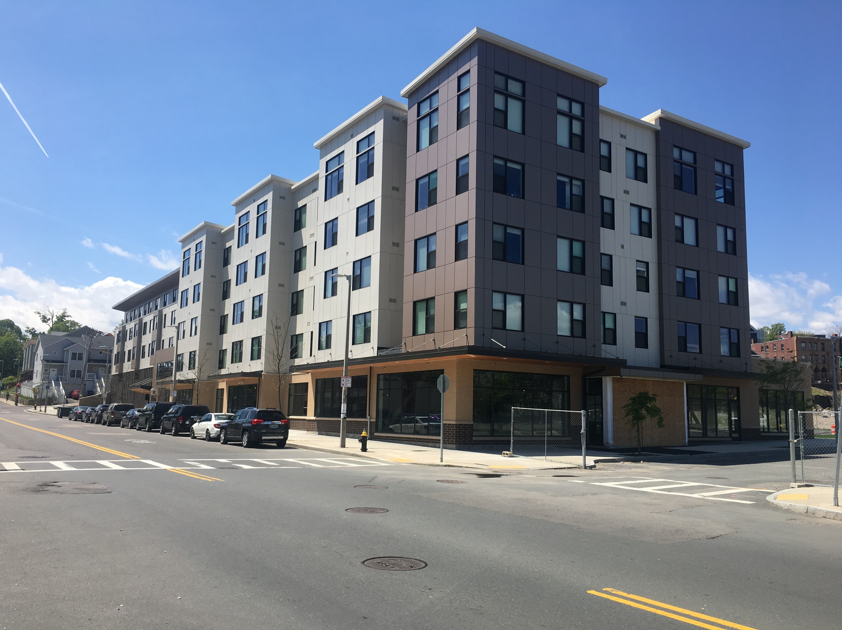
Urban EJ Case Study Roxbury, MA
$1 million in cleanup grants for the site
Redeveloped as an urban mixed-use development - Included 380 residential units
Intensive community engagement that involved a Community Advisory Committee (CAC)
The overall vision for the site developed by the community included mixed-income housing, local culture, open space and cleaning up contaminated sites
Key lesson learned: Importance of managing expectations early in the process and conveying them to the community
EPA Region 1 Brownfields Program
EPA 901F23005
Notes:
Bartlett Station in Roxbury, Massachusetts, used to be a mass transit facility operated by the Massachusetts Bay Transit Authority. The presence of this site and other brownfields were seen as contributing to the high asthma rates and other public health issues in this densely populated and largely minority neighborhood. The racial health disparities brought environmental justice concerns to the forefront. From 2011-2013, EPA awarded $1 million in cleanup grants for the site to a nonprofit housing developer. Now that this site has been cleaned up, it has been redeveloped as an innovative urban mixed-use development. The overall development included 380 residential units with an emphasis on equitable development
The project at the Bartlett Station site involved intensive community engagement throughout the cleanup and redevelopment process to keep the community informed. The city held a community event at the Bartlett Station site to activate the area and make it a focal point for the community to envision as a place they would go to in the future. The city also established an online project interface for people to access. This project also involved a Community Advisory Committee (CAC) that provided valuable input and is still in place
The results at the Bartlett Station site have been successful and met the expressed needs of the community. The overall vision for the site developed by the community included mixed-income housing, local culture, open space and cleaning up contaminated sites.
The redevelopment of the site also included a mixed-income affordable housing model to address concerns about gentrification and disinvestment in Roxbury. This approach was backed by local support and the city incorporated it into its amended comprehensive plan. The success of this redevelopment came from continued communication with the community, which is still ongoing and will have long-standing benefits for the community for future projects.
One key lesson learned was the importance of managing expectations early in the process and considering the feasibility of addressing all the goals of a project, then conveying them to the community.

Slide 13
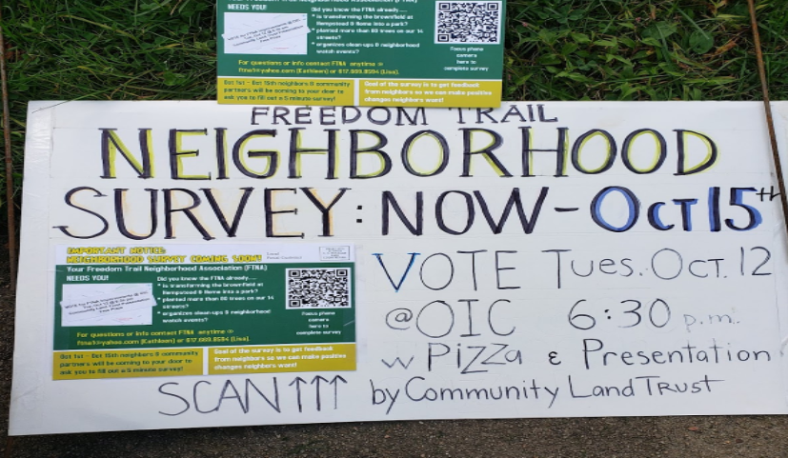
Urban EJ Case Study New London, CT
$500,000 EPA Cleanup Grant to clean up and redevelop a vacant property into a neighborhood park for kids to play
Example of a true community-based planning process in which the community determined the goals for the project based on neighborhood needs
Importance of partnership forming
Highly effective community engagement strategies
Relationships built within the community will translate to long-term benefits for future projects
Leveraged success for additional funding
New London Neighborhood Survey Results
EPA Region 1 Brownfields Program
EPA 901F23005
Notes:
New London is a distressed urban area in Connecticut, listed as the third most distressed municipality in the state, and the median household income is almost 50% less than the state median.
The city currently has a $500,000 EPA Cleanup Grant to clean up and redevelop a vacant property into a neighborhood park for kids to play. With the cleanup of the site, the remediated green space will become a safe place for the community to gather.
This project provides an example of a true community-based planning process in which the community determined the goals for the project based on neighborhood needs.
The partnerships formed during the project have been instrumental in understanding the needs of the community and designing a series of projects to address those needs in the cleanup and redevelopment processes. The city has been able to collaborate with nonprofit partners during site cleanup, as well as an EPA Technical Assistance to Brownfields provider to support community engagement and application submission.
New London’s community engagement strategies were very effective in mobilizing the community around revitalization as well.
In conducting a community survey to gain input, every individual and home was contacted by mail, door-to-door engagement and other means. The survey was sent in both English and Spanish, and trusted representatives went to homes to have conversations
Feedback from the surveys and neighborhood involvement conducted will inform future efforts after the cleanup.
Through persistence, New London also received grants for additional items such as speed signs, traffic signs, decorative street posts and minor home repairs from sources outside EPA.

Slide 14
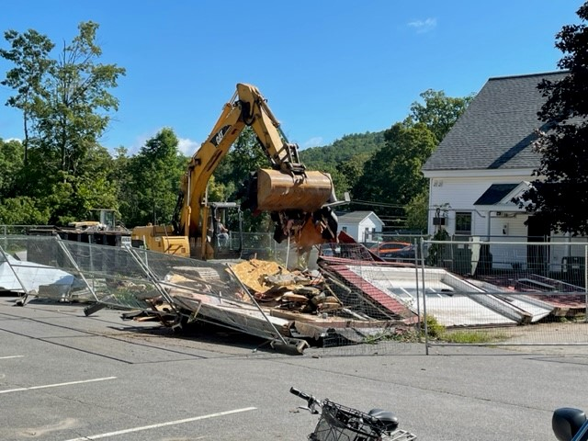
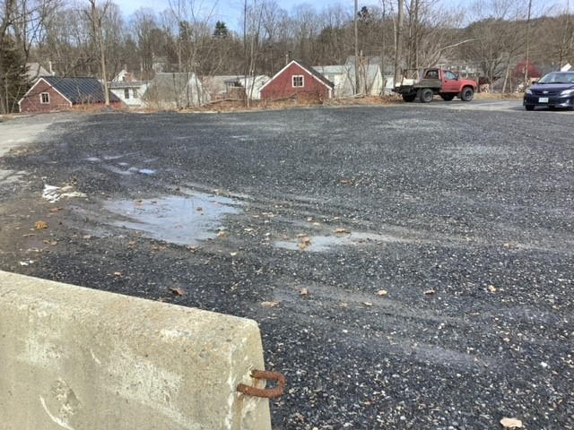
Small, Rural Case Study Walpole, NH
$500,000 EPA Cleanup Grant
Clean up and redevelop a parking lot and small pocket park with electric vehicle charging stations
Redevelopment aims to support existing senior population, attract new families, increase job growth and promote environmental stewardship
Multiple forms of community outreach utilized
Very positive community response
Persistent town effort to have the property purchased and apply for EPA grant
EPA Region 1 Brownfields Program
EPA 901F23005
Notes:
Walpole is a small, rural community in New Hampshire consisting of a mostly senior, retired and low-income population with a range of economic issues. The town has very little green space and improving walkability and parking have become important objectives for the Town. Walpole currently has a $500,000 EPA Cleanup Grant to clean up and redevelop the Central Plating Site into a parking lot and small pocket park with electric vehicle charging stations. The redevelopment aims to support Walpole’s existing senior population, attract new families, increase job growth and promote environmental stewardship.
Multiple forms of community outreach have been utilized during the clean up process, such as a monthly column for a newsletter in town is used to talk about this brownfield project, community meetings, as well as select board public meetings where residents can join and participate.
The community had a very positive response to the site being cleaned up and the prospect of removing the decaying building that may now be transformed into a public space and bus stop area. To meet the needs of the community and the senior population, those who do not live within walking distance, will now be able to access it via bus.
The site will also provide paved and expanded parking to accommodate the nearby commercial areas.
The town staff had to be very persistent in their efforts to have the property purchased and then apply for an EPA grant. In applying for the grant, the town also received support in preparing their application from the Technical Assistance to Brownfields provider.

Slide 15
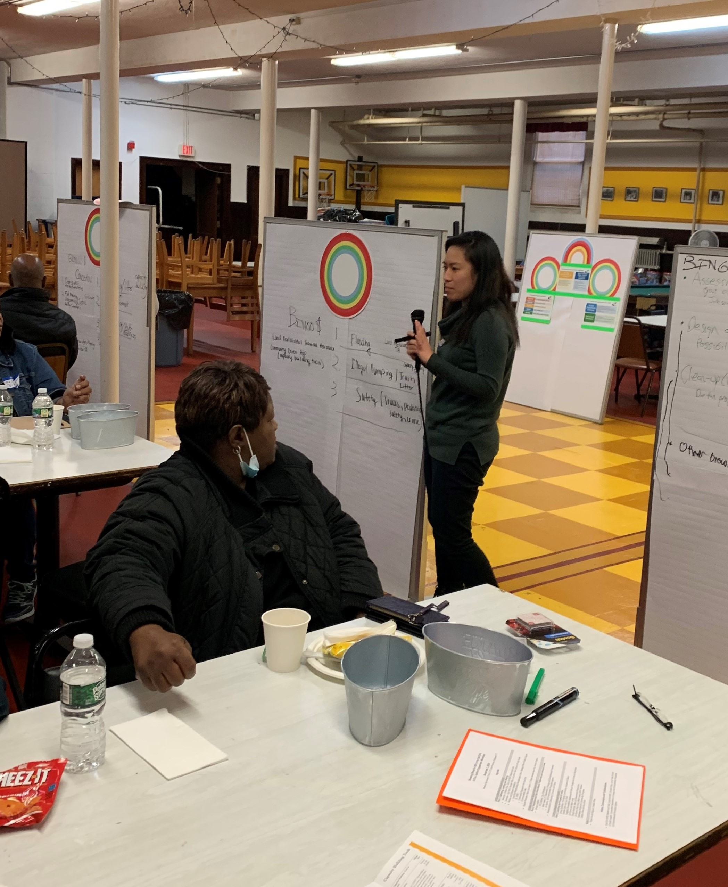
Key Takeaways
Advance environmental justice and equitable development throughout the brownfields grant process.
Adapt the equitable development best practices to the unique context and specific needs of your community.
Develop partnerships, collaboration and deep community engagement to build implementation support and ensure investments meet community needs.
Understand specific goals of the community and identify how the brownfield investments can achieve equitable outcomes.
Build the capacity of the community to achieve goals that may be outside the brownfield redevelopment process.
Build in small, frequent wins as part of the longer cleanup and redevelopment process.
Adapt the process as needed based on new information and community feedback.
EPA Region 1 Brownfields Program
EPA 901F23005
Notes:
Feedback from these Region 1 grantees led to some key takeaways regarding best practices in incorporating EJ and equitable development principles:
Consider how to advance environmental justice and equitable development throughout the brownfield cleanup and redevelopment process.
Adapt the equitable development best practices to the unique context and specific needs of your community.
Develop partnership, collaboration and deep community engagement to build implementation support and ensure investments meet community needs.
Engage with the community to understand their specific goals and identify how the brownfield investments can achieve equitable outcomes by meeting those needs.
Look for ways to build the capacity of the community to achieve goals that may be outside the brownfield redevelopment process.
Build in small, frequent wins as part of the longer cleanup and redevelopment process.
Adapt the process as needed based on new information and community feedback.

Slide 16
How Climate Ready are Your Cleanups? (do you know EPA has both evaluation requirements and tools that can help?)
ME All-Grantee Meeting
September 14, 2023

Slide 17
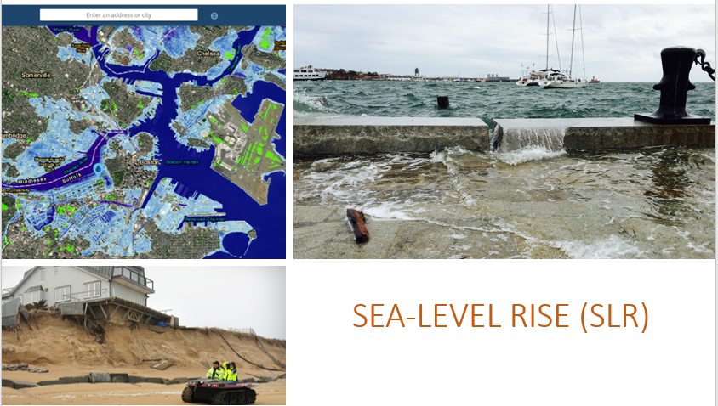
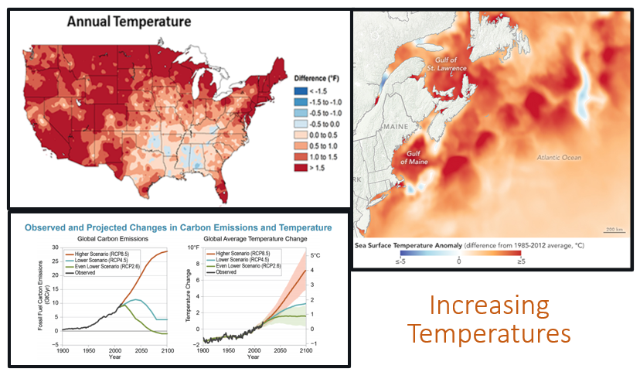
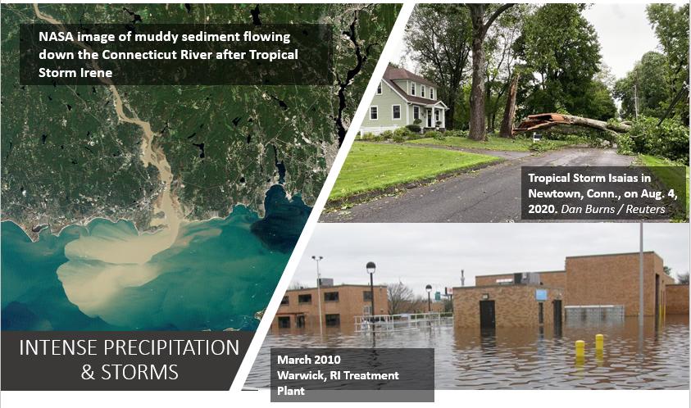
Know the Climate Trends in Your Area
Assess Vulnerabilities of both Remedy and Reuse

Slide 18
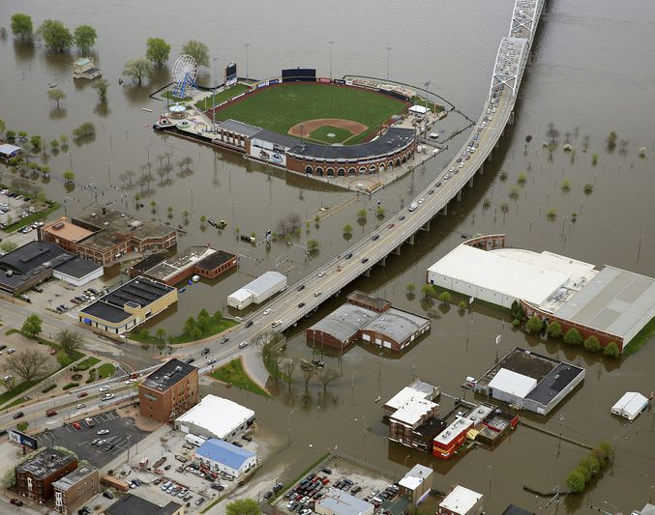
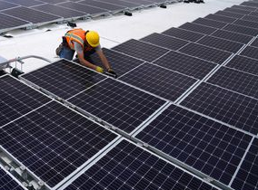
Climate Change Terms
Climate Adaptation
Taking action to prepare for and adjust to both the current and projected impacts of climate change
Climate Mitigation
Actions limiting the magnitude and rate of future climate change by reducing greenhouse gas emissions and/or advancing nature-based solutions
https://www.epa.gov/climate-adaptation
Adjust to and prepare for impacts
Prevent and reduce emissions
5
Sources: https://www.epa.gov/climate-adaptation/climate-adaptation-and-epas-role
Notes:
18
JD

Slide 19
What does this mean for EPA Brownfield Projects?
R1 EPA Brownfields is Tracking
Percent compliance of ABCA climate change vulnerability considerations (ACRES reporting)
Projects with identified climate vulnerabilities connected to climate adaptation resources. (site eligibility prompt)
THAT BEING SAID….while targets are important, we need to consider climate vulnerabilities and mitigation opportunities because:
it is necessary for the effectiveness of our cleanups and
the right thing to do for the climate-vulnerable communities we work in.
REQUIRED
Climate Change Vulnerability Consideration in ABCAs
INTEGRATED
ACRES Reporting (NEW!)
Site Eligibility Review (NEW!)
ENCOURAGED
Climate vulnerability analysis in site prioritization and reuse planning.

Slide 20
Example Process – Brownfield Cleanup Alternative Analysis
Background: Contaminated soils from historic mill activities.
Resiliency Context: Portions of the site along the river are within the 100 year flood elevation. Regional trends show risk of increased and extreme precipitation.
Alternatives: ♦ No Action ♦ Soil Cap ♦ Targeted Excavation and Disposal, ELUR
Analysis: Appropriate erosion control measures during construction and armoring and grading to prevent future events from exposing soils along the river will protect against flood events for active alternatives. The proposed project results in an overall reduction in impervious surface which will also reduce run-off to the river.
GSR Measures for Recommended Alternative:
Use existing office building instead of trailer;
Vegetation will be utilized for erosion control where practical;
Erosion control measures will be conservative and protective of the adjacent river;
Native tree removal will be minimized;
Contractors will be required to adhere to an idling reduction program;
Soils will be pre-characterized to facilitate direct loading and reduce handling.
Recommended Alternative: Targeted Excavation and Disposal, ELUR
Optional ABCA Climate Consideration Checklist: https://www.epa.gov/brownfields/climate-adaptation-and-brownfields
…..the checklist is optional, not the consideration. ☺
38

Slide 21
In Addition to the ABCA Checklist: More Recent Guidance for Fielding Climate Vulnerability Concerns
To determine forecasted climate change risks:
CMRA Website - https://resilience.climate.gov/
EPA Superfund Vulnerability Assessment Resources
Or can refer to local climate change planning that might exist - https://www.epa.gov/raine
To determine potential vulnerabilities of a potential remedy to climate change impacts:
Superfund Technical Fact Sheets: Identify, prioritize and implement resilience measures for:
Contaminated Sediment Sites
Contaminated Waste Containment Systems
Groundwater Remediation Systems
If there is potential unmitigated risk to climate change risks based on the above, some more helpful BMPs can be found here:
ITRC’s Sustainable and Resilient Remediation (SRR) Guidance

Slide 22
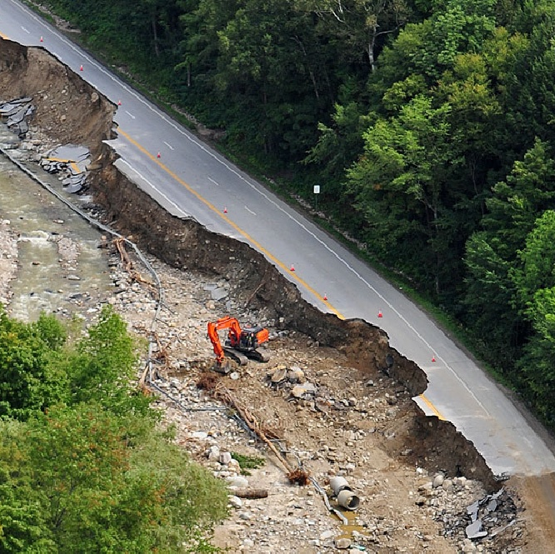
EPA 1 Recovery Coordination
Recovery Support Functions
The National Disaster Recovery Framework (NDRF) is organized into six Recovery Support Functions (RSFs):
Each RSF is led by a single Federal coordinating agency with multiple primary and support agencies. EPA is not the coordinating (leading) agency for any RSF but is a primary or a support agency under all six RSFs (see box, right).
The EPA program involved in a given recovery action varies by RSFs activated.
EPA RSF Roles:
Community Planning and Capacity Building RSF – EPA is a Support Agency
Economic RSF – EPA is a Support Agency
Health and Social Services RSF – EPA is a Primary Agency
Housing RSF – EPA is a Support Agency
Infrastructure RSF – EPA is a Support Agency
Natural and Cultural Resources RSF – EPA is a Primary Agency

Slide 23
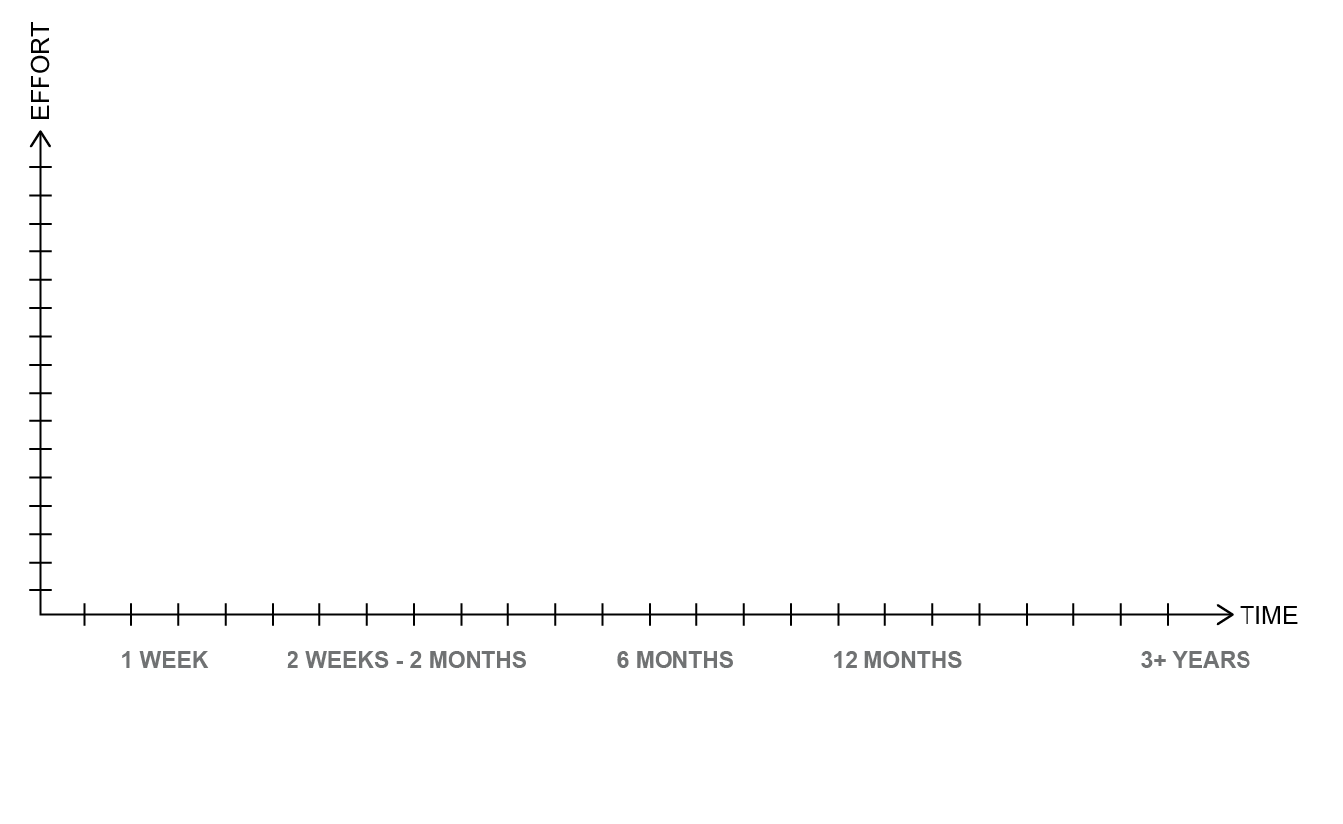
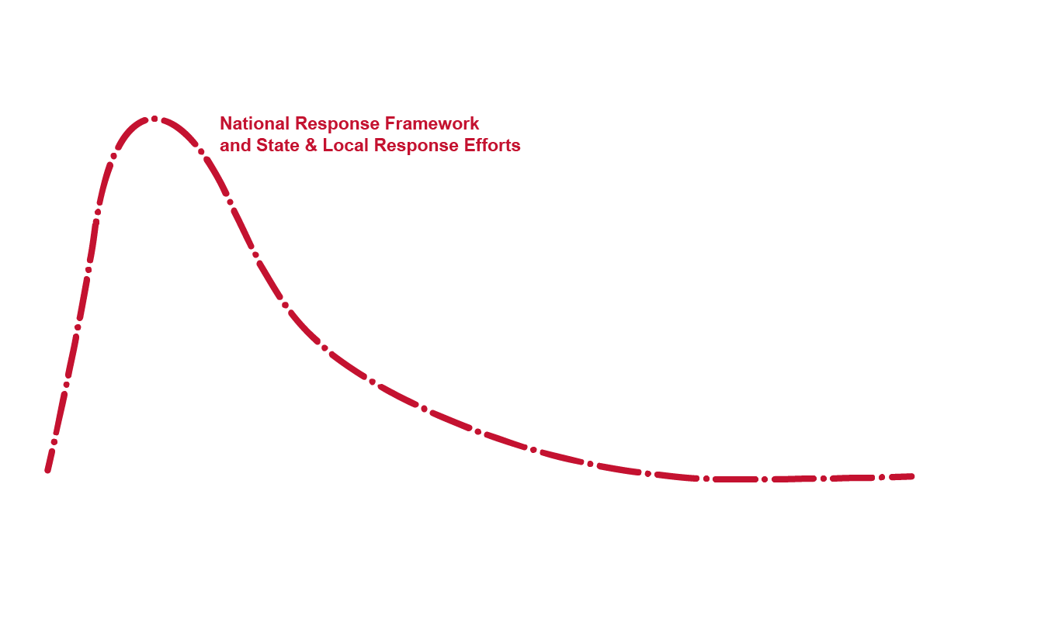
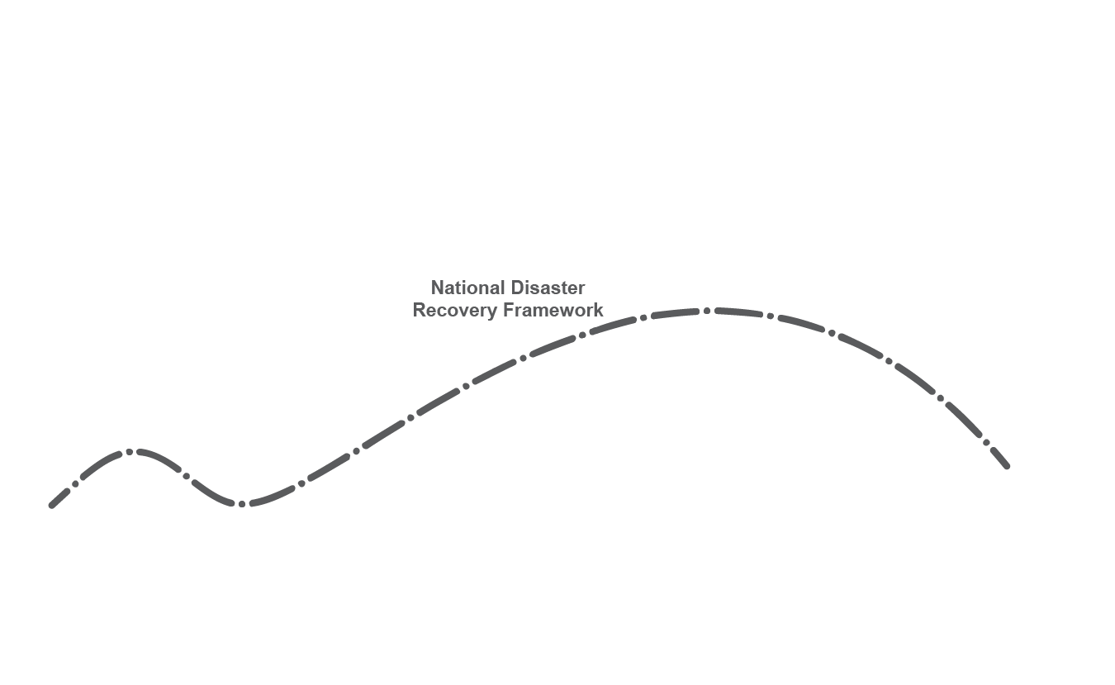
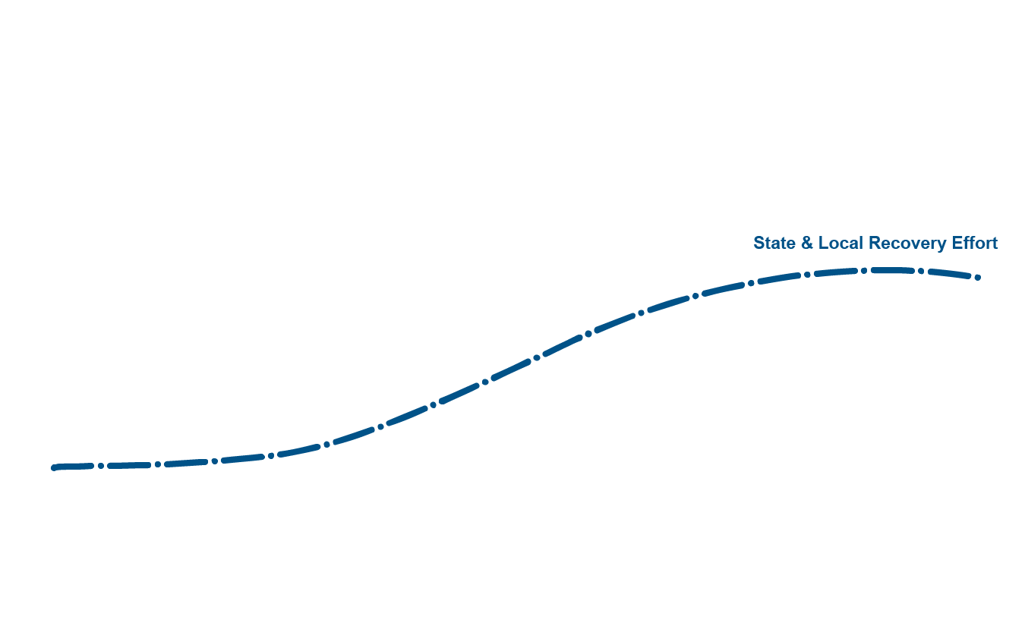
Response vs. Recovery Staff Effort Over Time

Slide 24
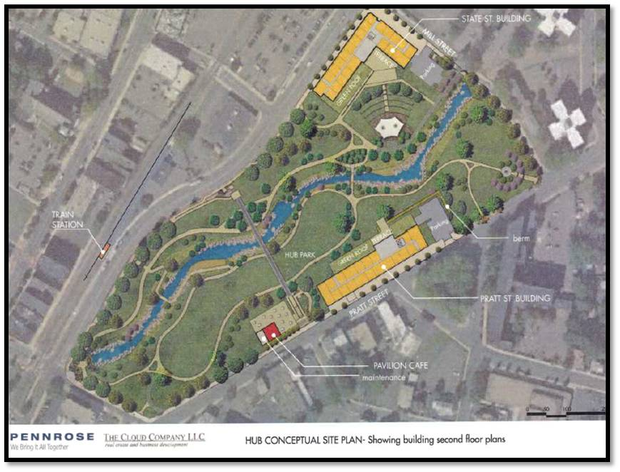
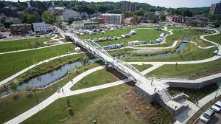
Site Reuse Planning: Leveraging the Brownfields Program to Help Meet Climate Adaptation Needs
New England has many “built-out” communities and densely populated areas along rivers and on the coast.
often exist in those locations due to historic industrial need for cooling, power, waste discharge, and transport.
can have limited options for addressing flood storage from extreme weather events and sea level rise.
the need to improve their infrastructure may require utilizing their vacant and underutilized land (brownfields) for solutions.
Meriden Green Design
Guidance and Resources:
EPA Climate Smart Brownfields Manual
Considering Climate and Public Health in Brownfield Projects
Land Revitalization in Climate Vulnerable Areas Project Examples
NEW!
Eligible planning activity under Assessment and Multipurpose Grants
Meriden Green Completed

Slide 25
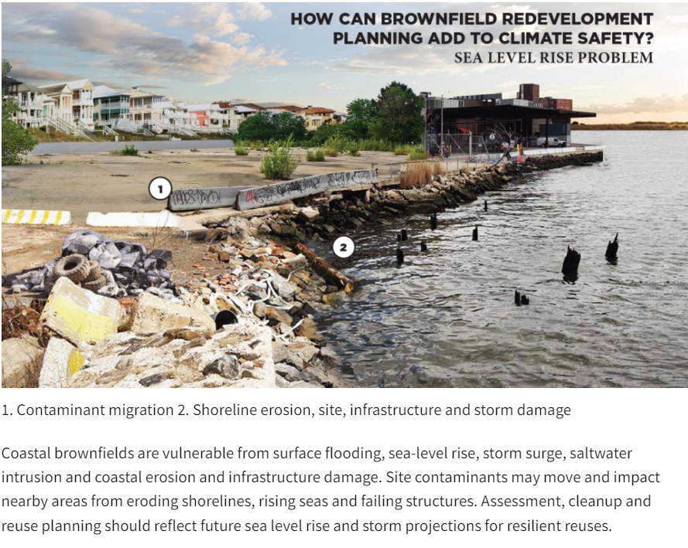
Major Forecasted Impacts in New England: Sea level Rise
Fact Sheet on Sea Level Rise and Brownfields: https://www.epa.gov/sites/default/files/2021-01/documents/epa_oblr_slr_climateadaptation_factsheet_release_508.pdf

Slide 26
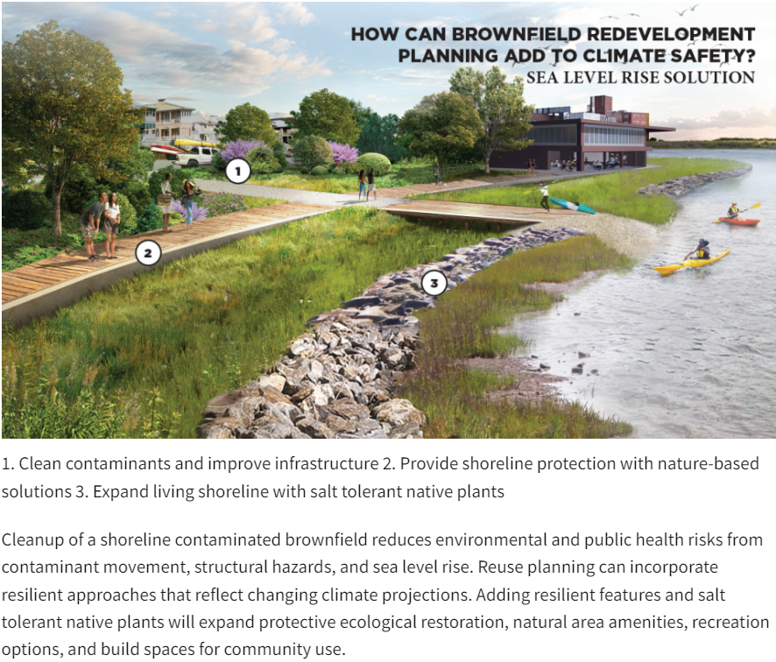
Major Forecasted Impacts in New England: Sea level Rise

Slide 27
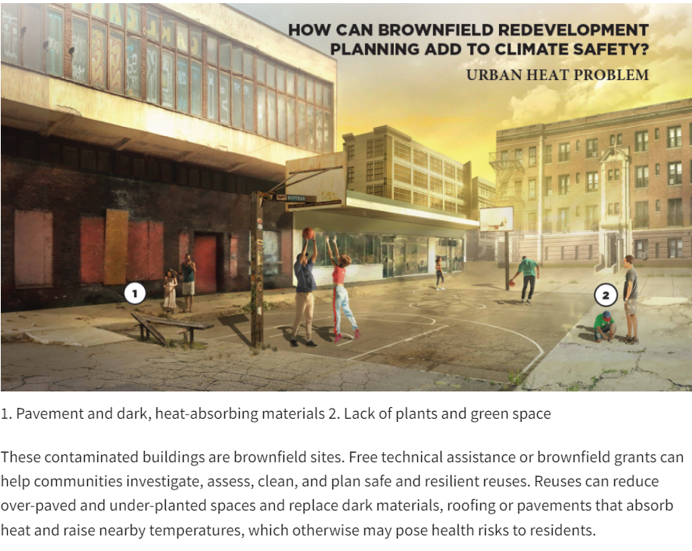
Major Forecasted Impacts in New England: High Heat

Slide 28
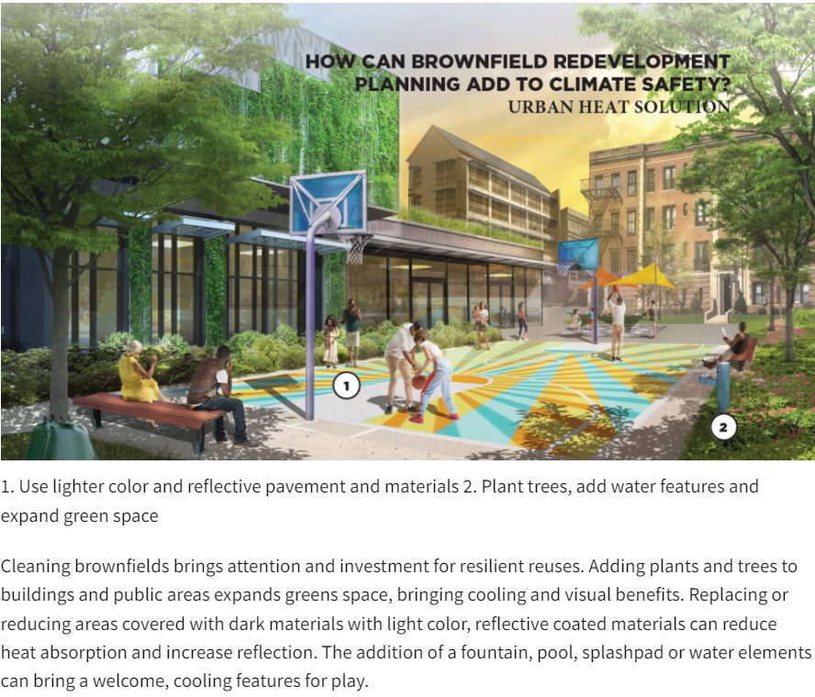
Major Forecasted Impacts in New England: High Heat

Slide 29
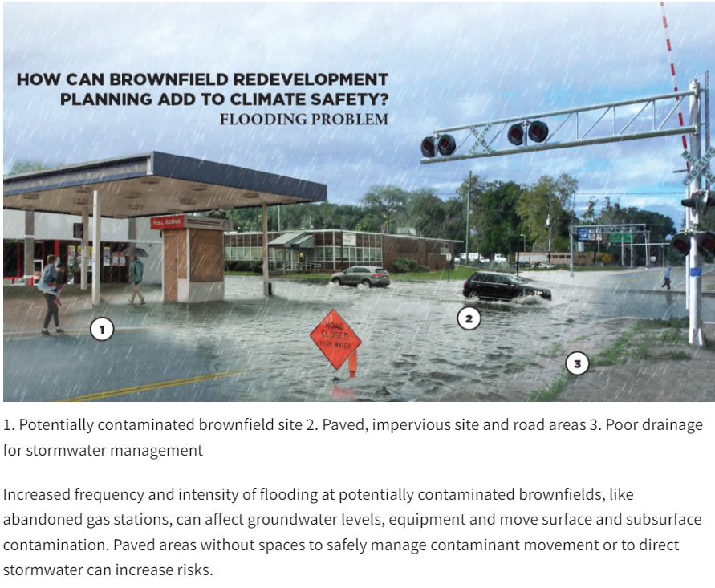
Major Forecasted Impacts in New England: Flooding

Slide 30
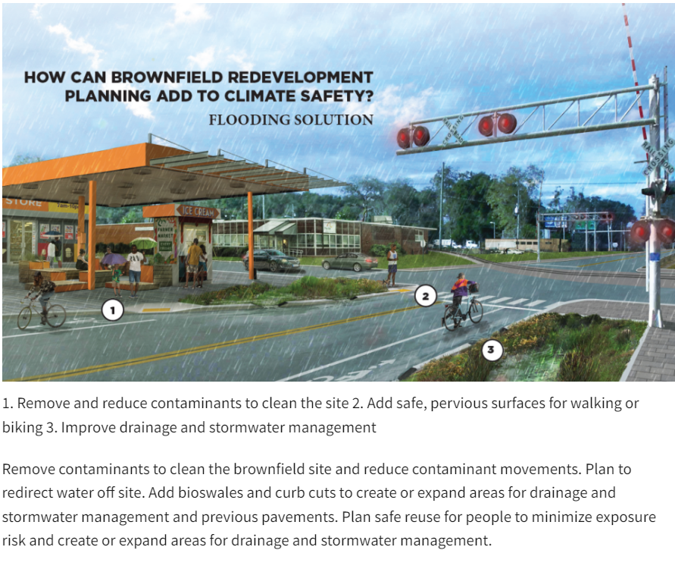
Major Forecasted Impacts in New England: Flooding

Slide 31
Things to Think About….
Have any of you encountered any climate change vulnerability issues cleanup planning?
What are the best opportunities in Maine to identify vulnerabilities and connect projects to tools and resources?
What can be done with the reuse of a site to help the site and/or community be more resilient to future extreme events?
What underserved populations may be disproportionately vulnerable?

Slide 32
Revolving Loan Fund Program

Slide 33
Revolving Loan Fund
The FY23 RLF Policy Webinar (which was a repeat of the EPA part of the RLF Workshop) was recorded and is now available https://www.epa.gov/brownfields/fy23-rlf-policy-webinar-august-28-2023
The webinar for ACRES Training for RLF Grantees is scheduled for Sep 21st from 1 – 2:30 pm EASTERN.
To join this training, use the Teams link at the bottom of the Online ACRES Training webpage. The intent is to train RLF CARs and answer their questions, and is a repeat of the presentation at the Brownfields Conference. This training will go over the recent RLF changes in ACRES for open and post-closeout grants. It is especially recommended for those CARs who will be completing Post-Closeout Reports and ACRES reporting on PCPI by October 31st (i.e., reporting as of Sep 30th as required by the FY22 COA).

Slide 34
Revolving Loan Fund continued
There was a RLF TA Listening Session on Aug 21st and the recording can be made available to the CARs if requested. Thanks to all those who attended and provided comments. TA anticipated to be released by the end of the year.
For those who have post-closeout grants and signed the FY22 COA, a reminder that you will need to submit a post-closeout report and complete ACRES reporting by 10/31 with info accurate as of 9/30.
HQ would like to know if any CARs are going to seek an Option 1 or 2 50/50 split waiver from the updated Policy Memo.
RLF will not be offered for the FY24 MAC competition, but supplemental funding will be available in March, 2024 and RLF will be part of the FY25 MARC announcement.

Slide 35
Additional Resources the EPA Offers

Slide 36
Targeted Brownfields Assessment (TBA) Program
The TBA Program is a form of direct technical assistance where an EPA contractor conducts assessment activities on behalf of an eligible entity.
Who can request services?
Public entities (e.g., municipalities, regional planning commissions) or non-profits
Services include:
Site Assessments (e.g., Phase I, Phase II, Hazardous Building Materials Survey)
Quality Assurance Project Plans
Cleanup Options and Cost Estimates
TBA Request Link (Requests accepted on a rolling basis)

Slide 37
REDEVELOPMENT TECHNICAL ASSISTANCE (TA)
EPA’s Land Revitalization Program supports the safe and sustainable reuse of brownfield properties through small investments of expert technical assistance to help communities identify practical reuse approaches.
Notes:
Elise

Slide 38
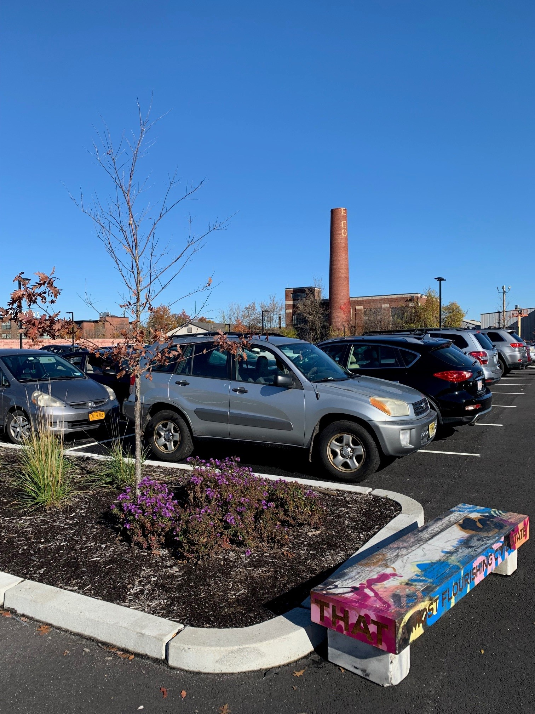
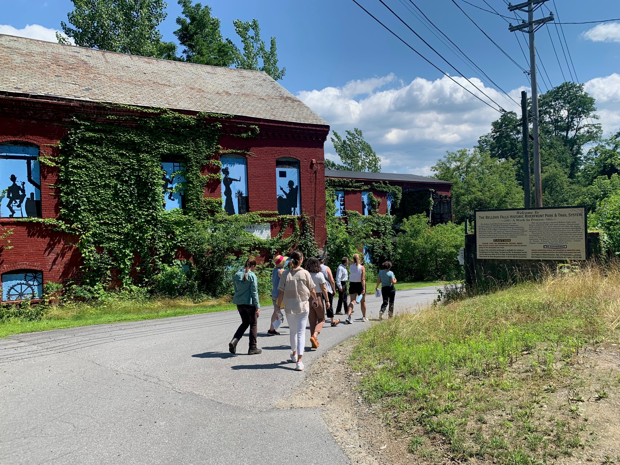
TA PROJECTS IN REGION 1
Projects can include site design, market analysis, community engagement, sustainable development and other topics.
Tools and guidance from past projects can be found in the Land Revitalization Toolkit and the Revitalization Ready Guide.
Contact your EPA Project Officer or Elise Simons (simons.elise@epa.gov, 617-918-1220) for further information
Notes:
Elise

Slide 39
Technical Assistance to Brownfields (TAB)
In addition to the assessment and cleanup grants of the Brownfields and Land Revitalization Program, there are various free resources available to help inform assessment, cleanup, and reuse decisions.
These technical assistance programs can help further the success of a brownfield investment.
Considering things such as market analyses, equitable development, and climate resiliency can help bring both project success and broad, long-lasting benefits to a community.

Slide 40
National Direct Technical Assistance (available to all)
GROUNDWORK USA
National Program (Strong NE ties)
help navigate the BF process, help engage your community
help with creative land use strategies
help you access, navigate and use GIS tools to integrate data into your decision-making
https://groundworkusa.org/ta-services/
HMTRI
National Program for those interested in Brownfields Job Training Grants ($500K)
Contract with EPA ends October 15 but they still have recorded webinars and helpful tools on their site
conduct meetings and webinars for all funded and prospective JT grantees
maintain an outreach listserv for direct contact and interactions
maintain a mentor link program
host bi-weekly Professional Learning Community (PLC) conference call that feature various aspect of building and sustaining a successful job development program.
https://brownfields-toolbox.org/

Slide 41
National Direct Technical Assistance (available to all)
Revolving Loan Fund Technical Assistance (https://www.epa.gov/system/files/documents/2022-11/RLF%20508.pdf)
Nonprofit Technical Assistance (https://www.epa.gov/system/files/documents/2022-11/Nonprofits%20508.pdf)
Local Government Leaders Technical Assistance (pdf) (https://www.epa.gov/system/files/documents/2022-11/Local%20Gvmts_0.pdf)
Minimizing Displacement Research (pdf) (https://www.epa.gov/system/files/documents/202211/Minimizing%20Displacement%20508_rev.pdf)
Land Bank Research (https://www.epa.gov/system/files/documents/2022-11/Land%20Banking_0.pdf)

Slide 42
UConn TAB (Available to Region I only)
Region I Technical Assistance can provide a wide variety of direct technical assistance to any community or entity that is eligible for Brownfields funding.
UCONN offers municipal assistance, continuing education and grant writing.
https://tab.program.uconn.edu/services/

Slide 43
How to comply with Section 106 of the National Historic Preservation Act

Slide 44
National Historic Preservation Act of 1966 (as amended)
Established the National Register of Historic Places.
Established the Advisory Council on Historic Preservation and authorized them to develop implementing regulations.
Established a required review process which is now commonly known as “106 Review”.
Required all Federal Agencies to develop a Preservation Program.

Slide 45
Overview of Section 106
Section 106 of the National Historic Preservation Act requires all federal agencies to take into account the effects of their undertakings on historic properties.
Section 106 is “triggered” by federal involvement; not by the presence of historic properties.
Notes:
Discuss the difference between HUD funding. If a Town receives funding from HUD they can act of behalf of HUD under Section 106. EPA does not delegate Section 106 responsibility to entities receiving our funds.

Slide 46
Why Do I have to Comply?
Notes:
Wood Island Lifesaving Station in Kittery, Maine. Dorrie Paar was the EPA PO. They had a 200,000 cleanup grant. We have written a success story.

Slide 47
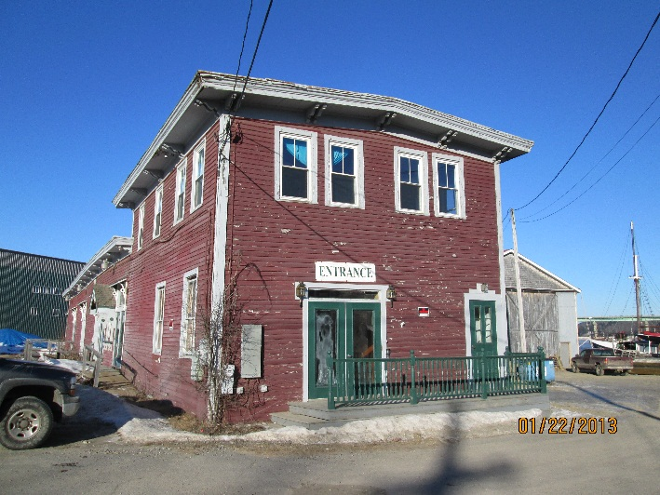
Assessment and Cleanup Grant T&Cs
“Prior to conducting or engaging in any on-site activity with the potential to impact historic properties (such as invasive sampling or cleanup), the CAR shall consult with EPA regarding potential applicability of the NHPA and, if applicable, shall assist EPA in complying with any requirements of the Act and implementing regulations.”
Notes:
The photo is of the Masker’s Theater and Thompsons’ Wharf site in the City of Belfast, Maine. We cleaned up this site. I was the PO..

Slide 48
Section 106 Process
Step 1: Initiate Review
Step 2: Determine if activities have potential to cause “effect”
Step 3: Determine if property is historically or culturally significant
Step 4: Mitigate, if necessary
Notes:
You need to start planning for 106 early in the process. Section 106 of NHPA requires Federal agencies to take into account the effects of their undertakings on historic properties and afford the Advisory Council a reasonable opportunity to comment on such undertaking.

Slide 49
Step 1: Initiate Review
Do you have an “undertaking”
Definition of an “undertaking”:
“…a project, activity, or program funded in whole or in part under the direct or indirect jurisdiction of a federal agency, including those…carried out with federal financial assistance…”
BROWNFIELD ACTIVITY = UNDERTAKING
Note: No federal dollars, no NHPA.
Notes:
Definition of an undertaking may be found in 36 CFR § 800.16(y).
It is the Agency Official’s determination as to whether or not there is an undertaking.

Slide 50
Step 2: Determine if Undertaking has the potential to cause an “Effect”
An adverse “effect” is found when an action alters, directly or indirectly, any of the characteristics of a historic property that qualify the property for inclusion in the National Register in a manner that diminishes the integrity of the location, design, setting, materials, workmanship, feeling or association, now or in the future.
Notes:
READ THIS DIRECTLY FROM SECTION 106
“The agency Official (THE EPA PROJECT OFFICER) shall determine…whether it is a type of activity that has the potential to cause effects on historic properties. IF the undertaking is a type of activity that does not have the potential to cause effects on historic properties, assuming such historic properties were present, the agency official has no further obligations under section 106 or this part.”
Therefore, assume the property is historic. Will the activity cause and “effect”?

Slide 51
Examples of Activities that do not have potential to cause an “Effect”
Phase I Site Assessments
Surficial Soil Sampling
Surface Water/ Sediment/ Soil Boring
Monitoring Well Installation
Excavation of previously disturbed land *
Concrete/ Wood Floor Sampling
Sub-slab sampling
Haz. Bldg Materials inventory
Demolition of non historic buildings and structures (<50 yrs)*
Notes:
Most Site Assessment activities are not activities that cause “effects”. Most likely exception is test pitting.
An example of previously disturbed land – is the localized area around a tank grave , areas that have been extensively re-graded are considered previously disturbed land (clear cutting is not considered prior disturbance).
DEP and Grantee/Grantee’s consultant will work with activities required for the project, and determine if the activity will cause an “effect”. If an activity may possibly cause an effect, such as test pitting, revisit the work plan to see if information can be obtained in a less obtrusive way, such as test boring, or locate test pits in already disturbed areas.
Please contact your PO for assistance.

Slide 52
If No Effect
If there is an undertaking but it is not the type of activity that has the potential to cause effects on historic properties, then
That concludes the Section 106 review.
EPA Project Officer documents decision for file and communicates information to Grantee and State Agency.
Notes:
If the activity will not cause an effect, there is no need to contact the State Historic Planning office.

Slide 53
If your Activities have Potential to Cause an “Effect”, for example
Test Pitting
Exception: area already disturbed, such as tank grave
Soil Excavation
Capping or covering of contaminated soil
Building Renovation – Examples:
Changes to interior floor plan
Installation of new windows
Building Demolition
Notes:
When in doubt ask Project Officer!! The DEP might suggest ways to implement your Scope of Work to avoid having an effect.
Most clean up activities would be considered potentially causing an effect. Keep this in mind during the planning stages of a clean up to keep project from getting bogged down.
Public funded activities only! If the assessment was completed with Brownfields money, but the clean up will be conducted with private funding, then 106 is not an issue with the clean up work.

Slide 54
Continue to Step 3:
Determine if it is a Significant Historic Property
Notes:
Photo is taken of the Norwich State Hospital in Preston, CT.

Slide 55
Is it a Historic Property?
Is the property/building listed in or eligible for listing on the National Register of Historic places?
Is the building greater than 50 years old?
Is the property in an archaeologically sensitive area?
Is the site in an area where traditional cultural properties are located?
Notes:
This is a picture of the Lyman Cousens Memorial School in Lyman, Maine. 2015 $200,000 cleanup grant. 1937 building. Jim Byrne was the Project Officer.

Slide 56
What is a Historic Property cont.
Associated with Significant Events
Associated with significant people
Embodying Distinctive Characteristics
Containing important Precontact Information
Notes:
The World Trade Center is on the National Register because of the events that took place there (it is associated with Significant events.
Homes of US presidents can be considered historic.- because they are associated with significant people.
An example of a property that embodies distinctive characteristics would be the Bates Mill No. 5 in Lewiston because of the saw tooth roof. Albert Kahn architect.
The shell middens on North Haven contain important pre-contact information and would be a historic property.
Photo is of the Paragon Mills in Olneyville, RI , Alan Peterson is the EPA PO for these three grants.

Slide 57
How do you determine if it is a historic property?
EPA Project Officer consults the SHPO and/or THPO.
Town/Grantee
US Department of the Interior
Consult the local historical society
Ask members of the public

Slide 58
If property is not a cultural resource
Grantee will provide documentation to EPA and DEP that cultural resources are not at risk from activities.
EPA will document final determination that there are no historic properties affected and 106 review process is complete.
Notes:
The grantee may have to hire a historical contractor to complete this review.
This information may have been completed already by another party.
Consult with the SHPO and town.
If grantee hires a cultural resource specialist, we recommend that they submit their resume with the report. Additionally they certify that the meet the Secretary of the Interior's Professional Qualification Standards, found in 36 CFR 61 (48 FR 44738-9) to carry out any reviews. Said professionals shall have demonstrated understanding of how to interpret and apply the Secretary of the Interior's Standards and the National Register criteria.

Slide 59
Step 3 – If Yes
EPA PO makes a determination and asks for concurrence from the SHPO, regarding the historical status of the property and potential for adverse effects.
If there will be an adverse effect, EPA will consult with SHPO and the case team and go on to Step 4.

Slide 60
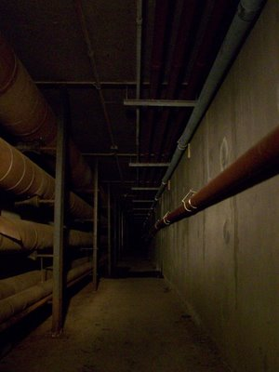
Step 4: Resolve Adverse Effects
Avoid
Minimize
Mitigate
Notes:
This is a photo of the underground steam tunnels at the Paul Dever School in Taunton.

Slide 61
Consider alternatives to avoid or minimize effects….
Shift in alignment
Relocation to a different area
Design or process modification
….or you may need to mitigate.
Recordation
Education and outreach (exhibits, pamphlets, reports, etc.)
Data recovery (archaeological excavation)
Notes:
SHPO may suggest changes in a project or impose conditions so that adverse effects can be avoided and thus result in a no adverse effect determination.

Slide 62
Memorandum of Agreement
Activities to that result in an adverse effect require that mitigation must be agreed upon in a MOA before work begins.
MOA is usually between, EPA, SHPO and Grantee.
ACHP may be consulted if there is a dispute, but ultimately, the decision is EPA’s.

Slide 63
Additional Resources
EPA Brownfields: epa.gov/brownfields
EPA Region 1 Brownfields and Land Revitalization in New England: epa.gov/brownfields/r1
EPA Environmental Justice Home Page: epa.gov/environmentaljustice
Region 1 Technical Assistance to Brownfields (TAB) Provider: tab.program.uconn.edu
Groundwork USA Equitable Development: groundworkusa.org/ta-services/equitable-development-resource-hub
Environmental Justice Mapping Tool: epa.gov/ejscreen
Climate Economic and Justice Screening Tool (CEJST): screeningtool.geoplatform.gov
Environmental Justice Thriving Communities Technical Assistance Centers: epa.gov/environmentaljustice/environmental-justice-thriving-communities-technical-assistance-centers
Brownfields: Strategies to Minimize Displacement: https://www.epa.gov/brownfields/strategies-minimize-displacement
Technical Assistance Fact Sheet: Attached to this ppt
EPA Region 1 Brownfields Program
EPA 901F23005
Notes:
Additional websites and resources are listed here to explore information, data, and tools for assessing EJ concerns and creating a more equitable brownfield cleanup and redevelopment process.
A fact sheet resource has also been developed with the information from this presentation as well.

