Slide 1
Pesticide Choice for Schools
Gary Fish
Maine Board of Pesticides Control
287-7545
gary.fish@maine.gov

Slide 2
Where do you start?
Read the labels
The label must list the “site” to be treated
Should also list the pest to be controlled, e.g., weed, insect, fungus, rodent, germ, etc.
Once you determine the above, then you can look at other product characteristics.

Slide 3
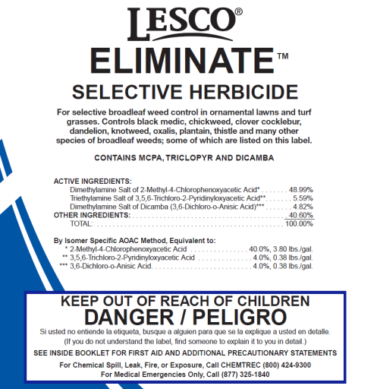
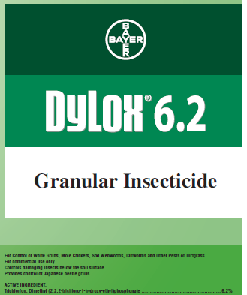
What chemical characteristics are important?
Toxicity – To humans (children especially), pets, bees and other pollinators, wildlife, plants
Acute and chronic
Formulation – granular, spray or bait
Drift potential
Volatility
Odors
Equipment used to apply
Injected in crack
Sprayed
Incorporated into soil
Watered into the soil
No endorsement intended or implied

Slide 4
Reduce exposure by using targeted materials
Enclosed baits & gels
Spot treatments
Broadcast treatments
Best
Worst

Slide 5
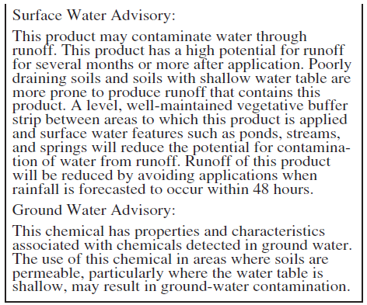
Environmental Fate
Will it runoff?
Is it leachable?
Is it volatile?
Will it leave a residue on the surface?
No endorsement intended or implied

Slide 6
Which characteristics do you think are most important?
Toxicity
Persistence
Formulation
Cost
Efficacy
Risk/Hazard
Residues
Environmental Fate

Slide 7
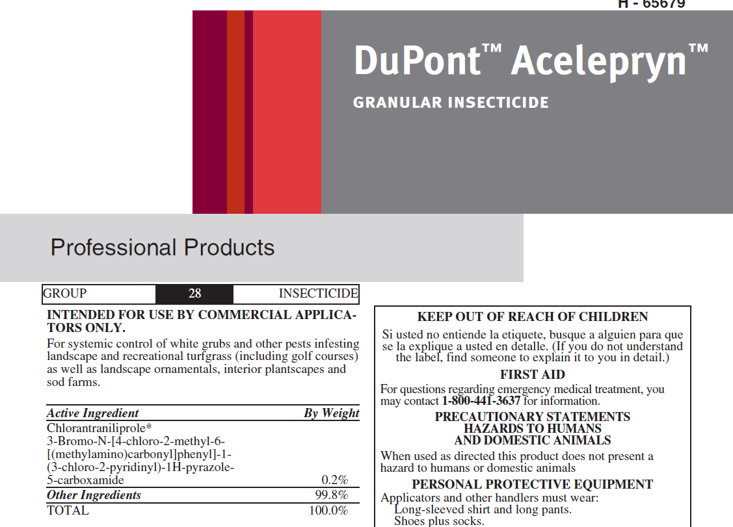
Where can you find this information?
Pesticide label
Signal word (Caution, Warning or Danger)
Precautionary statements
PPE requirements
Re-entry statements
Environmental hazards
Application restrictions
Mode of action
No endorsement intended or implied

Slide 8
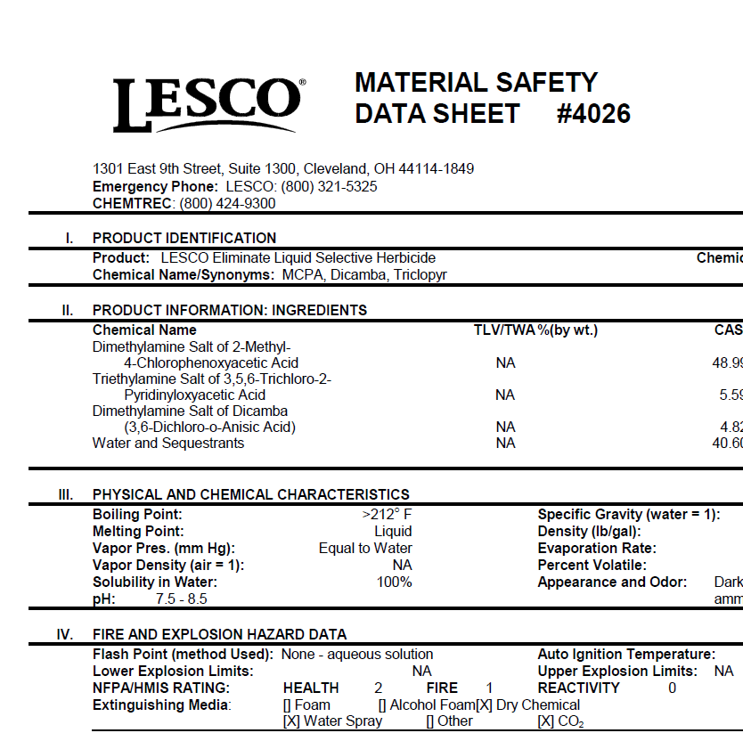
Where can you find this information?
MSDS or SDS
Flammability
Reactivity
PPE
Long term health effects
Carcinogen
Teratogen
Mutagen
Reproductive effects
Vapor pressure
No endorsement intended or implied

Slide 9
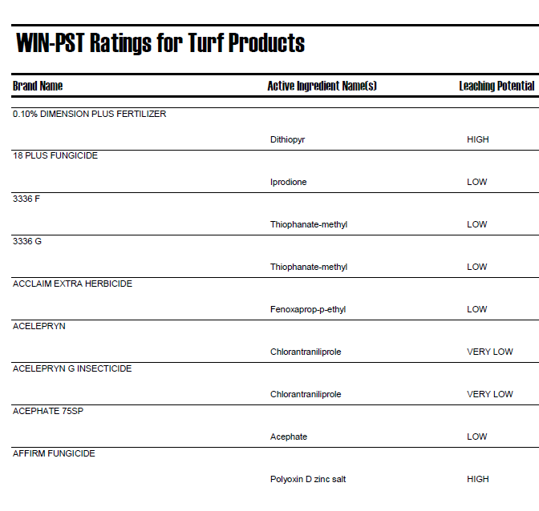
Where can you find this information?
Windows Pesticide Screening Tool WIN-PST
Relative leaching potential
Relative surface loss potential
Potential loss attached to eroded soil
Relative risk to humans in drinking water
Relative risk to aquatic organisms in water or sediments
No endorsement intended or implied

Slide 10
Where can you find this information?
Turf Pesticide & Cancer Risk Database - Cornell University
Pesticide Action Network Database - PANNA
No endorsement intended or implied

Slide 11
Which product is least hazardous to humans?
Acelepryn
Dylox
Eliminate
No endorsement intended or implied

Slide 12
Which product is more likely to leave a residue that poses some risk to students?
Acelepryn
Dylox
Eliminate
No endorsement intended or implied

Slide 13
Which product has the lowest drinking water risk?
Acelepryn
Dylox
Eliminate
No endorsement intended or implied

Slide 14
Which product has the greatest risk to aquatic life if it gets into a stream?
Acelepryn
Dylox
Eliminate
No endorsement intended or implied

Slide 15
Which product is more likely to give off vapors?
Acelepryn
Dylox
Eliminate
No endorsement intended or implied

Slide 16
Which product would you choose if you identified European chafer grubs in an athletic field at 10/sq. ft. in late July?
Acelepryn
Dylox
Eliminate
No endorsement intended or implied

Slide 17
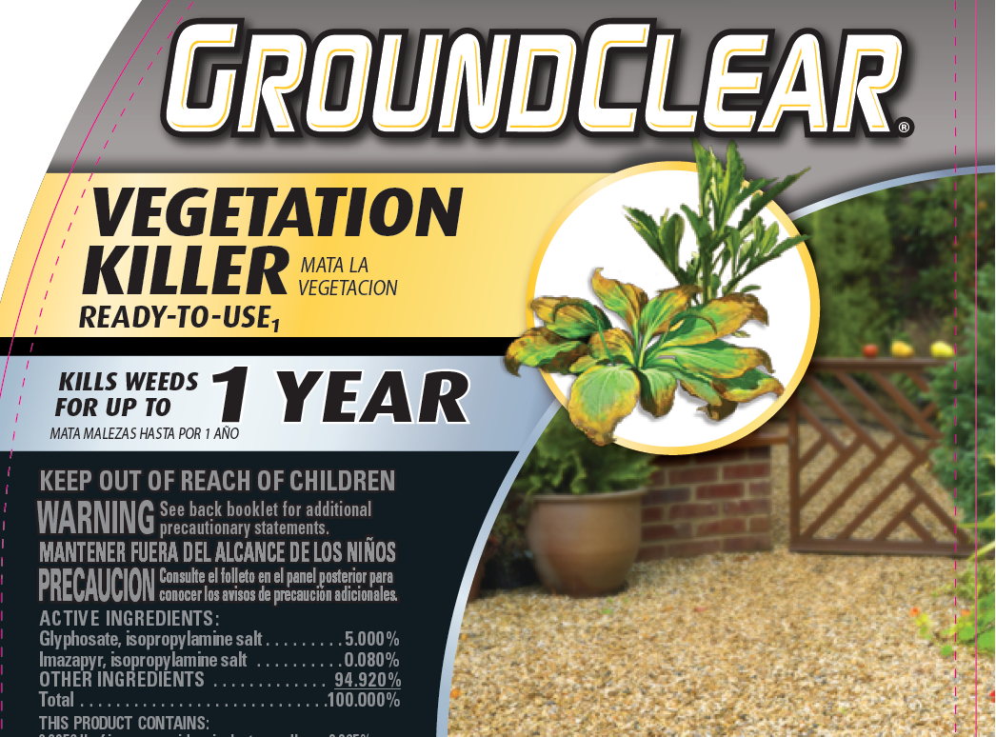
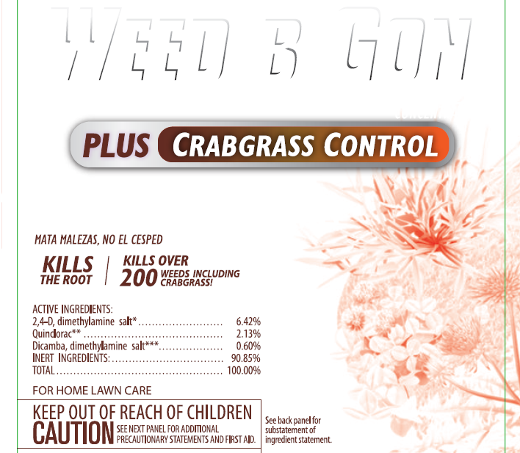
What about persistence?

Slide 18
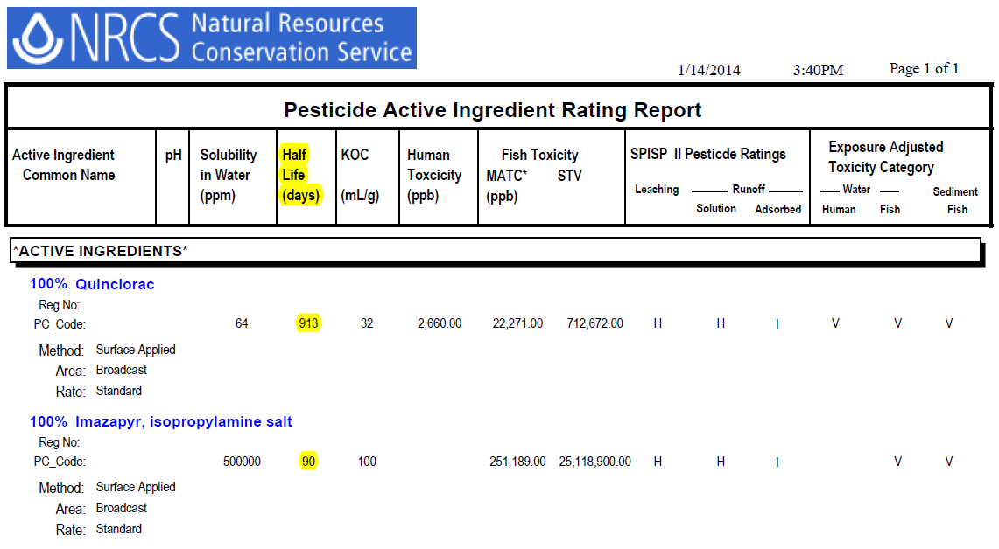
WIN-PST shows half-life in days

Slide 19
Where can you go for product efficacy and pest management information?
School IPM website
Got Pests website
University of Maine Pest Management
YardScaping website
U-Mass Turf Program
U-Mass Landscape & Nursery Program
The label
Research articles in journals
Pesticide dealer
Pesticide manufacturer

Slide 20
Which product is least likely to leach into groundwater?
Acelepryn
Dylox
Eliminate
No endorsement intended or implied

