Slide 1
TAX MAP QUANDARIES AND CURIOSITIES
DARK TALES AND MYSTERIES FROM THE DRAWER OF SECRETS IN THE MAP ROOM

Slide 2


Robert G. Rogers, CMA
BA, University of Maine Farmington
Interdisciplinary, Environmental Science
1995
Aerial Survey and Photo, Inc
1996-2016
546 Airport Road, Norridgewock, ME
207 634-2006
Hilltop Northeast Enterprises, LLC
2016-Present
30 Mill Lane, Brimfield, MA
508 434-1200
207 779-0660

Slide 3
TAX MAP - PARCEL MAP - CADASTRAL MAP
Cadastral (kăda ֗ străl), a. [mod. F. cadas-tral relating to the cadastre, as in les registres cadastraux (Littré).]
1. Of, pertaining to, or according to a cadastre; having reference to the extent, value, and ownership of landed property (strictly, as a basis of distributing taxation).
2. Cadastral survey: a. strictly, a survey of lands for the purposes of a cadastre; b. loosely a survey on a scale sufficiently large to show accurately the extent and measurement of every field and other plot of land. Applied to the Ordnance Survey of Great Britain on the scale of 1/2500 or 25.344 inches to a mile. So cadastral, map, plan, etc.
A New English Dictionary on Historical Principles, James A. H. Murray editor, Volume II. C
Oxford: At the Clarendon Press, Oxford, England, 1893. (Accent added)

Slide 4

TODAYS DISCUSSION
A BRIEF OVERVIEW OF TAX MAPPING/MAPPING
DEED PROBLEM
TOWN LINE STORY
REALLY WEIRD SHAPED LOTS
TO MERGE OR NOT TO MERGE
PAPER STREETS
FAMILY SUBDIVISION
OWNER UNKNOWN
BRIEF LOOK AT ADVERSE POSSESSION
PARTING SHOT

Slide 5
Cadastre (kăda ֗ stǝɹ). [a. Fr. Cadastre; = Sp., It. Catastro: ̶ late L. capitastrum ‘register of the polltax’, f. caput head, poll.]
a. (꓿ L. capitastrum.) The register of capita, juga, or units of territorial taxation into which the Roman provinces were divided for the purposes of capitatio terrena or land tax. (Poste Gaius.)
b. A register of property to serve as a basis of proportional taxation, a Domesday Book.
c. (in modern French use) A public register of the quantity, value, and ownership of the real property of a country.
A New English Dictionary on Historical Principles, James A. H. Murray editor, Volume II. C
Oxford: At the Clarendon Press, Oxford, England, 1893. (Accent added)

Slide 6
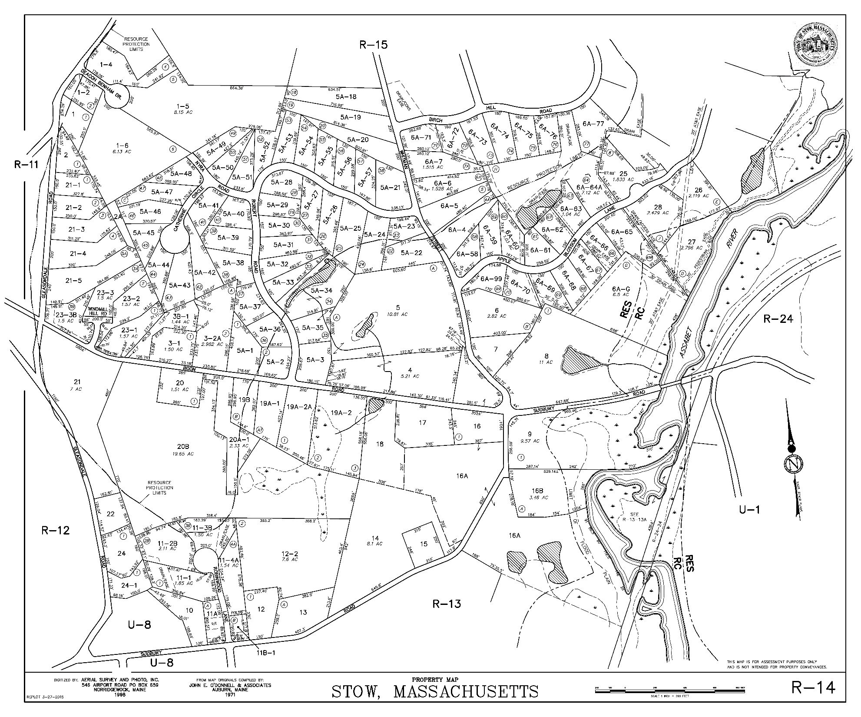
TAX MAP INGREDIENTS
BASE MAP
SOURCE MATERIALS
COMMITMENT BOOK/LIST
ACCESS TO REGISTRY
DRAFTING/MAPPING SOFTWARE
WIDE FORMAT SCANNER
PLOTTER/PRINTING SERVICE
END USER/ON-LINE APPLICATIONS
Image courtesy Town of Stow, MA

Slide 7
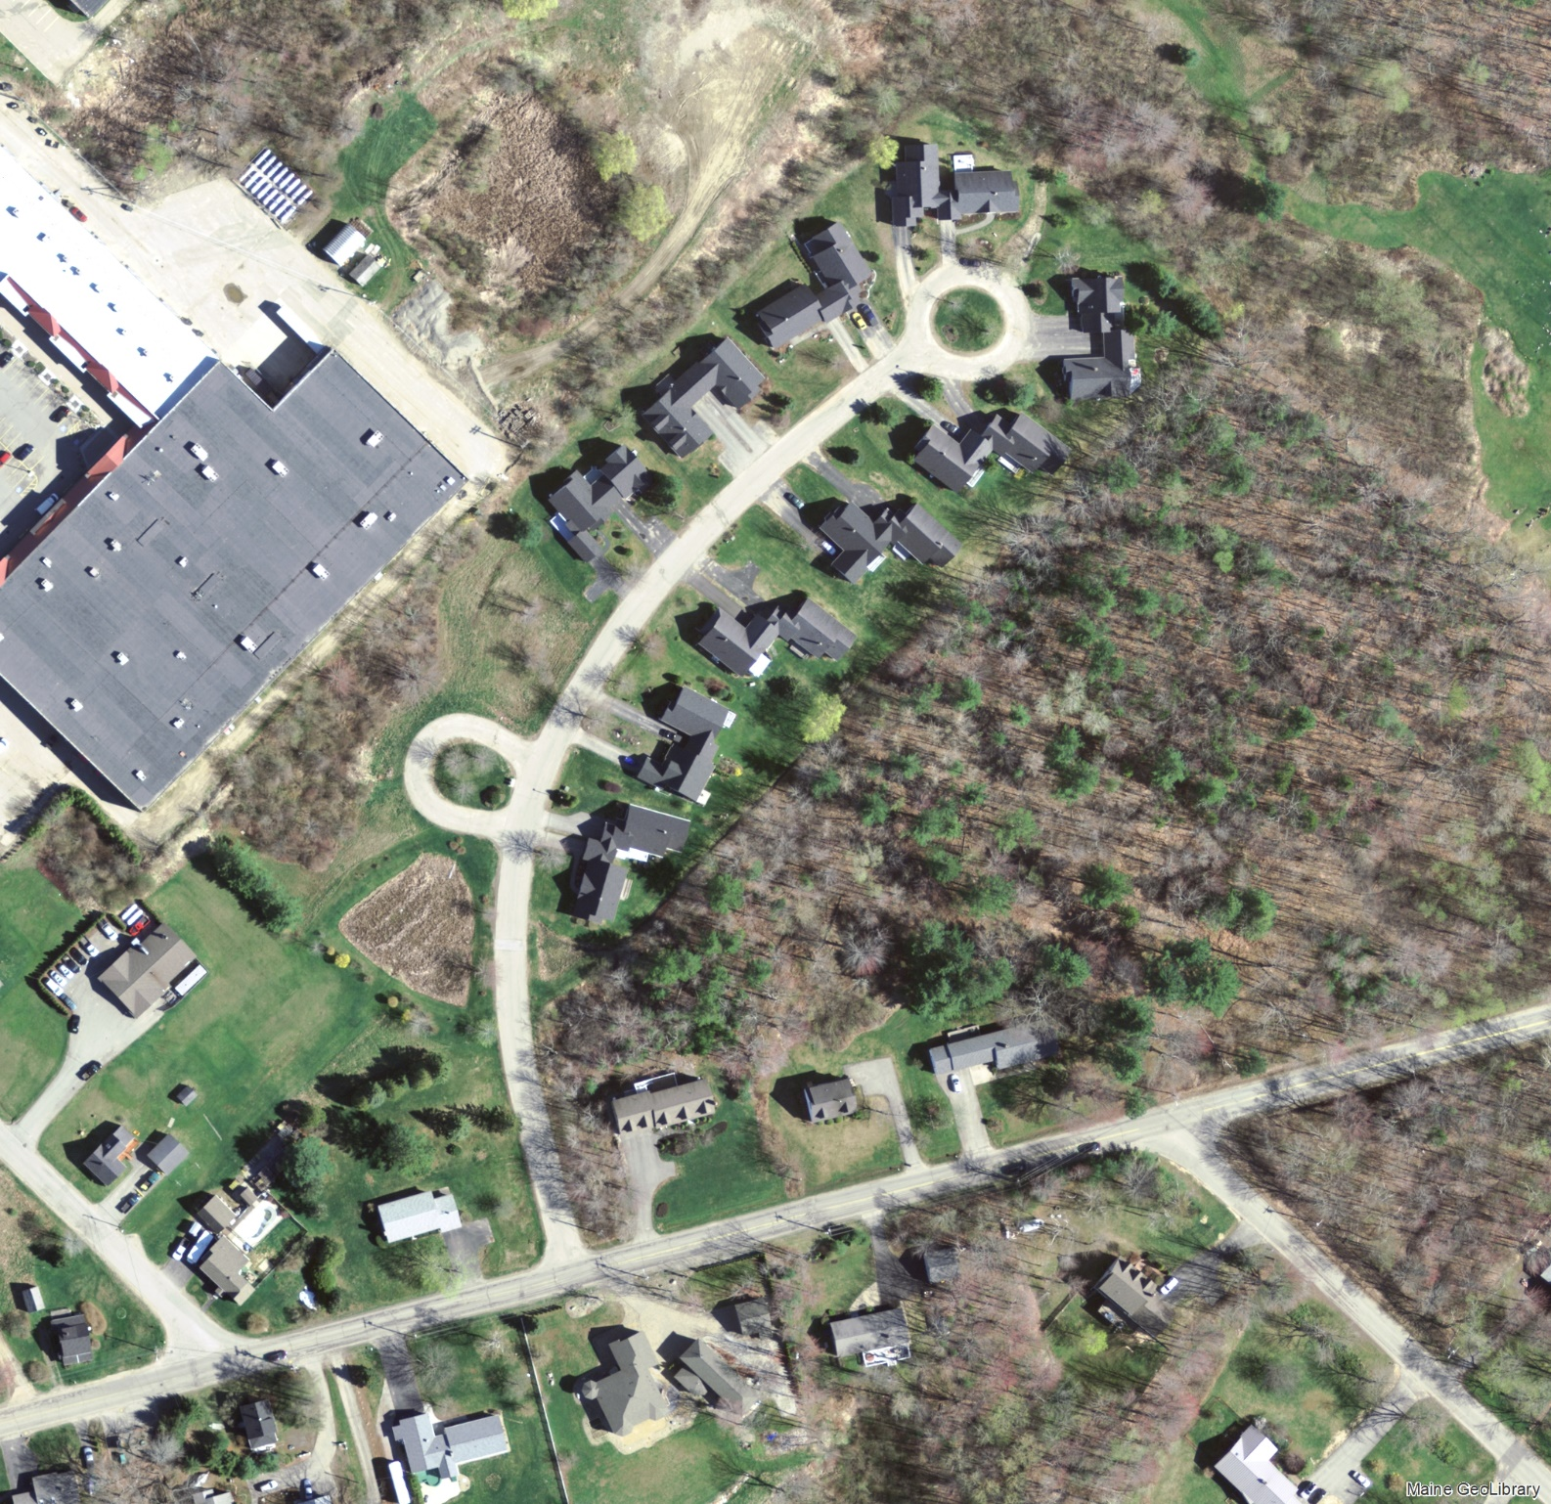
BASE MAP
AERIAL PHOTO-ENLARGEMENT
USGS TOPOGRAPHIC MAP DATA
PHOTOGRAMMETRIC BASE MAP
DIGITAL ORTHO - PHOTOGRAPHY/IMAGERY
LIDAR
Image Credit: Maine GeoLibrary
Maine Orthoimagery Municipal Rockland 2018
https://geolibrary-maine.opendata.arcgis.com/

Slide 8
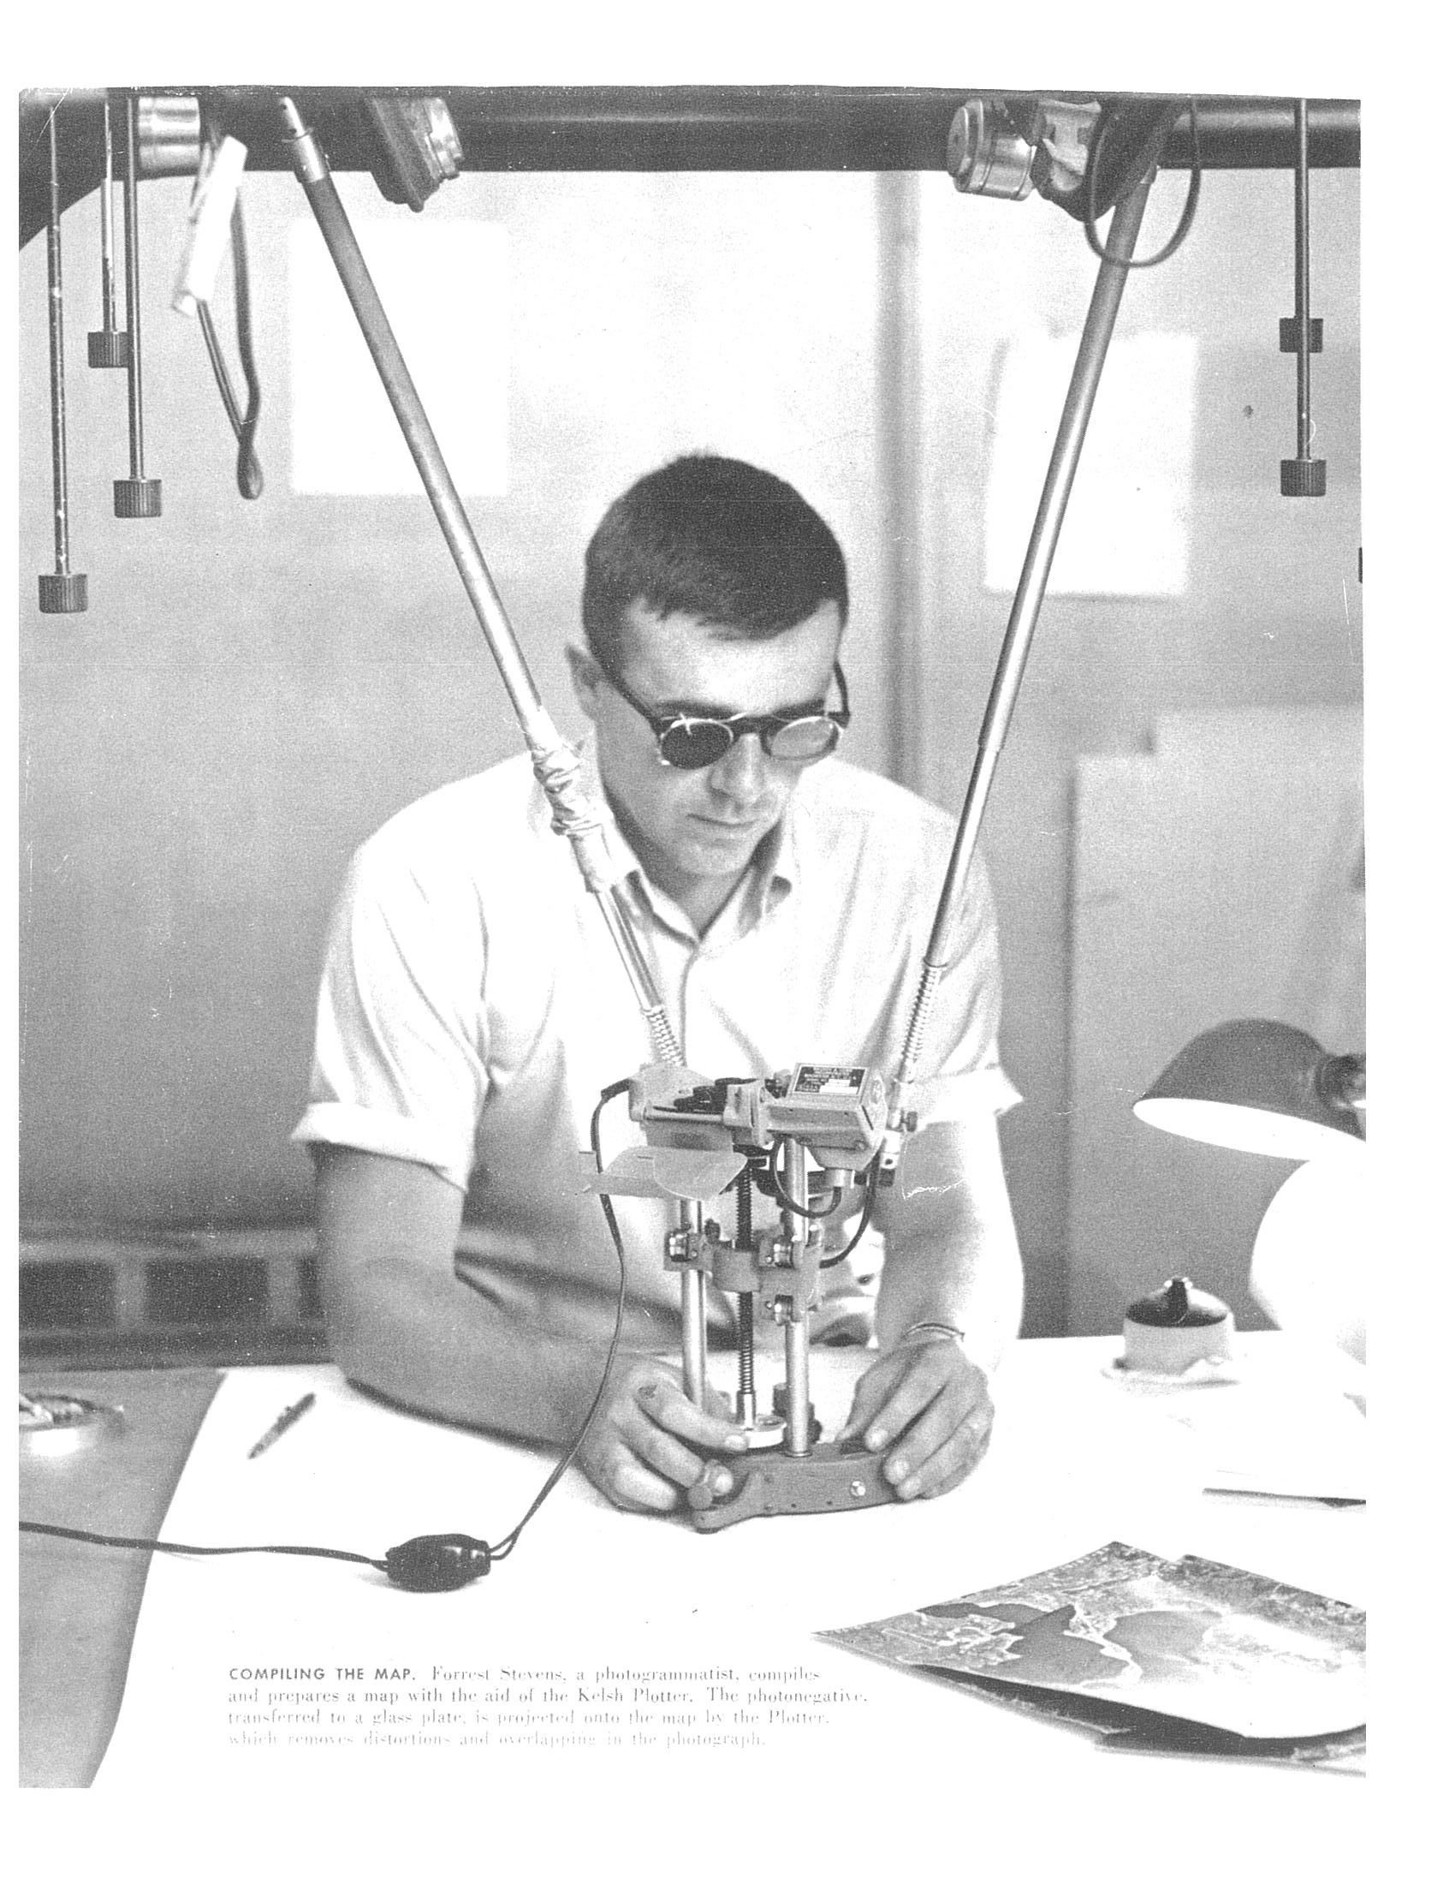
PHOTOGRAMMETRIC MAPPING
ROD’S DAD, BUD STEVENS
Owned and operated Aerial Survey and Photo, Inc 1981 – 1995
Licensed photogrammetrist.
Previously SLF, Inc (Survey, Layout, and Forestry) 1975 – 1981
Kelsh Stereoplotter
Stereo pair diapositives
Projected through series of lenses and mirrors
Composite image visible in 3d
“Data” captured to paper or mylar manuscript
Image courtesy, Rod Stevens, Aerial Survey and Photo, Inc.

Slide 9
LIDAR
LIGHT DETECTION AND RANGING
LIGHT IMAGING, DETECTION, AND RANGING
A KIND OF LASER SCANNING
AIRBORNE REQUIRES LIDAR INSTRUMENT COUPLED WITH GPS AND AN IMU (INERTIAL MEASUREMENT UNIT)
REPLACING PHOTOGRAMMETRY FOR SOME APPLICATIONS (MOSTLY TOPOGRAPHIC)
LIDAR IN MAINE GOT GOING WITH AMERICAN RECOVERY AND REINVESTMENT AND RECOVERY ACT (2009)

Slide 10
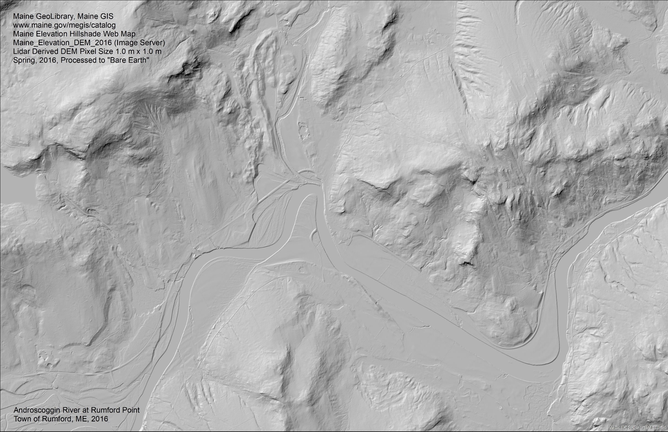
LIDAR

Slide 11
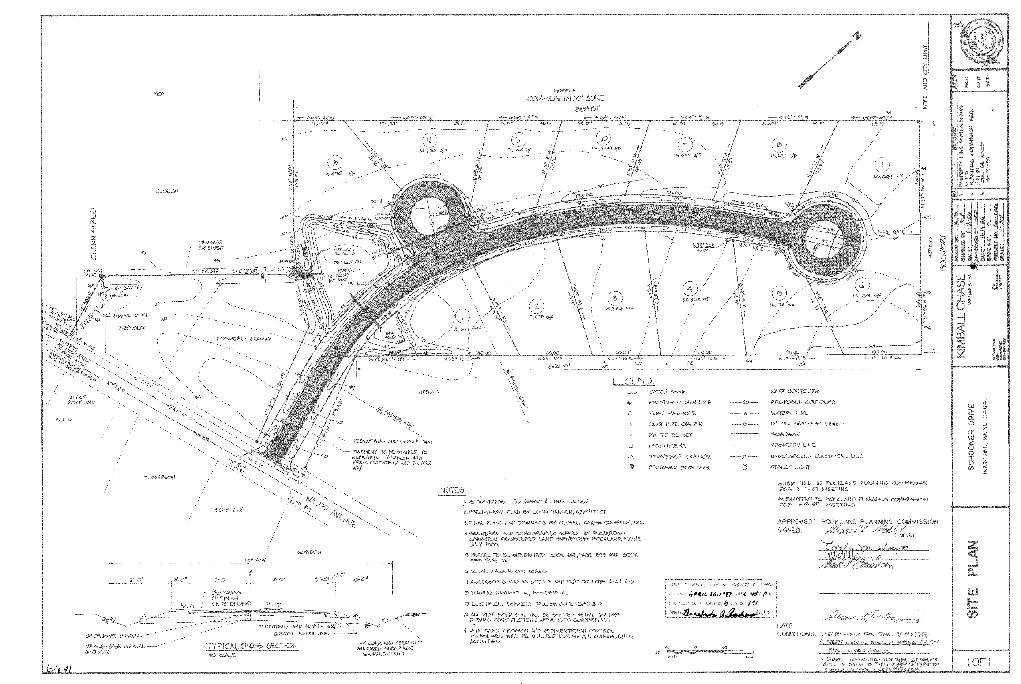
SOURCE MATERIALS
OLD TAX MAPS
SUBDIVISION AND BOUNDARY SURVEY PLANS
HIGHWAY RIGHT OF WAY PLANS
RAILROAD RIGHT OF WAY PLANS
DEEDS
EARLY LOT PLANS
Plan source: Knox County Registry of Deeds
Plan Cabinet 6 Page 191
http://www.maineregistryofdeeds.com/

Slide 12
BUILD THAT SPECIAL RELATIONSHIP WITH YOUR MAPPING VENDOR
DEEDS RULE, SEND THEM WITH THE RTTF AND DOUBLE CHECK THE MAP/LOT NUMBERS
USE YOUR DEED PLOTTER OR SKETCHING SOFTWARE TO SUPPORT CHANGES
CHECK REGISTRY FOR RECORDED PLANS THAT YEAR, SEND THOSE TOO.
CHECK WITH OTHER DEPARTMENTS FOR NEW SUBDIVISIONS, NEW ROAD NAMES, ZONING CHANGES ETC.
SEND MARKED UP WORKING MAPS OR 11X17’s
TAX MAP ANNUAL OR PERIODIC UPDATE

Slide 13
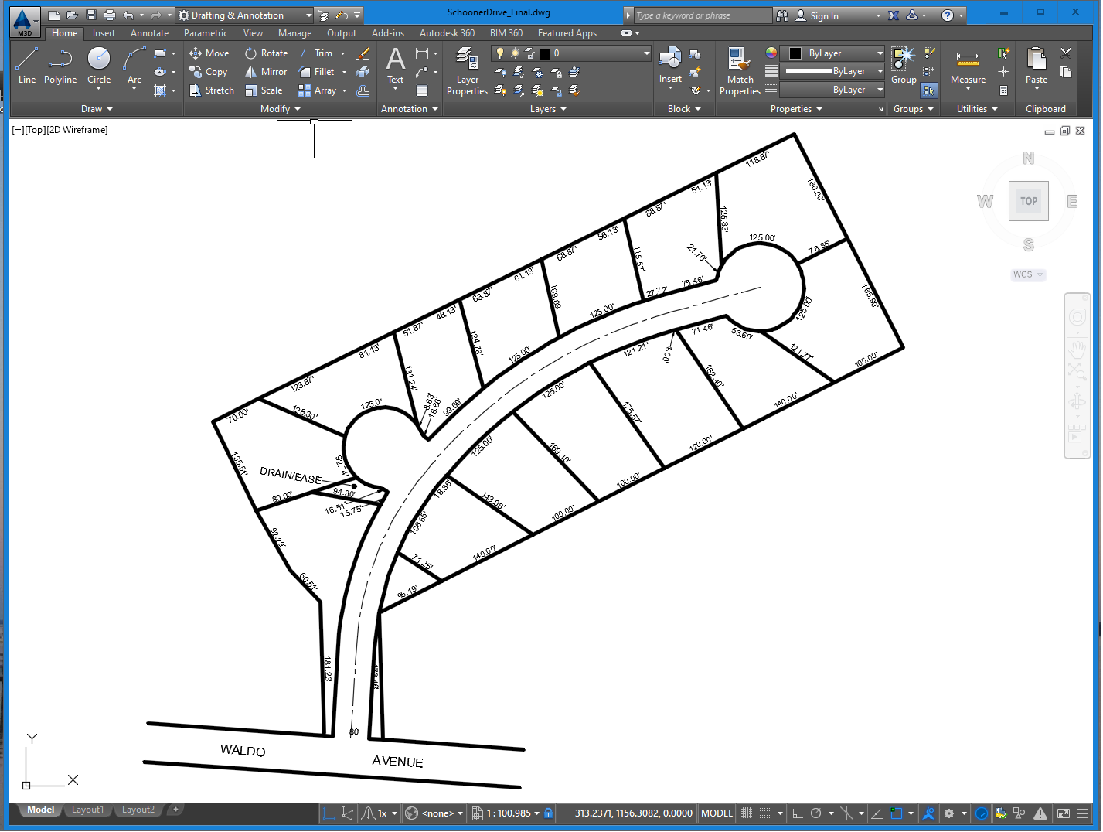
COORDINATE GEOMETRY (“COGO”)
North 14°, 57’, 32” East a distance of 86.90 feet…
Thence along a bearing of 267° a distance of 89 rods…
Thence turning an internal angle of 57’ 36’ 29” to the right a distance of 81.64 feet…
Along a tangent curve to the left having a radius of 25 feet and a central angle of 90.0° a distance of 39.27 feet…

Slide 14
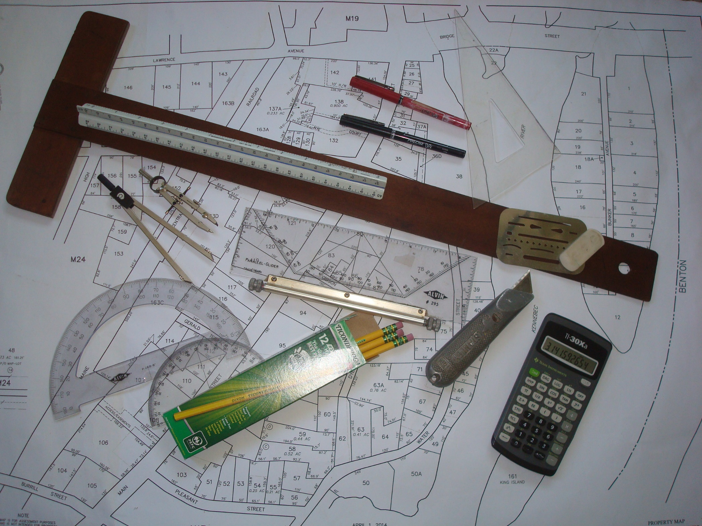
NOTHING WRONG WITH THIS

Slide 15
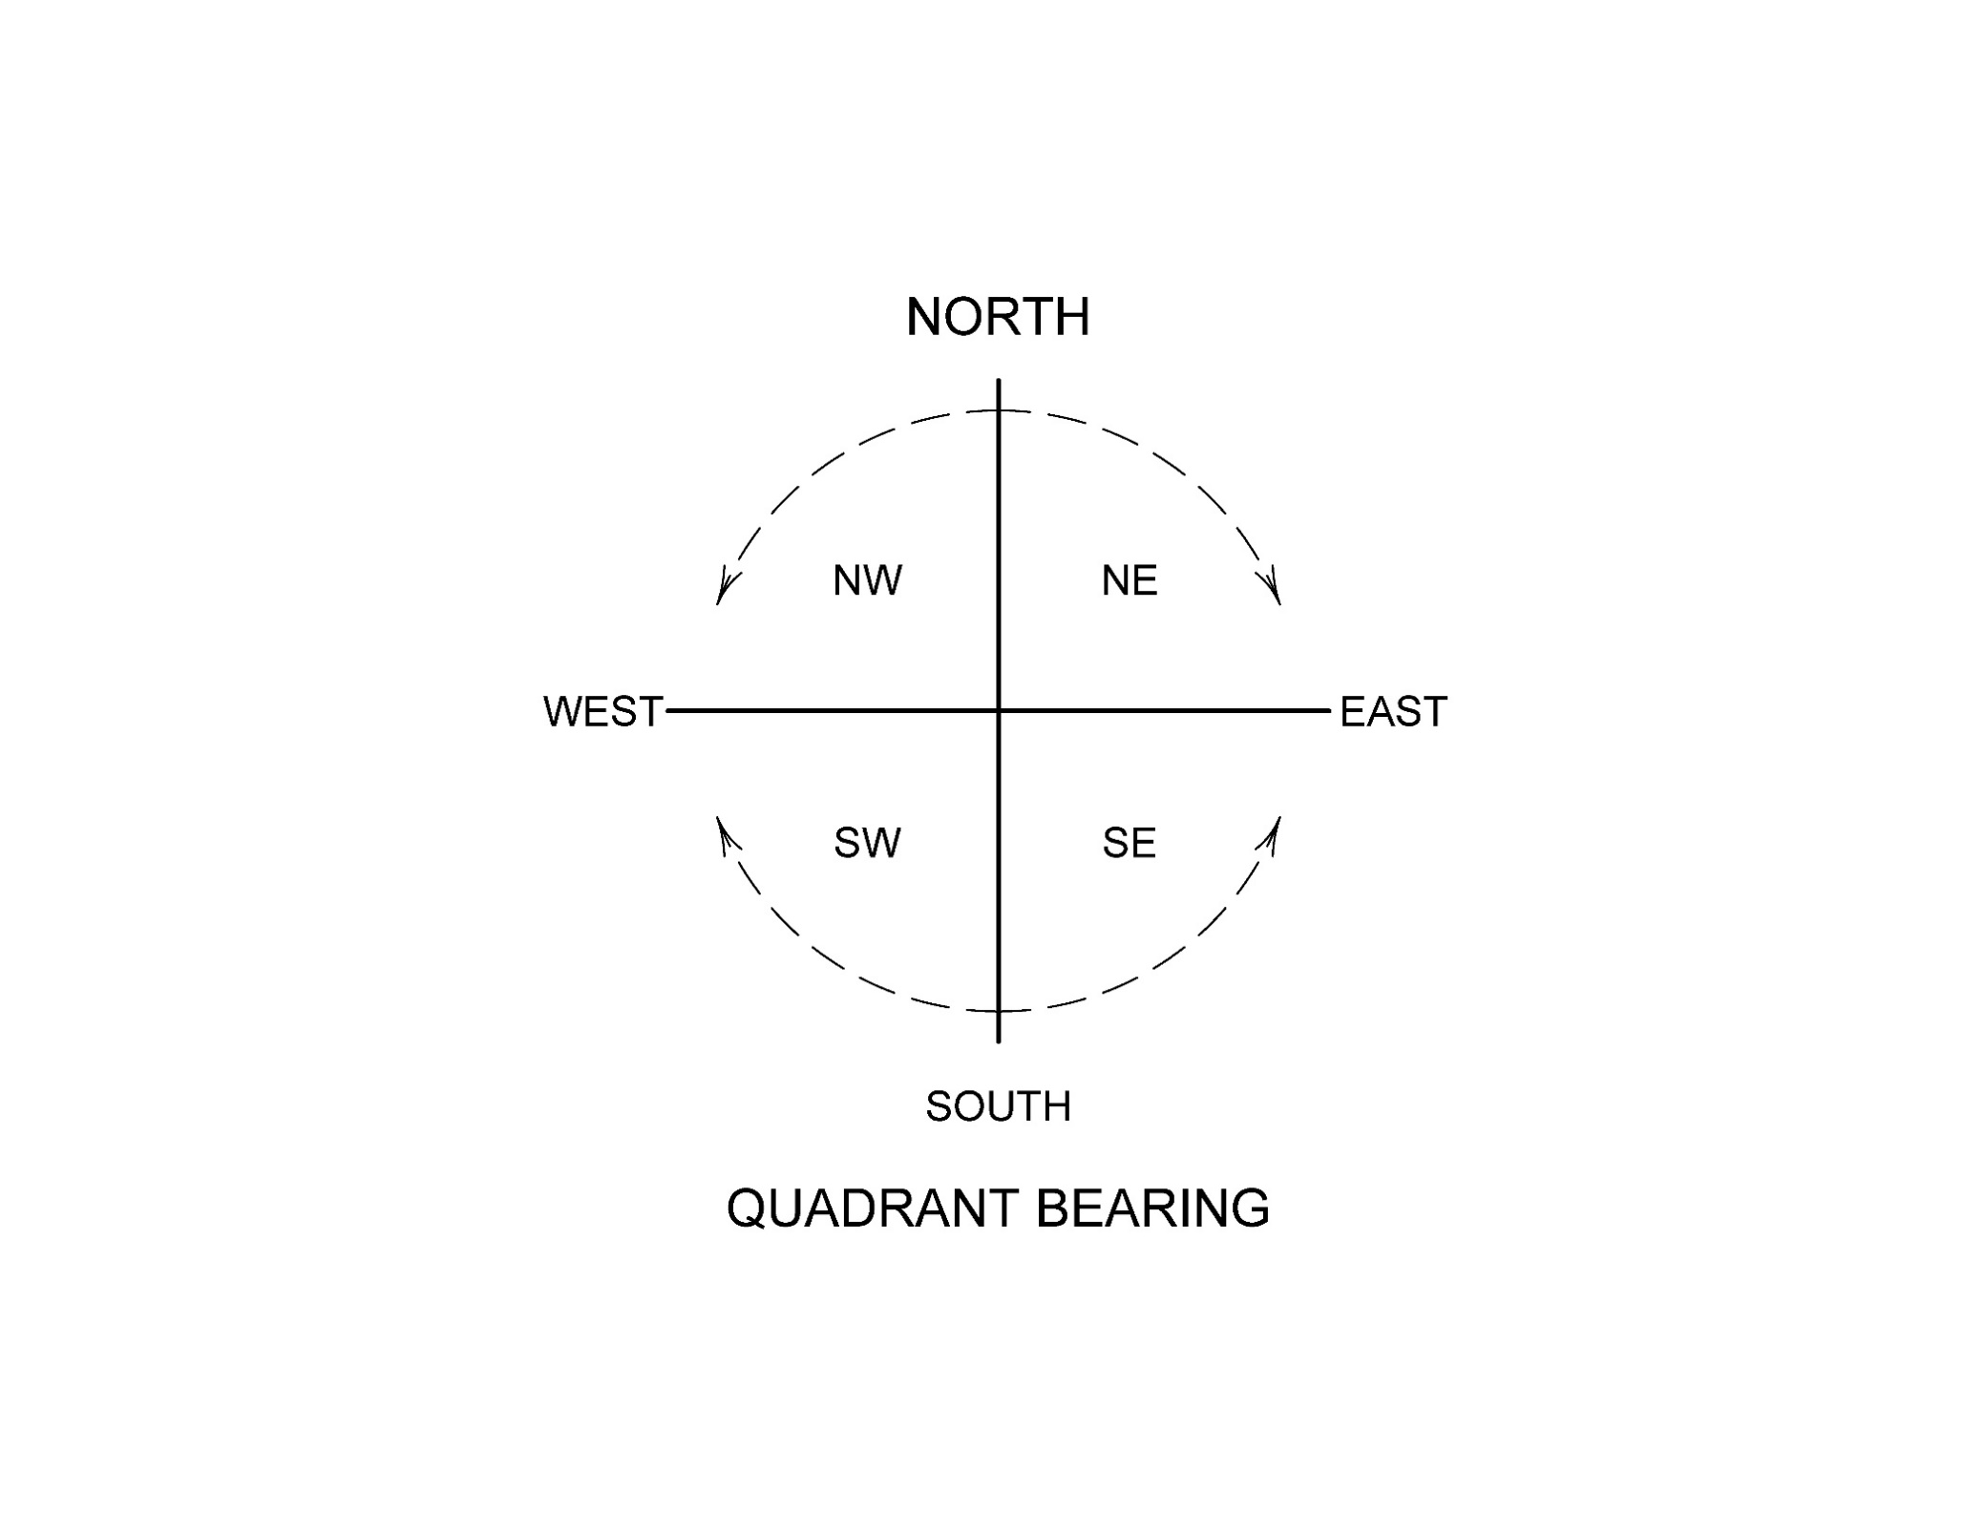
WHAT DIRECTION?

Slide 16
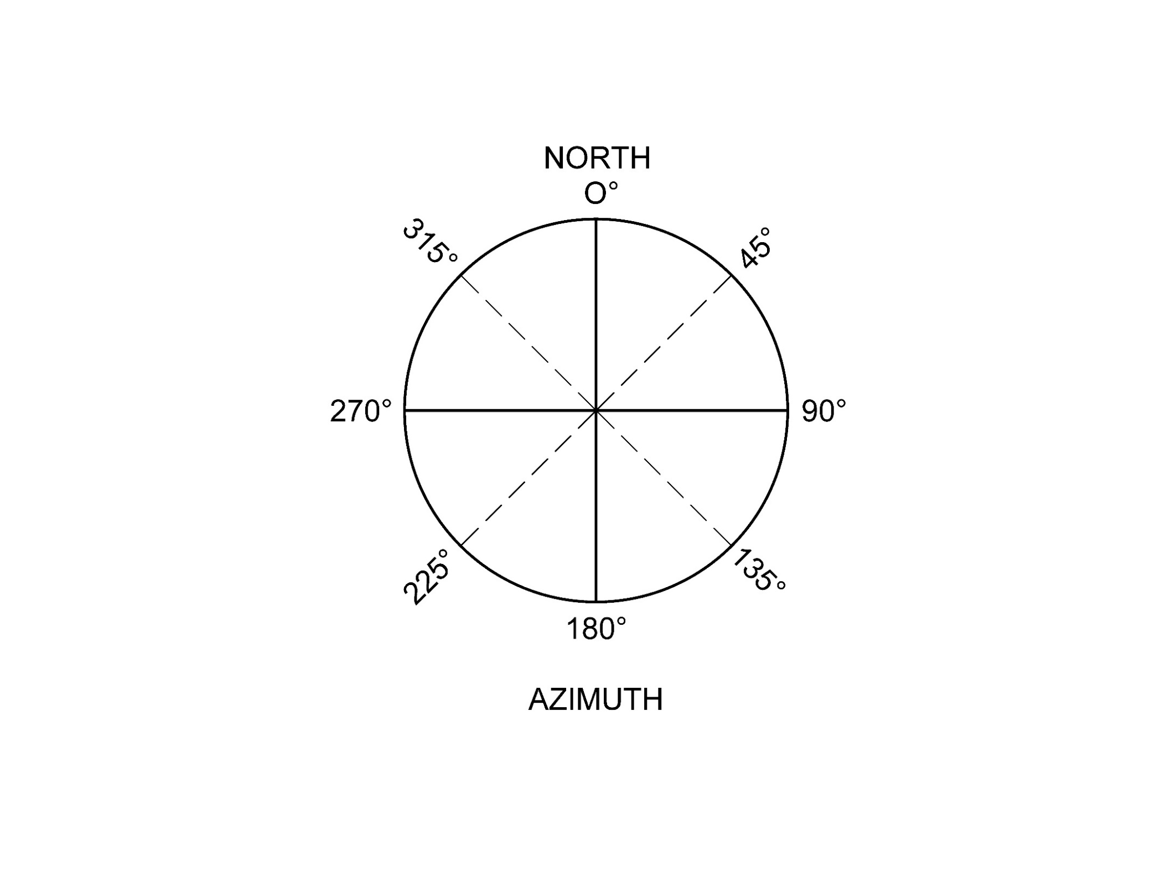
AZIMUTH ANGLES

Slide 17
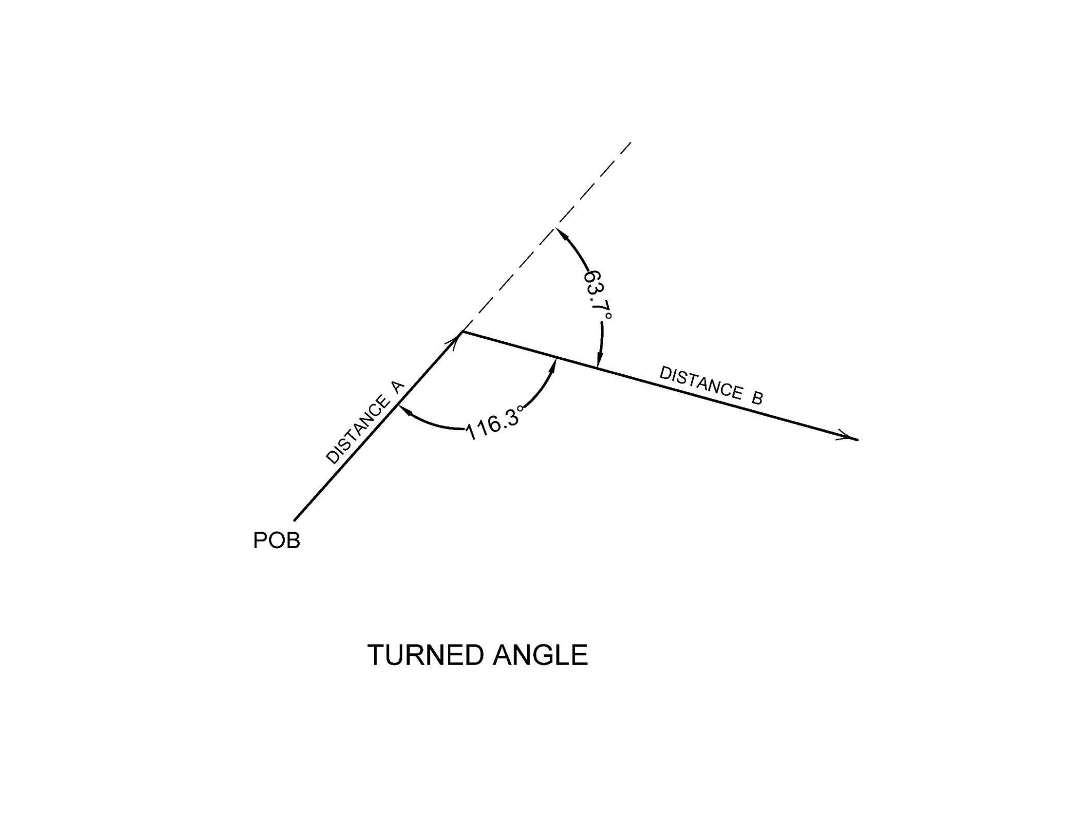
TURNED ANGLES

Slide 18

MISCELLANEOUS HELPFUL (OLD) STUFF
1 rod = 16.5 feet
1 chain = 4 rods = 66 feet
1 chain = 100 links
1 link = 0.66 feet (8 inches ±)
OUR NEIGHBORS TO THE NORTH*
One French foot (pied) in Quebec is 12.79 Inches
One arpent in Quebec is 180 French feet or 191.85 feet
One square arpent (arpent carrée) is = 0.845 acres
*_https://en.wikipedia.org/wiki/Arpent (5-19-2019)

Slide 19
MORE HELPFUL (OLD) STUFF
1 acre = 43,560 square feet
1 acre = 160 square rods
1 acre = 10 square chains
A perfectly square acre is 208.71’ x 208.71’
WHAT ABOUT THE MILE ?
1 mile = 5,280 feet
1 mile = 320 rods
1 mile = 80 chains
1 furlong = 10 chains (660’).

Slide 20
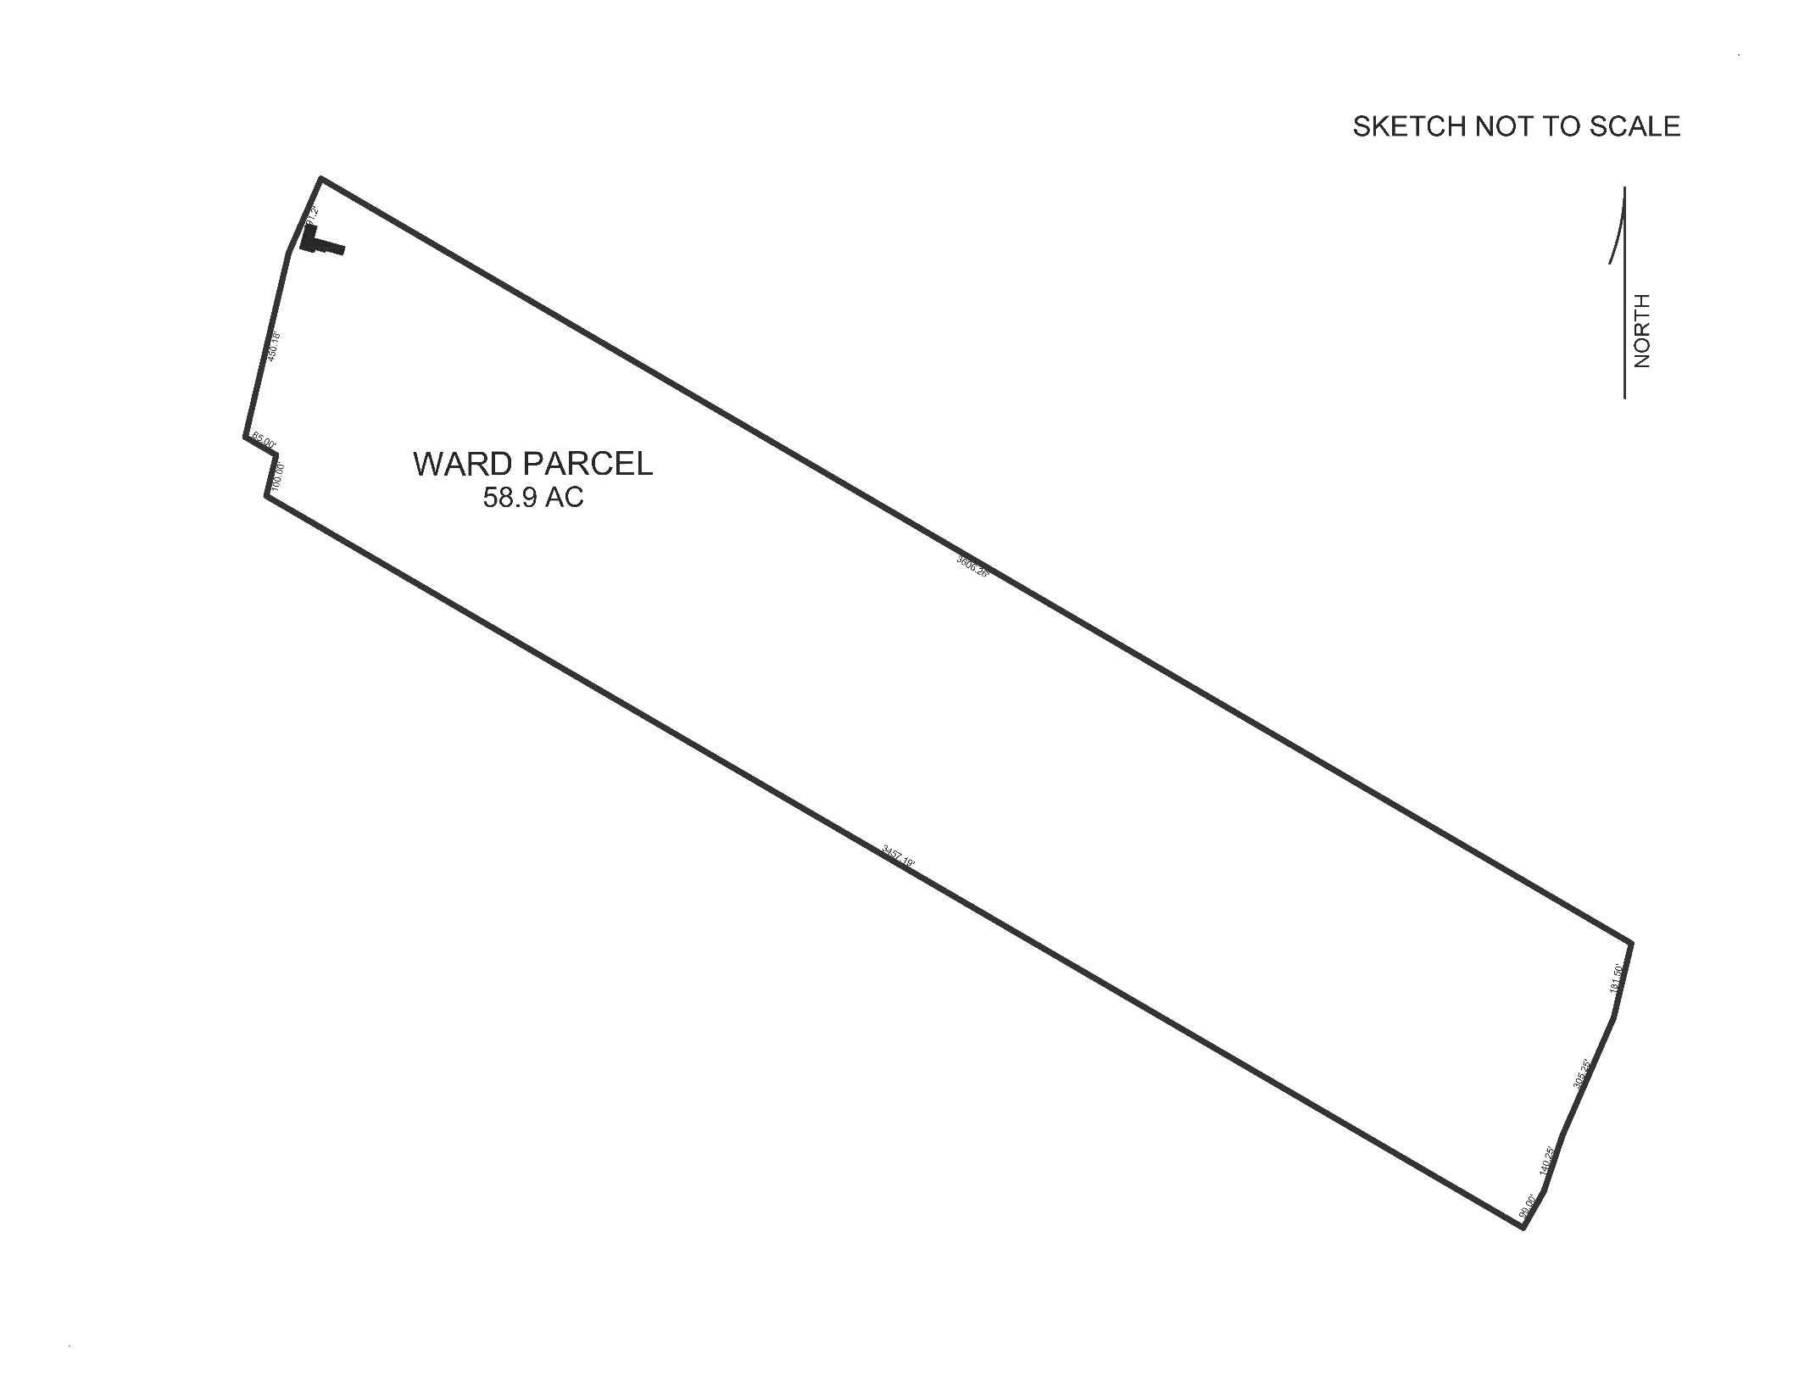
DEED PROBLEM

Slide 21
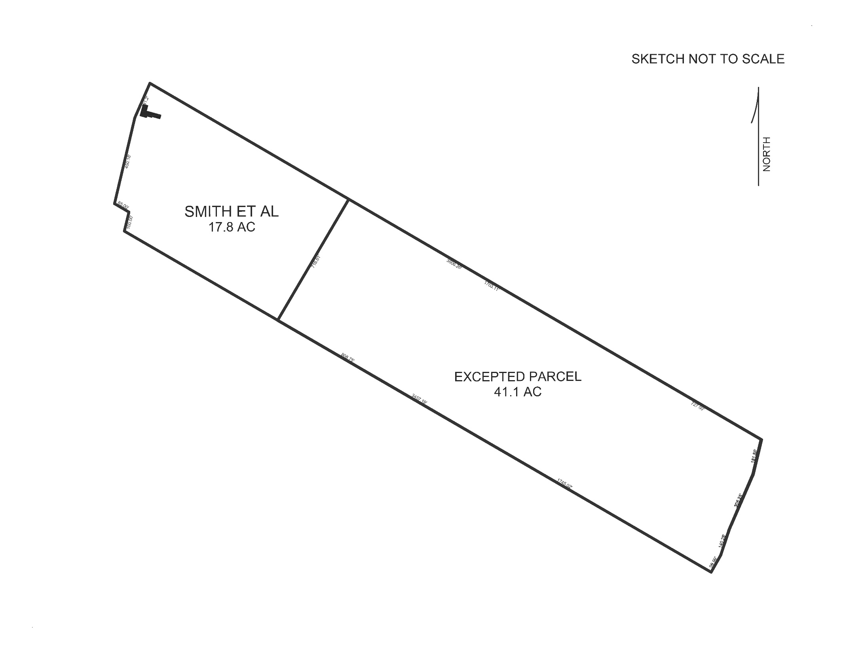
SMITH et al BUY FRONT LOT AND HOUSE
April 30, 2007 Book 3791 Page 290 Smith et al buy property from Ward
April 30, 2007 Book 3791 Page 300 (mortgage, TD Bank)
Book 3830 Page 65 (mortgage signature correction)
http://www.maineregistryofdeeds.com/
https://www.searchiqs.com/mekno/

Slide 22
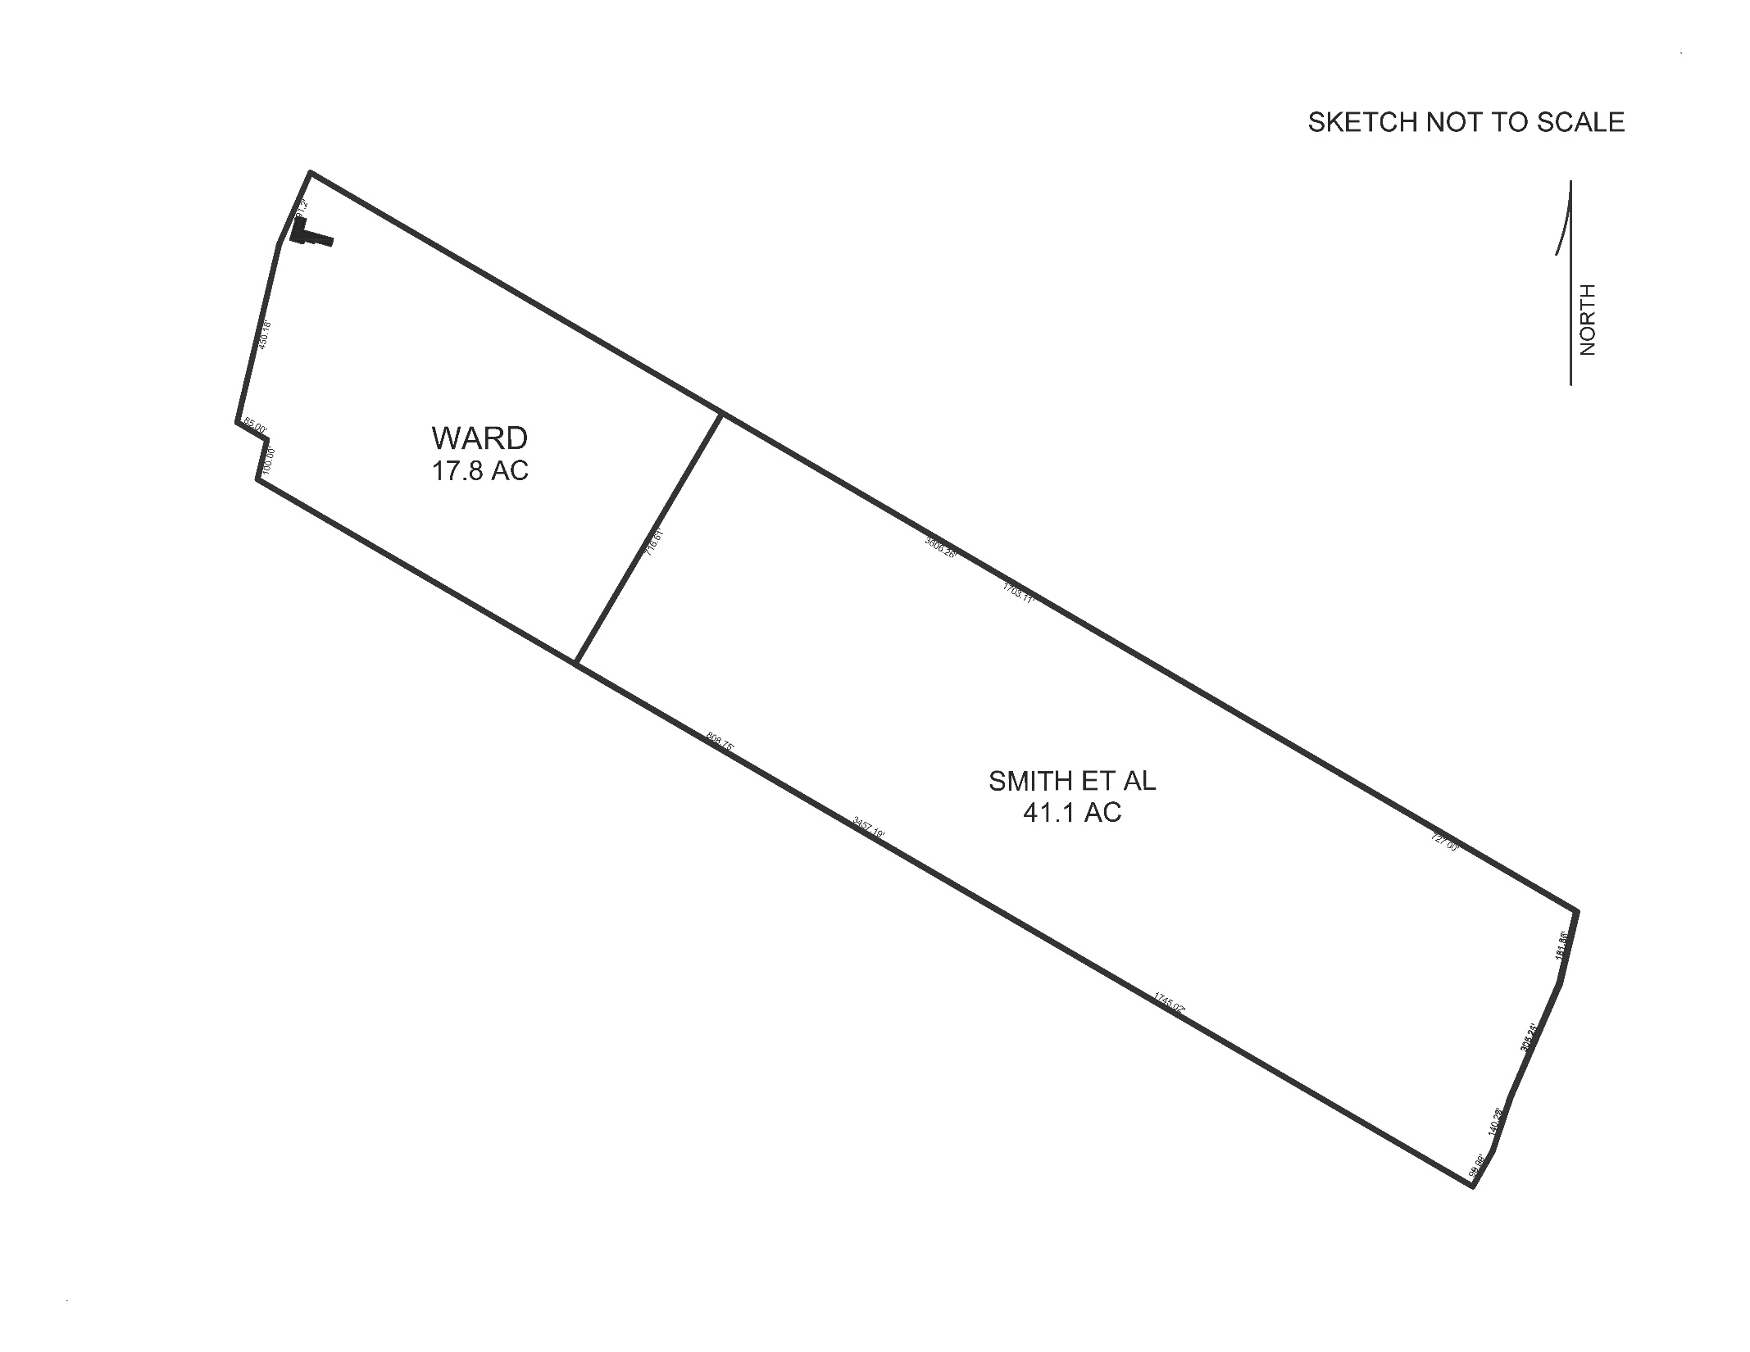
WHAT THEY REALLY MEANT TO DO
March 3, 2008 Book 3934 Page 177
Smith et al back to Constance Ward
“…THE PROPERTY INCORRECTLY CONVEYED…”
February 20, 2008 Book 3934 Page 186
Ward conveys correct parcel to Smith et al.
“…THE CORRECT PARCEL…”
April 21, 2008 Book 3951 Page 240
Loan Modification Agreement with TD Banknorth to correct legal description.
http://www.maineregistryofdeeds.com/
https://www.searchiqs.com/mekno/

Slide 23

WHAT SHOULD THE ASSESSOR DO ?
TELL THE SELLER
TELL THE BUYER
TELL THE REAL ESATE AGENT
TELL THE ATTORNEY
DON’T NOTICE, ASSESS AS CONVEYED
DO NOTICE, ASSESS AS CONVEYED
DO NOTICE, ASSESS AS INTENDED
http://www.maineregistryofdeeds.com/
https://www.searchiqs.com/mekno/

Slide 24
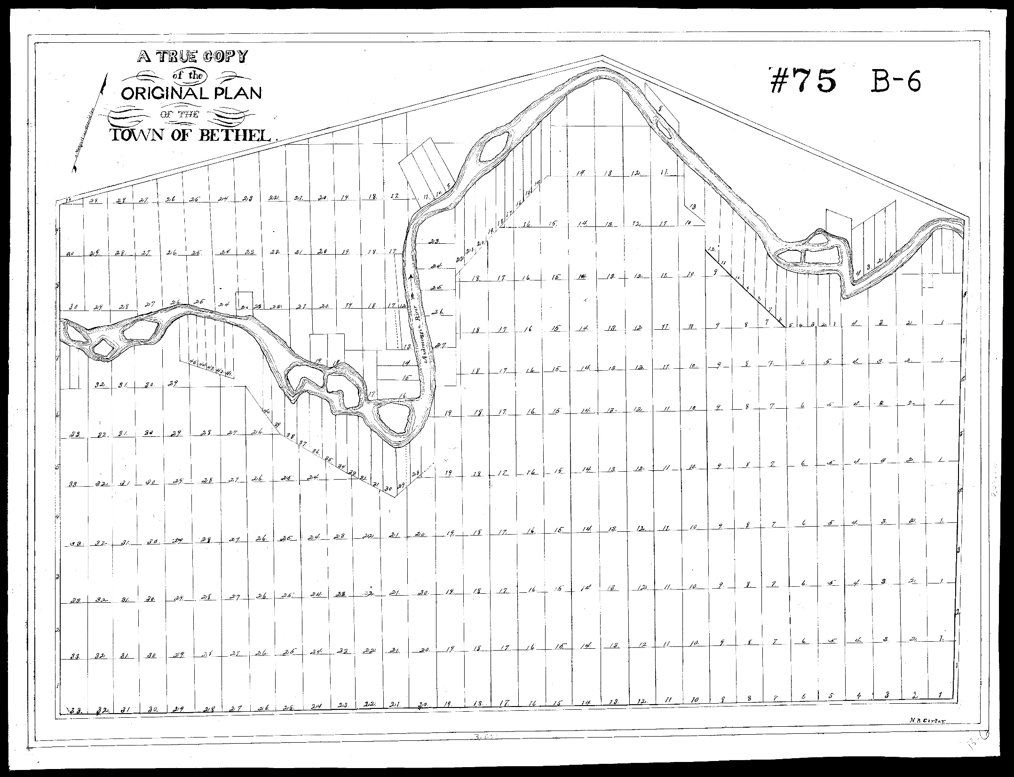
INTERESTING
TOWN LINE
STORY
Oxford County East
Registry of Deeds, Plan 75
1/1/1805

Slide 25
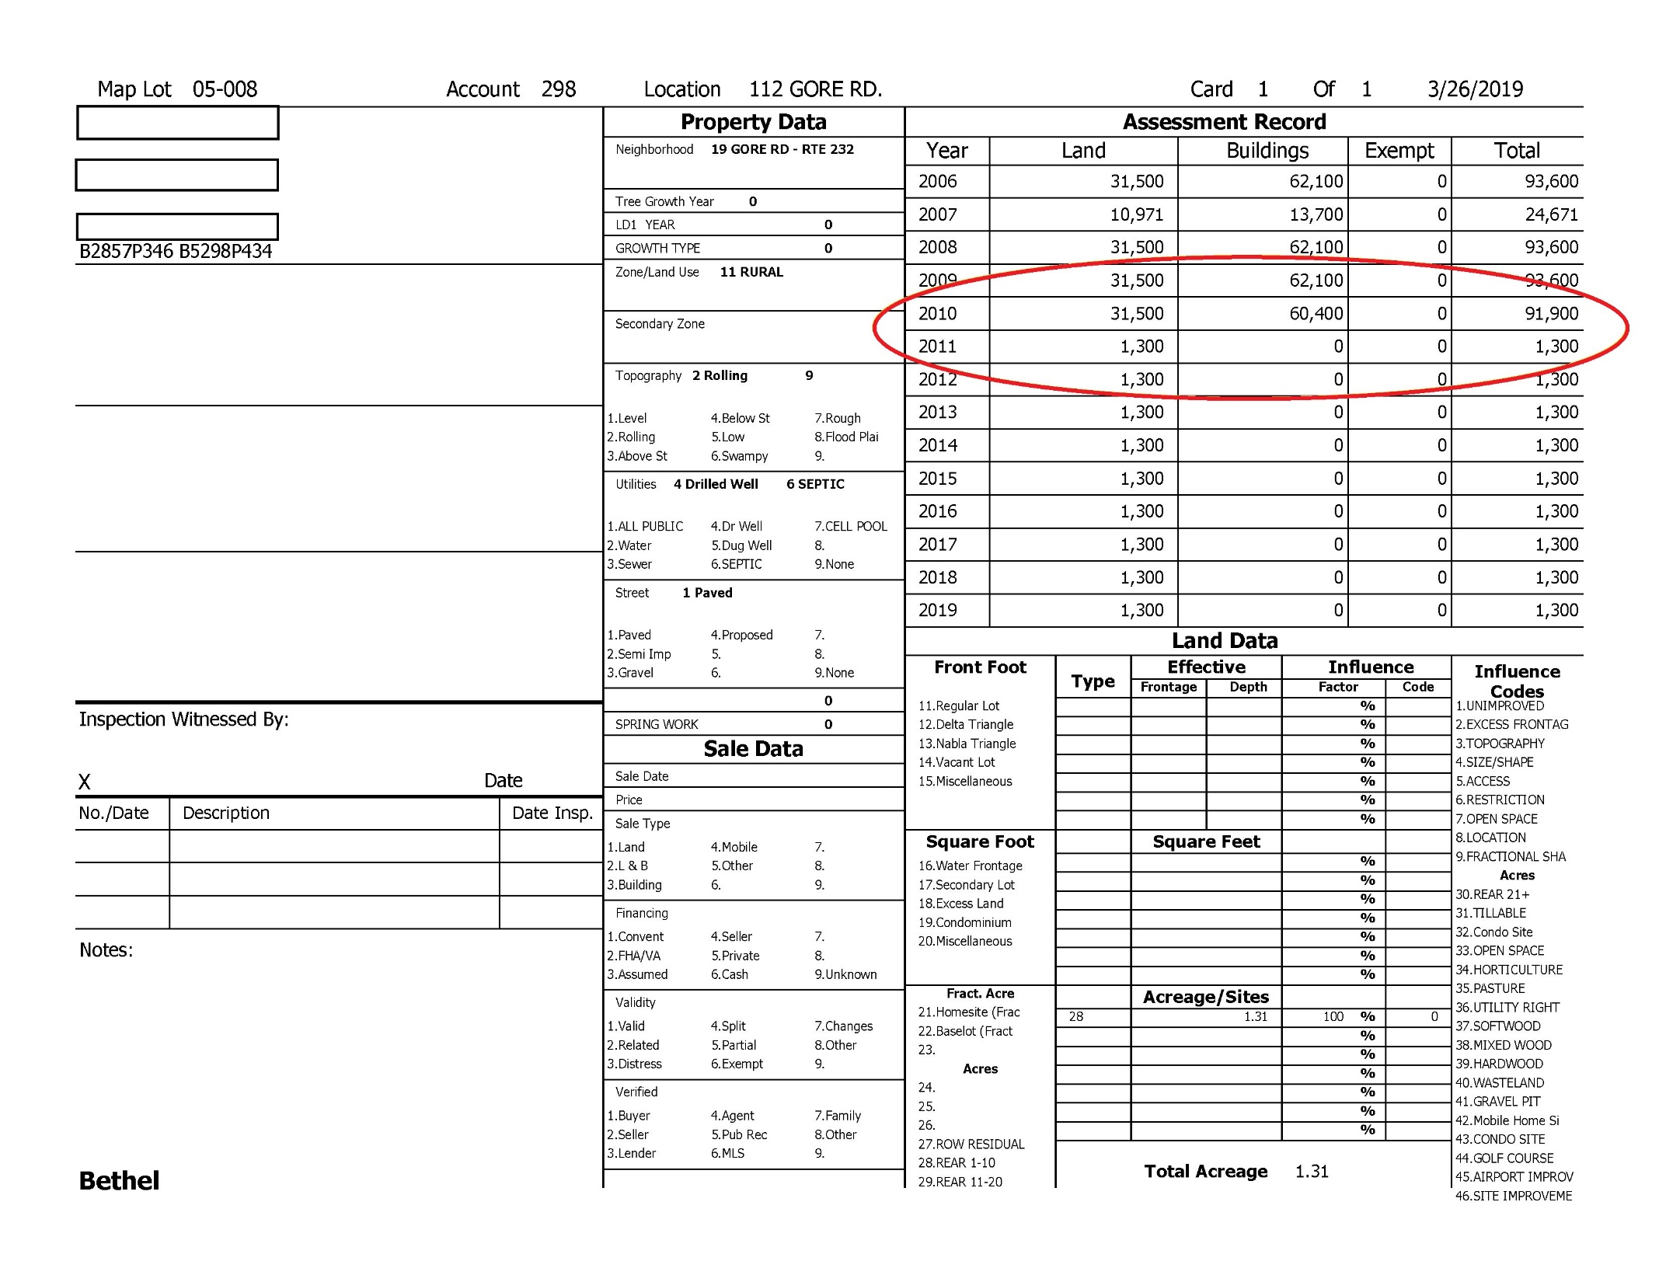
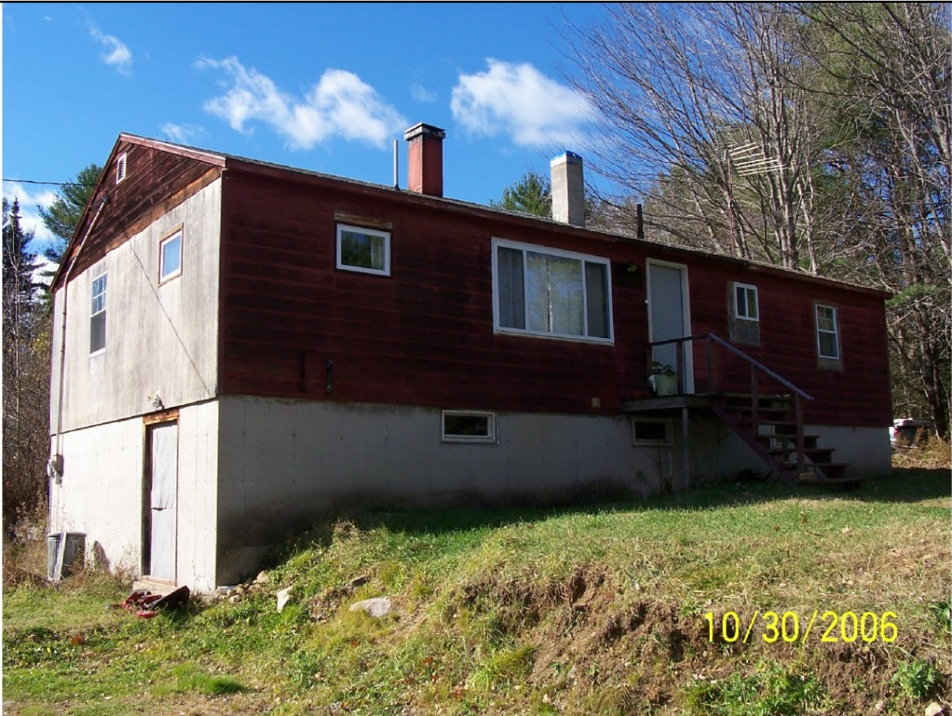

Slide 26
Inhabitants of Bethel vs. Inhabitants of Albany et als. (1876)
“At the September term, 1873, Samuel R. Perley, Rufus Prince, and Augustus H. Walker were appointed commissioners, who on due proceedings had, returned their report at the September term, 1874, describing the line and stating the costs of the commission at $718.25.”
“The petitioners (Inhabitants of Bethel) objected to the acceptance of the (commissioners’) report on the ground that the commissioners’ line, not being straight, was not the line established by the act incorporating Bethel, approved June 10, 1796.”
1876 Me. Vol. 65 Pg. 200, Pulsifer

Slide 27
“Towns are created and their territorial limits defined by the legislature alone, and no other authority can change them Westbrook v. Deering, 63 Maine, 231, Ham v. Sawyer, 38 Maine, 37. When the precise locality of the common limit between adjoining towns is from any cause, so involved in doubt as to become the subject of a controversy among them, the statute has provided a tribunal and conferred upon it the exclusive authority to settle it. Its authority is limited to ascertaining and determining and marking upon the face of the earth the line described in the charter; and such line when thus ascertained and marked shall be deemed in every court of law and for every purpose the true dividing line between such towns” R.S., c. 3, §43. Lisbon vs. Bowdoin, 53 Maine, 324.
1876 Me. Vol. 65 Pg. 200, Pulsifer

Slide 28
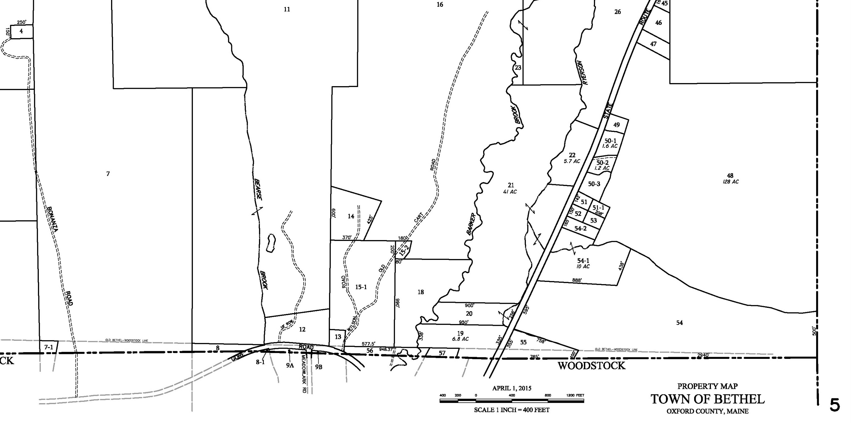
Map courtesy Town of Bethel
https://www.bethelmaine.org/2224/Tax-Maps

Slide 29
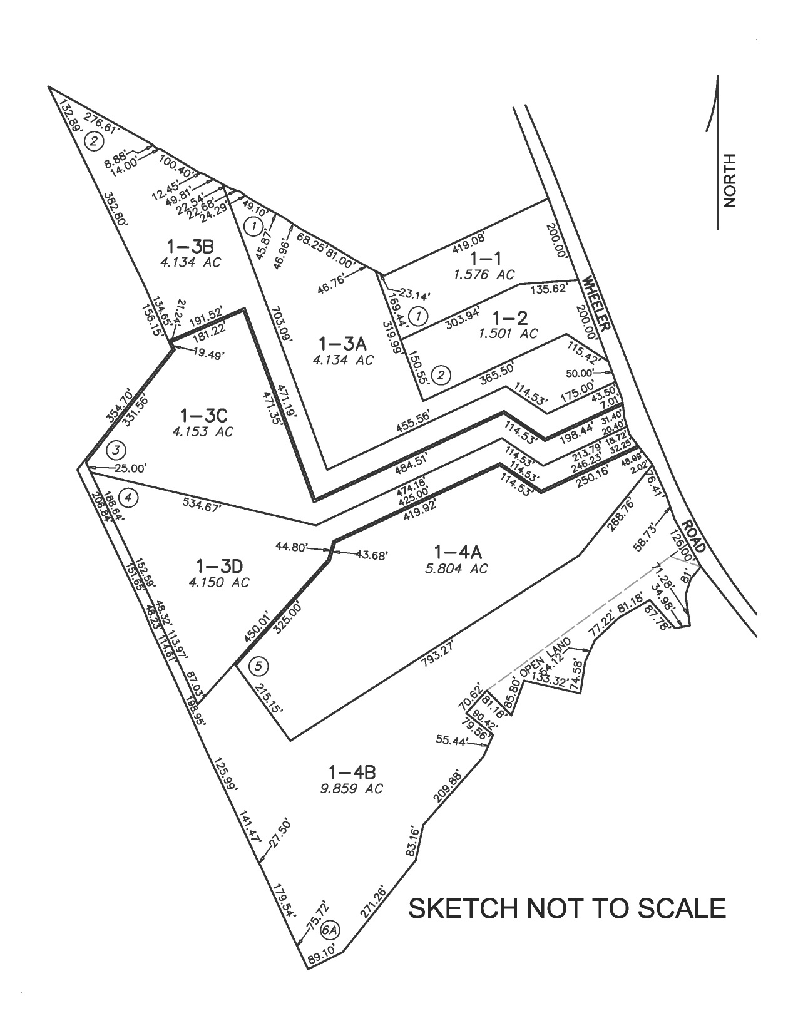
REALLY WEIRD SHAPED LOTS
STANDARD RESIDENTIAL LOTS
1.5 ACRES MINIMUM
200’ ROAD FRONTAGE
HAMMERHEAD RESIDENTIAL LOTS
4.132 ACRE MINIMUM
50’ ROAD FRONTAGE
OPEN SPACE PARCEL CONVEYED TO TOWN
Image courtesy Town of Stow, MA
Map R10

Slide 30
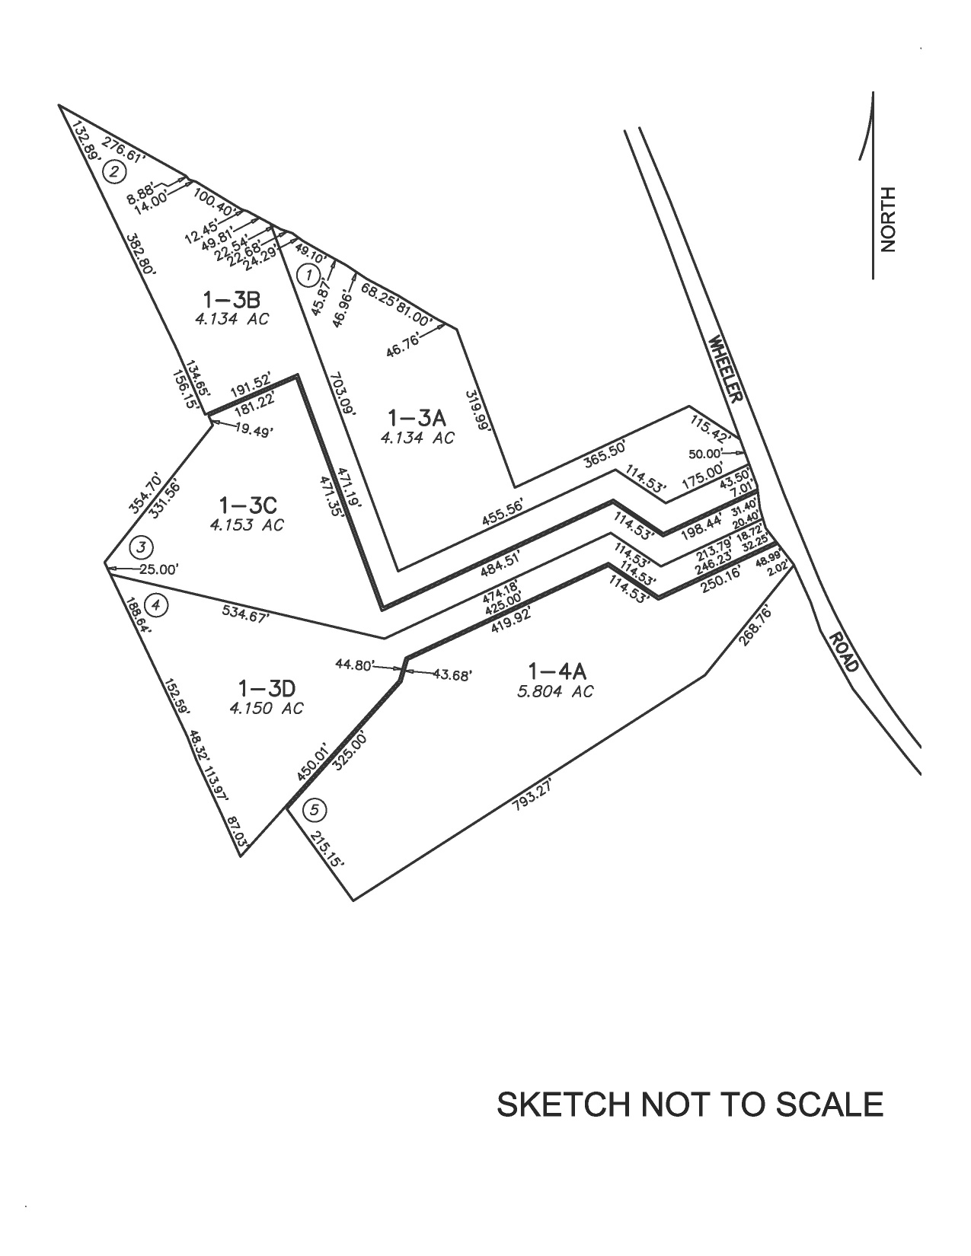
FIVE HAMMERHEAD LOTS
214’ COMBINED ROAD FRONTAGE
22.38 COMBINED ACRES
TWO SHARED DRIVEWAYS
AVERAGE VALUE $651,260
Image courtesy Town of Stow, MA
Map R10

Slide 31
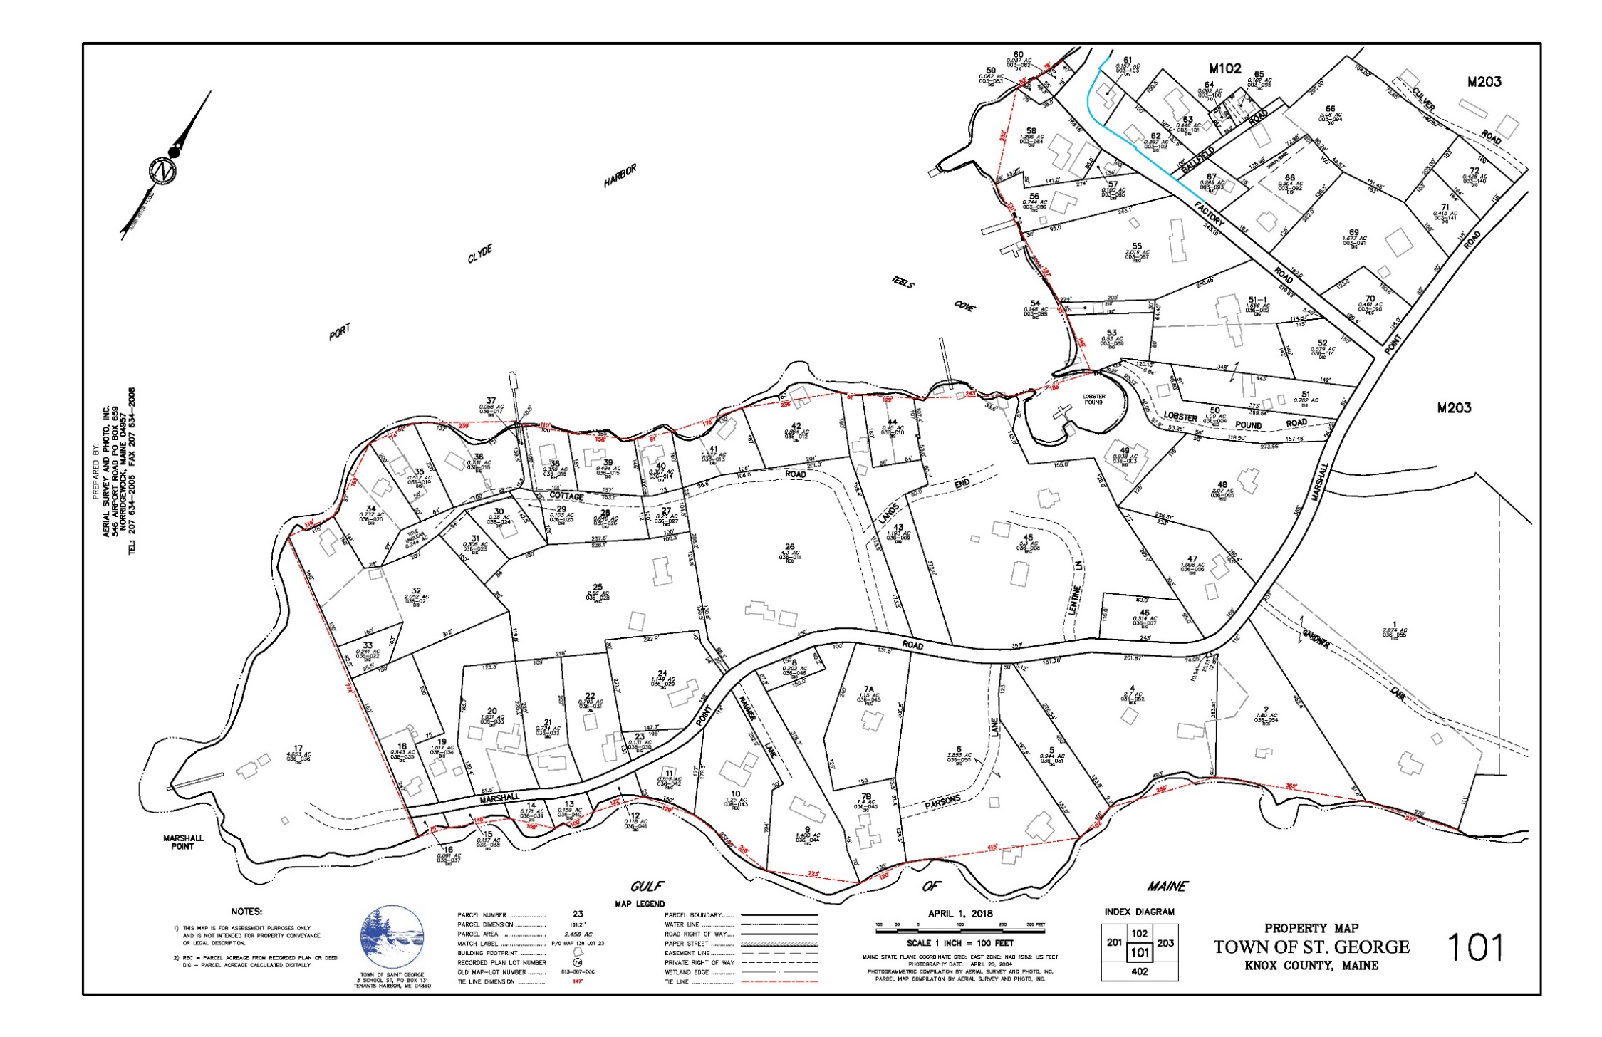
TO MERGE OR NOT TO MERGE
https://www.stgeorgemaine.com/online-services/pages/town-tax-maps

Slide 32
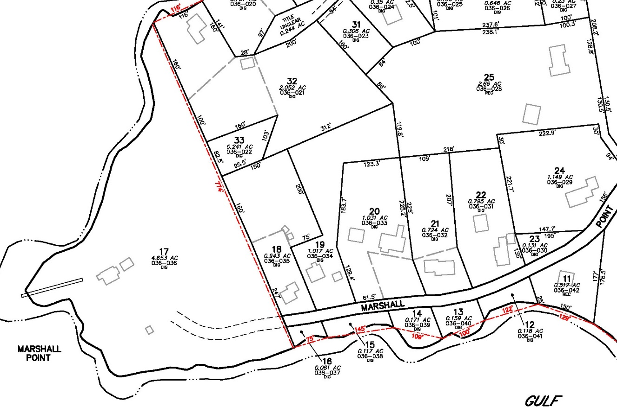
“That’s just Maine”
Cynthia Michaud, CMA, 2010
https://www.stgeorgemaine.com/online-services/pages/town-tax-maps

Slide 33
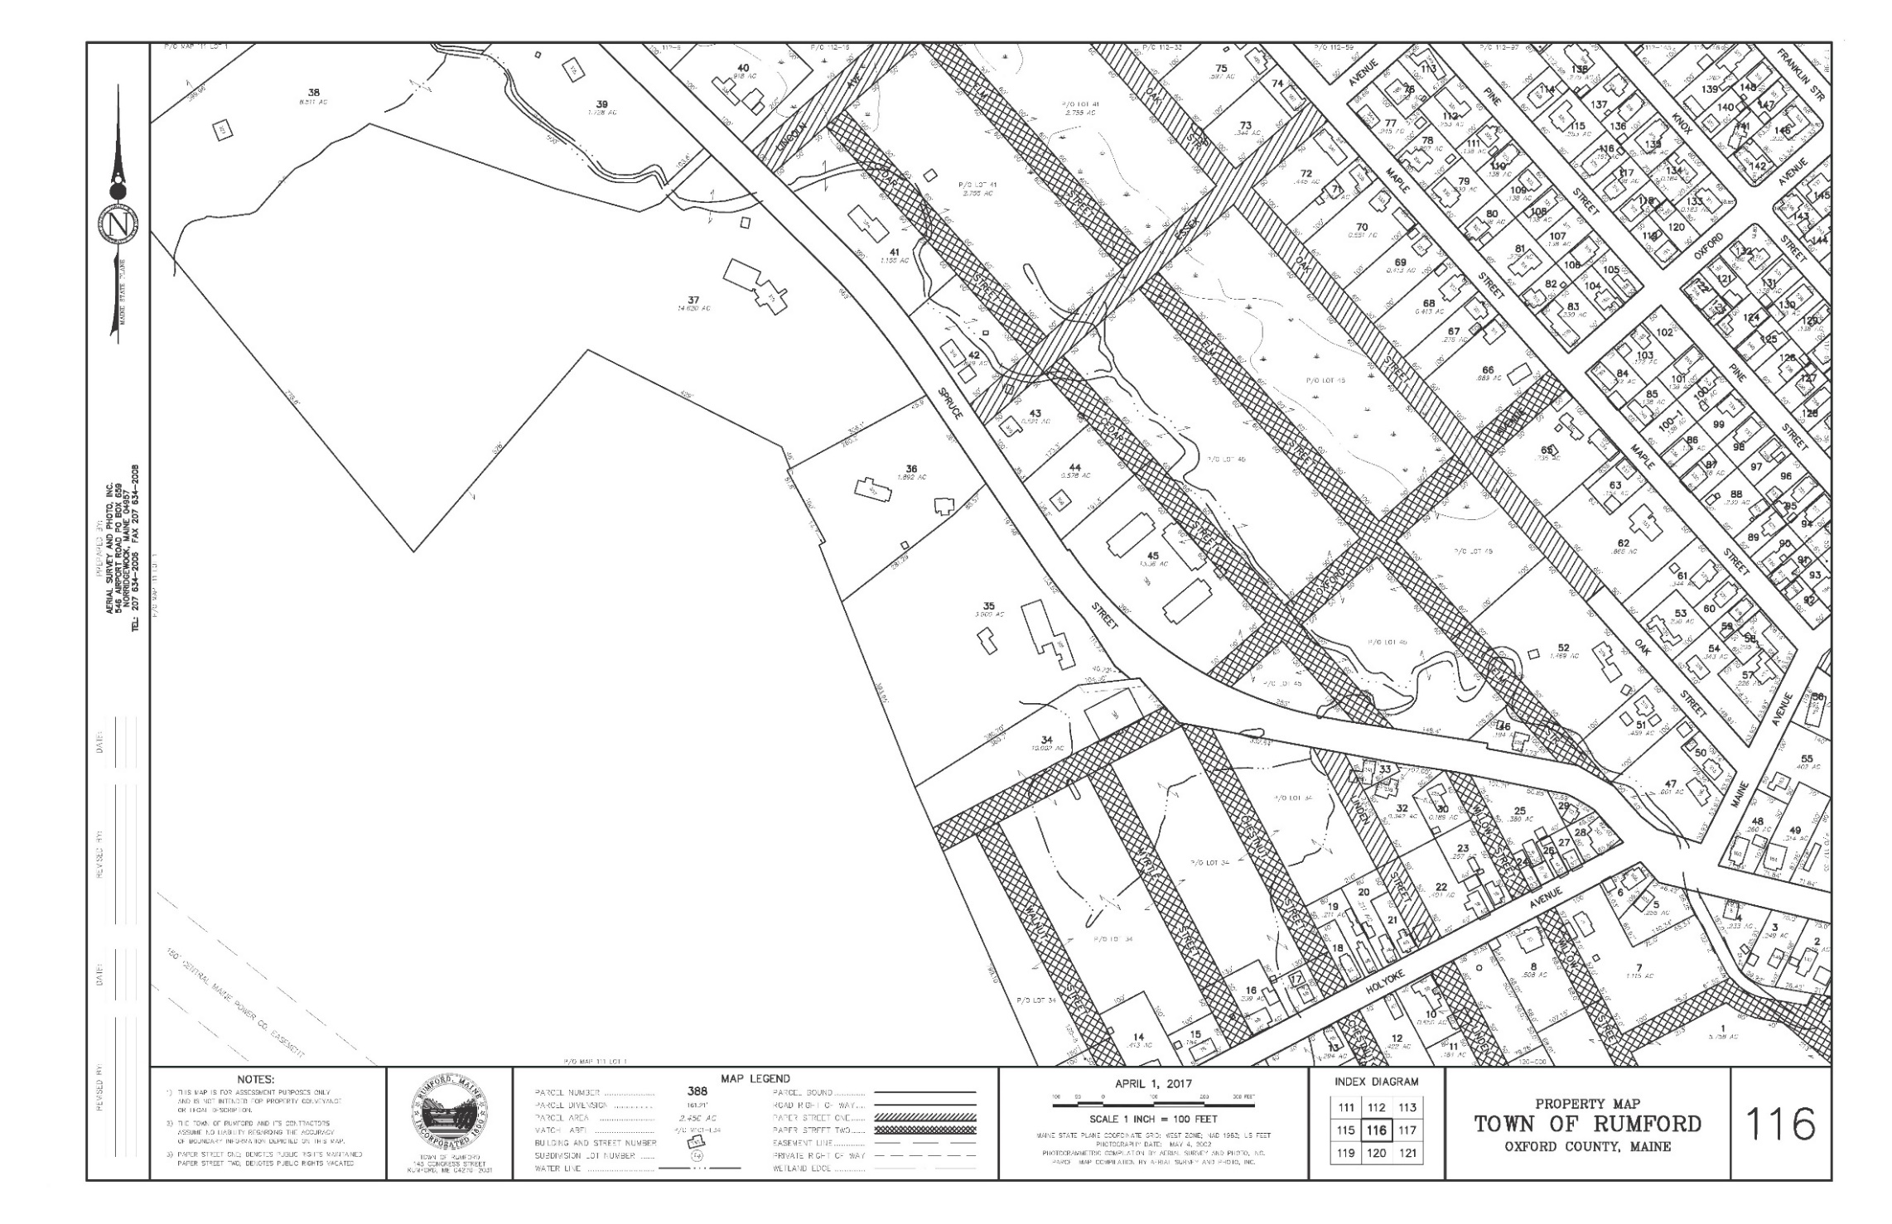
PLANNED BUT UNDEVELOPED
WAYS (PAPER STREETS)

Slide 34
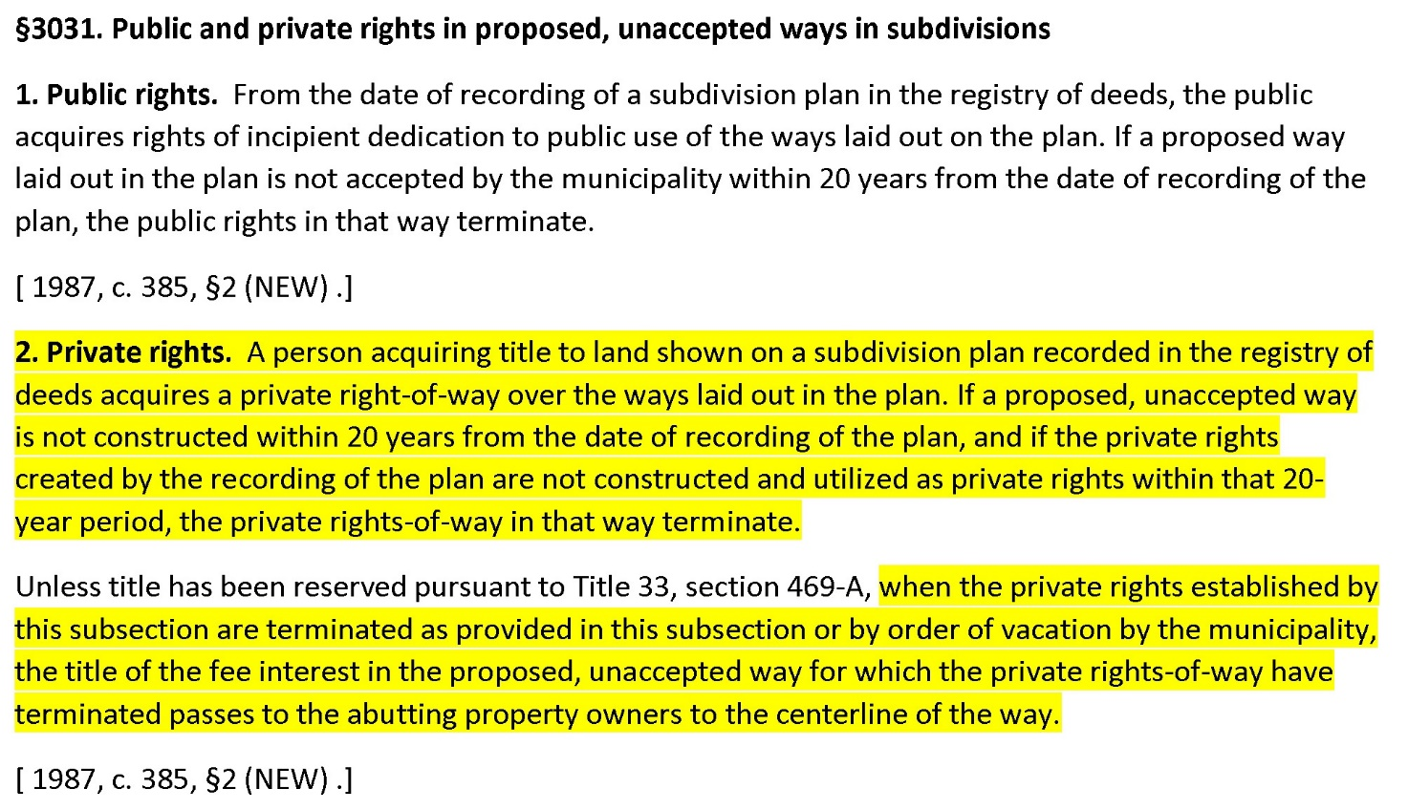
TITLE 23 MRSA (TRANSPORTATION)

Slide 35
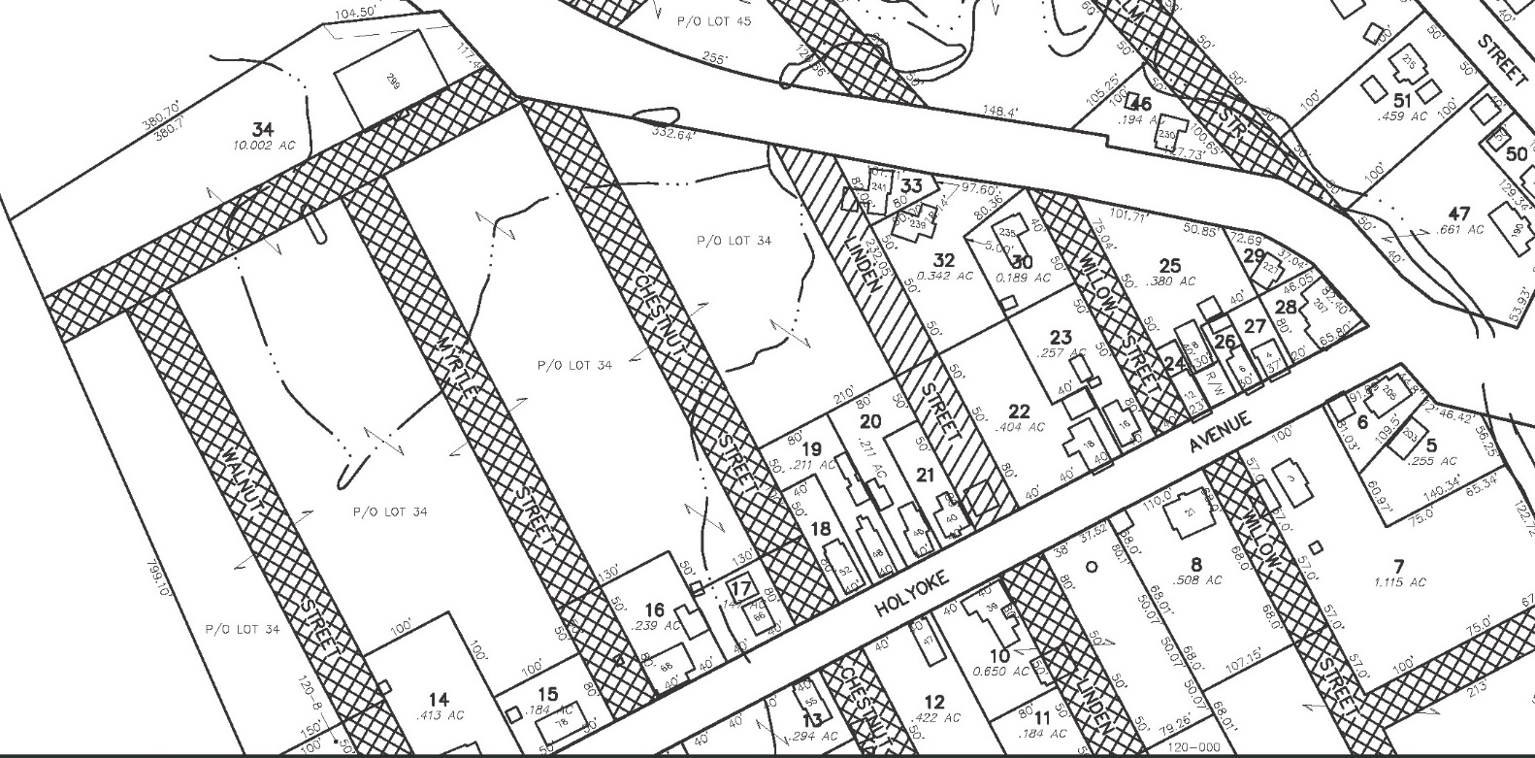
PLANNED BUT UNDEVELOPED WAYS (PAPER STREETS)

Slide 36
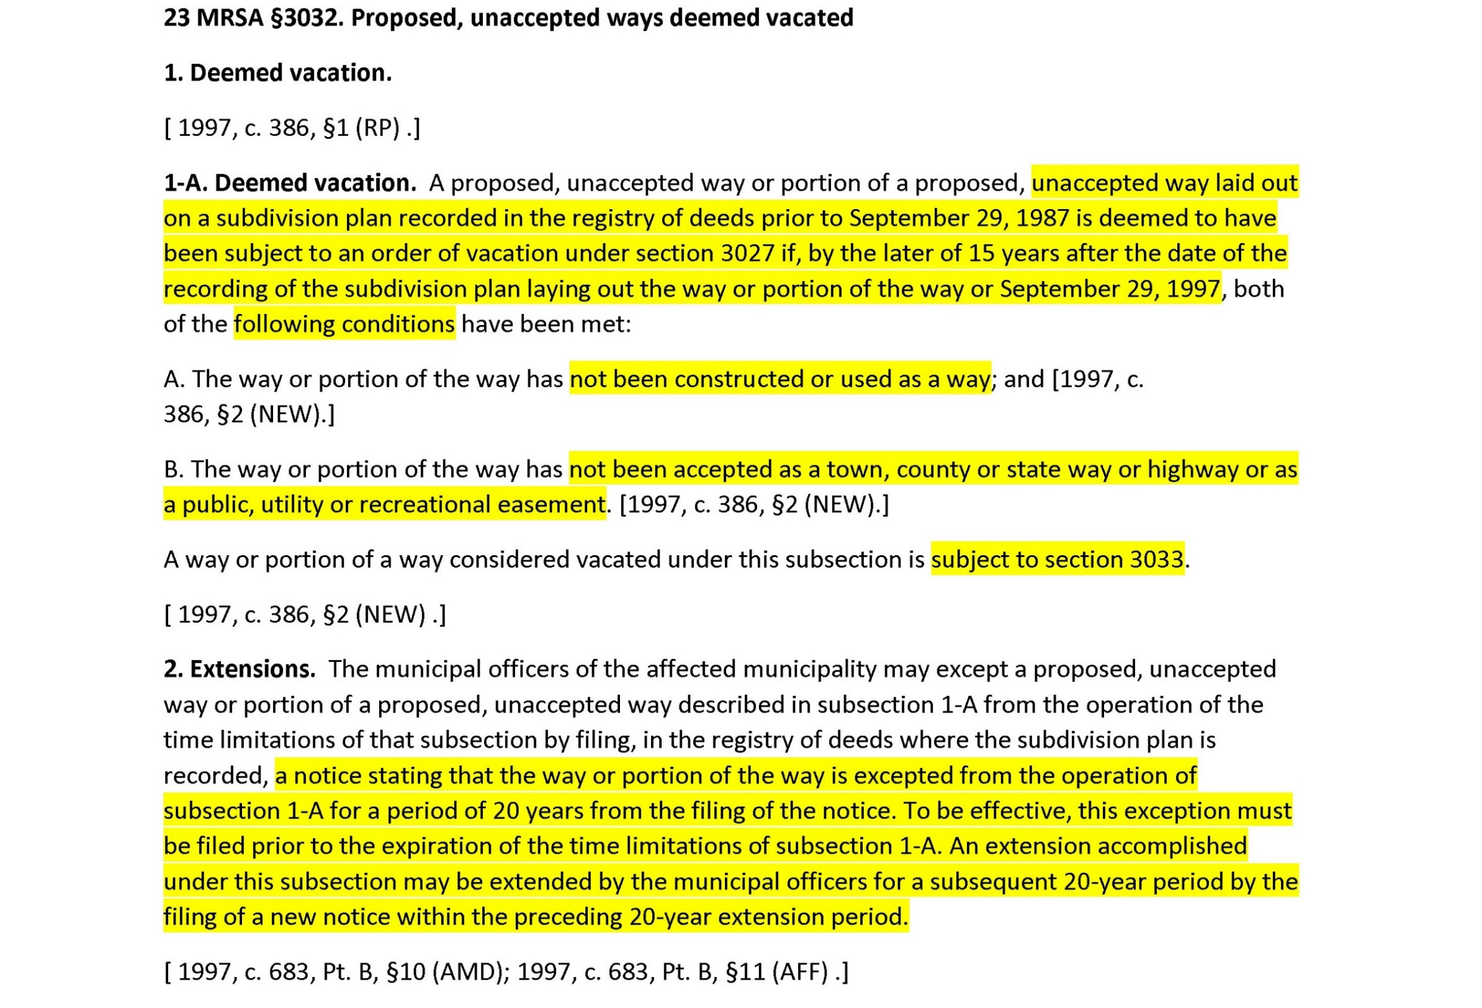
TITLE 23 MRSA (TRANSPORTATION)

Slide 37
MORE ABOUT ROADS…DEVELOPED AND OTHERWISE
TITLE 33 MRSA (PROPERTY)
Chapter 7: CONVEYANCE OF REAL ESTATE
Subchapter 7: TITLE TO ROADS AND WAYS
33 MRSA §460
33 MRSA §462
33 MRSA §465
33 MRSA §466
33 MRSA §467
33 MRSA §468
33 MRSA §469
33 MRSA §469A

Slide 38
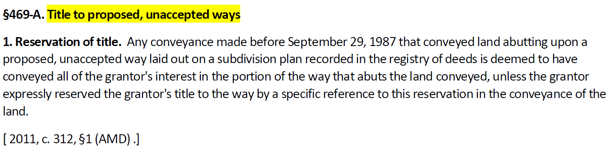
TITLE 33 MRSA (PROPERTY)
Chapter 7: CONVEYANCE OF REAL ESTATE
Subchapter 7: TITLE TO ROADS AND WAYS

Slide 39
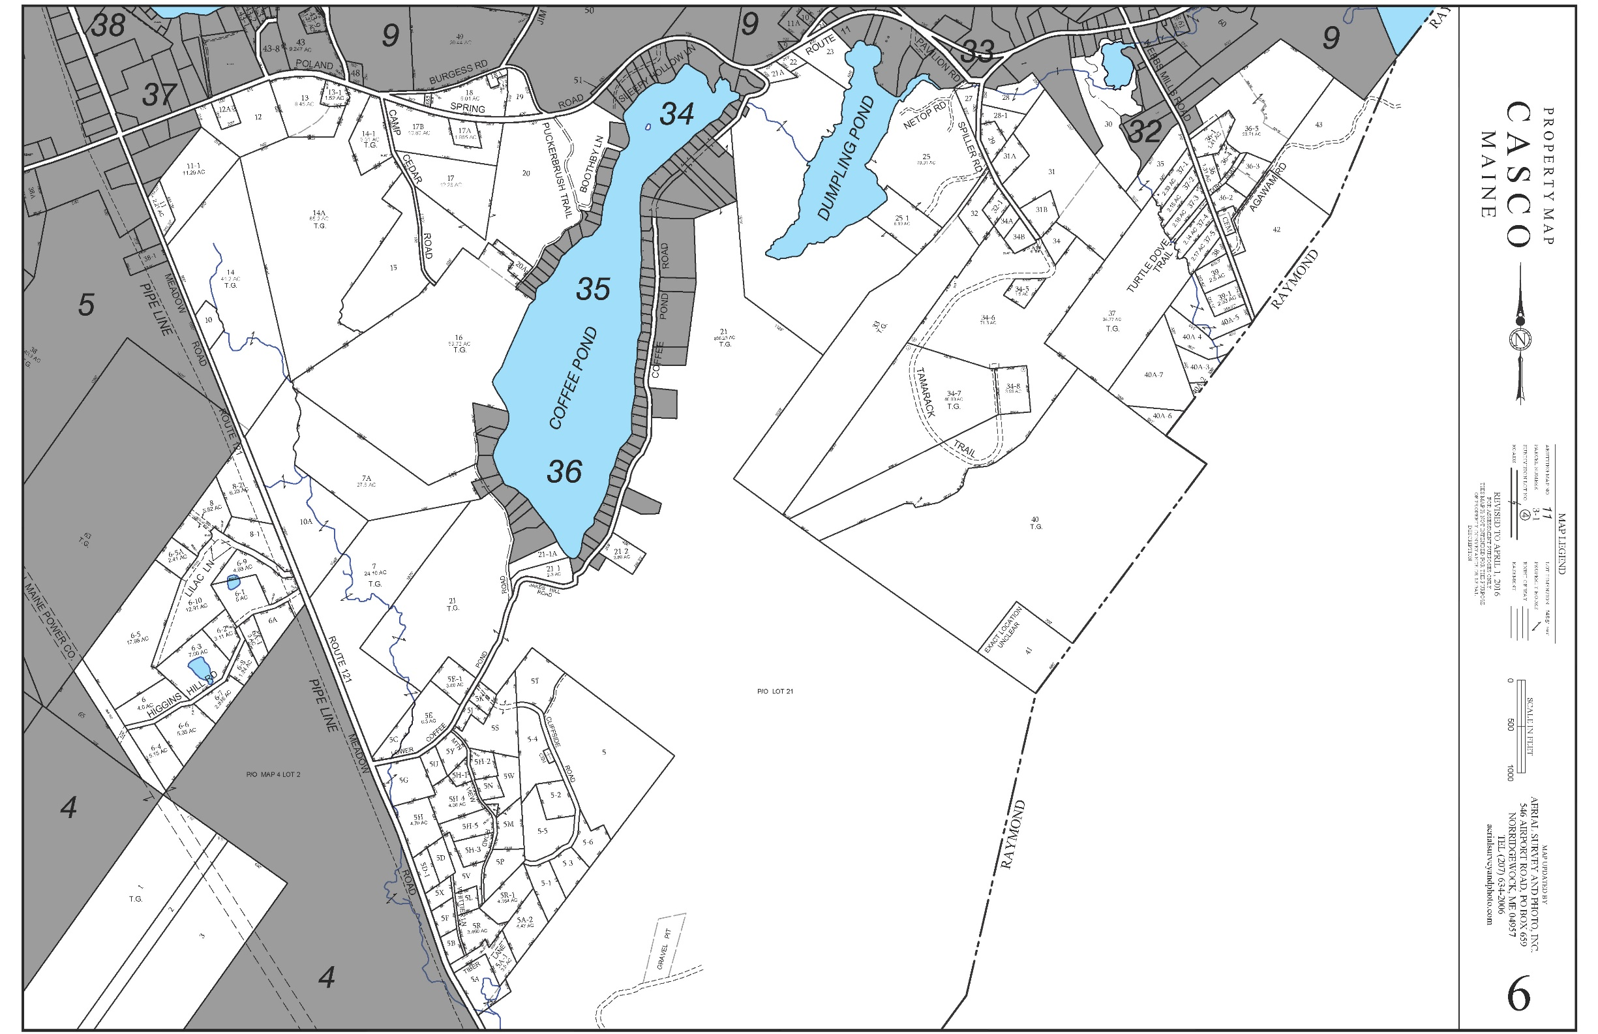
FAMILY SUBDIVISION
Map courtesy Town of Casco

Slide 40
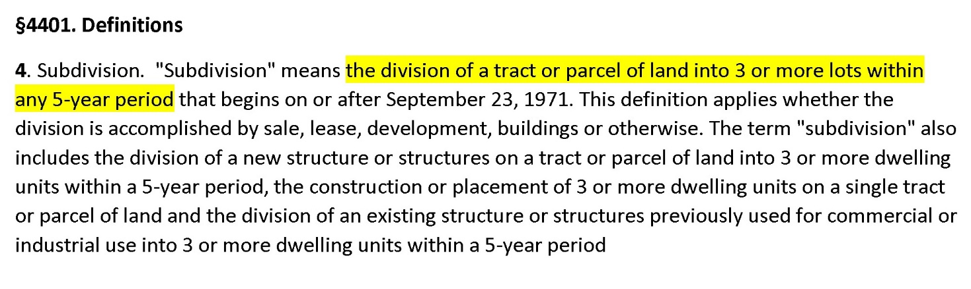
TITLE 30-A MRSA (PROPERTY)
Chapter 187: PLANNING AND LAND USE REGULATION
Subchapter 4: SUBDIVISIONS

Slide 41
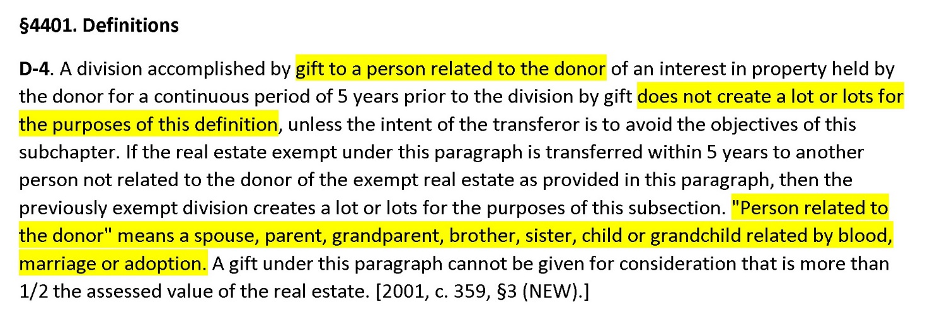
TITLE 30-A MRSA (PROPERTY)
Chapter 187: PLANNING AND LAND USE REGULATION
Subchapter 4: SUBDIVISIONS

Slide 42
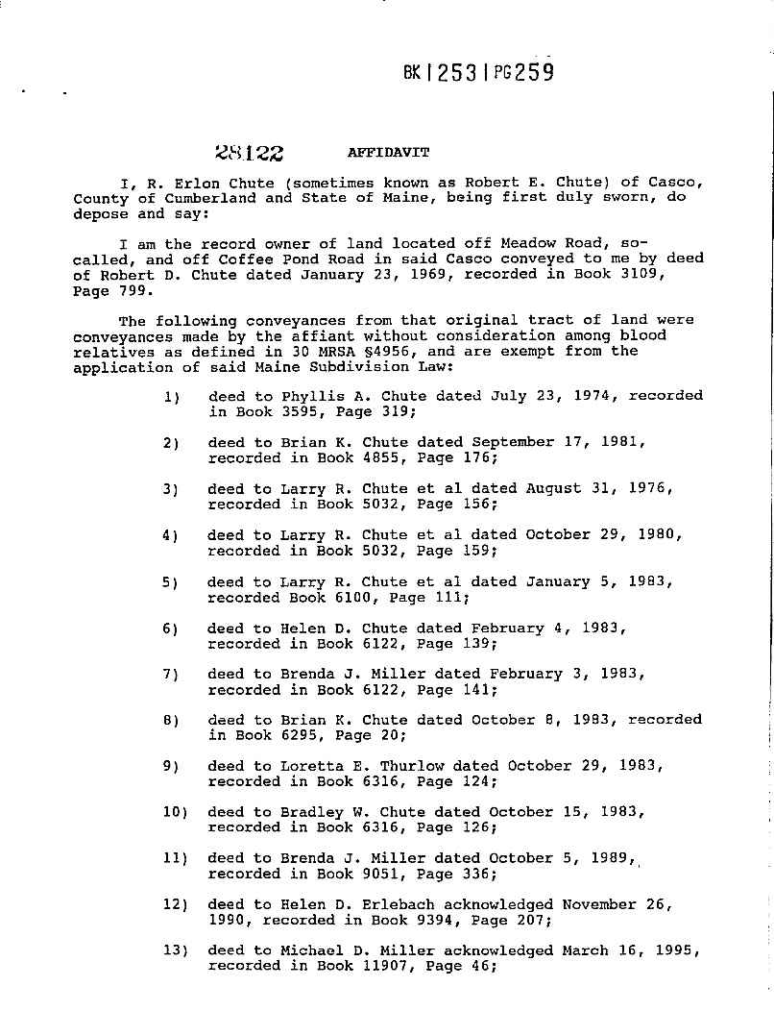
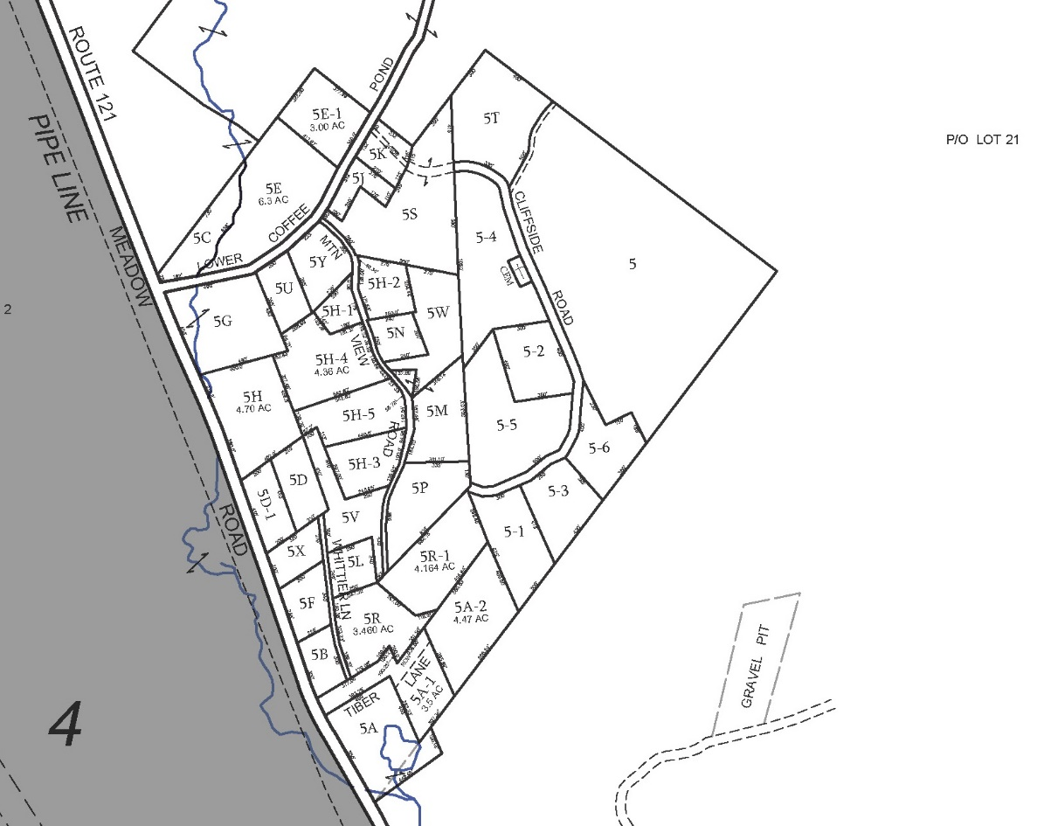
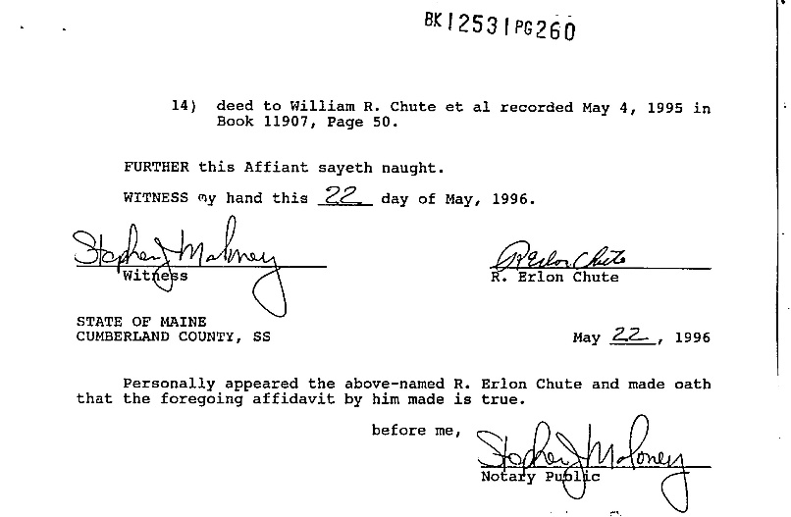
MAP 6 LOT 5
R. Erlon Chute
Bk 3109 Pg 799
1/23/1969

Slide 43
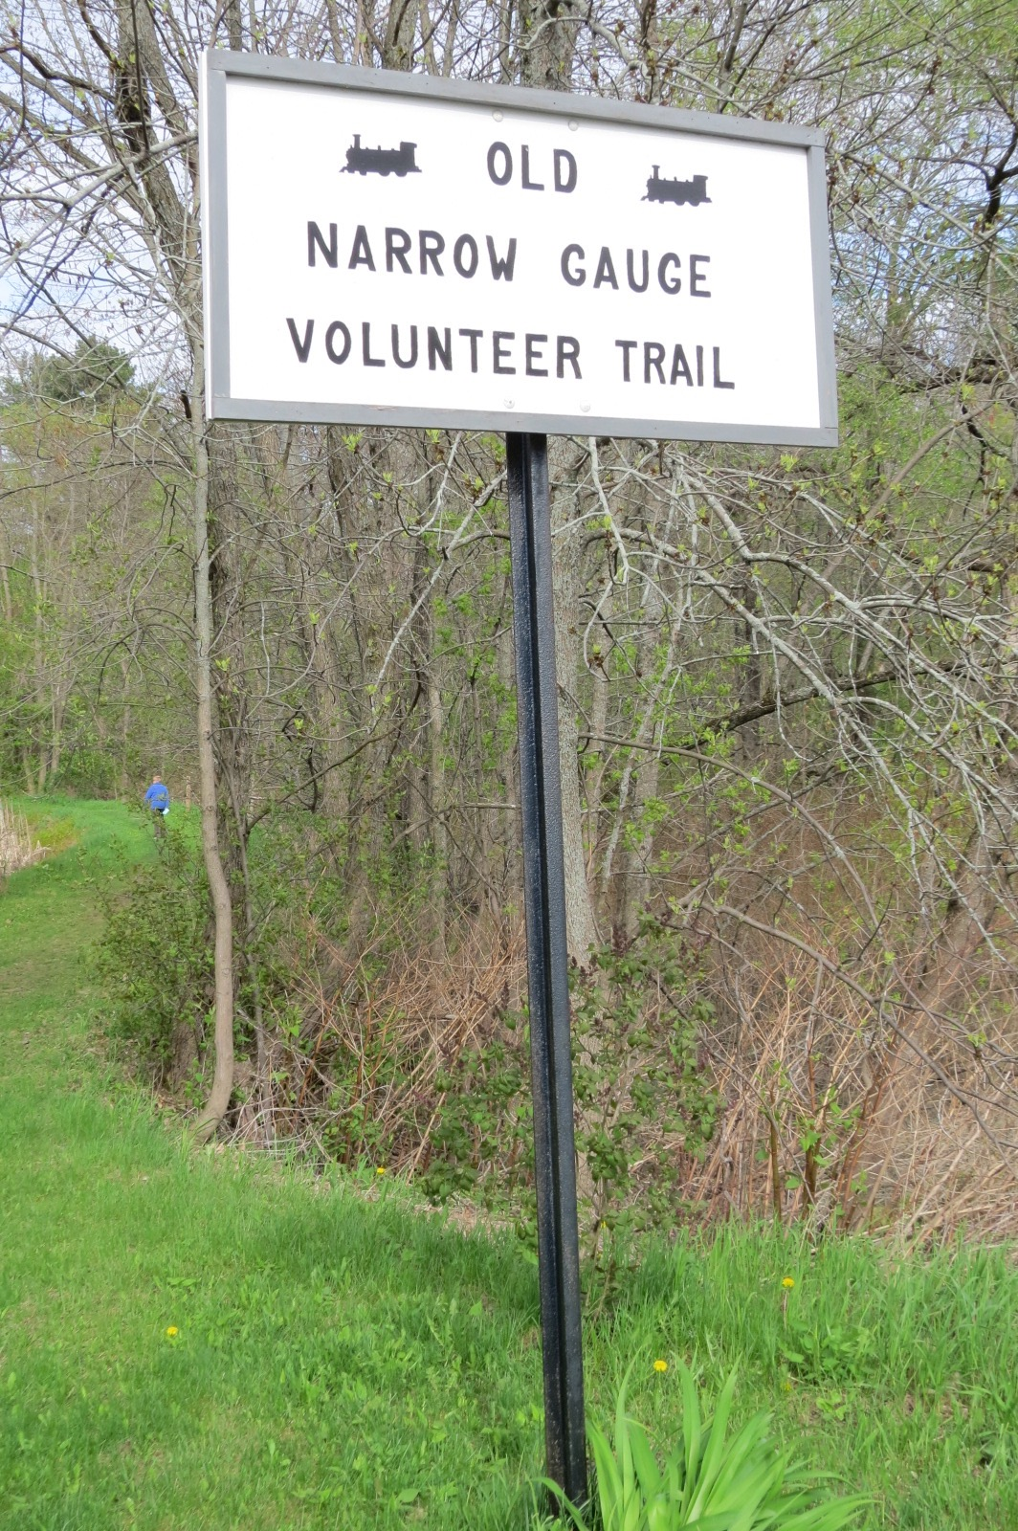
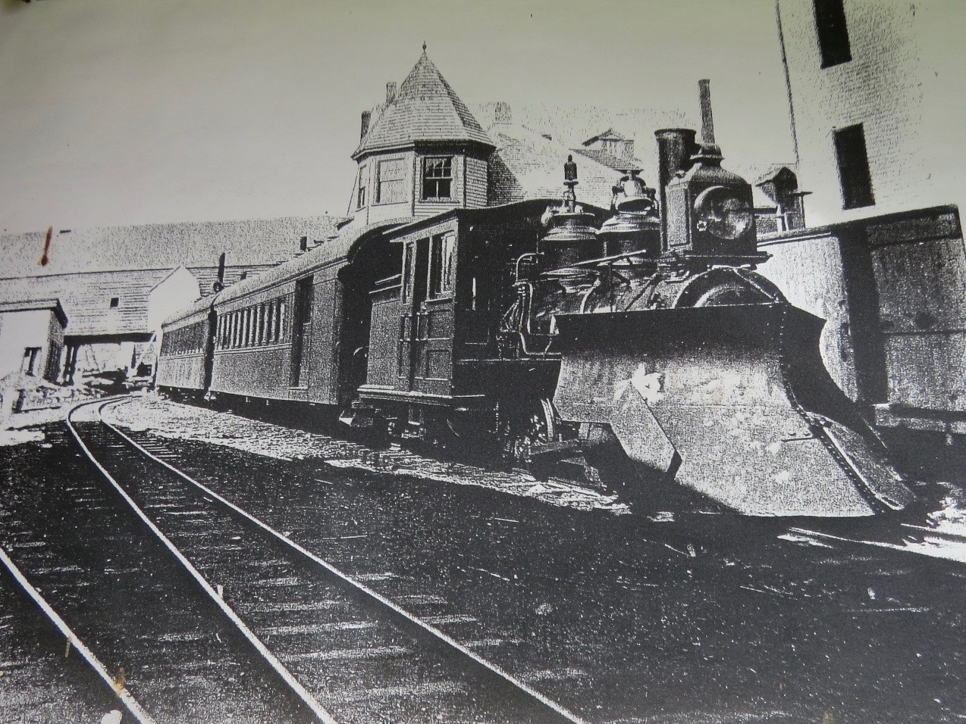
OWNER UNKNOWN?
IMAGE SOURCE: TRAIL HEAD KIOSK, WATER ST., RANDOLPH, MAINE
PHOTO CREDIT: P. MILLETTE

Slide 44
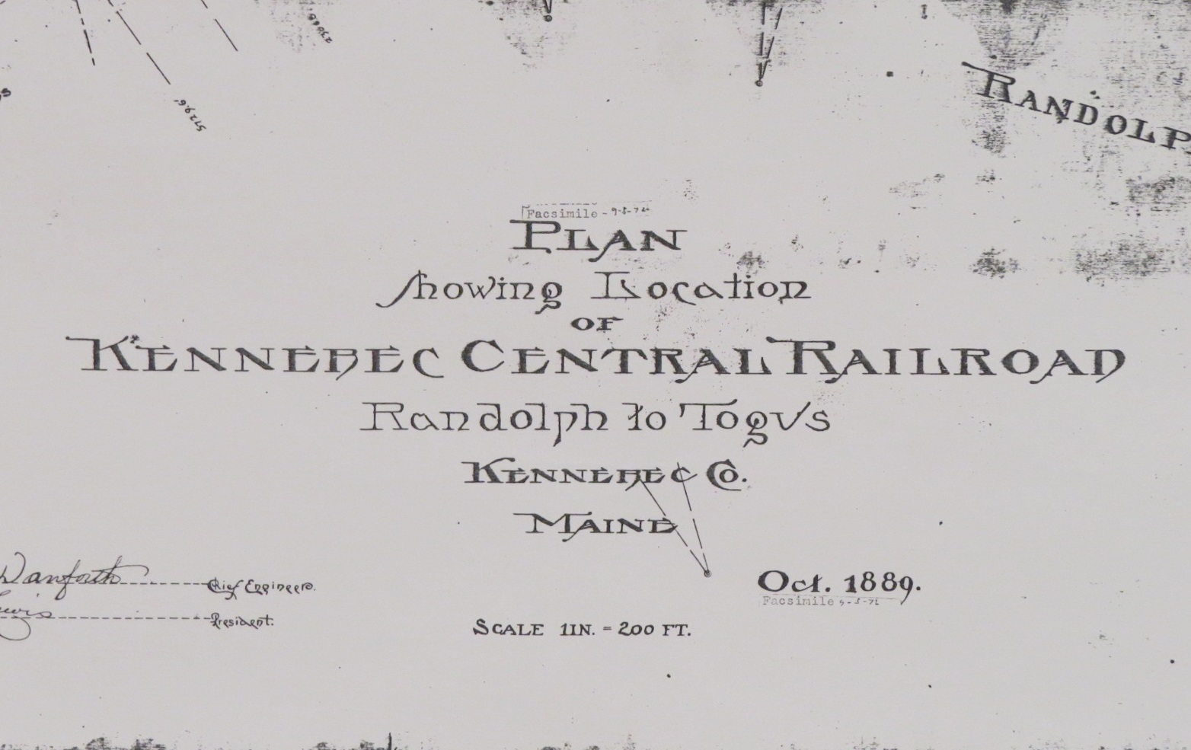
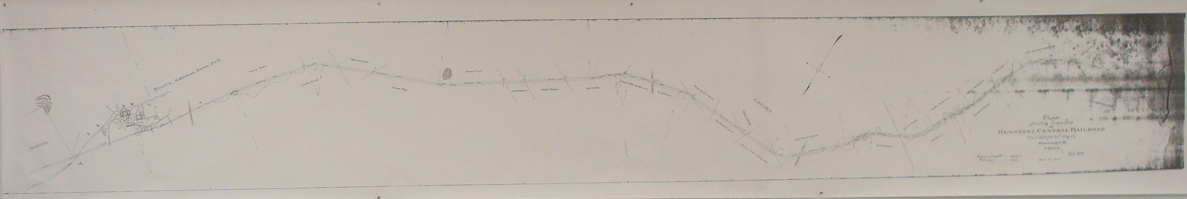
PLAN OF THE KENNEBEC CENTRAL RAILROAD
DRAWN BY CHIEF ENGINEER
FREDERICK DANFORTH, OCTOBER, 1889
RECORDED: PLAN #1-7, KENNEBEC COUNTY CLERK OF COURTS
COUNTY COMMISSIONERS OFFICE
PLAN COURTESY OF DAN ALBERT:
FRIENDS OF THE OLD NARROW GUAGE TRAIL

Slide 45
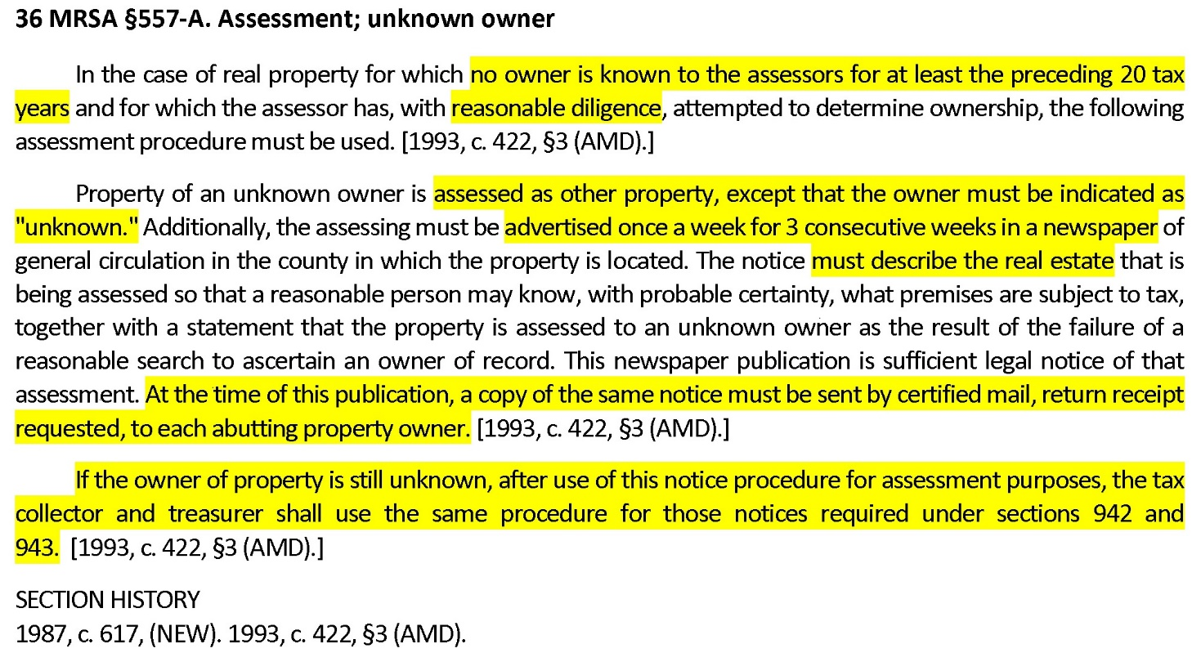
Title 36: TAXATION
Chapter 105: CITIES AND TOWNS
Subchapter 2: REAL PROPERTY TAXES

Slide 46
ADVERSE POSSESSION – EIGHT CONDITIONS
ACTUAL
OPEN
NOTORIOUS
ADVERSE UNDER A CLAIM OF RIGHT
CONTINUOUS
EXCLUSIVE
HOSTILE
20 YEAR TIME PERIOD
RAILROAD PROPERTY IS EXEMPT (MRSA 23 §6025)
ACTION OF RECOVERY BARRED AFTER 40 YEARS (MRSA 14 §815)

Slide 47

Thanks to the following:
Rod Stevens, President, Aerial Survey and Photo, Inc., Norridgewock, Maine.
Dan Walters, National Map Liason – New England, U.S. Geological Survey, Augusta, Maine
The State of Maine GeoLibrary
Kristen Fox, MAA, Town of Stow, MA
Town of St. George, Town of Chelsea, Town of Casco, Maine
Sarah Tucker, Town of Bethel, Maine
Linnell Geronda, CMA, Town of Rumford
Patricia Millette, Ph.D, West Farmington, Maine
Jones, Robert C. Two Feet to Togus. Evergreen Press, Burlington, VT 1999
Barney, Peter S. The Kennebec Central and Monson Railroads. A&M Publishing, 1986
Raymond Hintz, Ph.D., PLS University of Maine
Joseph Young, Former Executive Director Maine GeoLibrary, GIS Administrator, Maine Office of GIS
Lyle, the cat.
Locke Pond, Chesterville. 2017

Slide 48
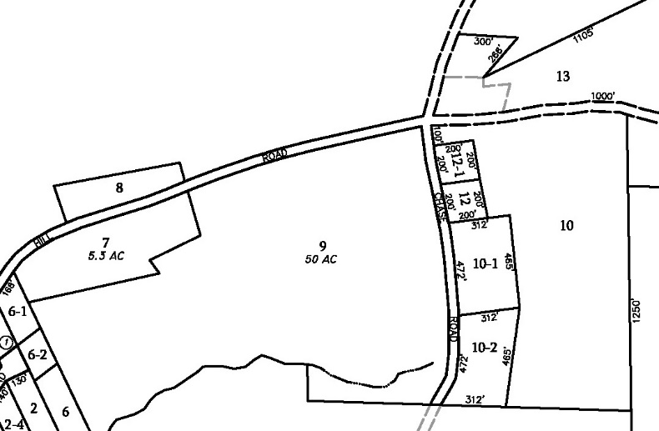
PARTING SHOT
Map 14 Lot 12-1
Mallory
One acre, with house.
HOUSE
Map 14 Lot 12
Nevel
One acre, vacant

Slide 49
PARTING SHOT
Formerly George/Brenda Gould,
Conveyed to Ox. County Savings and Loan, 1967
Conveyed to Tetreault, 1967
Tetreault Mortgage, 1969
Conveyed to Nevel, 1974
HOUSE
Also Nevel, 1983
Nevel sells lot with house to Mallory in 1998, but uses wrong description as basis for new deed to Mallory.

Slide 50
PARTING SHOT
Map 14 Lot 12-1, is occupied by Mallory but with flawed 1998 title describing wrong parcel.
HOUSE
Map 14 Lot 12
Assessed and taxed to Nevel, but lot technically conveyed to Mallory by mistake.
Exchange of corrective deeds recorded, 2018.

