Slide 1
Case Work Notes
A General Overview of Effective Case Work Documentation for Adult Protective and Developmental Services Case Managers
(State and Community)
10/24/2016

Slide 2
What is a Note?
A note:
Documents and reports on meeting the Participant’s needs and desires.
Documents events in the Participant’s life.
Documents actions of Case Manager taken on behalf of Participant.
Is a legal document.

Slide 3
What Should I Write a Note About?
All meetings and follow-up activities related to those meetings.
Ongoing documentation on problematic or unresolved issues and follow-up.
A plan to address needs that are identified but lack a resource to get the need met.
Any life-altering events, including changes in family or marital status, housing situation or arrangements, employment status, etc.
All actions undertaken by the Case Manager or other members of the team related to the Participant’s services.
Medical/Dental updates and changes.
Current Participant Status: Physical appearance (appropriate clothes, good hygiene), mental status, health, safety, and wellbeing.

Slide 4
What Information Should NOT be in a Note?
The name of the referent of a Reportable Event.
Information regarding other Participants receiving services.
Information compiled and correspondence with legal counsel in reasonable anticipation of a civil action or proceeding between the client and agency providing services

Slide 5
Why are Notes Important?
Documents progress towards meeting Participant's needs and desires.
Notes are legal documents.
Ensures continuity of service for Participant.
Improves accountability between the Case Manager and Participant.
Gives the Case Manager credit for the quality of work completed.
Allows oversight of the services being performed.

Slide 6
What Makes a “Good” Note?
Clear, purposeful, and links to the plan of meeting Participant needs and desires.
Free of grammatical and spelling errors.
Must be factual and observable.
Only includes commonly used acronyms or abbreviations.
Not only makes sense to the author, but also to any neutral party.
Assumes that the reader is not familiar with the case.
Covers a specific contact, are not summaries that cover long periods of time. A note must only cover a less than 24 hour period.

Slide 7
What Should be Included in a Note?
Date of Contact
Type of Contact
Observation(s)
Action(s) towards meeting needs and desires of Participant.
Follow-Up
Facts and verified information
Objective statements
Relevant Information
Signature (Electronic is valid)
Click Here
for MaineCare Policy (Section 13 Case Management only).
Click here
for Adult Protective procedure.

Slide 8
Title of the Note (EIS Only)
The Title of the Note must be a clear indication of what is being documented within the note. If there is an emergency or crisis after hours, on the weekend, or during a vacation, other people not as familiar with the case will review the notes and look for relevant and pertinent information to help the Participant.
A poorly titled note can result in valuable information being over looked or take up time during an emergency situation.

Slide 9
Title of the Note (EIS Only)

Slide 10
Date of Contact
Case notes need to document the date of the contact. EIS and MAPSIS usually prompt you for this, but it’s up to you to enter it correctly

Slide 11
Date of Contact - EIS

Slide 12
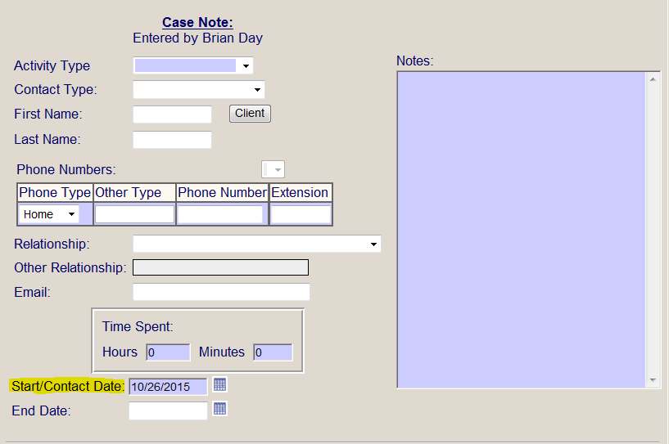
Date of Contact - MAPSIS

Slide 13
Type of Contact
EIS and MAPSIS give options for what type of contact a note can cover, though the Case Manager must document the place of the contact and the person/people contacted.
Full names should be used, clear relationship to the Participant identified in each note, and their role in the Participant’s life. If the person is a provider their service and the agency should be identified.

Slide 14
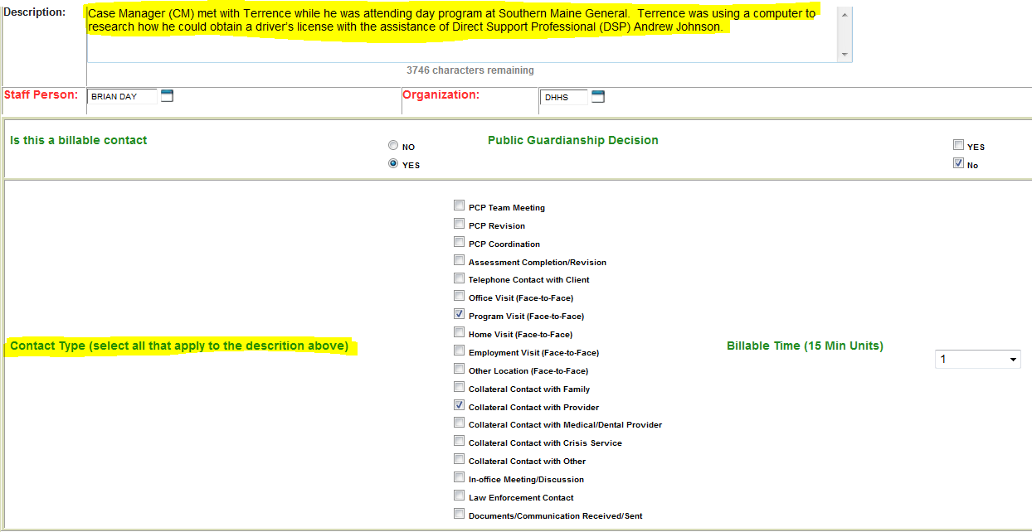
Type of Contact - EIS

Slide 15
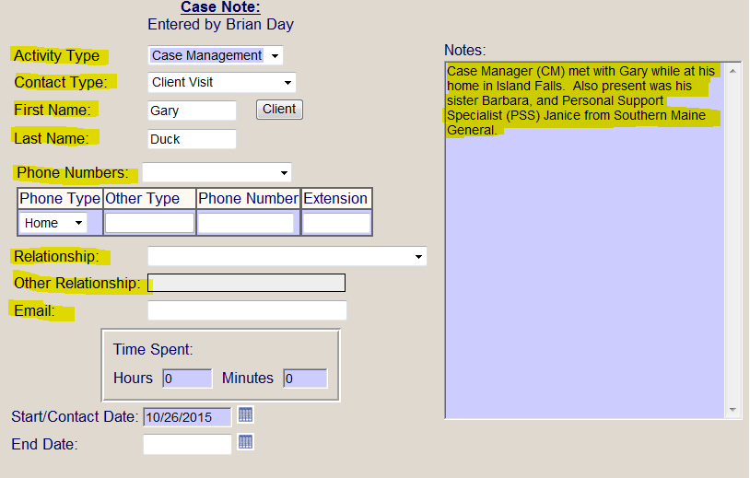
Type of Contact - MAPSIS

Slide 16
Observation(s)
Issues regarding the Participant’s quality of life, satisfaction with services, current life situations, any and all health and safety issues.
Personal opinions, judgments or subjective perceptions must not be included in the case note.

Slide 17
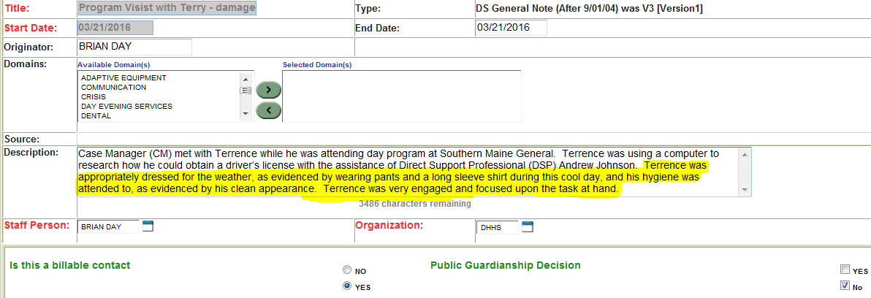
Observation(s) – EIS
Terrence was appropriately dressed for the weather, as evidenced by wearing pants and a long-sleeve shirt during this cool day….

Slide 18
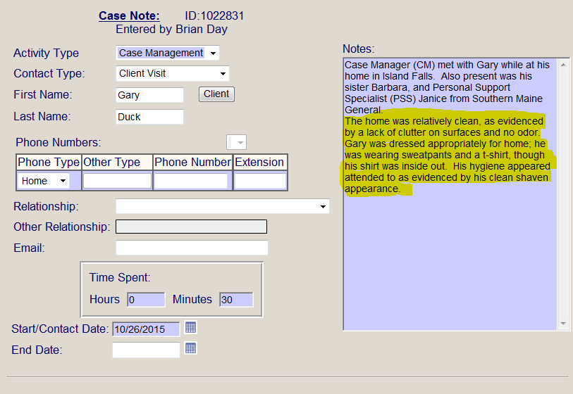
Observation(s) – MAPSIS
The home was relatively clean, as evidenced by a lack of clutter on surfaces and no odor…

Slide 19
Action(s)
Actions that have taken place or take place during the contact.
What happened as a result of the contact with the Participant/provider/family member, etc.
Actions should have a clear link to the Plan or document progress towards meeting needs and desires of Participants.

Slide 20
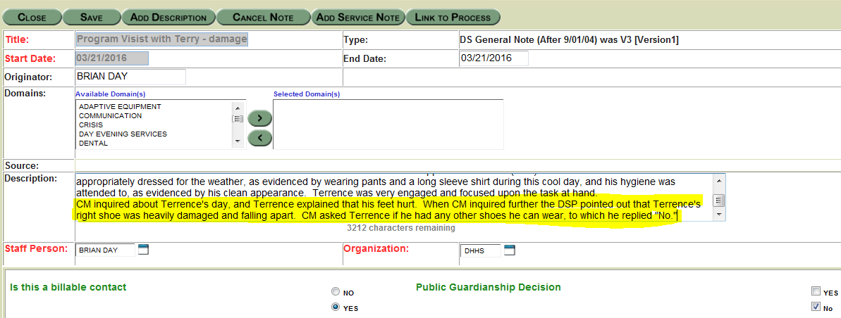
Action(s) - EIS
CM inquired about Terrence’s day, and Terrence explained that his feet hurt…..

Slide 21
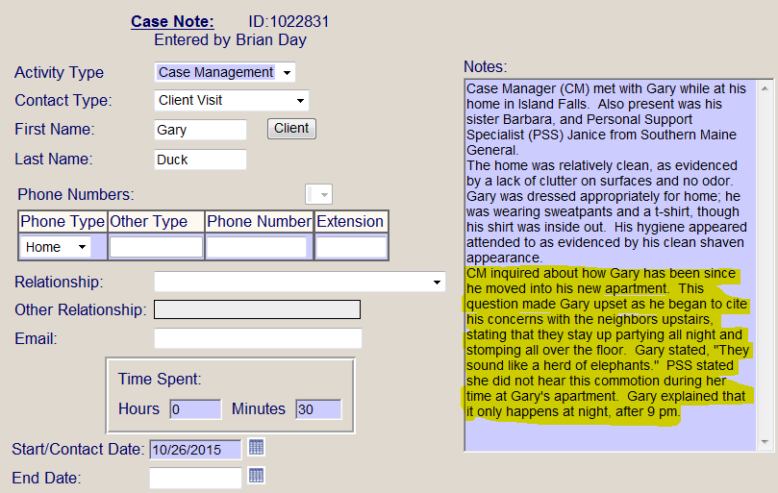
Action(s) - MAPSIS
CM inquired about how Gary has been since he moved into his new apartment. This question made Gary upset as he began to cite his concerns about the neighbors upstairs…

Slide 22
Follow-Up
The follow-up includes the actions which need to take place.
What needs to happen and who will do it.

Slide 23
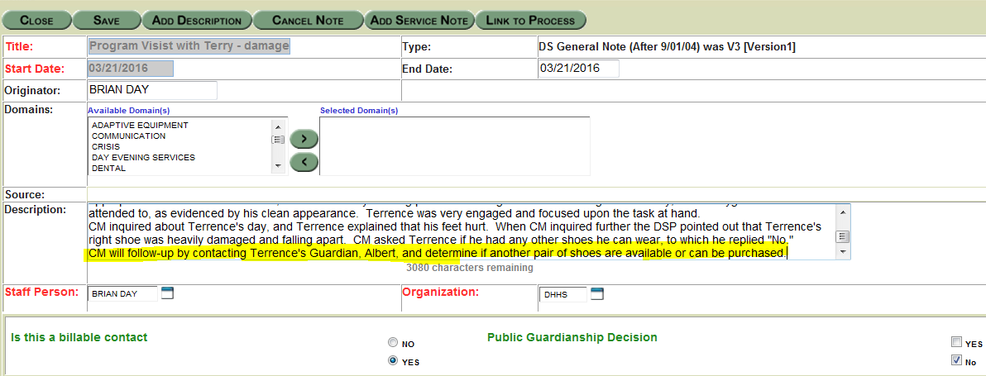
Follow-Up - EIS
CM will follow up by contacting Terrence’s Guardian, Albert, and determine if another pair of shoes are available or can be purchased.

Slide 24
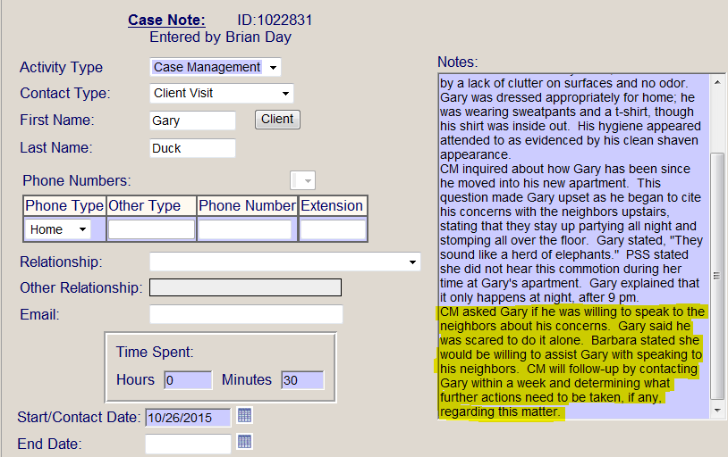
Follow-Up - MAPSIS
…CM will follow up by contacting Gary within a week and determining what further actions need to be taken, if any, regarding this matter.

Slide 25
Signature
All notes require the “signature” of the worker who entered it. EIS and MAPSIS document who entered each note. It is up to the Case Manager to make sure that the name listed is correct and that the correct username is being used.

Slide 26
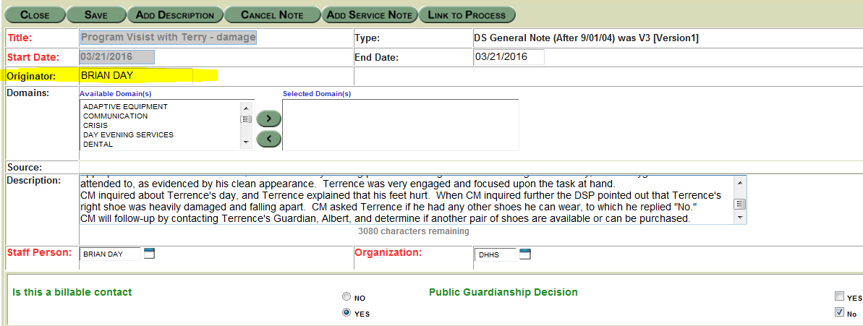
Signature - EIS

Slide 27
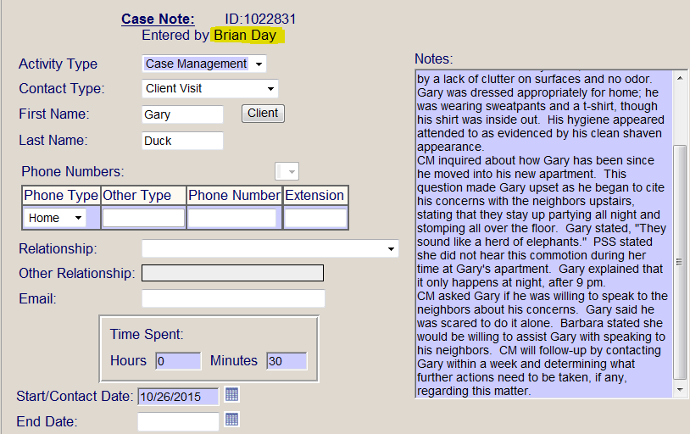
Signature - MAPSIS

Slide 28
Specific Note Examples
Now that we have covered how a typical note is written and documented, we will now cover specific examples of what makes a note incorrect or correct.

Slide 29
Facts
Notes should include facts and verified information. Do not write assumptions or hearsay.

Slide 30
Example of Assumption (Incorrect)
CM assumes that Bobby just doesn’t want to provide Terrence with transportation

Slide 31
Example of Verifying Information and Writing Facts (Correct)
Bobby notified CM that Terrence is currently in the hospital due to being involved in a car accident.

Slide 32
Objective
Notes should be objective
Not subjective
Notes:
Scientist Image from freeimages.com; Jean Scheijen; Thumbs up image from freeimages.com; Phillip Collier

Slide 33
Subjective Example (Incorrect)
The place was disgusting and this Case manager cannot understand how anyone can live in such filth

Slide 34
Objective Example (Correct)
The home was cluttered with magazines, newspapers, and trash bags. A strong odor was also present.

Slide 35
E-Mails
E-mail contacts can be summarized in a note.
The entire e-mail should not be pasted as a case note.

Slide 36
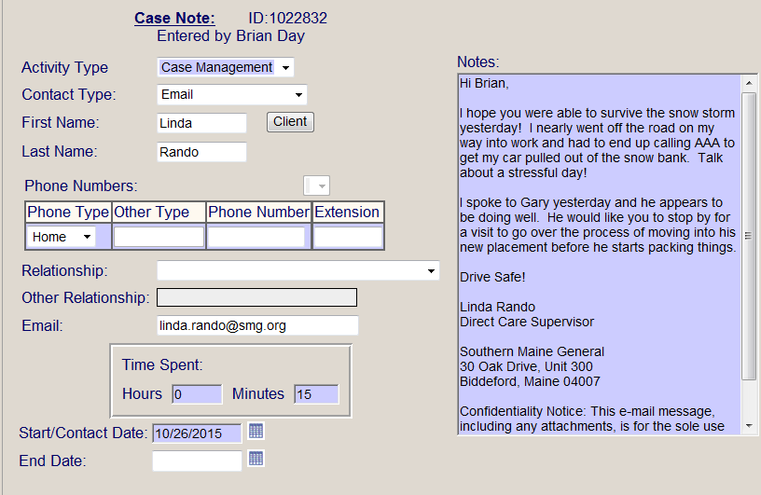
E-mail Example (Incorrect)

Slide 37
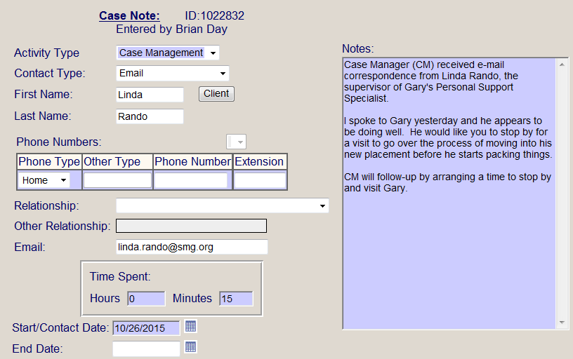
E-mail Example (Correct)

Slide 38
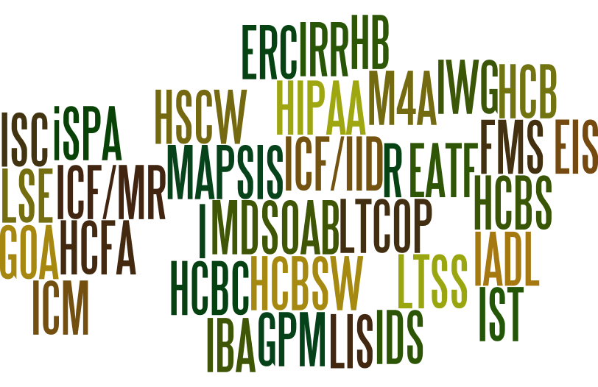
Acronyms and Abbreviations
Acronyms and abbreviations are acceptable, so long as they are defined before they are used in each note.

Slide 39
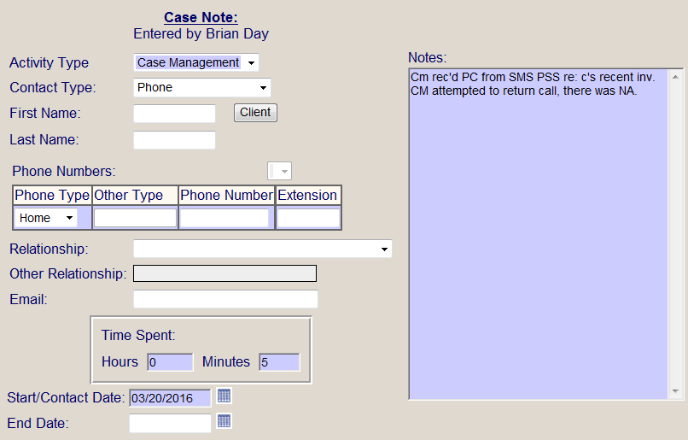
Acronyms and Abbreviations (Incorrect)
CM rec’d PC from SMS PSS re: c’s recent inv. CM attempted to return call, there was NA.

Slide 40
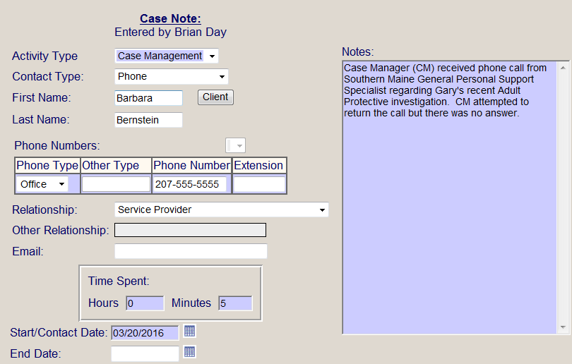
Acronyms and Abbreviations (Correct)
Case Manager (CM) received phone call from Southern Maine General Personal Support Specialist regarding Gary’s recent Adult Protective investigation. CM attempted to return the call but there was no answer.

Slide 41
Remember!
Notes must be entered within the applicable timeframes:
State DS and APS Case Worker Policy: Within 10 business days of contact, except as follows: O Public Guardianship/Conservatorship Appointment: Immediately O Public Guardianship/Conservatorship Temporary Appointment: Immediately O Public Ward Medical Authorization: Within 24 hours of the authorization. O Crisis Services: Within 24 hours of services being provided.
Adult Community Case Manager Guideline: OADS suggests at least within 10 business days of contact.
OADS best practice is to enter a note as soon as possible after the contact.
What is written in a note is part of a Participant’s legal record.
Notes are public record, can be used in court, and are available to Participants and guardians.

Slide 42
Questions?
Wanda Lindsay, LSW
Wanda.Lindsay@maine.gov
Developmental Services Supervisor
Brian Day, LSW
Brian.A.Day@maine.gov
Policy and Compliance Specialist

Slide 43
Earn The Certificate
You may earn a certificate by completing the Knowledge Check: https://www.surveymonkey.com/r/OADSnotes

Slide 44
STOP
The remainder of this PowerPoint speaks to the Billing Requirements of MaineCare Section 13 Targeted Case Management.

Slide 45
Targeted Case Management
DS Case Management services is covered under MaineCare Section 13 policy, specifically Section 13.02.
As the majority of DS Case Management providers utilize EIS General Notes as their source of billing, we will define the different contact types and then identify where the various contact types fall within MaineCare Policy.
Case Managers may not bill for writing the note itself, only for completing the tasks the billable note documents.
For a quarter-hour unit, anything less than 7.5 minutes is not billable.

Slide 46
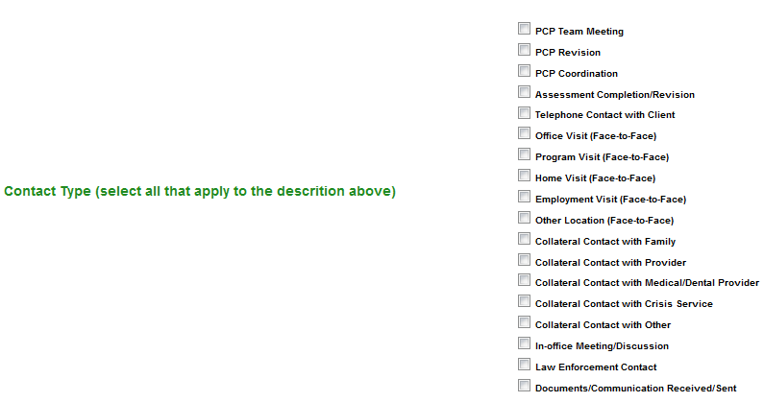
Contact Types in EIS
/Guardian

Slide 47
New Contact Types
PCP Team Meeting: Documents the annual team meeting, or a monthly, quarterly or semi-annual review meeting of a Person Centered Plan (PCP).
PCP Revision: Documents when a PCP is being revised due to a change in services.
PCP Coordination: Documents all tasks associated with preparing for the annual PCP meeting, such as contacting the Participant, family, providers, and writing the plan itself.
Assessment Completion/Revision: Documents all other Case Manager completed EIS assessments aside from the PCP, such as the DS Supports and Services (V7)/90 Day Review, Comprehensive/Support Waiver (BMS 99), Severely Intrusive and Safety Plans, Individual Support Team (IST) Plans, etc.

Slide 48
Participant Contact Types
Telephone Contact with Client: Documents a conversation between the Case Manager and the participant.
Office Visit (Face to Face): Documents a face to face visit between the Case Manager and the participant in an office setting.
Program Visit (Face to Face): Documents a face to face visit between the Case Manager and the participant while the participant is attending a day program.
Home Visit (Face to Face): Documents a face to face visit between the Case Manager and the participant while at the participant’s home.
Employment Visit (Face to Face): Documents a face to face visit between the Case Manager and the participant while the participant is working.
Other Location (Face to Face): Documents a face to face visit between the Case Manager and the participant at any other location that is not covered by another contact type (such as a School or Hospital).

Slide 49
Collateral Contact Types
Collateral Contact with Family/Guardian: Documentation of contact with a participant’s family member that pertains to the participant.
Collateral Contact with Provider: Documentation of contact with a participant’s provider that pertains to the participant (typically a waiver provider, such as Community Supports, Home Supports, etc.)
Collateral Contact with Medical/Dental Provider: Documentation of a contact with a participant’s Medical or Dental Provider that pertains to the participant.
Collateral Contact with Crisis Service: Documentation of a contact with a Crisis Worker that pertains to the participant.
Collateral Contact with Other: Documentation of a contact with any other person that is not documented in the other collateral contact types and pertains to the participant.

Slide 50
Other Contact Types
Law Enforcement Contact: Documentation with Law Enforcement Personnel that pertains to the participant.
In-Office Meeting/Discussion: A meeting or discussion within an office that is pertaining to the participant (such as supervisory consultation regarding a specific participant, Social Security personnel consultation regarding a specific participant, etc.)
Section 13 Policy Writer: Regular conversations that would occur during supervision are not MaineCare reimbursable. If a supervisor is called in to consult on the development of the care plan, that time can be reimbursable.
Documents/Communication Sent/Received: The sending or receiving of documents or other forms of communication that pertain to the participant.

Slide 51
MaineCare Benefits Manual, Section 13.02 Covered Services
EIS Contact Types
A. Comprehensive Assessment and Periodic Re-assessment of an eligible member to determine service needs, including those activities that focus on needs identification, to determine the need for any medical, educational, social or other services. The comprehensive assessment and re-assessment must be conducted through face-to-face contact with the member and, where appropriate, consultation with other providers and with the member's family. A comprehensive assessment must be completed within the first thirty (30) days of initiation of services, and reassessment must occur as change in the member’s needs warrants or at a minimum on an annual basis. These activities include but are not limited to the following:
1.Taking client history;
2.Identifying the needs of the individual and completing related documentation; and
3.Gathering information from other sources (family members, medical providers, social workers, and educators) if necessary, to form a complete assessment.
PCP Team Meeting
PCP Revision
PCP Coordination
Assessment Completion/Revision
Notes:
A. Comprehensive Assessment and Periodic Re-assessment of an eligible member to determine service needs, including those activities that focus on needs identification, to determine the need for any medical, educational, social or other services. The comprehensive assessment and re-assessment must be conducted through face-to-face contact with the member and, where appropriate, consultation with other providers and with the member's family. A comprehensive assessment must be completed within the first thirty (30) days of initiation of services, and reassessment must occur as change in the member’s needs warrants or at a minimum on an annual basis. These activities include but are not limited to the following:
1.Taking client history;
2.Identifying the needs of the individual and completing related documentation; and
3.Gathering information from other sources (family members, medical providers, social workers, and educators) if necessary, to form a complete assessment.

Slide 52
MaineCare Benefits Manual, Section 13.02 – Covered Services
EIS Contact Types
B. Development and Periodic Revision of the Individual Plan of Care is based on information collected through a comprehensive assessment or re-assessment that:
1.Specifies the goals and actions to address the medical, social, educational, and other services needed by the eligible individual. Because the assessment of the member’s needs must be comprehensive, the individual plan of care must also be comprehensive to address all identified needs. Re-evaluation of the individual plan of care must occur as a change in the member’s needs occurs or at a minimum every ninety (90) days. A member may decline to receive services that have been identified as needs in the individual care plan. If the member declines services listed in the individual care plan, this must be documented in the individual’s case record. This 90 day re-evaluation may be completed by the comprehensive case manager.
2.Develops and periodically revises the Individual Care Plan and to the extent possible:
a. Ensures the active participation of the member and as appropriate, the member's parent(s) or legal guardian;
b. Works with the member (and others as appropriate) to develop goals; and
c. Identifies a course of action to respond to the member’s assessed needs. For a child, the plan of care must be developed with a Child and Family Team.
PCP Team Meeting
PCP Revision
PCP Coordination
Assessment Completion/Revision

Slide 53
MaineCare Benefits Manual, Section 13.02 – Covered Services
EIS Contact Types
Documents/ Communication Sent/ Received
Collateral Contact with Family/Guardian
Collateral Contact with Provider
Collateral Contact with Medical/Dental Provider
Collateral Contact with Crisis Service
Collateral Contact with Other
In Office Meeting/ Discussion
C. Referral and Related Activities that help an eligible member obtain needed services. As part of the coordination function, the comprehensive case manager must avoid the duplication of services. The case management referral activity is completed once the referral and linkage has been made. (Referral and related activities do not include providing transportation to the service to which the member is referred, escorting the individual to the service, or providing child care so that an individual may access the service.) These activities are for the purpose of linking the member with medical, social, educational providers or other programs and services that are capable of providing needed services to address identified needs and achieve goals specified in the care plan.
These activities include:
1.Making referrals to providers for needed services, including documentation, and
2.Scheduling appointments for the member.

Slide 54
MaineCare Benefits Manual, Section 13.02 – Covered Services
EIS Contact Types
PCP Coordination
Telephone Contact with Client
Office Visit (Face to Face)
Program Visit (Face to Face)
Home Visit (Face to Face)
Employment Visit (Face to Face)
Other Location (Face to Face)
Collateral Contact with Family/Guardian
Collateral Contact with Provider
Collateral Contact with Medical/Dental Provider
Collateral Contact with Crisis Service
Collateral Contact with Other
In Office Meeting/ Discussion
Collateral Contact with Provider
Collateral Contact with Medical/Dental Provider
Collateral Contact with Crisis Service
Collateral Contact with Other
In Office Meeting/ Discussion
Law Enforcement Contact
D. Monitoring and Follow-Up Activities that include activities and contacts that are necessary to ensure that the individual care plan is effectively implemented and adequately addresses the needs of the eligible member. This includes contact with the member as needed to monitor the care plan objectives and, if appropriate, periodic contact with the member's family, providers, or other entities. Monitoring may involve either face-to-face or telephone contact. These activities may be conducted as frequently as necessary, but not less than annually, to help determine whether:
1.Services are being furnished in accordance with the individual care plan;
2.Services in the care plan are adequate to address the needs of the member; and
3.Needs or status of the member has changed which requires necessary adjustments in the care plan and service arrangements with providers or service termination.

Slide 55
Questions About Billing?
Contact the MaineCare Provider Relations Specialist for Section 13: http://www.maine.gov/dhhs/oms/contacts.shtml

Slide 56
Thematic Note
Multiple contact types can now be selected within one note. As an example, if a home visit is completed with both the participant and their parent then 2 contact types could be selected: Home Visit (face-to-face) and Collateral Contact with Family/Guardian.
This also allows for the completion of a thematic note. If multiple contacts are made regarding the same theme then one note can be made to cover all of the contacts as opposed to creating separate notes for each separate contact.
Even if a thematic note takes place over hours of time, only the time spent that was billable can be claimed as billable time.
No note may cover more than a 24 hour period.

Slide 57
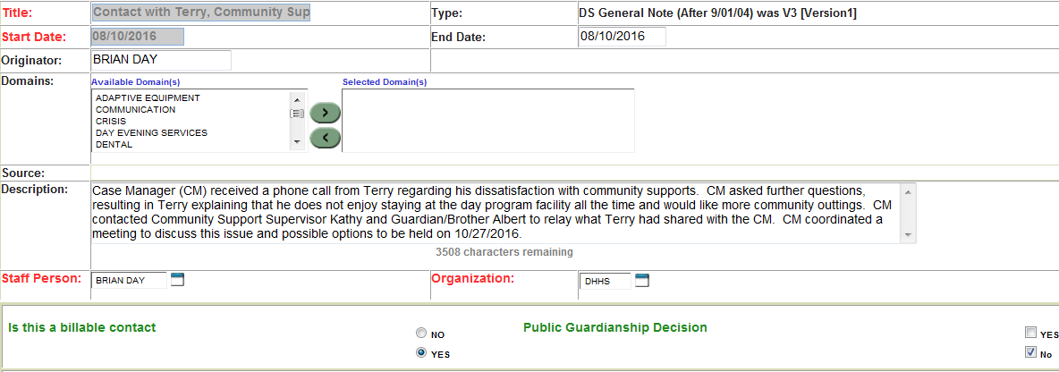
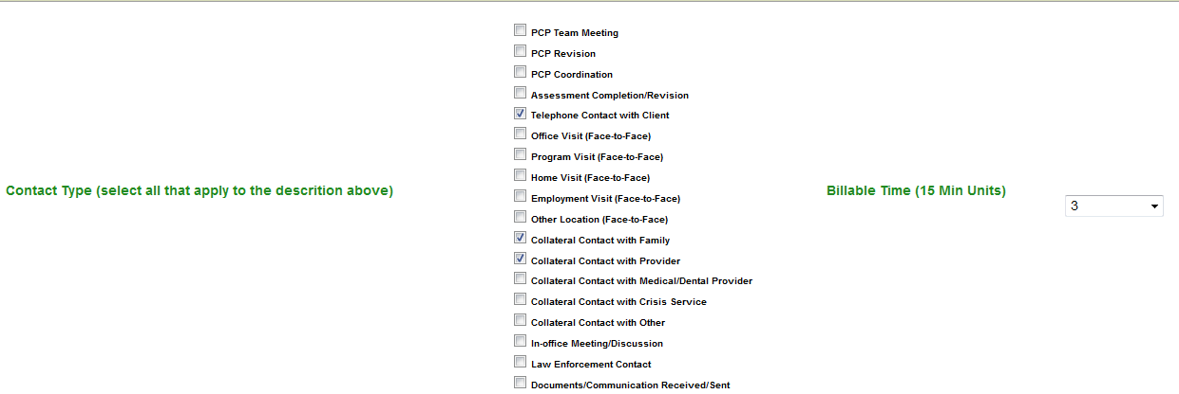
Thematic Note Example
Case Manager (CM) received a phone call from Terry regarding his dissatisfaction with community supports. … CM contacted Community Support supervisor… CM coordinated a meeting…
/Guardian

Slide 58
Writing Skills
Maine Department of Health and Human Service’s Staff Education and Training Unit (SETU) offers regularly scheduled trainings pertaining to writing skills.
Visit www.maine.gov/dhhs/setu/ to see when trainings are available in your area.

Slide 59
Earn The Certificate
You may earn a certificate by completing the Knowledge Check: https://www.surveymonkey.com/r/OADSnotes

