Slide 1
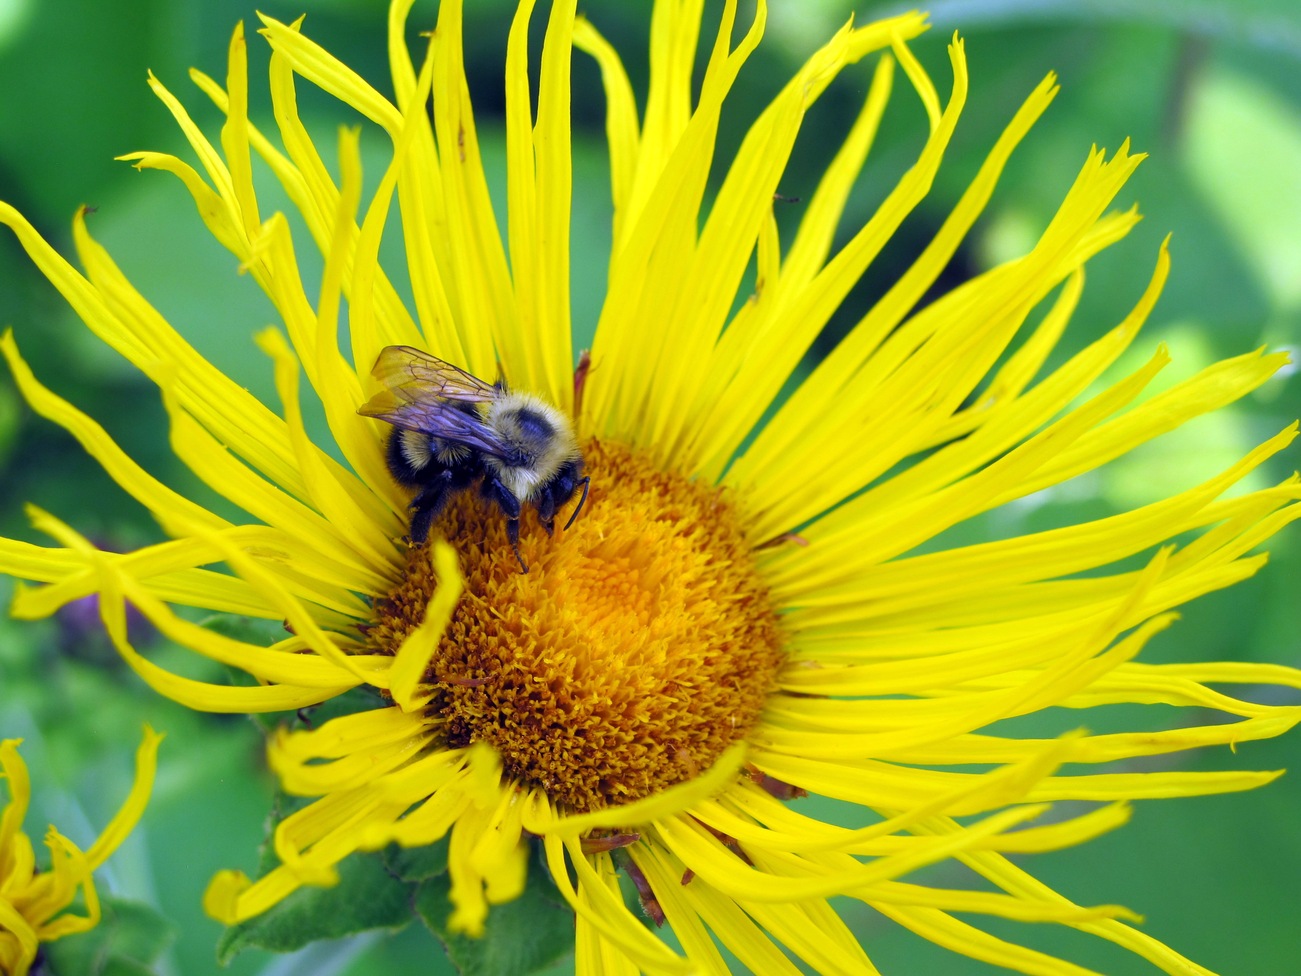
Pesticides
Gary Fish
Maine Board of Pesticides Control
28 SHS
Augusta, ME 04333-0028
207-287-7545
gary.fish@maine.gov

Slide 2
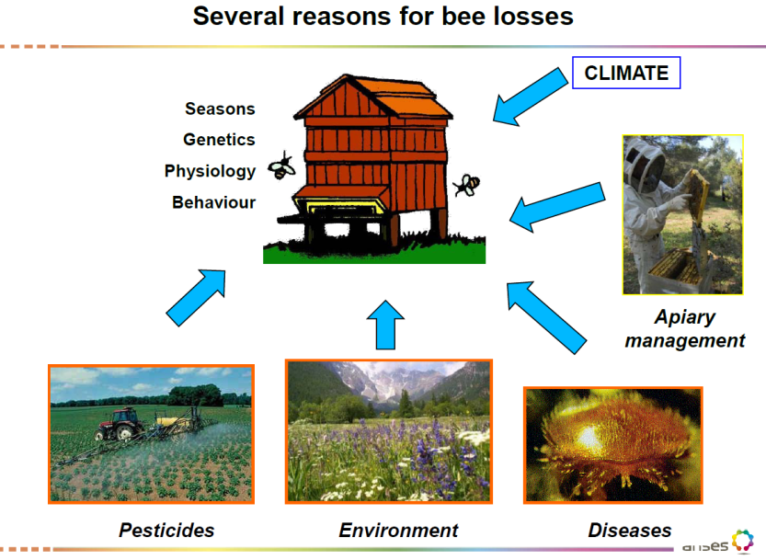

My premise
I am not here to defend or indict pesticides
I will try to outline the latest research findings
I am not a bee or CCD expert by any means
My head continues to spin from all the reading I have done

Slide 3
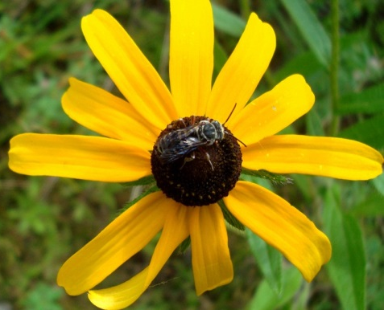
Pesticide Use in NH
NH agricultural production (organic and conventional) relies on many pesticide families for yield and quality
  Potatoes
  Apples
  Vegetables
  Small Fruits
  Nurseries
  Sod Farms
Turf and Ornamental managers rely on them, and
Homeowners rely on them too
2011 NH Insecticide use by licensed private and commercial applicators
Insecticide Class | Total Pounds
Organophosphates | 6259
Nitro – Neonics | 4315
Pyrethroids | 4047
Other | 3573
Carbamates | 2314
Petroleum Oils | 1840
Cyano – Neonics | 90
Total | 22,438

Slide 4
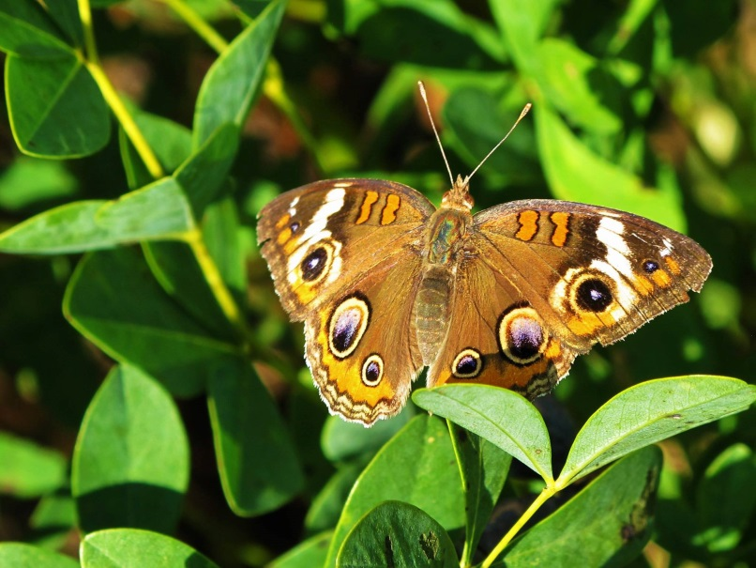
Home & Garden (Homeowner) Use of Pesticides in Maine
8% of Conventional Pesticide Use, but 15% of the Insecticide Use
National Data
Qualitative Estimate of Insecticides Sold *
67% herbicides
22% insecticides
11% fungicides
Active Ingredient | Number of Units Sold
Bifenthrin | 18,000
Cypermethrin | 12,000
Carbaryl | 10,000
Chlorantraniliprole | 7,500
Imidacloprid | 2,500
Pyrethrins | 2,100
* 2013 Maine Sales Reports

Slide 5
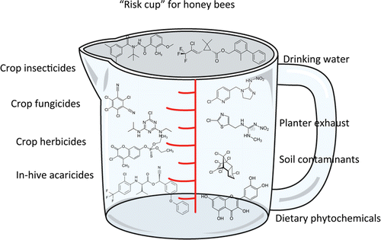
Many potential pesticide hazards exist

Slide 6
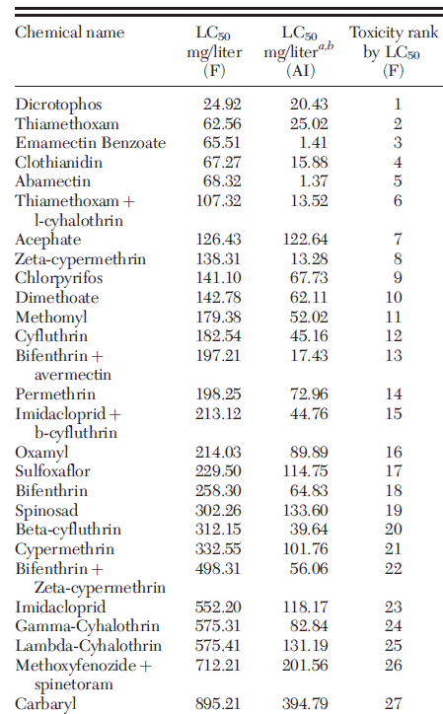
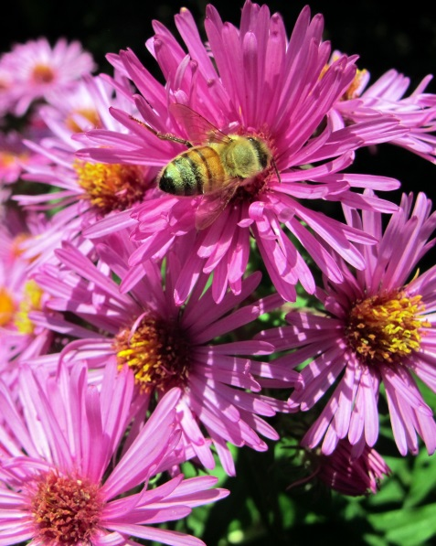
Formulation Toxicity
Top 27 most toxic insecticide formulations to honey bee adults
Tested at row crop application rates with a tower sprayer
J. Econ. Entomol. 1–8 (2015); DOI: 10.1093/jee/tov269

Slide 7
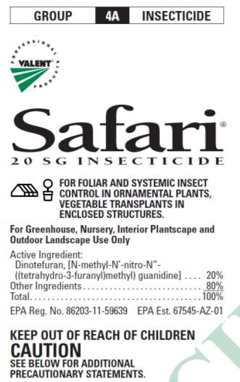
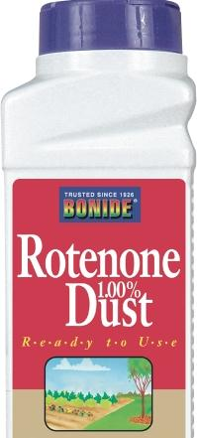
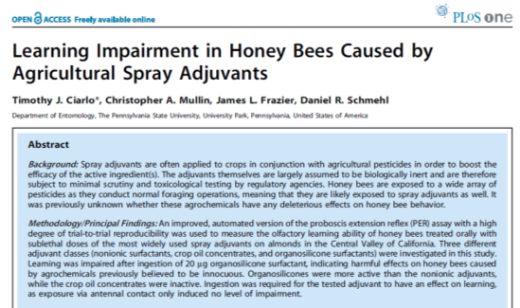
Formulation types differ in risk to pollinators
More risky
  Dusts
  Microencapsulated
  Wettable powders
  Flowables
  Emulsifiable concentrates
  Systemic products
  Some adjuvants
    Super-Organosilicone surfactants
No endorsement intended or implied
Notes:
Granular formulations are least hazardous because they are applied to the ground and are too big for bees to pick up. EC are safer than Wettable Powders because WP stay toxic longer. Dusts & Micro Encapsulated are most hazardous because they are similar in size to pollen and tend to stick to bee hairs, going back to the hive. Bees are temporarily inactivated by direct contact with oil sprays. Mixing miticides with insecticides can be more toxic to bees. Mixing some fungicides the (demethylation-inhibiting (DMI) like propiconizole (Propimax, Quilt) with synthetic pyrethroids like lamda-cyhalothrin (Warrior). Similar effects have been seen with Neonics and DMI fungicides but not translated out to the field (Schmuck ,etal 2003)

Slide 8
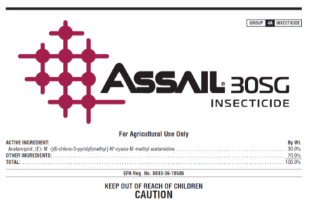
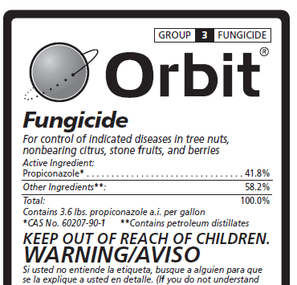
Different tank mixes may also increase risk to pollinators
Some combinations can be very risky…
  Insecticides mixed with miticides
  Insecticides mixed with fungicides or PBO
    Acetamiprid (Assail) and propiconazole (Orbit)
    Pyrethroids and propiconazole
    Piperonyl butoxide and some neonicotinoids
Avoid tank mixes entirely
No endorsement intended or implied

Slide 9
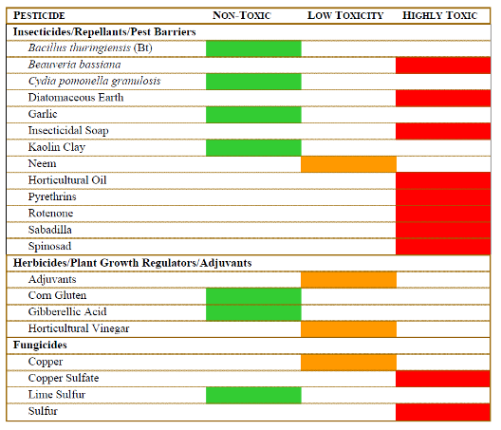
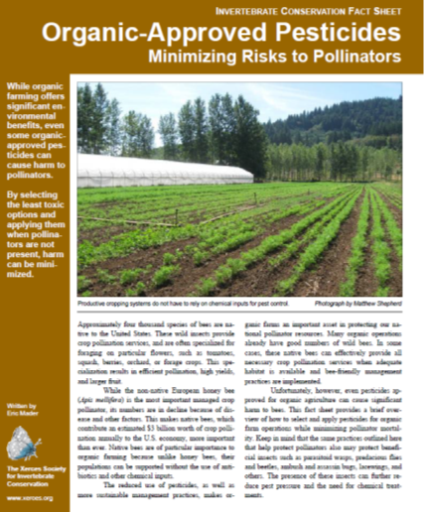
Even pesticides approved for organic grower use can be highly toxic to pollinators
Toxicity of Common Organic-Approved Pesticides to Pollinators
Soaps and Oils, only when directly sprayed upon the pollinator
Eric Mader – The Xerces Society for Invertebrate Conservation

Slide 10
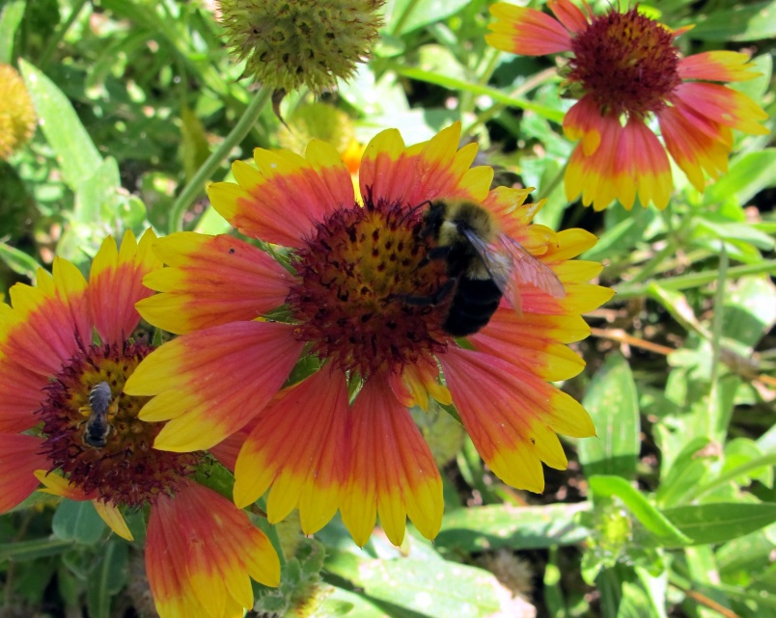
Recent research on botanical pesticides
Acute Toxicity and Sublethal Effects to Honey Bees
  Andiroba oil, Garlic extract, Eucalyptus oil, Rotenone, Neem oil and Citronella oil applied to adults and fed to larvae
    All but Andiroba oil caused significant mortality to adult bees
    Andiroba, Garlic and Neem caused significant larval mortality
      These may work like insect growth regulators preventing ecdysis (moulting)
J. Insect Sci. (2015) 15(1): 137; DOI: 10.1093/jisesa/iev110

Slide 11
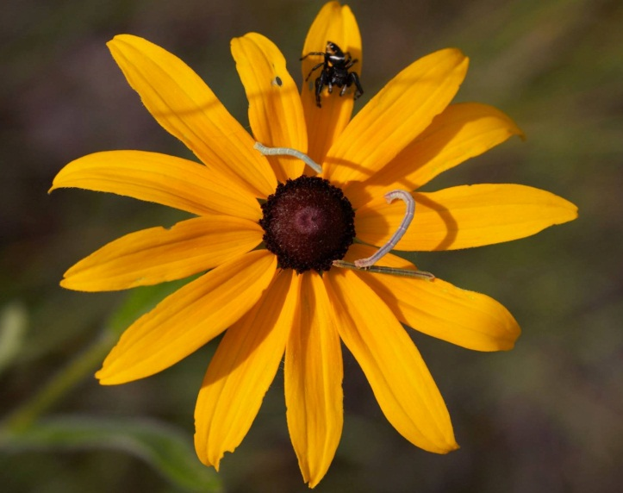
Neonicotinoids - History
Neonicotinoids are “insecticides” and of course they can and will kill bees, other pollinators, beneficials and aquatic invertebrates
Came onto the market when EPA began to encourage registration of alternatives to organophosphates and carbamates
Imidacloprid came first in 1994 and was originally conditionally registered for ornamental & turf uses
The rest soon followed after EPA instituted a Reduced Risk (RR) and OP Alternative (OPA) accelerated registration process
  Thiamethoxam – 2000
  Acetamiprid – 2002
  Clothianidin – 2003
  Dinotefuran – 2004
Thiacloprid was conditionally registered in 2003 outside of the RR/OPA program

Slide 12
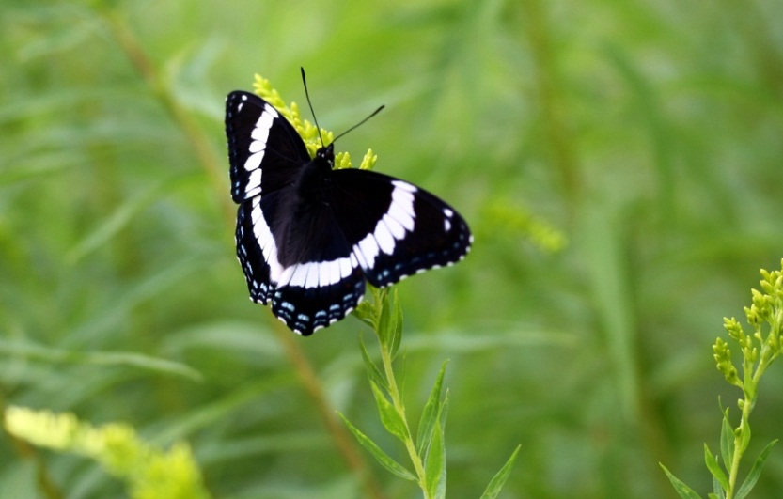
More history
Neonicotinoids were favored for their
  low mammalian toxicity
  lack of mammalian CNS effects, and
  lack of carcinogenic (cancer) effects
Use rates are very low (ml vs pts/Ac)
EPA knew all along that they had some negatives:
  Very water soluble (good & bad)
  very leachable (groundwater concerns)
  fairly persistent in woody plants and soils

Slide 13
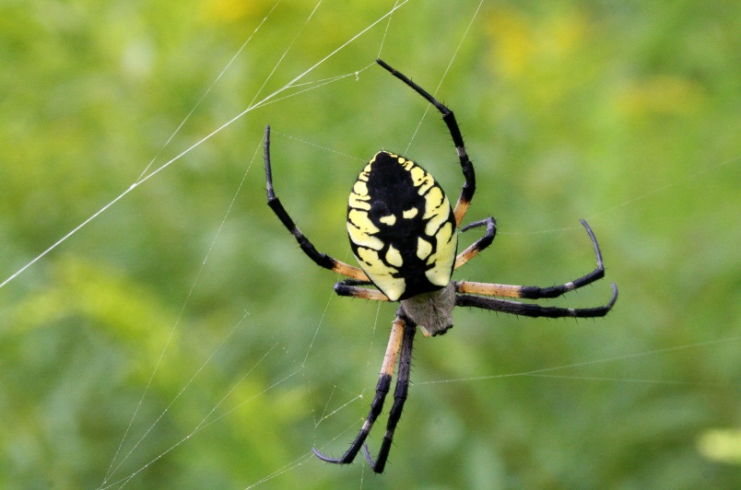
Neonic history
EPA decided right from the beginning to manage the negatives with very specific label language
Ground water warnings, reduced rates, pollinator warnings, etc.
EPA scientists agreed that using neonics as labeled would be a better alternative to the continued use of OPs and carbamates because:
  Ops and Carbamates are much higher in mammalian toxicity, data on carcinogenicity is equivocal and nervous system effects are definite

Slide 14
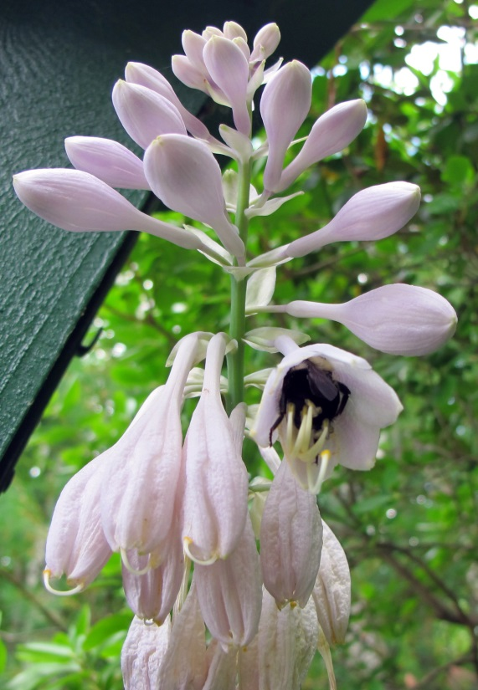
Recent neonic studies
Assessment of Chronic Sublethal Effects of Imidacloprid on Honey Bee Colony Health
  Sub-lethal effects of imidacloprid
    No significant effects on foraging up to 100 ug/kg
    Varroa mites significantly higher in exposed colonies
    High doses in pollen “could” reduce colony health and reduce overwintering success
    Relevant field dose from seed treated crops had negligible effects
March 18, 2015 DOI: 10.1371/journal.pone.0118748

Slide 15
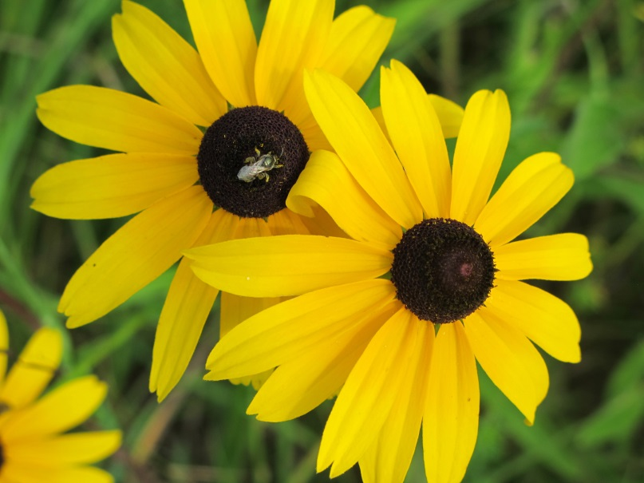
Recent neonic studies
Neonicotinoid pesticides severely affected honey bee queens
  Thiamethoxam and Clothianidin fed in pollen supplements at “environmentally relevant” concentrations
  Queens’s ovaries and stored sperm affected
  Flight behavior was not affected
Scientific Reports 5, Article number: 14621 (2015) doi:10.1038/srep14621

Slide 16
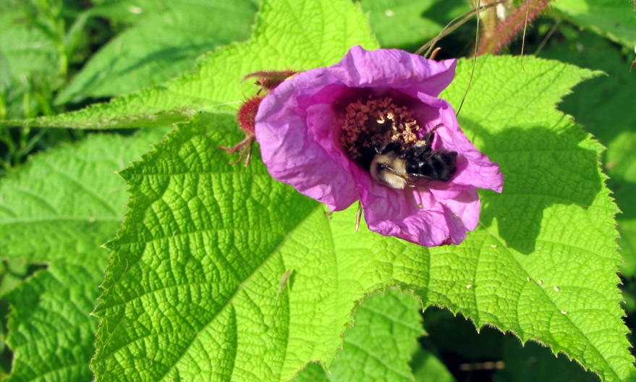
Recent neonic studies
Neonic seed treatments negatively affected wild bees
  Clothianidin and beta-cyfluthrin treated canola seed in Swedish fields caused:
    Reduced density of wild (bumble and solitary bees)
    Reduced nesting in Osmia (solitary bee)
    Reduced colony growth and reproduction in Bumblebee
    No significant effects on Honey bee colony strength
Nature 521, 77–80 (07 May 2015) doi:10.1038/nature14420

Slide 17
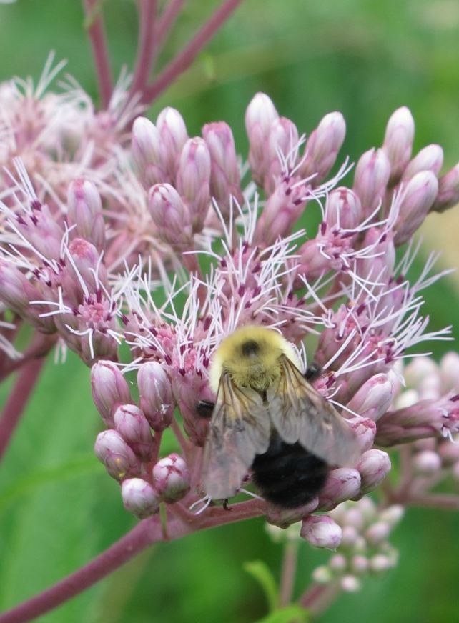
Recent neonic studies
Bees prefer sucrose solutions with neonicotinoids
  No feeding avoidance in honey bees and bumblebees
  Both preferred solutions with imidacloprid and thiamethoxam
  Those two neonics and clothianidin reduced feeding for both species
  Why are they attracted to something that reduces their overall feeding?

Slide 18
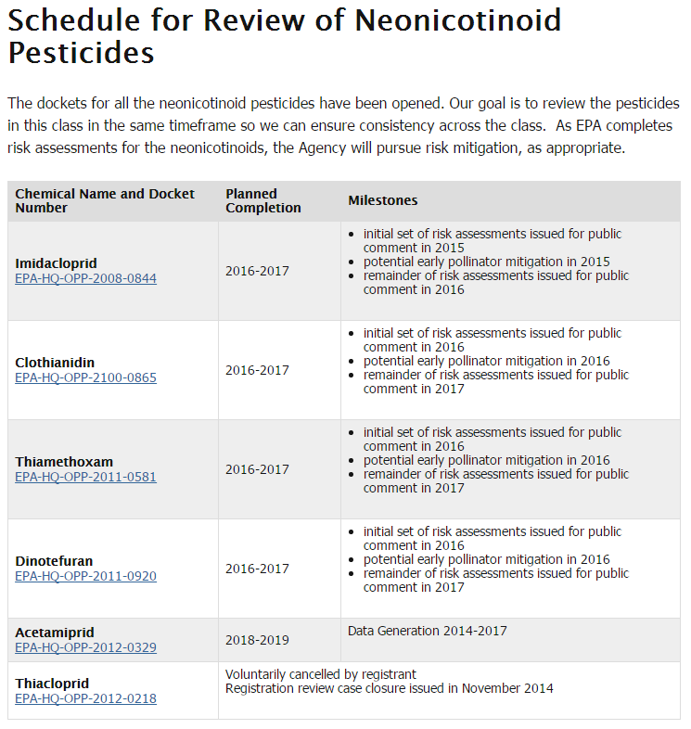
Future of neonicitinoids
EPA is opening the re-registration docket on all the neonicotinoids
EPA - “some uncertainties have been identified since their initial registration”
  Environmental fate and
  Effects on pollinators
Concerns about persistence and bioaccumulation
  Higher levels in guttation water
  Higher levels expressed in soil injected woody plants
  Higher levels expressed in ornamental plants

Slide 19
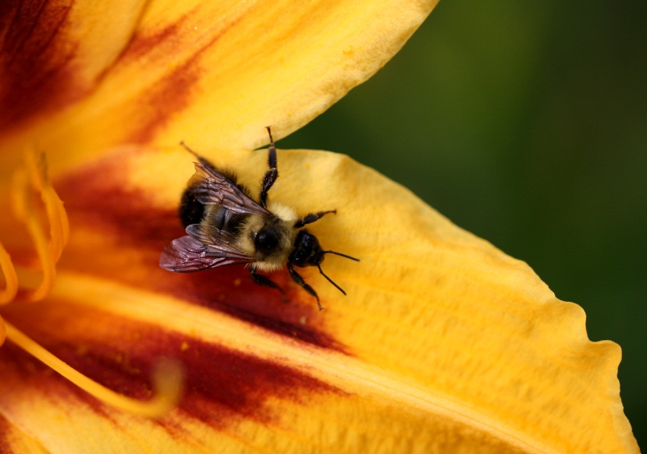
What if…
neonicotinoids are banned…
Other pesticides will fill the vacuum
Pyrethroids, OPs, Carbamates, Spinosad, Phorate, Chlorantraniliprole, Indoxacarb, Spinetoram, etc.
  Most of these are as toxic or more toxic to bees than neonics
  Some of these are also systemics
What if bee declines continue?
We need to look at the whole universe of exposures
  insecticides, fungicides, herbicides
  surfactants and other adjuvants
  tank mixes and synergistic effects

Slide 20
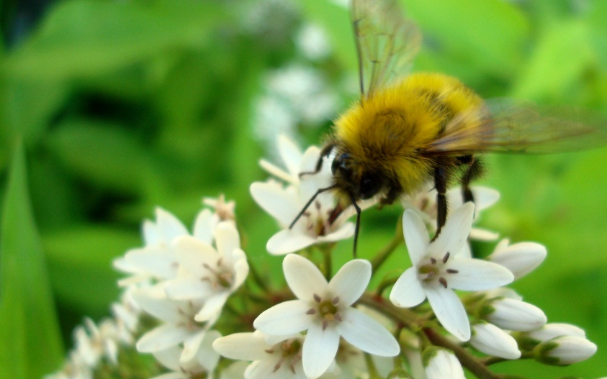
The facts about systemic insecticides – Richard Cowles - CAES
CCD has not diminished in countries where neonicotinoid insecticide use was curtailed⁶,
CCD is not found in Australia, where neonicotinoid insecticides are used, but where Varroa mite (a parasite and vector of bee viruses) is also not found⁶,
96% of colonies with CCD have been found to harbor a complex of viruses, for which Israeli Acute Paralysis Virus is most strongly implicated⁷;
6 Ratnieks, FLW and N. L. Carreck. 2010. Science 327: 152 - 153.
7 Cox-Foster, D. L., et al. 2007. Science 318: 283 - 287.

Slide 21
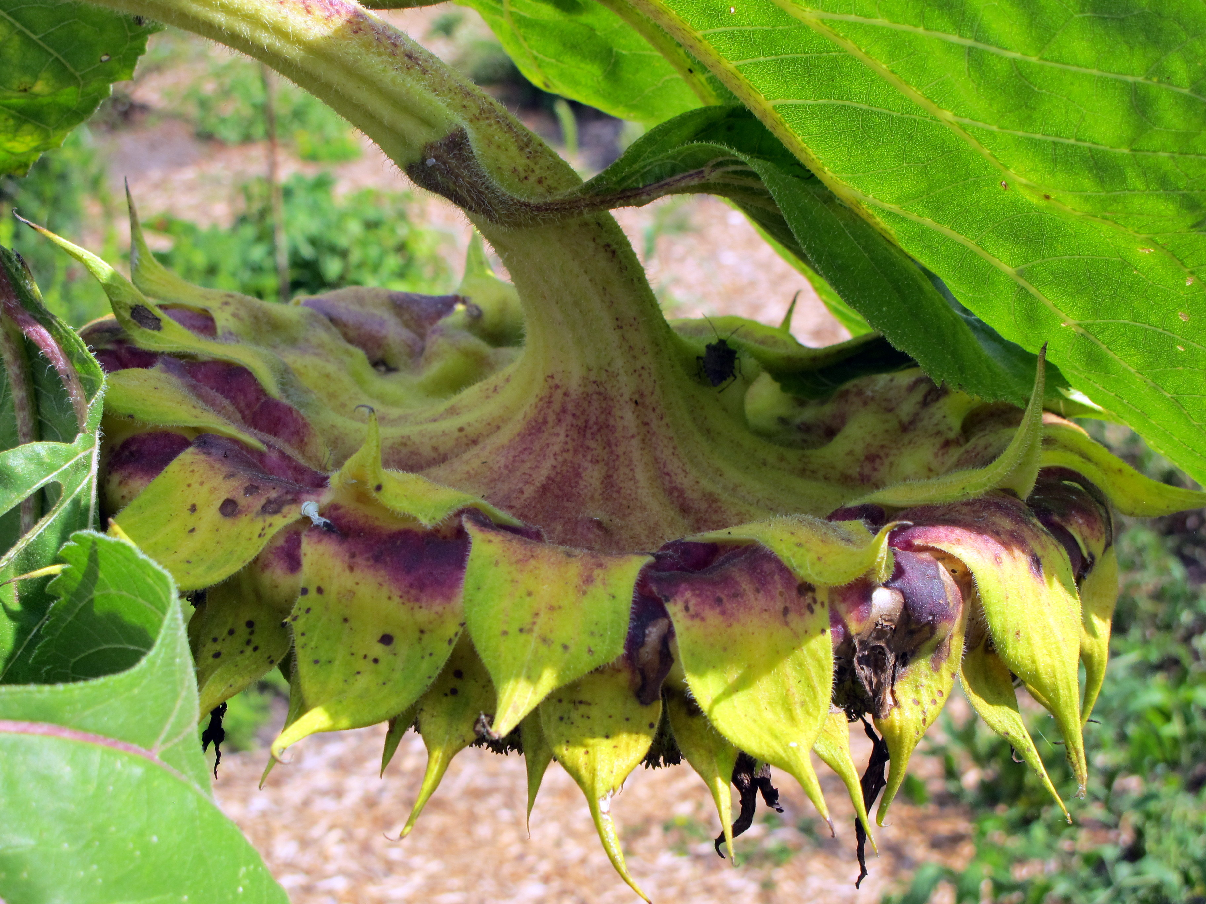
Do some pesticides make bees more susceptible to disease?
One study shows how the miticides* beekeepers use are the most risky for making the bees susceptible to Nosema ceranae
Relative risk of nosema was significantly worse for:
  Chlorothalonil (2.31)
  Pyraclostrobin (2.85)
  *DMPF (Amitraz) (2.13)
  Bifenthrin (2.08)
  Endosulfan (1.60)
  *Fluvalinate (2.43)
PLoS ONE 8(7): e70182. doi: 10.1371/journal.pone.0070182

Slide 22
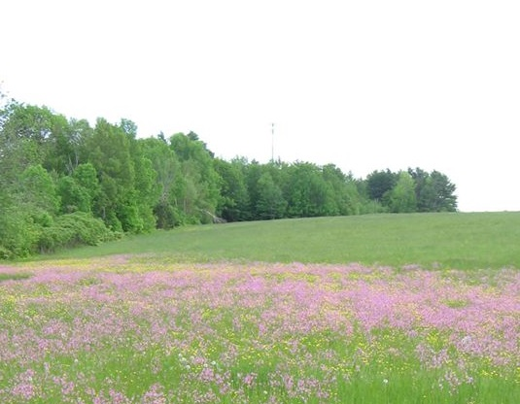
Do some pesticides make bees less susceptible to disease?
One study shows how the some pesticides actually reduce the incidence of nosema compared to the control, including all the neonics that were found
Relative risk of nosema was significantly less for:
  Captan (0.59)
  Cyprodinil (0.31)
  Difenoconazole (0.31)
  Acetamiprid (0.31)
  Carbaryl (0.42)
  *Coumaphos (0.62)
  Diazinon (0.56)
  Esfenvalerate (0.51)
  Imidicloprid (0.31)
  Indoxacarb ( 0.28)
  Phosmet (0.36)
  Thiacloprid (0.35)
PLoS ONE 8(7): e70182. doi: 10.1371/journal.pone.0070182

Slide 23

What about herbicides
Much more research needed to access the impacts that herbicides have on pollinator floral resources
Herbicides have been used for years
Growers have always strived for clean fields and headlands
Are the impacts related to the way herbicides are used or are impacts more related to the intensity of the agriculture?
These questions need to be answered

Slide 24
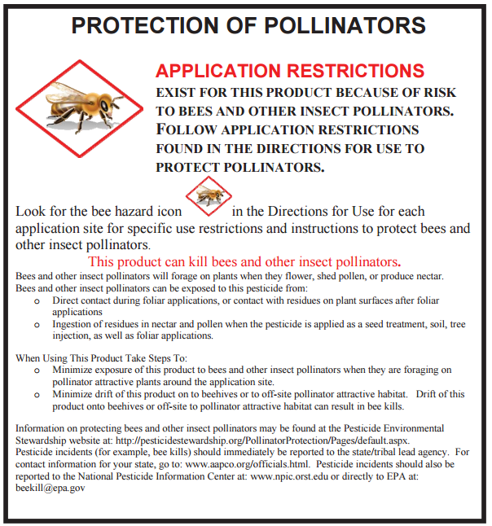
What has EPA done?
EPA and the State FIFRA Issues Research and Evaluation Group (SFIREG) have been discussing better ways to label pesticides for pollinator protection since I started as a regulator in 1988
Pesticide labels have always had warnings and restrictions
Neonics and new systemic insecticides have new labeling to help protect pollinators

Slide 25
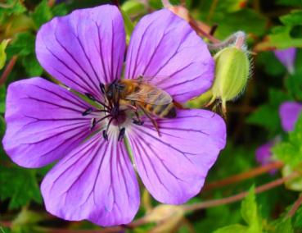
Many insecticides have specific label warnings

Slide 26
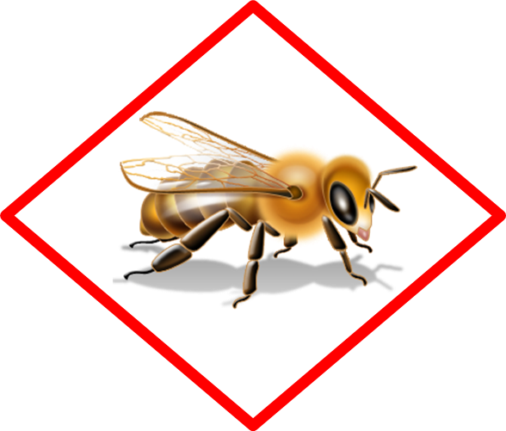
Look for the bee icon on new labels
Products with acute or residual toxicity to pollinators will have the bee icon on their labels
The new warnings will be next to that icon

Slide 27
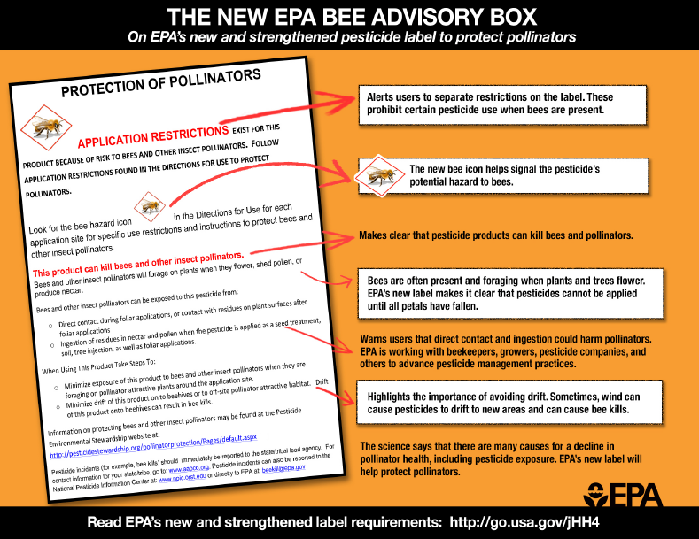
Pollinator Protection

Slide 28
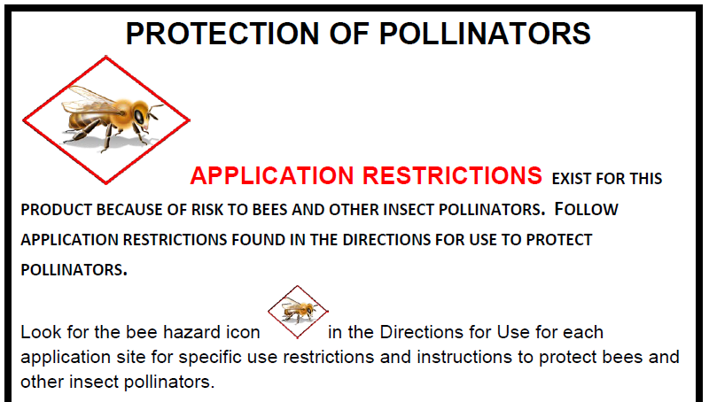

Slide 29
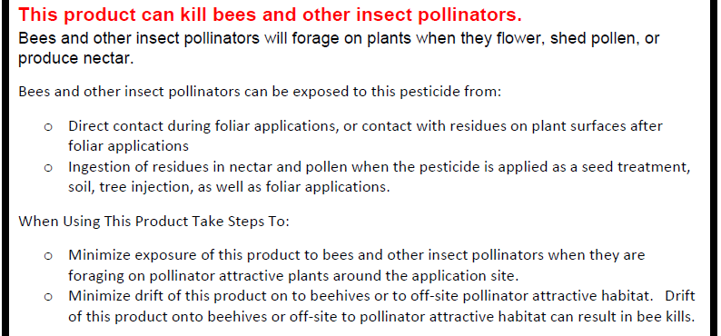
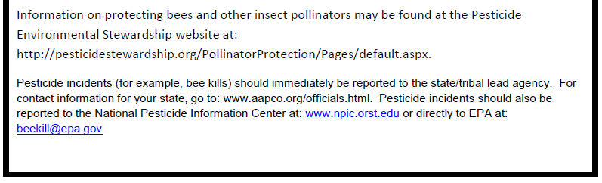

Slide 30
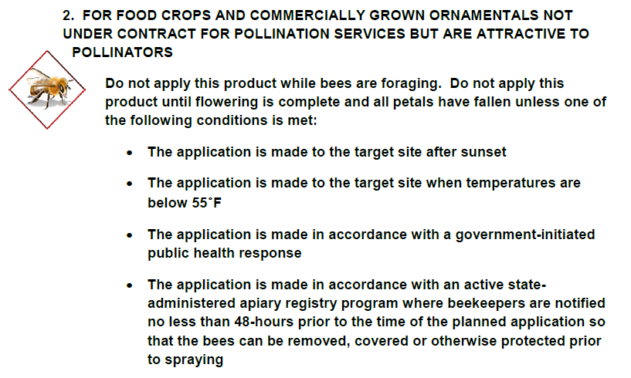
New use directions – Ag products

Slide 31
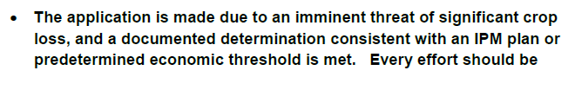
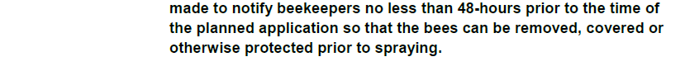
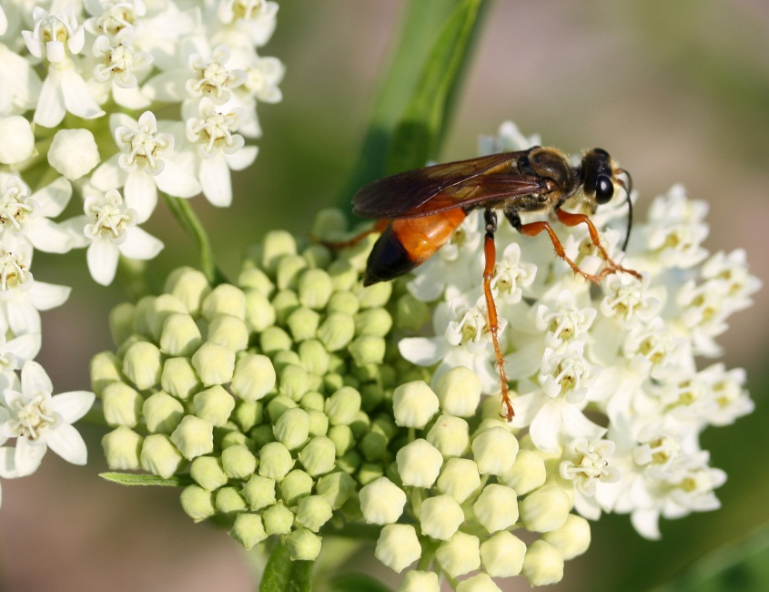
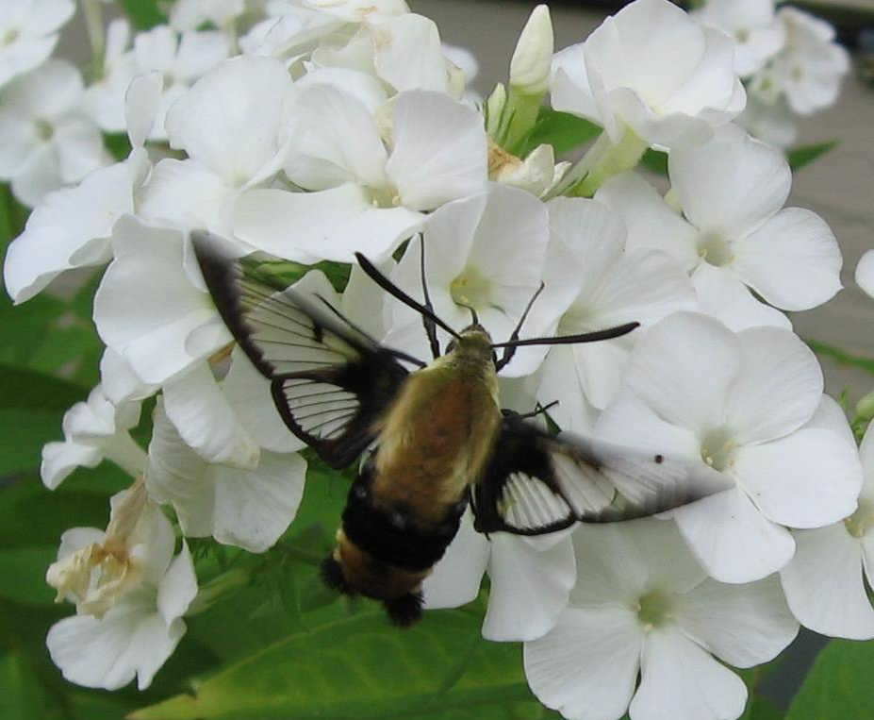
New use directions – Ag products

Slide 32
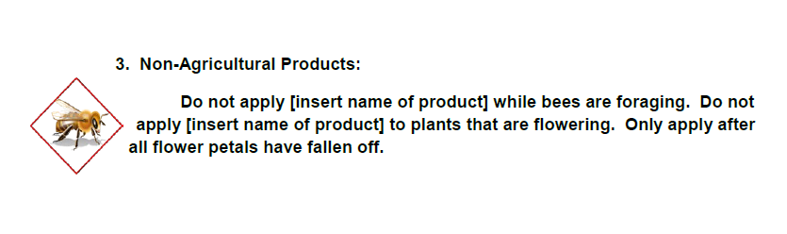
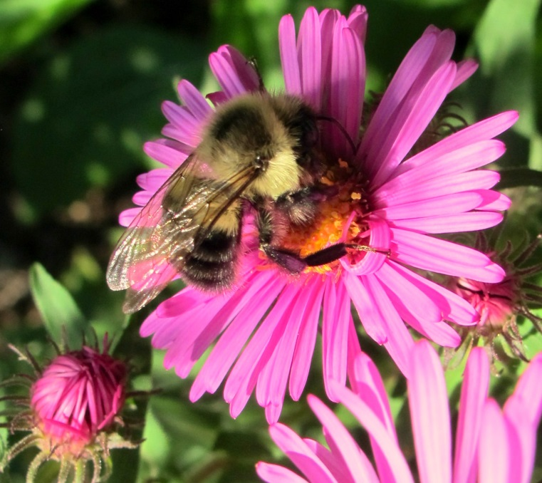
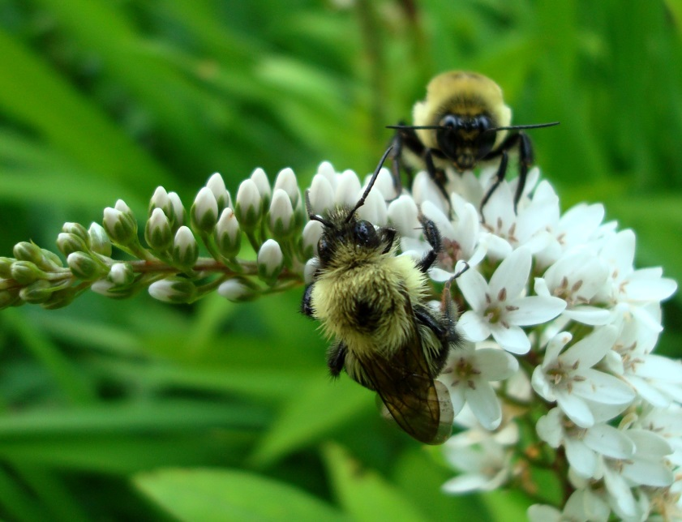
New use directions – Non-Ag products

Slide 33
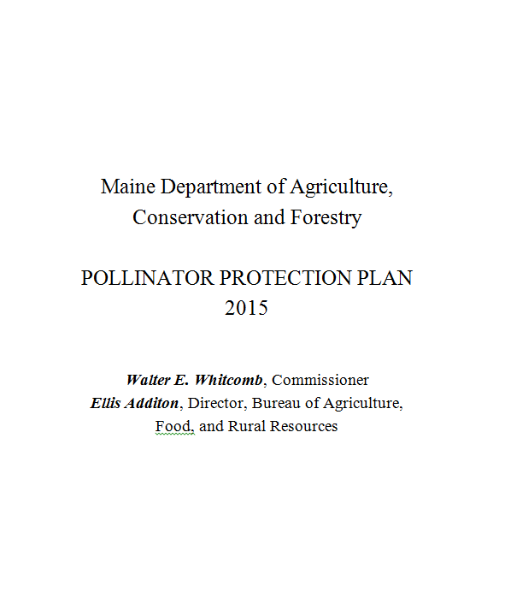
Maine DACF Pollinator protection plan
The Maine DACF developed a pollinator plan
It is based on the North Dakota plan
It stresses voluntary measures such as education, BMPs and communication
It does not contain any new regulatory requirements
http://www.maine.gov/dacf/php/pesticides/documents2/pollinators/Maine%20DACF%20Pollinator%20Protection%20Plan%206-2015.pdf

Slide 34
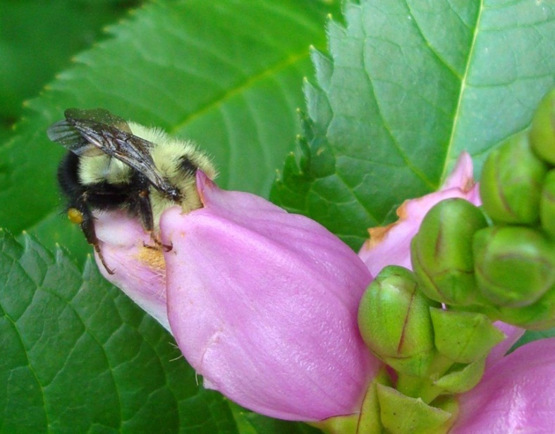
Plan contents
Challenges Faced by Beekeepers
Challenges Faced by Growers and Pesticide Users
DACF Activities Committed to Pollinator Health
Best Management Practices
  Beekeeper Best Management Practices
  Landowner/Grower/Agency Best Management Practices
  Pesticide User Best Management Practices
Supporting Pollinator Forage and Habitat

Slide 35
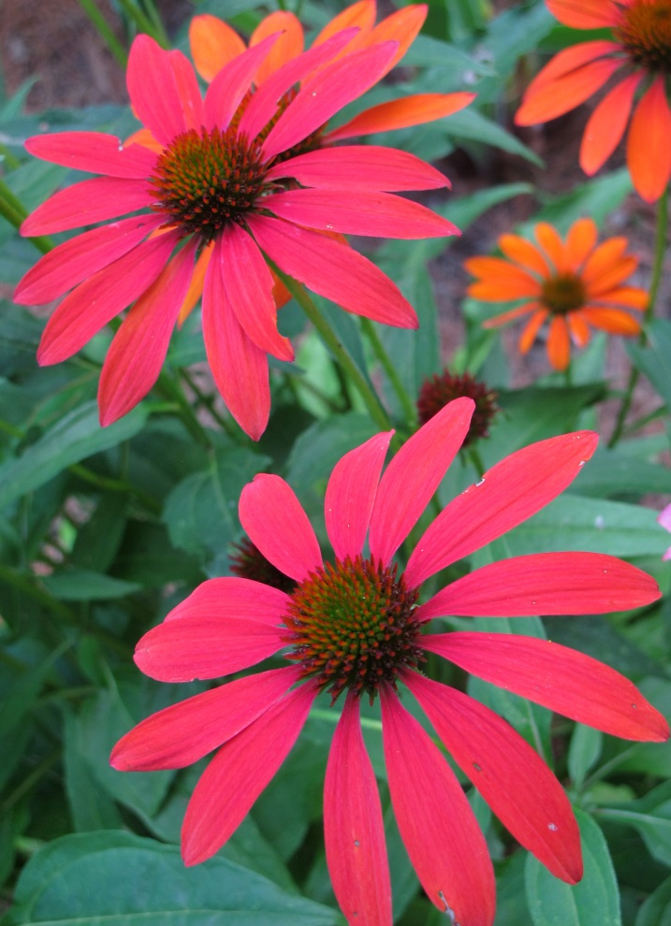
Summary
Insecticides do kill bees
Both growers and bee keepers need to follow BMPs and practice IPM to reduce the overall impacts of pesticides on bees
Fungicides need to be carefully evaluated for effects on immature bees
Overall grower practices (including herbicide use) need to be evaluated for reductions in floral resources
Scientists, growers and bee keepers need to work together to help figure out the risks and benefits of pesticide use

Slide 36
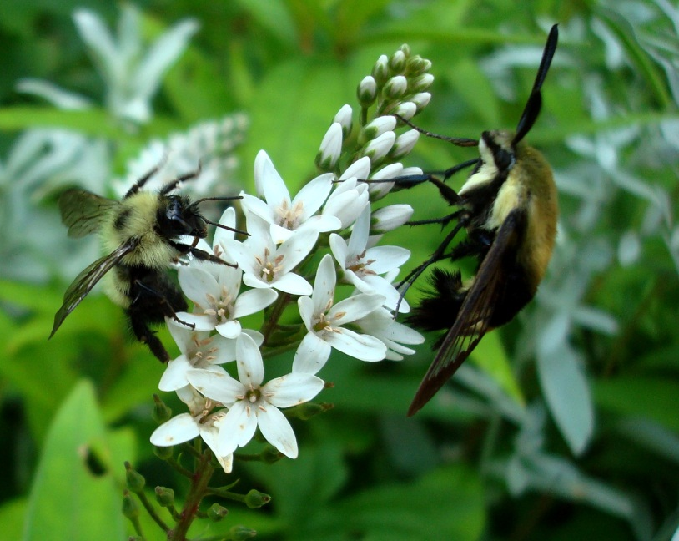
Questions?
That’s all folks!

